Slide 1
California Collaborative on the Social-Emotional Foundations for Early Learning (CA CSEFEL)
CA CSEFEL is part of the MAP to Inclusion & Belonging
WestEd Center for Child & Family Studies
www.CAinclusion.org

Slide 2
National CSEFEL
It began at the national level with the Center on the Social Emotional Foundations for Early Learning
National Center focused on promoting the social emotional development and school readiness of young children birth to age 5
Jointly funded by the Office of Head Start and the Office of Child Care, under the auspices of the Administration on Children, Youth and Families at the U.S. Department of Health and Human Services
Funding ended in 2012. Many of the faculty are part of Head Start National Center on Quality Teaching and Learning (NCQTL ) and are still promoting Pyramid practices and Practice-Based Coaching

Slide 3
Partner Project: TACSEI
TACSEI (Technical Assistance Center on Social Emotional Intervention for Young Children) is a partner National Center focused on sharing practices that improve the social-emotional outcomes for young children with, or at risk for, delays or disabilities
Recent focus on early intervention practices
Funded by the US Department of Education, Office of Special Education Programs
Funding ended in 2013. Many faculty are part of the Early Childhood Technical Assistance Center (ECTA Center) funded through OSEP

Slide 4
Three Levels of Need
1-10%
Children w/Persistent
Challenges
Focused
Interventions
5-15%
Children at-Risk
Group Intervention & Support
All Children
Universal Interventions

Slide 5
Teaching Pyramid
The Teaching Pyramid is the name used by CA CSEFEL to describe the training and technical assistance for the approach developed by the national Center on the Social Emotional Foundations for Early Learning (CSEFEL)
There are California adapted versions for preschool, infant/toddler, and family child care
The Teaching Pyramid Framework was built on evidence-based practices and has been shown to increase social-emotional competence and decrease challenging behavior

Slide 6
The Pyramid Framework: Promoting Social-Emotional Competence in Infants and Young Children
[Assessment-based interventions result in individualized behavior support plans.]
Treatment
Prevention
Universal Promotion
Notes:
The “CSEFEL approach” is sometimes simply referred to as “The Pyramid Model.”
MODULE 1 - focuses on the BASE of the pyramid → The BASICS of IMH (or S/E dev.)
MODULE 2 – Targeted Supports
MODULE 3 – Intervention – Determining meaning of behaviors and developing appropriate responses.
*****************
Key points about pyramid model:
Healthy social/emotional development (behavior) is nurtured, supported, and promoted through positive preventive measures
Most children’s behavior and development does not require intensive intervention
Promotion, Prevention, Intervention

Slide 7
Teaching Pyramid
Children with persistent challenges
Intensive Individualized Interventions
Positive Behavior Support
Children at-risk
Targeted Social Emotional Supports
Targeted Social
Skills Curricula
High Quality
Supportive Environments
High quality
Early Education
All children
Nurturing and Responsive Relationships
Effective Work Force

Slide 8
CA CSEFEL (The California Collaborative on Social Emotional Foundations for Early Learning) is a state-wide, multi-agency group focused on spreading the Teaching Pyramid framework throughout California

Slide 9
California’s CSEFEL: Collaborative on Supporting Early Childhood Social-Emotional Foundations in Early Learning
Map to Inclusion & Belonging
WestEd
Team Co-Leaders
California Department of Education
(CDE) Early Education & Support Division
CDE. Special Education Division, Assessment, Evaluation & Support
California Early Childhood Comprehensive System, Maternal, Child, Adolescent, Health
Department of Developmental Services,
Early Start State Services,
Interagency Coordinating Council
Center for Excellence in Child Development, The Center for Human Services, UCD Extension
Sacramento Co. Office of Ed.
Implementing Groups Representation
First 5 California
Department of Health Care Services, Mental Health Services Division
SELPA
Special Education Local Plan Areas
WestEd
Center for Prevention & Early Intervention
Team
Members
WestEd
Center for Child & Family Studies
CDE
Head Start Collaboration Office
Children & Family Services Division,
California Department of Social Services
California Child Care
Resource & Referral Network
Child Care Licensing Division,
California Department of Social Services
California Head Start Association
Head Start State-Based Training &
Technical Assistance Office for CA
Child Development & Foster/Kinship Care Education
California Community Colleges

Slide 10
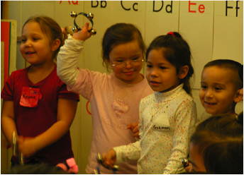
California’s Vision

Slide 11
CA CSEFEL Coordination
WestEd Center for Child & Family Studies, San Marcos Office provides the coordination for the CA CSEFEL Teaching Pyramid Framework in California
The state leadership team acts as an advisory group for the CA CSEFEL Activities
WestEd works closely with the national CSEFEL Pyramid Model to maintain fidelity

Slide 12
Notes:
Brief description of the system and how each of us fit into it, CPIN, Mentor, PITC.
Discuss continuum
The California Department of Education has endeavored to capture a vision for the “what” and the “how” of early childhood education and to think about the way the components of our professional development system would fit into this vision.
Foundations are the “what” 
the knowledge children acquire, the skills they develop, the behavior they learn, and their social and emotional competency.
What we do is the “how” 
how do we relate to children and their families,
how do we create a quality learning environment,
how do we chose or develop a curriculum and employ effective teaching strategies,
how do we assess the child’s learning and development, and
how do we acquire the competencies we need to be effective teachers.
Central Role of Foundations
Our focus is on the child, and the foundations are about the child.
Foundations are the competencies  the knowledge and skills  that we would expect to see in the typically developing child in a quality preschool setting, or in a quality infant/toddler care group setting.
The foundations are represented at the center of the chart and influence each of the other elements of the system.
Learning and Development Guidelines
Learning and Development Guidelines provide guidance on how to create a quality programs for infants and toddlers, and preschool children.
Program guidelines present broad recommendations for program quality based on research, theory and practice, and are available for voluntary participation of programs seeking a high quality of care and education for infant/toddler and preschool children.
Curriculum Frameworks
Curriculum frameworks are being developed to correspond to the Infant/Toddler Learning and Development Foundations, and the Preschool Learning Foundations, Volume 1. As volumes two and three of the preschool foundations are finalized, a corresponding curriculum framework will be released.
Curriculum frameworks elaborate on the foundations and describe the curriculum and instruction necessary to help children achieve the levels of mastery.
They are not the curriculum. Choosing of specific curricula and instructional strategies are the purview of local programs.
Assessment
California employs a teacher observation developmental assessment instrument in state-funded programs. The Desired Results Developmental Profile (DRDP) is a valid and reliable tool for teachers to observe and assess children’s learning.
Being clear about the distinction between foundations (or standards) and assessment instruments is important. The foundations describe what children typically learn with appropriate support, whereas the DRDP provides a means to document what individual children actually have learned.
This observational instrument is being aligned with the foundations through a matching study.
Professional Development
Professional development gives practitioners opportunities to learn about the other components of the system, namely, the foundations, the program guidelines, the curriculum frameworks, and assessment.
But it goes beyond any one professional development program. It includes the pre-service training that teachers receive in our institutions of higher education, the training that we provide for beginning teachers, and the in-service that we provide experienced teachers to pursue continuous improvement.
Professional growth in these areas can help teachers become more intentional in their work with young children.

Slide 13
Compliments CA Documents
The CA CSEFEL Teaching Pyramid is aligned with the California Early Learning & Development System (Foundations and Frameworks)
As part of the California Department of Education’s Early Learning & Development System, there are documents being produced to guide teachers of young children
Foundations, Curriculum Frameworks, Program Guidelines, Assessment through the Desired Results measure, and Professional Development are all part of the Early Learning & Development System
The Preschool Volume 1 and the Infant Toddler Learning & Development Foundations and Curriculum Framework all begin with Social-Emotional Development
That was intentional by the CDE as that area of development is the foundation for future learning

Slide 14
Program-Wide is What Makes CSEFEL Unique!
The power of the Teaching Pyramid is most clearly seen when it is implemented across an entire site, district, or agency – Program-Wide!
Training is only one small part of the approach
It takes planning by a group of leaders, training in a systematic way, and coaching/technical assistance to support implementation in order to be “doing CSEFEL”

Slide 15
CA CSEFEL Teaching Pyramid
Leadership Team
Training over Time
Coaching
Plans for sustainability
Specialized Training
Top of the Pyramid
Teaching Pyramid for Families

Slide 16
Key Points about the CSEFEL Pyramid Model
Most social/emotional development and behavior is promoted through positive preventive measures
Most children’s behavior and development does not require intensive intervention

Slide 17
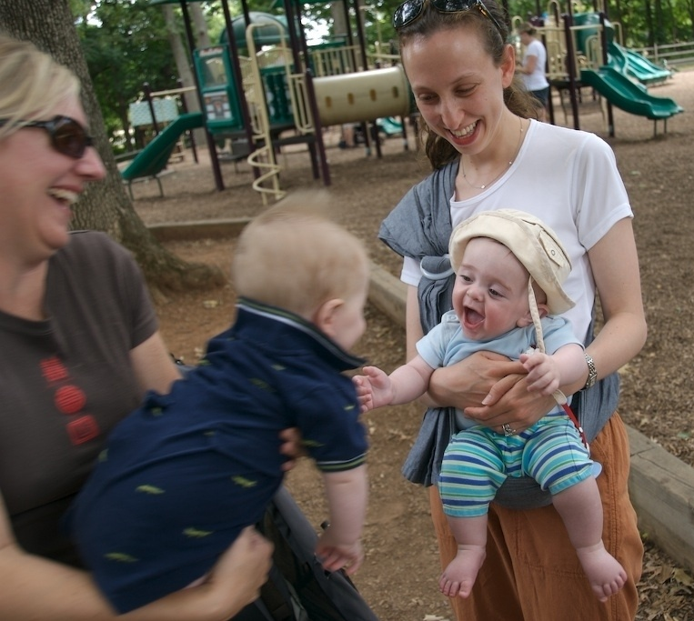
What is Social-Emotional Development?
The developmentally and culturally appropriate ability to:
Experience, express and manage emotions
Establish positive and rewarding relationships with others
California Infant/Toddler Learning and Development Foundations, 2009
Notes:
Source: California Foundations

Slide 18
It Begins Early…
Capacity to:
Feel confidence/ competence
Develop relationships
Make friends
Persist
Follow directions
Be emotionally literate
Manage emotions
Be empathetic
Capacity to:
Form relationships
Express emotions
Self-regulate
Explore with security
Develop “emergent” emotional literacy
Birth
Five

Slide 19
Looking at Behavior from a Reverse Chronology…
Gaps in ability to:
Form relationships
Express emotions
Self-regulate
Explore with security
Develop “emergent” emotional literacy
Challenging Behavior:
Has roots
Has meaning
Unlikely to begin suddenly “at 3.”
Birth
Five

Slide 20
Young children who exhibit healthy social, emotional, and behavioral adjustment are more likely to have good academic performance in elementary school (Cohen and others 2005; Zero to Three 2004). This recent research strengthens the view that early childhood programs support later positive learning outcomes in all domains by maintaining a focus on the promotion of healthy social emotional development (National Scientific Council on the Developing Child 2004; Raver 2002; Shonkoff 2004).
California Infant/Toddler Learning and Development Foundations, page 8 (2009)

Slide 21
Who Has Challenging Behavior?
For children under age three:
Behavior is how they communicate their needs
They are generally not capable of intentional misbehavior
Children will often develop coping skills that may be interpreted as challenging behavior
Adult’s can find some behaviors challenging, however it is the adult who needs to adjust and change, not the child

Slide 22
We Need to Teach!
“If a child doesn’t know how to read, we teach.
If a child doesn’t know how to swim, we teach.
If a child doesn’t know how to multiply, we teach.
If a child doesn’t know how to drive, we teach.
If a child doesn’t know how to behave, we…….....
Tom Herner (NASDE President ) Counterpoint 1998, pg.2
…….punish?
…….teach?
Why can’t we finish the last sentence as automatically as we do the others?”
Notes:
This sums it all up for me.

Slide 23
Brief Description of the Preschool Module Content
Adapted by WestEd Center for Child & Family Studies, San Marcos Office, 2012-13 version
Originally developed by the Center on the Social and Emotional Foundations for Early Learning

Slide 24
Module 1: Promoting Children’s Success: Building Relationship and Creating Supportive Environment
Topics included in this module:
Building positive relationships with children, families and staff members
Reflecting on values, perceptions, and beliefs about young children and their behavior
Designing environments that support appropriate behavior
Using schedules, routines, and visual strategies
Examining transitions and group size
Establishing expectations
Implementing activities that promote child engagement
Providing positive descriptive acknowledgement

Slide 25
Module 2: Social Emotional Teaching Strategies
Topics included in this module:
Identifying teachable moments
Facilitating the development of friendship skills
Teaching children to recognize and express emotions (emotional literacy)
Teaching children to understand and manage strong emotions such as anger, giddiness
Teaching problem solving and conflict resolution

Slide 26
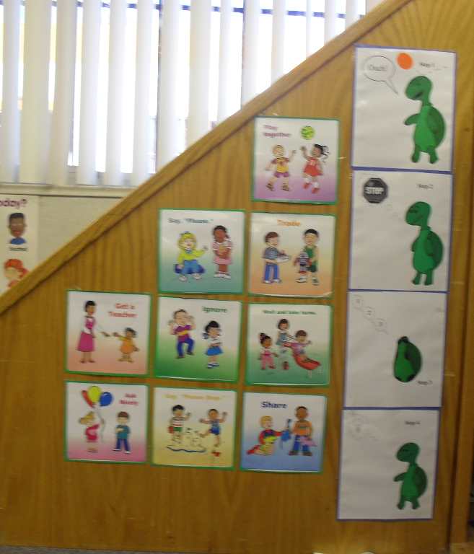
Strategies and Materials that Teach
Friendship skills
Super Friend
Emotional Literacy
Identifying feelings in self and others
Managing Strong Emotions
Tucker Turtle/Sonia Snail
Feel Good space
Problem-Solving/Conflict Resolution
Problem-Solving Steps
Solution Kit
Systematic process, visuals

Slide 27
Module 3A & B: Individualized Intensive Intervention
Topics included in this module:
Modifying and adapting materials and activities to meet the individual needs of all children, including those with disabilities
Identifying the function of challenging behavior
Identifying behaviors and social skills to target for intervention
Focusing on teaching new behaviors that still meet the original function
Developing a plan for supporting social-emotional development and preventing challenging behavior
Using a team approach to addressing challenging behavior and social-emotional needs

Slide 28
Reflection on What Works
Think about a time that you were able to work with a child who had some challenging behavior and help him or her be successful in your program
What strategies did you use to help the child to succeed?
What did you learn?

Slide 29
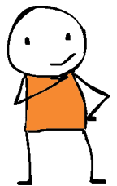
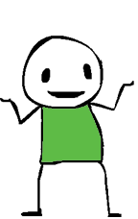
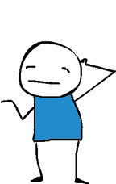
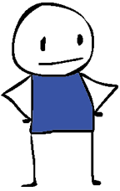
When Concerned About Behavior, Walk Up The Pyramid!
Ask questions below for specific child
Have I taught social & emotional skills?
Is the environment high-quality
and supportive to ALL children?
How have I built nurturing & responsive relationships with children, families, co-workers?
Notes:
When you are Concerned About Behavior, Walk Up the Pyramid!
Start by thinking about relationships. How have I built nurturing and responsive relationships with children, families and co-workers?
Is the environment in my setting of high-quality and supportive to ALL children?
Have I taught specific social-emotional skills?
And if you find that you have concerns about a specific child, you can walk up the pyramid with that child in mind

Slide 30
Also: Leadership Strategies for an Effective Work Force
Topics addressed with the Leadership Team:
Identifying challenges and barriers to implementing effective practices
Identifying strategies for addressing barriers and challenges
Developing program policies, procedures and staff development plans that promote the use of effective practices
Identifying steps to collaborative planning for programs and systems that support all young children’s social-emotional development and addressing challenging behaviors as needed

Slide 31
Counties With Programs Trained by WestEd and/or Authorized Trainers
Alameda County
Contra Costa County
El Dorado County
Fresno County
Los Angeles County
Madera County
Marin County
Merced County
Monterey County
Orange County
Sacramento County
San Diego County
San Francisco County
San Joaquin County
Santa Barbara County
Santa Clara County
Santa Cruz County
Ventura County
Yolo County

Slide 32
Levels of Implementation
Entry CA CSEFEL Teaching Pyramid Sites Community sites who have some, but not all of the components and are interested in growing to the next level
Practicing CA CSEFEL Teaching Pyramid Sites Community sites who are committed to implementing all components of the Pyramid model
Partner CA CSEFEL Teaching Pyramid Sites Sites with the goal of implementing with fidelity to the framework, sending a team to a Leadership Summit, and collaborating with CA CSEFEL on data collections
Mentor CA CSEFEL Classrooms in Partner Sites Mentor classrooms are located within Partner Sites, have implemented with fidelity to the framework, and agree to reach out and mentor other programs

Slide 33
Online Overview
There is an overview of the CA CSEFEL Teaching Pyramid available online through the California Early Childhood Online (CECO) website: http://www.caearlychildhoodonline.org
The three-hour overview is provided free of charge for those who register and a verification certificate will be issued upon completion

Slide 34
Strengthening Families
This is a national movement to provide a framework for promoting family strengths and a family environment that promotes optimal child and youth development
There are five “protective factors” that, when well established in a family, diminish the likelihood of child abuse and neglect
Information on the Protective Factors can be found at
http://www.cssp.org/reform/strengtheningfamilies/about

Slide 35
Five Protective Factors
Parental resilience
Social connections
Concrete support in times of need
Knowledge of parenting and child development, and
Social and emotional competence of children

Slide 36
CA CSEFEL Addresses the Protective Factors
The materials and the CA CSEFEL Teaching Pyramid Framework support most of the protective factors
They directly address knowledge of child development and social emotional competence of children
When support is provided to families in groups it can increase parental resilience and lead to social connections
And all early care and education providers need to learn about concrete supports in times of need available in their community

Slide 37
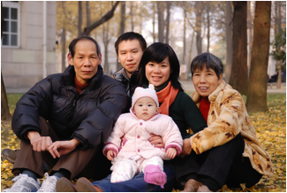
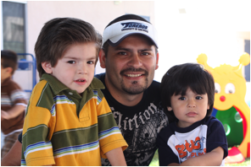
Families are Central
Throughout the material, families are included
“Positive Solutions for Families” is a set of materials to use with families of young children
There are six total sessions that can be done in two series
The materials are in English, Spanish, Chinese, and Vietnamese.

Slide 38
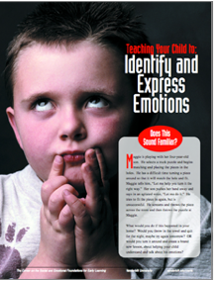
Material on Website
The Teaching Pyramid Website has a page dedicated to materials you can use with families
There are many articles and tools that will give strategies to address typical, yet challenging, behavior
On the website, these are organized by module
Module 1: Relationships and Environment
Module 2: Teaching Social-Emotional Skills
Positive Solutions for Families Series
The resources can either be shared directly with family members, or they can provide you with background information and tools to use with family members
www.cainclusion.org/teachingpyramid/materials_family.html

Slide 39
To Summarize
CA CSEFEL Teaching Pyramid is a tiered approach to promote health social-emotional development, prevent problem behavior, and address challenging behavior in young children
The Teaching Pyramid is designed to work in partnership with families, specialists, administrators, teachers, and more

Slide 40
Thank You!
For more information:
teachingpyramid@wested.org
CA Map to Inclusion & Belonging http://www.CAinclusion.org

