Slide 1
A Brief Overview of California’s Early Start Program
Early Intervention Services in California
Developed by
California MAP to Inclusion and Belonging…Making Access Possible
WestEd Center for Child & Family Studies
in collaboration with the California Department of Education and the
California Department of Developmental Services
Updated to reflect changes in state law as of January 1, 2015
California Map to Inclusion and Belonging is funded by the California Department of Education,
Early Education & Support Division, with a portion of the federal
Child Care Development Fund Quality Improvement Allocation
Notes:
This PowerPointTM and accompanying notes were developed by the California Map to Inclusion & Belonging Project for use in training and educational settings.
This PowerPoint and accompanying notes have been updated over time to to reflect changes in law as of October 1, 2009, July 1, 2011 and January 2015. The most recent update was completed on July 12, 2015. Changes as of January 1, 2015 are in blue.
Changes in law as of January 1, 2015 are due to enactment of Senate Bill 856 (Chapter 30, Statutes of 2014).
The focus of this overview updated as of June 2015 is on Early Start as a Program as it exists today. Eligibility criteria for Early Start has reverted back to the criteria before the 2009 changes in law. Changes as of January 1, 2015 are highlighted in this Overview.

Slide 2
Conditions for Use of This Presentation
This PowerPointTM and accompanying notes were developed by the California Map to Inclusion & Belonging Project for use in training and educational settings
This document was reviewed and approved by the California Department of Education, Early Education and Support Division, as well as the Special Education Division and Department of Developmental Services, when appropriate
The information regarding the laws and regulations were accurate at the time of distribution (updated in 2015)
Modification of the content is not permitted. Local information may be used as a supplement, but shall not be represented as part of the document
Users are free to duplicate this material in its entirety, with appropriate credit, for educational purposes only
Notes:
Use of the Notes Pages
The notes are included to provide clarification, additional information, and examples for those presenting this information to others. Presenters are encouraged to review the notes and recommended resources as they prepare to share the PowerPointTM slides. It is not necessary to share all of the notes.
When sharing these slides with the audience, it is likely that questions will be raised that are not able to be answered given the information contained in the notes. It would be helpful to have local resource information, including referrals, available for those who would like additional information or to address individual issues. Presenters are welcome to add activities or information to the presentation that assist their audience in understanding and implementing the concepts.
While these slides describe the Early Start process as it is intended, some individuals may have had a different experience with their local system. Presenters are encouraged to listen with empathy, yet reinforce that the slides represent an overview for the statewide system, so individual experiences may vary.
More information for early educator concerns is available on the Map PowerPointTM Talking with Parents When Concerns Arise.

Slide 3
Intent of This Overview
To assist early care and education providers in understanding the Early Start early intervention system:
when a child in their care, birth to age three years of age, has an identified disability
when they have concerns that a child in their care, birth to age three years of age, might have a disability, developmental delay or be at risk for a disability 2015 update
Notes:
The term early care and education provider is used for any person providing early care and education for a child including family child care providers, early childhood teachers, preschool teachers, Head Start staff, elementary teachers, before- and after-school staff, and so on.

Slide 4
California’s History of Serving Infants and Toddlers
California law since 1980
Lanterman Developmental Disabilities Services Act in 1982
Notes:
This slide and the background in the notes are included to provide context to the PowerPointTM. The detail in the notes is not necessary to share unless it is particularly relevant to a local community. For example, in a community with a history of serving infants and toddlers with special needs, the 1980 date may seem to negate those efforts.
Background
Several communities in California have been serving infants and toddlers since long before 1980. The service was not federally required, and was rather inconsistent across the state.
Before service to children below age three was required of all states (see the next slide), California amended the Education Code in 1980 to maintain services by public school agencies that were already providing services (often County Offices of Education).
The Lanterman Developmental Disabilities Services Act (also called the Lanterman Act, for short) was passed in 1969. The Lanterman Act established the Regional Centers of California. Service to children from birth was written into this act in 1982 and is applied to the Department of Developmental Services and its local representatives, the regional center.

Slide 5
Individuals with Disabilities Education Act (IDEA)
Federal legislation mandates special education for all eligible children
IDEA Part B: services for children with disabilities ages three through twenty-one
IDEA Part C: services for children birth to three years of age
Notes:
Federal legislation mandates special education for all eligible children in the United States and territories. (Historical background is in smaller print.)
Prior to 1975, educational services to children with special needs were not protected by federal law and therefore availability of these services varied greatly from state to state, even city to city. Many children with severe physical or mental impairments received no public education at all. A group of parents of children with special needs and advocates for the disabled lobbied successfully for “The Education for All Handicapped Children’s Act of 1975,” also known as PL 94-142. (PL stands for Public Law; it was the 142nd law passed by the 94th Congress.) Since the original passage of the law, there have been several amendments that added to and expanded the basic rights of the law. One amendment, PL 101-476, was passed in 1990 and resulted in the renaming of the original law to the “Individuals with Disabilities Education Act,” most commonly referred to simply as IDEA. This change was needed to reflect a philosophy known as “People First,” referring to the individual first and then to the disability rather than labeling someone as a “disabled individual” or a “handicapped child.” IDEA was amended in 1986 to include children ages birth to three years and three to five. The most recent amendment was done in 2004.
IDEA Part B guarantees services for children with disabilities ages three through twenty-one
A free, appropriate public education
An education in the least restrictive environment
A fair assessment in the delivery of special education and related services
Participation of parents and family members in the process through an Individualized Education Program (IEP)
IDEA Part C guarantees services for children birth to age three

Slide 6
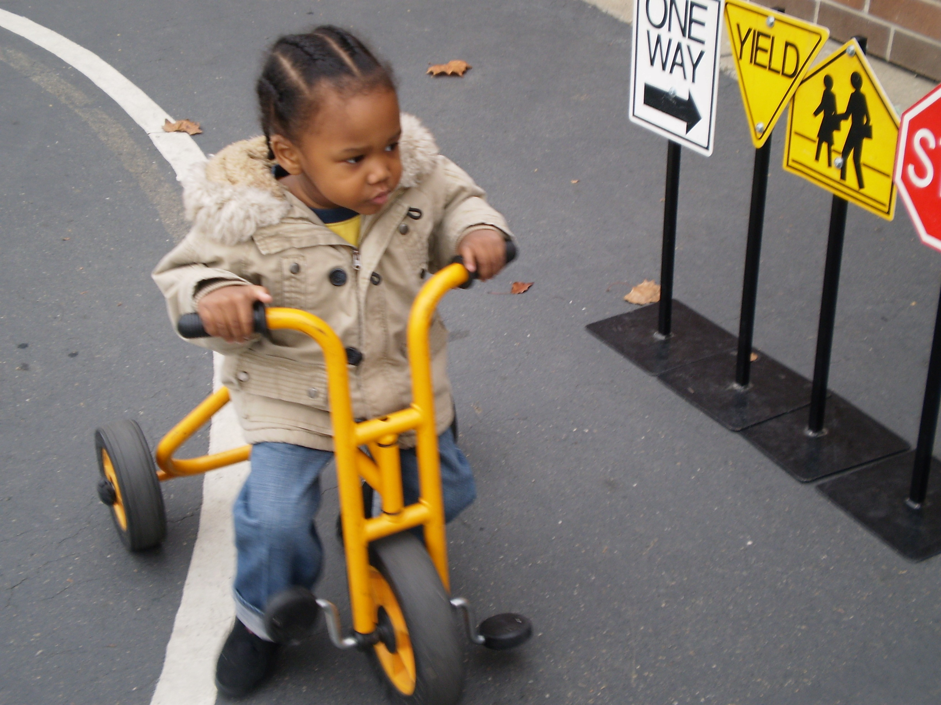
Early Start = Part C
Early Start is California’s early intervention service system under Part C of IDEA
Notes:
Our discussion today is about Part C. Infants and toddlers with disabilities (birth to age three years) and their families are eligible for early intervention services under Part C of IDEA.
Older children, ages three through twenty-one, receive services under Part B of IDEA.
The early intervention system has a different name in different states across the country. For example, in Oklahoma it is called Sooner Start; in Iowa, it is called Early ACCESS; and in Louisiana, Early Steps.
In California, Part C is called Early Start, although many communities use the name of the local early intervention provider when discussing California Early Start.
All these names refer to services provided under Part C of IDEA.

Slide 7
Early Start seeks to promote and enhance a coordinated, family-focused service system for infants and toddlers from birth to age three years with a significant developmental delay, a disability, an established risk condition with a high probability of resulting in a delay or disability, or be considered at high risk of having a substantial developmental delay due to a combination of biomedical risk factors
2015 updates
Notes:
This description contains some key words intended to support the unique needs of children under age three:
Coordinated: having all of the people and systems supporting the child and family working together
Family focused: Rather than focus on the child, as in education programs for older children, Early Start focuses on the family
Birth to age three: This includes the youngest children
“A significant developmental delay is defined as 33 percent delay in one or more developmental areas.” 2015 update
An established risk condition is for example Down’s Syndrome, or hearing loss
“At high risk”-Is a new criteria as of January 2015 that restores Early Start eligibility for those infants and toddlers experiencing developmental delays or disabilities due to a combination of biomedical risk factors. 2015 update
The Early Start program also helps transition children to agencies that provide services after the child turns three years old. More information is available on the Map PowerPointTM Transition in Early Childhood at Age Three for Children with Special Needs and from the publication, Effective Early Childhood Transitions found at www.dds.ca.gov/EarlyStart/docs/transitionHandbook.pdf

Slide 8
Early Start is Designed to:
Provide a system of referral and assessment that
results in individualized services
supports infants and toddlers and their families within their community
Be family-focused by
keeping families informed about services for their child
supporting families and including them as collaborative decision makers
Notes:
IDEA Part C legislation requires each state to implement a statewide, multidisciplinary, comprehensive, interagency system that provides early intervention services to infants and toddlers with disabilities and their families.
There are important components specifically designed for infants and toddlers that were incorporated into Part C of IDEA. These components are different from those mandated in Part B and two of them are listed in this slide.

Slide 9
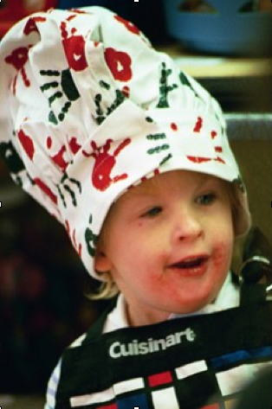
Early Start Administration
The California Department of Developmental Services (DDS) is the lead agency for overall administration of Early Start
DDS collaborates with the California Department of Education, Special Education Division, in the provision of services for some children
Notes:
DDS, the lead agency, collaborates with the California Department of Education, and the Departments of Health Services, Social Services, Mental Health, and Alcohol and Drug Programs.
The Early Start Program is implemented by:
21 regional centers,
125 special education local plan areas (SELPA), and
Over 50 family resource centers.
DDS (as lead agency) receives advice and assistance from the State Inter-agency Coordinating Council (ICC) on Early Intervention. The ICC includes representative family members as well as agency representation.
Local Impact
The state’s regional centers, through a contractual agreement with DDS, share primary responsibility with the California Department of Education’s local educational agencies (LEAs*) for coordinating and providing early intervention services at the local level.
LEAs are responsible for serving children with solely low incidence disabilities (vision, hearing, or orthopedic impairments).
* A LEA (Local Educational Agency) is the local public school agency responsible for overseeing special education. LEA is the local district. SELPA is responsible for overseeing special education.

Slide 10
Eligibility Criteria
The age at the time of the initial referral will be the age for consideration of eligibility.
Have developmental delay of at least 33% in one or more areas of either cognitive, communication, social or emotional, adaptive, or physical and motor development including vision and hearing; or
Have an established risk condition of known etiology, with a high probability of resulting in delayed development; or
Be considered at high risk of having a substantial developmental disability due to a combination of biomedical risk factors of which are diagnosed by qualified personnel
2015 update
Notes:
The developmental delay may be in one or more of these five areas
cognitive development
physical and motor development, including vision and hearing
communication development
social or emotional development
or
adaptive development
An established risk condition with a high probability of causing a delay (e.g., Down syndrome, hearing loss)
“At high risk” of a developmental disability includes for example prematurity, prenatal substance exposure and when the parent has a developmental disability.
Complete eligibility criteria is found in the California Code of Regulations Title 17, Division 2, Chapter 2 Early Intervention Services, Article 2, Eligibility Criteria
http://www.dds.ca.gov/Title17/T17SectionView.cfm?Section=52022.htm
As of January 1, 2015 eligibility criteria was re-established to the criteria prior to the changes in law as of October 1, 2009 and are reflected in the slide.

Slide 11
Early Start Services
Are designed to meet the individual needs of each infant or toddler and needs of the family
Are provided in “natural environments”
Are provided to families by qualified personnel
Include transition to appropriate services at three years of age
Notes:
To clarify:
Early Start services are specially designed to meet the unique developmental needs of each eligible infant or toddler and the needs of the family related to the infant’s or toddler’s development.
Services are based on the child’s needs AND are to be provided in “natural environments”— home and community settings in which children without disabilities participate. This may include home visits, group services, and family-involvement activities. Note: More clarification regarding Natural Environments is provided on the next two slides.
Effective July 1, 2011, parents whose adjusted gross family income is at or above 400% of the federal poverty level (FPL), and who are receiving qualifying services through a regional center for their children ages 0-18, shall be assessed an Annual Family Program Fee (AFPF) as prescribed by Welfare and Institutions Code, Section 4785 (Source: California Legislative Information, Welfare and Institutions Code). 2015 update
Parents of children under 3 must ask their private insurance or health care service plan to pay for medical services covered by the insurance or plan. 2015 update
Most children need to move to a different system at three years of age, either to special education -- if eligible -- or out of specialized services. IDEA Part C mandates that the Early Start system work together with the special education system to ensure a smooth transition for the child and family.
More information is available on the Map PowerPointTM Transition in Early Childhood at Age Three for Children with Special Needs and from the publication, Effective Early Childhood Transitions found at www.dds.ca.gov/EarlyStart/docs/transitionHandbook.pdf

Slide 12
Natural Environment
Any setting where typically developing children of a similar chronological age are found
Includes home, neighborhood, child care, preschool, parks, birthday parties, informal gatherings of family and friends, etc.
A “Natural Environment” is more than a location. It is a way of approaching service
Notes:
Natural environments are “settings that are natural or normal for the child's age peers who have no disabilities,” and include the home and community settings in which children without disabilities participate.
There is no single definition of a natural environment. Each family has an opportunity to create its own definition based on their routines, values, dreams and ever-changing circles of participation.
An inspirational quote
“This family-centered process never removes the family from their natural environment but rather works with the family to make their environment more responsive to the child’s needs. Service providers are challenged to value the family’s typical routine so that they make their supports and services ‘fit’ the family instead of the family having to ‘fit’ the service delivery model.”
Mary Elder
Texas Collaborative Planning Process

Slide 13
A Natural Environment
Is
Is Not
a location where this child would go if he did not have a disability
where other children go who do not have disabilities
in a part of the community where children and families without disabilities spend time when they are not being treated or tested for illness or health issues
a location where people usually go because they have disabilities or medical issues
a location that was chosen because it had specialized equipment
a location that was chosen because it was convenient for specialists who work with the child
Notes:
“Natural environments” are often an “inclusive setting” where children with special needs are included with their peers who are typically developing. Examples of these are: parent participation program, family’s church or synagogue preschool, family child care home or child care center, or any other setting where typically developing peers may attend.

Slide 14
Early Start Services can Include:
Assistive technology devices/services
Audiology services
Family training, counseling, home visits
Some health services
Medical services for diagnosis and evaluation
Nursing services
Nutrition services
Occupational therapy
Physical therapy
Psychological services
Service coordination
Special instruction
Social work services
Transportation services
Speech and language services
Vision services
Others as determined by the IFSP Team
Notes:
Not all children will need or will be eligible to receive all these services. This is simply a list of services available to the child and/or the family.
For example, Raj needs occupational therapy to help with improvement of fine motor skills. Raj does not need speech and language services because his development in this area is above age level.
Changes to Early Start Services as of July 2009
Use of Neighborhood Preschools
The law has been changed to promote the use of neighborhood preschool services and needed qualified personnel rather than center-based infant development programs for infants and toddlers.
Use of Group Behavioral Training
The law has been changed to promote the use of group behavioral training
instead of some or all of in-home parent training for behavioral intervention services.
Changes as of July 2011
“Respite” can be included as a service, but only if the child is eligible under the Lanterman Act. For those not eligible under Lanterman “Respite” is only provided to enable the parents to participate in early intervention services such as a training session.

Slide 15
Family Involvement
Families are an integral part of evaluation and assessment
Families participate in Individualized Family Service Plan (IFSP) development
Early Start services support families and help them meet the special needs of their infants or toddlers
Notes:
An Individualized Family Service Plan (IFSP) is developed for each eligible child and family.
In brief, the IFSP is:
a statement of the child’s present levels of all areas of development
a statement of the family’s resources, priorities, and concerns related to maximizing the development of the infant/toddler
a written plan developed by a multidisciplinary team, including parents and professionals based on a multidisciplinary assessment of the unique strengths and needs of the infant or toddler
developed within a reasonable amount of time after assessment and
reviewed at least semi-annually and evaluated yearly

Slide 16
Early Start Family Resource Centers (FRCs)
FRCs throughout California (~50) receive funding to provide parent-to-parent support to families
FRCs are primarily staffed by parents who have children with special needs
Services are provided in a nonclinical, family-centered atmosphere
Child care providers can also access libraries at FRCs
Notes:
To view information on Family Resource Centers in your region, visit
http://www.dds.ca.gov/EarlyStart/ESFamResource.cfm and http://www.frcnca.org/
Contact information and web links for all of the Early Start Family Resource Centers in each county is available on the MAP website under County Specific Resources http://cainclusion.org/camap/counties.html 2015 update
There are other types of Family Resource Centers (FRCs) in many communities with funding from other sources. The FRCs that receive funding from the Department of Developmental Service (DDS) Early Start program have unique resources and an obligation to provide services specifically for families of children with special needs between birth and age three.
Many of the FRCs with DDS funding serve a larger age range by accessing additional funding.

Slide 17
Family Resource Centers
Support the emotional and informational needs of families
Provide referral information and outreach to underserved populations
Support public awareness activities and family/professional collaborative activities
Assist families with transition
Provide support services and resources in many languages
Are culturally responsive to the needs of families
Provide resource, referral and outreach services
Notes:
Each Family Resource Center is asked to provide support and referral as listed in the slides. The way this is carried out varies depending on the size and staff of each FRC.
Other Family Resources
There are also several Parent Training & Information Centers (PTIs) in California with federal funding (see description below). Some PTIs are also Early Start FRCs.
Parent Training & Information Centers http://www.taalliance.org/centers/index.htm
Parent centers serve families of children and young adults from birth through twenty-one years of age with all disabilities: physical, cognitive, emotional, and learning. They help families obtain appropriate education and services for their children with disabilities; work to improve education results for all children; train and inform parents and professionals on a variety of topics; resolve problems between families and schools or other agencies; and connect children with disabilities to community resources that address their needs.

Slide 18
Parents’ Rights
Parents have rights and protections to ensure that early intervention services are provided to their children:
in a manner appropriate to their needs
in consideration of family concerns
in compliance with state and federal statutes
Notes:
These parent rights come from the IDEA legislation as well as other state and federal statutes.
More information regarding parent rights is available from any agency providing early intervention services, the Early Start Family Resource Centers, the Parent Training & Information Centers, the Department of Developmental Services, local regional centers, the California Department of Education, Special Education Division, or local education agencies.

Slide 19
Mediation and Due Process
Parents have the right to request a mediation and due process hearing in Early Start if they have a disagreement with a regional center or LEA about:
identification
evaluation
assessment
placement of their child
provision of appropriate early intervention services
Parents also may file a state complaint alleging a violation of federal or state statutes or regulations.
Notes:
These rights are specific to Part C of IDEA.
Brief Definitions
Identification is whether a child is identified as having an eligible condition
Evaluation means procedures used by qualified personnel to determine an infant's or toddler's present level of development
Assessment means the ongoing procedures used by qualified personnel throughout the period of an infant's or toddler's eligibility for early intervention services to identify the infant's or toddler's unique strengths and needs and the services appropriate to meet those needs. Assessment also includes the identification of the family's resources, priorities, and concerns regarding the development of the infant or toddler and the supports and services necessary to enhance the family's capacity to meet the developmental needs of the eligible infant or toddler
Placement of the child refers to the setting in which the child receives services
Provision of appropriate early intervention services designed to meet a student’s unique needs, sufficient to obtain “educational benefit,” and provided in conformity with the IFSP

Slide 20
Early Start Looks Different in Each Community – Why?
History
Local decision-making
Locally available resources
Notes:
History
As mentioned in slide 4, some areas of California were providing services to young children from the beginning of IDEA. In some places, education agencies were providing services to a wide range of children. This impacts who provides services in each community.
Local decision-making
There are many different geographic configurations to consider when making decisions locally. Some regional centers cover multiple counties; some cover only part of a county. In some areas, the county office of education has a strong role; in other areas, education agencies are less active as decision-makers.
Locally available resources
There are differences in the availability of service providers (early intervention, speech therapist, physical therapist, and so on). In some areas, service providers who speak the language of the child and family are not available.
As a result, the Early Start Program is implemented uniquely at the local level by:
21 regional centers
125 special education local plan areas (SELPA) that often pull together groups of LEAs
About 50 family resource centers

Slide 21
Transition at Three Years of Age
Because Early Start (Part C) applies only to a child under three years of age, the law requires the family to be informed about the transition that will occur when the child turns three years of age
Transition services are intended to support and prepare families and their child to exit Early Start and enter new services if needed at three years of age
Notes:
Transition to appropriate services at age three
Most children need to move to a different system at age 3, either to special education -- if eligible -- or out of specialized services. IDEA Part C mandates that the Early Start system work together with the special education system to ensure a smooth transition for the child and family.
More information is available in the publication, Effective Early Childhood Transitions, www.dds.ca.gov/EarlyStart/docs/transitionHandbook.pdf
2015 update

Slide 22
Transition Options
Special education preschool under Part B and/or
Ongoing regional center services and/or
Community options
Child care
Private preschool or Head Start
Remaining at home with the family
Other unique options in a community
Notes:
Due to changes in eligibility, service options often look different for children over age three years. These options are shared to show the range. An individual child may be using all three options, two of the options, or only one option.
More information is available in the publication, Effective Early Childhood Transitions, www.dds.ca.gov/EarlyStart/docs/transitionHandbook.pdf 2015 update

Slide 23
Transitions
For more information, see the publication, Effective Early Childhood Transitions http://www.dds.ca.gov/EarlyStart/ResourceMaterials.cfm
2015 update
Notes:
MAP is in the process of updating our training Power Point to reflect the new Part C regulations.

Slide 24
For More Information
Websites
Map to Inclusion and Belonging: www.CAInclusion.org
Early Start: www.dds.ca.gov/EarlyStart/
DDS Birth to 36 Months: http://www.dds.ca.gov/Birth36Months/Index.cfm
Early Start Resources (materials at no cost) http://www.dds.ca.gov/EarlyStart/ResourceMaterials.cfm
Other: http://idea.ed.gov, http://www.ideapartnership.org/
Early Childhood Special Education Handbooks: http://www.cde.ca.gov/sp/se/fp/ecseries.asp
Effective Early Childhood Transitions http://www.dds.ca.gov/EarlyStart/ResourceMaterials.cfm
2015 update

