Slide 1
Inclusion Works!
Creating Child Care Programs That Promote Belonging for Children with Disabilities
Based on the book and materials funded by the California Department of Education, Early Learning & Care Division and developed collaboratively with Linda Brault, WestEd

Slide 2
Information in this PowerPoint is from Inclusion Works!
Focus is on defining inclusive practice, describing collaboration, and sharing practical strategies
Intended for use in child care settings for children birth through age 12 years
Resources included in appendices as well as weblinks are on the Map to Inclusion & Belonging website
https://cainclusion.org/camap/map-project-resources/inclusion-works/
Book has been recently updated and has
videos accompanying the revision!

Slide 3
Chapters in
Inclusion Works!
Understanding Inclusion (important to read)
Including Children with Disabilities or Other Special Needs: A Rationale
Comparing Inclusive Child Care and Quality Child Care Settings
Creating Inclusive Child Care Programs
Identifying and Finding Help
Collaborating for Inclusion
Examples of Inclusive Child Care Strategies
Appendices

Slide 4
Chapter 1 Highlights
Understanding Inclusion
  Sets the tone of the book
  Includes definitions of terms
  New edition references the DEC/NAEYC Inclusion Joint Position Statement and three key principles of early childhood inclusion to be utilized collectively in identifying high-quality early childhood programs and services
    Access
    Participation
    Support

Slide 5
Key Elements
Access
  More than just getting in
  Programs are more accessible to ALL children when they incorporate “Universal Design” and “Universal Design for Learning”
Participation
  Individualized accommodations and supports can ensure full and active participation
Supports
  Services are to be integrated with the general education services and require an infrastructure

Slide 6
Belonging is Strengthened and Enhanced Through These Elements
I Belong! is a tool for self-assessment based on these three elements
The questions can guide conversations, particularly as programs work to promote true belonging through inclusion

Slide 7
Chapter 2
A Rationale
Chapter 2 provides a rationale for inclusive child care
  Attitude is still a big barrier
  Belonging is the key
  Benefits happen for all
  Children experience a range of disabilities and delays, with many being in the area of communication and learning
  Many fewer children with significant disabilities
  Learning about individual children is an important concept

Slide 8
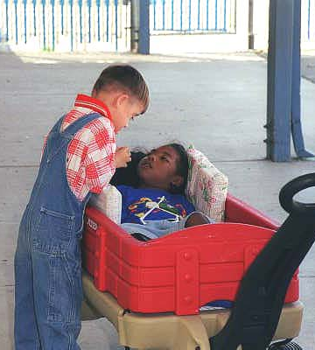
Fear is the Biggest Barrier
Not fear OF the child
Fear FOR the child
With knowledge, this fear fades and competence blooms
You can be successful at including children with disabilities or other special needs in your program
Funded by the California Department of Education, Early Learning & Care Division and developed collaboratively with Linda Brault, WestEd

Slide 9
Can I Include Children?
Absolutely! Most of you already are. Here
are some things to know:
You probably will not need to make major modifications to your program to do so
You may be able to receive assistance and support for the changes you do need to make
You will find that building an inclusive child care program will be rewarding for all the children, families, and staff in your child care program—and for you
Funded by the California Department of Education, Early Learning & Care Division and developed collaboratively with Linda Brault, WestEd

Slide 10
Focus on the
Individual Child
Teachers often want to learn “everything they can about _______ (autism, cerebral palsy, etc.)
In fact, there is such variability in how a disability impacts an individual person, one can NEVER learn everything
It is best to get to know the child and talk with the parents and family members
Ask “How does her {anxiety disorder or Down syndrome or…} impact her development? What has worked well at home or in other settings?

Slide 11
Chapter 3 Highlights
Chapter 3 compares inclusive child care and quality child care
  Quality is the foundation of providing inclusive care
  Programs can promote their inclusive practice
  New in the revised edition: Universal Design!

Slide 12
Keys to Quality
… the key to a high-quality program is what happens inside the classroom or family child care home, namely the interactions that take place between the teacher and child. In a high-quality program, teachers engage children with learning strategies that are tailored to the age of the child and use an appropriate curriculum to structure the learning experience. A variety of supports are needed to facilitate these interactions so that high-quality teaching and learning can occur. As such, the quality of an early childhood program is dependent on the following three key factors. … interpersonal interactions … physical environment … [and] program support structure.
Center for American Progress (2017)

Slide 13
For Children with Disabilities, 5 Key Indicators
A positive and healthy learning environment
The right number and mix of children and adults
Trained and supported personnel
A developmental focus on the child
Parents treated as partners
Child Care Aware

Slide 14
Universal Design
“The term 'universal design' means a concept or philosophy for designing and delivering products and services that are usable by people with the widest possible range of functional capabilities, which include products and services that are directly accessible (without requiring assistive technologies) and products and services that are interoperable with assistive technologies.”
Assistive Technology Act of 1998, as amended, 29 U.S.C. 3002.

Slide 15
Universal Design for Learning
WHAT DOES IT MEAN?
Multiple Means of Engagement
Multiple Means of Representation
Multiple Means of Demonstration
www.cast.org
Environment, curriculum, and activities that are inclusive of EVERYONE
Notes:
Examples, mini lecturette, discussion

Slide 16
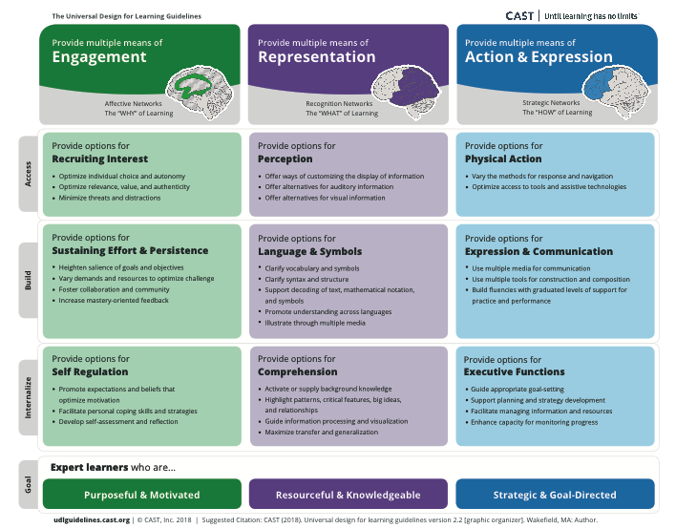

Slide 17
Chapter 4 Highlights
Chapter 4 provides factors that support inclusion
  Vision and champions help
  Success happens child-by-child, day-by-day
  Introduces common modifications, adaptations, and supports

Slide 18
Creating a Culture of
Inclusion & Belonging
Start with the assumption that all children are competent
Adapt the environment so that it is accessible, developmentally appropriate, challenging, and based on the needs and interests of each child
While there may be a need to support a child’s mastery of a specific skill, keep the whole child in mind, particularly the child’s social-emotional experience
Peter Mangione

Slide 19
Questions to Ask as You
Make Modifications
Does the child have an opportunity to be in control of the learning experience?
Is there a balance between adult-initiated learning and child-initiated learning?
Can the child make choices while learning the skill?
Is the child able to initiate his/her own efforts to practice the skill, with support given by the child care provider?
Is the child initiating and participating in activities with peers?
Is the child gaining self-confidence and showing the joy of accomplishment while learning?
Is there room in the activity for the child to make discoveries?
Peter Mangione

Slide 20
Chapter 5 Highlights
Chapter 5 discusses identifying and finding help for the child and the staff in the setting
  Talking with and supporting parents when concerns arise
  Overviews of the primary systems for accessing services
    Health and medical system
    Early Intervention/Special Education system

Slide 21
Chapter 6 Highlights
Chapter 6 covers Collaborating for Inclusion
  When including a child with a disability, it is important to work closely with the child’s family as well as any specialists who are providing service
  Family members are the first and most important resource
  Special educators, early interventionists, speech therapists, and other specialists bring essential expertise
  Early educators have much to contribute to the collaboration

Slide 22
Successful
Collaboration Elements
Respect for family members’ knowledge and experience with the child
Clear and regular communication
Time reserved for collaboration
Shared vision in the program
Collaboration in support services including Individual Education Plan (IEP) meetings

Slide 23
Chapter 7: Common Modifications, Adaptations & Supports
(In order of use in Preschool Classrooms)
Environmental support (Li’s story on page 58)
Materials adaptation (Danny’s story on page 63)
Activity simplification (Carlos’s story on page 65)
Child preferences (Luke’s story on page 68)
Special equipment (Jessie’s story on page 70)
Adult support (Andrea, Jamal & Tamika’s stories on page 73; Jazmine’s story on page 76)
Peer support (Sofia’s story on page 79)
Invisible support (Erica’s story on page 81)

Slide 24
Appendixes Highlights
Appendix A – Laws that Apply (page 87)
  Federal and California laws
Appendix B – Glossary (page 93)
  Includes definitions of special education terms
Appendix C – Laws that Apply (page 98)
  Sample forms
  Letter for families when supporting a child
Appendix D – Enrollment in Special Education (page 100)
  December 2019 California Data

