Slide 1

MAP To Inclusion and Belonging…..Making Access Possible
2018 Winter Open House and Resource Webinar
Cindy Arstein-Kerslake
Alejandro Castillon
WestEd Center for Child and Family Studies
Notes:
Introduce yourselves and your role related to MAP.

Slide 2
Overview
Orientation to the MAP to Inclusion & Belonging Project and Website
Essential inclusion resources and projects supported or developed by MAP
County specific resources
How could you use these resources?
Highlights of resources and links by topic area
Action plan
Notes:
Here’s what will be included in the Tour using this PowerPoint.

Slide 3
MAP to Inclusion & Belonging…Making Access Possible
Funded by the Early Learning and Care Division of the California Department of Education (ELCD/CDE) with quality improvement funds
Currently operated by WestEd Center for Child and Family Studies
Project originally started from a federal project in 1998, continued with ELCD/CDE funding
Website developed in 2004 & updated regularly and recently moved to disability accessible platform
Notes:
The Early Learning and Care Division of the California Department of Education has been fully supportive of inclusion of children with disabilities and other special needs as demonstrated by the funding of the MAP Project since 1998.

Slide 4
MAP’s Purpose
Primarily geared toward providing resources to support child care providers in implementing inclusive practices for children with disabilities from birth to 21 years of age in their programs
Provides comprehensive resources related to children with disabilities useful to families and professionals
Actively seeks to meet the needs of all stakeholders – welcome suggestions, questions and input
Notes:
The name of the MAP Project was recently changed from “Map to Inclusive Child Care” to “MAP to Inclusion and Belonging….Making Access Possible” to better reflect the applicability of the resources beyond the child care community. MAP resources support inclusion of children, youth, and young adults in child care, preschool, after school, and community settings. Anyone who lives with or works with children with disabilities or other special needs will find useful information on the MAP website.
The MAP website changes in response to the needs and suggestions of the people who use it. For example, all of the “Hot Topic” areas were developed based on suggestions from the field. The MAP Team welcomes feedback!

Slide 5

Welcome
Inclusion is more than the presence of children with disabilities or other special needs in early childhood settings or after–school programs; it really is all about belonging. As stated so eloquently by Norman Kunc...
It's All About Belonging
“When inclusive [practice] is fully embraced, we abandon the idea that children have to become ‘normal’ in order to contribute to the world. Instead, we search for and nourish the gifts that are inherent in all people. We begin to look beyond typical ways of becoming valued members of the community, and in doing so, begin to realize the achievable goal of providing all children with an authentic sense of belonging.”
--Norman Kunc (1992) www.normemma.com
Notes:
This quote by Norman Kunc is on the Home page of the website. I like to read it to help us focus on why we are here.
Inclusion is more than just being there, it’s about belonging.
All kids need to feel like they belong in their community. Child care is their neighborhood, their community.
We are going to show a short video that has gone viral on the web. You may have seen it on the news or on facebook. Here is Sophia!
Please tell me what you just saw….what do you think of Sophia?
For me Sophia demonstrates what the feeling of belonging and inclusion looks like. She’s a happy kid, full of confidence and ready to take on the world. That’s what we want for all kids!

Slide 6
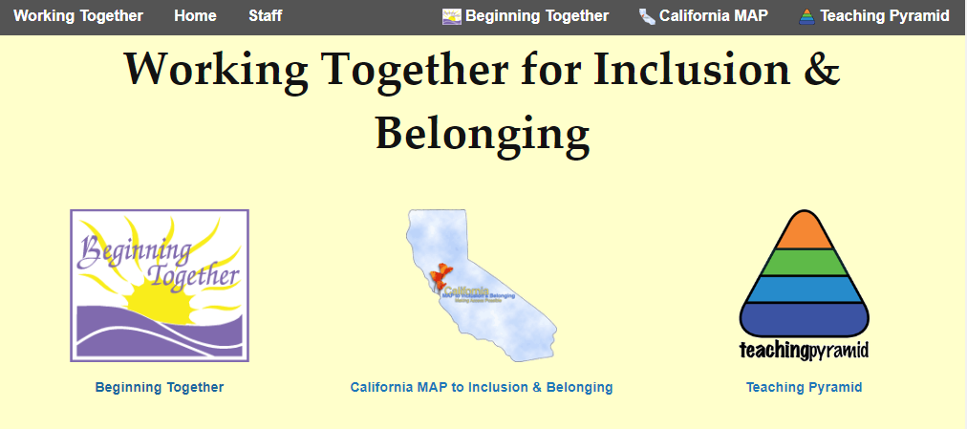
Where to Find MAP
Go to www.CAinclusion.org
Click on the MAP logo
Notes:
Now we will get right to the MAP website!

Slide 7
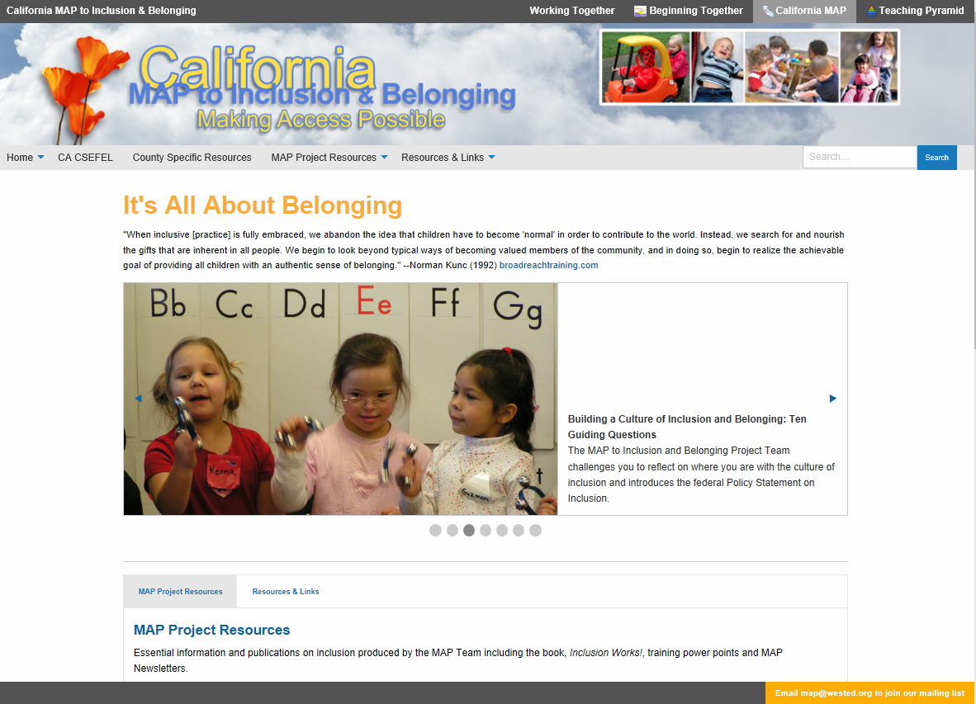
www.CAinclusion.org
Notes:
This is a snapshot of the “Home” page. I’ll have Alex take us to the live website now as provide an orientation to where things are on this new site.
The top black bar has links to all of the sister sites of the Working Together Team including Beginning Together that provides professional development for inclusion for birth to three (module 5 of PITC), MAP, and the Teaching Pyramid, that provides professional development for the California CSEFEL Collaborative on the Social Emotional Foundations of Early Learning.
The gray bar in the middle provides links to all areas of the website and remains visible all of the time. We have handy links to the CA CSEFEL, which I’ll expand on a bit later, County Specific Resources, MAP Project Resources and Resources and Links. In orange down in the bottom right hand corner, you see instructions on how to join the MAP mailing list.
MAP Project Resources and Resources and Links have drop down boxes that contain all categories of resources. MAP Project Resources include projects and resources created by the MAP Team. Resources and Links houses the collections of resources and web site links that have been gathered by the topic area.
In the middle of the page are the revolving announcements and links to timely resources.
Above the announcements under “it’s all about belonging” is a quote by Norman Kunc that describes the heart of the the MAP project.

Slide 8

MAP Project Resources
Essential information and publications produced by the MAP Team
CA CSEFEL
County Specific Resources
Hot Topics
Inclusion Works!
MAP Training PowerPoints
MAP Newsletter Archive
Reports and Useful Documents
Notes:
MAP Project Resources are the resources developed and authored by the MAP project.
We will take a close look at each of these.

Slide 9
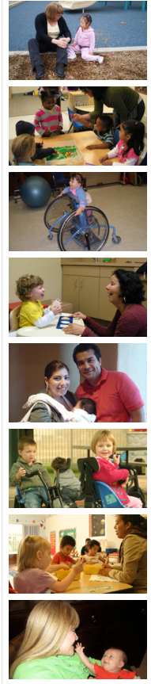
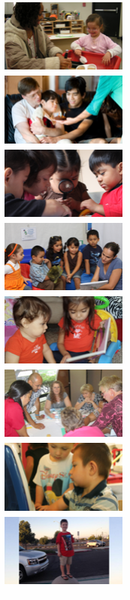
Resources and Links: By Topic Area
Coping with Trauma
Cultural Competency
Disability Specific
Early Identification
Family Engagement
Healthy Mind, Healthy Body
Inclusive Practice
Infant & Early Mental Health
Legal and Licensing
Organizations for Families
Policy/Trends
School Age & Beyond
Social Emotional & Behavior
Training & Technical Assistance
Video Collection
Visual Supports
Notes:
Resources and Links houses the collections of resources and web site links that have been gathered by the MAP Team by topic area to provide comprehensive, reliable information and resources to support the diverse needs of children with disabilities and their families.
Take a look at these categories and think about which ones you have a particular interest. I’ll make sure we get to the resources that would be most helpful to you.

Slide 10

MAP Project Resources:
CA CSEFEL
California Collaborative for the Social and Emotional Foundations for Early Learning
About CA CSEFEL- CA Department of Education’s vision and plan for supporting social and emotional development
  See the “Project Info Sheet”
Free sample adapted materials!
Notes:
How many of you are already familiar with CA CSEFEL? Raise your hand.
The California Collaborative for the Social and Emotional Foundations for Early Learning (CA CSEFEL) is the California Department of Education’s vision for promoting and supporting healthy social and emotional development for all children in California. The MAP Project and the California Department of Education co- lead the CA CSEFEL Leadership Team. CA CSEFEL partnered with the National Center for two years and is moving ahead with adaptations for California in line with California’s early learning foundations and curriculum frameworks.
For more about the CA CSEFEL see the Project Information Sheets and the Overview PP under “About CA CSEFEL”
A Sample of California Adapted Materials includes: Moving From Praise to Acknowledgement and Tell Me What to Do Instead. They are helpful tip sheets that provide guidance for using these effective strategies for supporting positive behavior.
More California Adaptations are explained and available in the Teaching Pyramid website.

Slide 11

Teaching Pyramid http://cainclusion.org/teachingpyramid/
The Teaching Pyramid is comprehensive pro-fessional development on the CSEFEL components
Materials for classrooms and families in Chinese and Spanish
Visit the website for more information
www.Cainclusion.org/teachingpyramid
Notes:
The Teaching Pyramid website provides information on professional development authorized by the California Department of Education for program-wide implementation of the Teaching Pyramid approach. To find out about the Teaching Pyramid Professional development, look at the Teaching Pyramid components.
Under “materials” you’ll find downloadable resources for your classroom and for families that have been translated into Spanish and Chinese.

Slide 12

Preventing Suspension and Expulsion of Young Children in Child Care & Early Education Settings https://preventingchildcareexpulsionca.org/
New website developed by the CA CSEFEL Leadership Team
Actionable resources to help early care and education programs support all children to be successful
See MAP’s Summer 2018 Newsletter to guide you
https://cainclusion.org/resources/camap/newsletter-archive/201808-news-brief.html#nine-resources

Slide 13
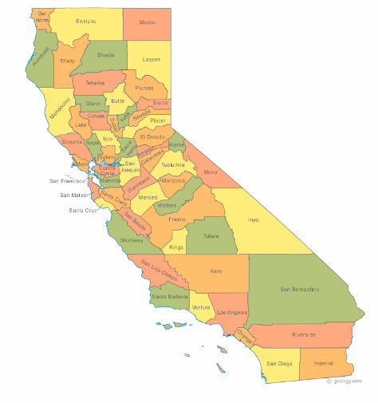
County Specific Resources http://cainclusion.org/camap/map-project-resources/county-specific-resources/
For California:
County specific
  Organizations that support children with disabilities and
  Inclusion/Behavior Resources
Click on the county name or map
Notes:
This area of the website is one of the most popular.
Many state agencies refer to this area of the MAP website when they are looking for county-by-county contact information for organizations supporting children with disabilities.
Let’s take a look at the information available for one of the counties. How about Alameda?
Participants, is there a county that you want me to show?
Now let’s go back to the PowerPoint…..to keep me on track.

Slide 14
Hot Topics
New Resources Collected to Meet Needs Identified by the Field
Inclusion Checklists and Self Assessments
Play! Play! Play!
Preventing Suspension and Expulsion in Early Education Settings (Social, Emotional and Behavior)
Supporting Immigrants and the Homeless (Cultural Competency)
Dual Language Learners (Cultural Competency and Resources in Multiple Languages)
Federal Policy Statements (Reports and Useful Documents)
Building a Culture of Inclusion: 10 Guiding Questions (Reports and Useful Documents)
Visual Supports
Early Identification: Learn the Signs Act Early
Video Collection
Coping with Trauma
Notes:
Hot Topics are new areas of the website developed in response to requests from the field and to address important issues. Research, tools, frameworks and tips are gathered to create a new topic area in MAP. They are usually introduced in in MAP Newsletters related to the theme of the newsletter. The most recent additions are sections in the fall newsletter about support for immigrants and homeless families. We also have a new category of resources related to Dual Language Learners within Cultural Competency and Resources in Multiple Languages, a new section within Reports and Useful Documents that contains all of the Federal Policy Statements and Guidance that have been released over the past few years and Building a Culture of Inclusion: 10 Guiding Questions also found within Reports and Useful Documents. The others are found in Resources and Links. We will take a closer look at these later.

Slide 15
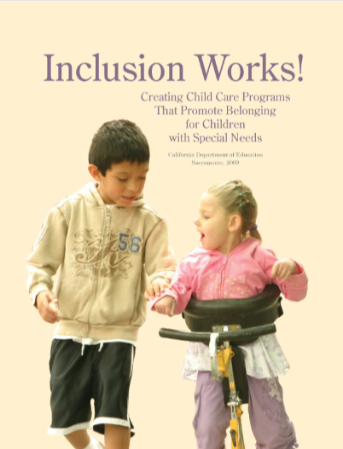
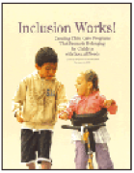
Inclusion Works! http://cainclusion.org/camap/map-project-resources/inclusion-works/
Focus is on inclusive practice, collaboration, and practical strategies
Intended for use in child care settings for children birth to age 12 years
Training PowerPoint complete with
presenters notes and Inclusion Works!
book is free to download
Will be updated soon
and videos will be added!
Notes:
Inclusion Works! is a book written by our project director, Linda Brault. It provides a primer on the meaning and implementation of inclusive practice in a variety of different settings. It explains the importance of collaboration, identifies the people who need to be engaged and provides strategies for working effectively as a team with the child.
The book is geared toward use in child care settings, preschool, and afterschool settings for children birth to age 12 years. The concepts presented are applicable to any age and any setting.
The last half of the book describes 8 Inclusion Strategies that are real life stories of inclusion that all highlight different ages, abilities and needs and ways these particular children were supported for inclusion.
The Book and a Training PowerPoint are available for download.
CDE is in the process of updating the book with new resources and developing video examples of all of the strategies of support!

Slide 16
MAP Training PowerPoints http://cainclusion.org/camap/map-project-resources/map-training-powerpoints/
Talking to Parents When You Have Concerns About a Child in Your Care
Inclusion Works! (Training Power Point to be used with the book)
For California
Overview of California Early Start – (Early intervention services) Updated as of October 2009, 2011 and 2015
Notes:
Child care providers are often the first to notice when a child may be showing signs of a developmental delay, learning, communication, or behavior issue. “Talking to Parents When You Have Concerns about a Child in Your Care” takes you through step-by-step what to do before you have the conversation, how to have the conversation, and what you might expect after the conversation.
“Overview of California Early Start” is an introduction to early intervention services in California and has been updated to include changes in laws as of 2009, 2011 and 2015.
The Inclusion Works! PowerPoint is to be used along with the Inclusion Works! book.

Slide 17
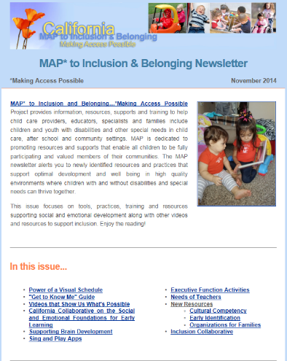
MAP Newsletters http://cainclusion.org/camap/map-project-resources/map-newsletters/
The very latest information, articles and new MAP web links and in depth resources on specific topics (Hot Topics)..Most recent:
Five Sets of Tools and Resources to Support Learning for All Children
Preventing Suspension and Expulsion August 2018
Supporting Immigrant and Homeless Children Fall 2017
Resources for Trauma Informed Care
Be sure you join the mailing list by emailing map@wested.org
Notes:
MAP Newsletters are a great source for the latest tools, publications, videos and new websites.

Slide 18



Reports and Useful Documents http://cainclusion.org/camap/map-project-resources/reports-and-useful-documents/
MAP Produced Publications
  The Americans with Disabilities Act and Child Care: A Parent’s Guide (English and Spanish)
  Building a Culture of Inclusion: 10 Guiding Questions
  MAP Newsletters, Inclusion Works!, MAP Training PowerPoints
California Department of Education Publications
  Guidelines for Early Learning in Child Care Home Settings (Now available in Spanish –January 2018)
  Effective Early Childhood Transitions (Jan. 2015)
  Best Practices for Planning Curriculum- Series
    Family Partnerships and Culture (2016)
    Integrated Nature of Learning (2016)
US Ed Policy Statements and Guidance for Early Childhood-All in one place!
  ED HHS Policy Statement on Inclusion-Law, Research, Attitudes, Recommendations and Resources
Notes:
Reports and Useful Documents is the area of the website that houses important documents and publications that we want you to be sure to notice and have easy access to.
All early childhood California Department of Education Publications related to early childhood are available in this area. I have the most recent listed on the PowerPoint
All Federal Policy Statements and Guidance are posted in one place on this page.
Other useful documents are listed on the PowerPoint and essential to inclusion!

Slide 19


Reports and Useful Documents:
Other Useful Documents
  Early Childhood Joint Position Statement by DEC and NAEYC-provides a working definition of inclusion: Access, participation and support!
  People First Language: All about respect-puts the person before the disability
  Preschool Inclusion Finance Tool Kit 2017 (for administrator making decisions about how to fund inclusion)

Slide 20

How can you use these resources?
What resources do you need to support the success of ALL children?
Notes:
Now we are taking time for a brain break! Take a minute to think about what resources stood out for you and how you might use those resources.
Also now is the time for you to think about questions or comments that you might have. Do you have specific needs or challenges that you would like to see addressed? Hopefully I’ll be able to address them as I go through the topic related resources and links.
We’ll go back to the Resources and Links page so that you can see all of the topic areas again.
Go back to Slide #9 to show the Resources and Links.
Take 3 minutes to talk to the person next to you about the resource that you will follow-up on and the area of Resources and Links that you’d like to explore further.

Slide 21
Resources and Links http://cainclusion.org/camap/resources-and-links/
Useful, well-respected web resources with readily available materials
Downloadable documents
Training materials
Video
Resources in other languages identified
For the rest of this PPT (so you can go back an access the content later), the slide title is the menu area of the website, followed by the name of the website
Notes:
Websites that are chosen to be on the MAP website are evaluated by MAP project staff and reviewed by the California Department of Education. Generally, commercial sites are included only if they have resources not available anywhere else and have been recommended by respected experts or state or national government projects. Our goal is provide useful information that is readily available.
We might not be able to get through all of the slides representing all of the various categories of information, but I’ve provided enough information that you can get to the site itself or find it on the MAP website. Everything listed is highly recommended.

Slide 22

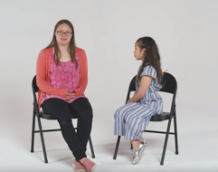


Video Collection
  Inclusion:
    Ian: A Moving Story https://youtu.be/6dLEO8mwYWQ
    Draccess Video Library:
  Inspiration:
    Kid Meets a Woman with Down Syndrome https://www.youtube.com/watch?v=zTE4OHpC2EU
  Autism:
    DAD: A Film About Autism and Fatherhood https://www.autismawareness.com.au/news-events/events-campaigns/dad-a-film-about-autism-and-fatherhood-online-now/
    Second Grade Friendship Binds Teenagers https://www.kare11.com/article/news/local/land-of-10000-stories/2nd-grade-friendship-binds-hs-honor-student-teen-with-autism/89-609564285
  Social/Emotional:
    Accentuate the Positive: The Transformative Power of Small Encouragements and Welcoming Interactions
    Aces Too High: Five Minute
    Growing Stronger Pre-K Teachers in San Jose, California, May 3, 2018, 6:03 https://www.youtube.com/watch?v=uydn_hr2Ook
  Training Videos
    Inclusion Collaborative Conference You Tube Channel-Keynote Joshua Sparrowhttps://www.youtube.com/watch?v=eEzJjLyAw74&index=34&list=PL4Ffky1G0tHInpltmYq5GfCowKm3H2Qjo&t=0s
Notes:
MAP’s Video Collection has become really popular. Newly added videos that are very well produced are brought forward here.
The video you saw earlier of Sophia is the first one under inspiration….7 year old girl’s message. Grant has a great message too….one of my favorites!
Aces Too High is a great introduction to Adverse Childhood Experiences…
Georgia Education Leaders have produced 5 videos that show what school-wide implementation of the positive behavioral support looks like.
The Draccess Video Library has several very well produced videos that demonstrate inclusion for both birth to three and preschool.
We are going to give you just a glimpse of one of the videos from Draccess produced by Larry Edleman. A Mother’s Voice Technology and Inclusion is actually the third video in a series that describes the experience of inclusion for Getty, who uses technology to participate in preschool (the first video)and then kindergarten (the second video).

Slide 23

Coping with Trauma
Resource Guide to Trauma-Informed Human Services (DHHS)-Resources Specific to Early Childhood Programs https://www.acf.hhs.gov/trauma-toolkit/early-childhood-programs
  Comprehensive resources including resources for secondary trauma
Helping Children Birth – 5 Rebound From Traumatic Experiences: Create Classrooms that Support Recovery
  Recorded Webinar and Resources: October 25, 2016 http://www.earlychildhoodwebinars.com/webinar-resources/
See the Fall 2017 Newsletter for recommended resources
Once I was Very Very Scared! Free stories and activities http://piploproductions.com/stories/once/
by Chandra Ghosh Ippen, Ph.D.
Webinar on about stress and trauma using
Once I was Very Very Scared
https://www.youtube.com/watch?v=DcAPbDpgoso&feature=youtu.be
Notes:
The federal government just released the Resource Guide to Trauma Informed Human Services. It has a wonderful introduction to Early Childhood mental health, complete with videos and lots of resources.
The Webinar Helping Children Rebound is really worth your time because it is completely geared toward what child care providers need to know about trauma.
Become trauma-informed!
Equip yourself with resources for yourself, co-workers and the children and families you work with
Learn how to use resources and activities
http://piploproductions.com/stories/once/ by Chandra Ghosh Ippen, Ph.D.
Take care of yourself

Slide 24
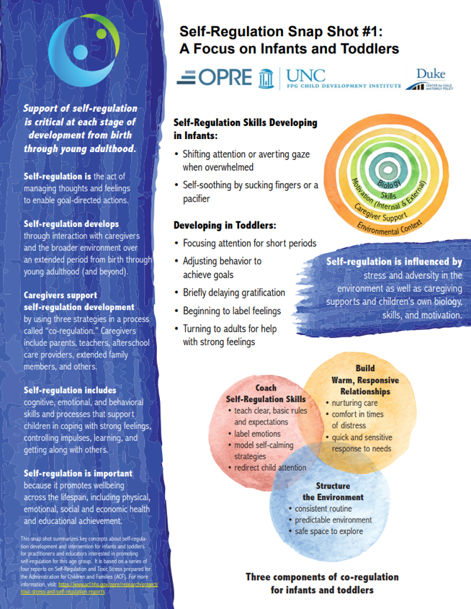
Coping with Trauma: Self Regulation
Self Regulation Snapshots:
Snapshots ( 2 page infographics) are mini-lessons in self-regulation for various age groupshttps://fpg.unc.edu/resources/self-regulation-snap-shots
For more detailed information
  Self-Regulation and Toxic Stress
  see the Self-Regulation Briefs https://fpg.unc.edu/resources/self-regulation-briefs and
  the pod cast, Teaching Self-Regulation in the Classroom, https://www.unc.edu/discover/well-said-teaching-self-regulation-classroom/

Slide 25

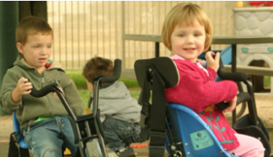
Healthy Mind, Healthy Body
Head Start: ECLKC: EarlyEdu Alliance: Mindfulness: A Resilience Practice https://eclkc.ohs.acf.hhs.gov/professional-development/article/earlyedu-alliance
  Professional Development for learning and teaching mindfulness includes PowerPoint and activities
Zero to Three: Mindfulness in Early Childhood –Research behind mindfulness https://www.zerotothree.org/resources/series/mindfulness-in-early-childhood
Early Childhood Mental Health Consultation (ECMHC) -Taking Care of Ourselves: http://ecmhc.org/relaxation.html
  Tool kits and Tutorials in English and Spanish
  Stress reduction & relaxation exercises video in English and Spanish
  Stretch + Breathe: 5 Ways to Reinvigorate Students, July 12, 2018 https://blog.gonoodle.com/2018/07/stretch-breathe-5-ways-to-reinvigorate-students/

Slide 26

Cultural Competency & Resources in Multiple Languages: Cultural Competency
In the News!
  Supporting Bi-Lingual Children with Special Education Needs
  Five Things to Know About Racial and Ethnic Disparities in Special Education
Fall 2017 MAP Newsletter:
  Supporting Immigrant Children and Their Families: What Early Care and Education Providers Can Do
  Working with Homeless Families
New Comer’s Tool Kit-Comprehensive guide to working with immigrant students and families
Teaching Tolerance: Immigrant Refugee Children: A Guide for Educators
Notes:
We recently divided Cultural Competency and Resources in Multiple Languages into three categories
Cultural Competency-resources that promote diversity and resources to support refuges and immigrants.

Slide 27
Cultural Competency & Resources in Multiple Languages: Dual Language Learners
California Department of Education publications:
  Family Partnerships and Culture https://www.cde.ca.gov/sp/cd/re/documents/familypartnerships.pdf
  Preschool English Learners https://www.cde.ca.gov/sp/cd/re/documents/psenglearnersed2.pdf
Head Start: ECLKC: Culture and Language: Dual Language Learners Tool Kit and Policy Statement https://eclkc.ohs.acf.hhs.gov/culture-language/article/dual-language-learners-toolkit
Useable Knowledge: Harvard Graduate School of Education:
  Multi-Lingual Preschoolers: Young children are increasingly linguistically diverse. How can early childhood educators provide a safe, nurturing environment? https://www.gse.harvard.edu/news/uk/18/04/multilingual-preschoolers
Notes:
Dual Language Learners resources are posted in this area.
I’ve pulled out a website that has an Inventory for self assessment of programs addressing both linguistic ability and ability diversity
There’s a DLL Training Module and
the Federal Dual Language Learners Policy Statement and Tool kit

Slide 28
Cultural Competency and Resources in Multiple Languages: Multiple Languages
All About Young Children: Information for Families on Children’s Early Development (California Department of Education)
  Videos, tip sheets and parent discussions by age group in 8 different languages
Center for Parent Information and Resources (for parents of children with disabilities)
  Index to Resources in Spanish for English speakers and link to the index that is entirely in Spanish http://www.parentcenterhub.org/spanish-to-english/
Child Mind Institute: Trauma Resources in 10 Different Languages
Love Talk Play
  Free Poster with everyday activities for parents and their babies and toddlers in 6 languages
Pathways: Downloadable brochure of developmental milestones in 15 languages
Notes:
In this area of the website we try to post any of the websites or resources that are available in multiple languages. Three examples are listed.

Slide 29
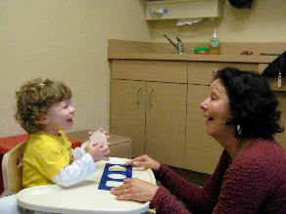
Early Identification: Learn the Signs Act Early http://cainclusion.org/camap/resources-and-links/inclusive-practice/
Early Identification Guide: Explains the
Key Elements
Resources by Topic Area:
  Healthy Development and Developmental
  Milestones
    CDC Learn the Signs Act Early Free Materials
    New! Milestone Tracker App (Individualized screening)
    New! Milestone Moments—videos and photos
    Watch Me! Celebrating Milestones and Sharing Concerns -Training Modules for ECE
    Birth to 5: Watch Me Thrive-Resources in Spanish
  Developmental Screening:
    Developmental and Behavioral Screening Guide-California specific
Notes:
The Early Identification page was developed in collaboration with the California Learn the Signs Act Early Grant partners that specifically wanted to promote the free developmental tools and materials on available from the Center for Disease Control.
An Early Identification Guide is available that describes the key elements of developmental screening.
The resources are presented by topic area. The resources highlighted in purple are must have resources for child care providers.

Slide 30
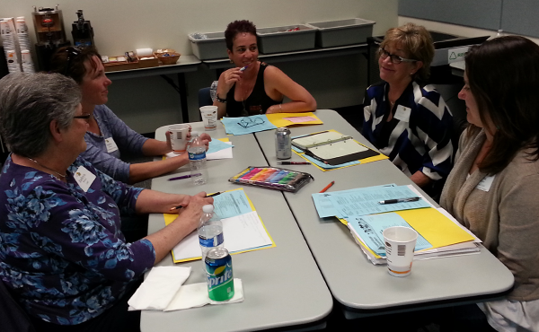
Inclusive Practice: Inclusion Checklists and Self-Assessments
MAP Inclusion Checklists and Self-Assessments https://cainclusion.org/camap/resources-and-links/inclusive-practice/#inclusion-checklists-and-self-assessments
Choose the Checklist that
fits your needs, discuss
it with your inclusion team
to help you improve your
program

Slide 31


Inclusive Practice: Brooks Publishing Inclusion Lab http://blog.brookespublishing.com/
Free Booklets, Calendars and Tips
2019 Reading Readiness Calendarhttps://brookespublishing.com/campaigns/2019-reading-readiness-calendar/
2018-2019 Inclusion Calendar
Taking Care of Them, Taking Care of You
Power in Friendship Toolkit https://www.inclusionproject.org/friendship/
Notes:
Brooks Publishing provides access to all kinds of free inclusion materials, posters and calendars. The Growing Strong 2017 Calendar provides tips for supporting social and emotional development.

Slide 32
Inclusive Practice: Head Start: ECLKC
Children with Disabilities
Resources for Supporting Individualization https://eclkc.ohs.acf.hhs.gov/children-disabilities/article/resources-supporting-individualization Organized around the 8 topic areas of evidence-based DEC Recommended Practices
High Quality Inclusion Webinar Series https://eclkc.ohs.acf.hhs.gov/children-disabilities/article/series-high-quality-inclusion
Highly Individualized Teaching and Learning https://eclkc.ohs.acf.hhs.gov/children-disabilities/article/highly-individualized-teaching-learning 15 minute In-service Suites addressing curriculum modifications including 8 different types of strategies to support children and tools for putting them into action in the classroom
Strategies for Support:
Environmental Support
Materials Adaptation
Activity Simplification
Child Preferences
Special Equipment
Adult Support
Peer Support
Invisible Support

Slide 33

Inclusive Practice:
Head Start: Disabilities Services Newsletters
Supporting Peer Interactions, December 2017 – Includes:
  Video clips, Child-Child Interaction Checklist, Peer Support In-service,
  Practice Guides for Families
  http://hsicc.createsend1.com/t/ViewEmail/j/0648BB5AD98C81C72540EF23F30FEDED/70A99C8D978FABD416B21F2806CB3AEB
Adapting the Environment to Support Engagement, November 2017- Includes:
  Case Study, DEC Recommended Practices, CONNECT Module 5: Assistive Technology Resources
  Environmental Adaptations Checklist
  Practice Guide for Families
  http://hsicc.createsend1.com/t/ViewEmail/j/FDBD2286855920C02540EF23F30FEDED

Slide 34
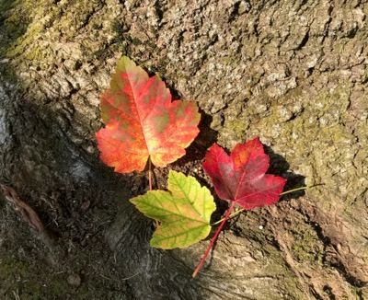
Inclusive Practice:
Transitions
Classroom Transitions https://eclkc.ohs.acf.hhs.gov/video/classroom-transitions 15 Minute In -service includes a brief video, tips for teachers and families and materials for trainers.
Infant /Toddler to Preschool Transitions for Children with Disabilities http://hsicc.createsend1.com/t/ViewEmail/j/F5C57E8A57E96B222540EF23F30FEDED/43B33EB248BC0C006CBD507C784BD83B Moving from services under an Individualized Family Service Plan (IFSP) to an Individualized Education Plan (IEP) at age 3.
Preschool to Kindergarten Transitions for Children with Disabilities http://hsicc.cmail19.com/t/ViewEmail/j/CC2186FD836C88C82540EF23F30FEDED/7CCABA7A7C72DC79405DC10595964AA8
  DEC Recommended Practices Preschool to Kindergarten http://ectacenter.org/~pdfs/decrp/PG_Trn_PreschoolSEtoKindergarten_family_print_2017.pdf
  Transition to Kindergarten Checklist http://ectacenter.org/~pdfs/decrp/TR-3_Transition_to_Kindergarten_2017.pdf
Strategies for Easing Transition Shock for new immigrants and English Language Learners https://www.edutopia.org/article/strategies-easing-transition-shock

Slide 35
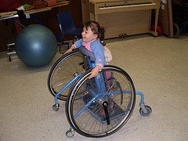
Disability Specific
Organizations that provide information, research and support to families on specific disabilities such as:
Autism-1 in 40 children!
  Autism Speaks: Autism and Health
  Sesame Street and Autism (Meet Julia)
Cerebral Palsy
Down Syndrome-NDS Society
Learning Disabilities and ADHD
  Understood
For rare diseases and disabilities see
  General Disabilities: NORD Rare Disease Information
Notes:
This area of the site identifies key organizations and resources that support specific disabilities.
For rare diseases look under General Disabilities: NORD National Organization for Rare Diseases.

Slide 36
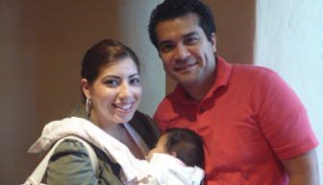
Family Engagement
Engaging Families and Creating Trusting Partnerships Webinar Series
Head Start: ECLKC Family Engagement-
  Best Practices Video Series
  Celebrating what fathers do every day-Posters
US Department of Education (USDE): Family Engagement Policy
Zero to Three:
  Daddy Matters
  Podcast Series: Sharing the Care

Slide 37
Legal and Licensing
State and federal organizations providing oversight of services to children with disabilities as well as regulatory agencies and advocacy groups are found here.
  Americans with Disabilities Act
  California Department of Developmental Services (DDS)-Early Start and Regional Centers coordinating services for children with disabilities
  California Department of Education-Early Education & Support Division
  California Department of Social Services-California Child Care Licensing-Resources for Parents and Providers-Videos…New!
  Individuals with Disabilities Education Act (IDEA): New website
  US Department of Education
  Wrights Law: Free publications that explain the law
Notes:
Here’s where you’ll find the websites of the Federal and State Agencies and disability rights organizations that may have information, services, supports, or resources helpful to families of children with disabilities and other special needs.
On the MAP website page direct links to key resources are listed in bulleted entries below the description of the site.

Slide 38
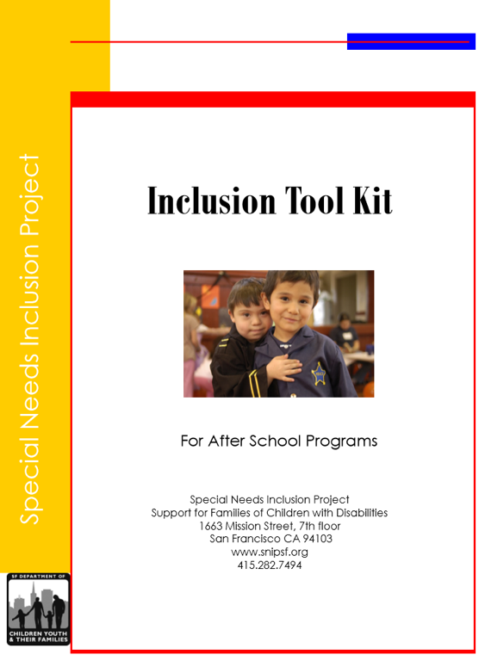
School Age and Beyond
The Special Needs Inclusion Project SNIP www.snipsf.org
Inclusion Kit
Tip Sheets and Resources
  Inclusive Practice Tip Sheets
  Snippets Articles
  Strategy Specific Workshop Tool Kits

Slide 39
Social and Emotional
Bullying and Youth with Special Health Needs https://www.stopbullying.gov/at-risk/groups/special-needs/index.html
Center for Healthy Minds: 5 Tips for Building Empathy in Youth https://centerhealthyminds.org/join-the-movement/5-tips-for-empathy-building-in-teens
Center for the Promotion of Social & Emotional Learning CPSEL www.cpsel.org/
  Growth Mindset Tool Kit https://www.transformingeducation.org/growth-mindset-toolkit/
  Mindfullness Tool Kit https://www.transformingeducation.org/mindfulness-toolkit/

Slide 40
Social and Emotional
American Academy of Pediatrics: Effective Discipline to Raise Healthy Children http://pediatrics.aappublications.org/content/early/2018/11/01/peds.2018-3112 November 2018
Head Start ECLKC : Mental Health: Help Me Calm Down: Teaching Children How to Cope With Their Big Emotions October 15, 2018 https://eclkc.ohs.acf.hhs.gov/teaching-practices/teacher-time-series/help-me-calm-down-teaching-children-how-cope-their-big This webinar reviews "emotional regulation"
Understood: Managing Meltdown’s and Outbursts: Helping Kids to Self-Regulate https://www.youtube.com/watch?time_continue=175&v=Y0xpVwCh0v8 October 15, 2018 Webinar, with expert Ellen Braaten, Ph.D., 30:37.
Brooks Inclusion Lab:15 Tips on Supporting Emotional Regulation for Young Children with and Without Autism http://blog.brookespublishing.com/15-tips-on-supporting-emotional-regulation-for-young-children-with-and-without-autism/

Slide 41
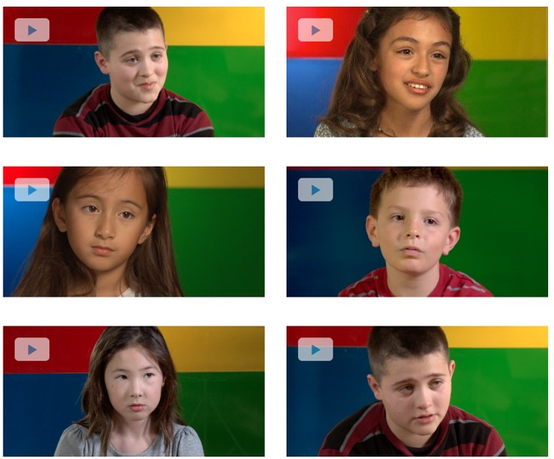
Social and Emotional
Great Schools! Resources for helping children expand their feeling vocabulary-books and video game.
Do You Feel Me? Feeling Words Game https://www.greatschools.org/gk/do-you-feel-me/

Slide 42
Training & Technical Assistance
Beginning Together-Intensive 5 day Seminar or Institute (PITC Module 5) on inclusion for children birth to 5
CIBC-California Inclusion & Behavior Consultant network supports CDE funded programs with concerns about inclusion or challenging behavior
CPIN-California Preschool Instructional Network provides professional development and technical assistance to preschools
ECTA Center-Inclusion in Least Restrictive Environments
  Webinar Series http://ectacenter.org/webinars.asp#pastwebinars
Inclusion Collaborative Conference:
  CA Inclusion Conference October 2019. For 2018 Conference Sessions see the Inclusion Collaborative You Tube Channel https://www.youtube.com/playlist?list=PL4Ffky1G0tHInpltmYq5GfCowKm3H2Qjo
Notes:
This area of the site provides links to state and national training and technical assistance projects or organization.
Desired Results Access has a video library with wonderful examples of the elements of inclusion at work in California schools produced with the help of Larry Edelman. Excellent inclusion videos are available from this site.
ECTA Center has webinars and the latest resources on least restrictive environments (inclusion in preschool).
Save the date for the annual California Inclusion Conference October 26th and 27th . Attendance is in person or virtually! Recorded sessions from the 2016 conference are now available!
The Early Start Neighborhood has just posted Guidelines for Evidence-Based Infant Toddler Social and Emotional Assessment and Screening

Slide 43

Action Plan
Identify three resources that stood out for you today?
How will you use each resource?
What resource or idea will you follow-up on to learn more about?
Notes:
As we close the webinar you might want to create an action plan to use for the resources that you might use. This is to help you reflect.
Also Alex will post a very short poll to help us learn more about you and your needs and improve the MAP Tour. Please take a couple of minutes to do the poll.

Slide 44
Talk to Us
Be sure you are on our Mailing List to get our newsletter to hear about new resources and updates
You can also let us know what you’re doing with inclusion by emailing us at map@wested.org or carstei@wested.org
Thank You for Visiting MAP!
Notes:
44
We would love to hear from you. Tell us about projects that you are involved with and the questions that you have related to inclusion. If you have suggestions for Hot Topics, let us know.
Join the mailing list on the MAP website to get updates on inclusion and belonging resources through the MAP Newsletter. Check out other resources under Inclusive Practice. For questions, email map@wested.org.

