Slide 1

Introduce Expectations to Families
This Family Orientation PPT is available on Canvas for you to download and use for your classroom or site as part of the open house, or other back to school activity.

Slide 2
Expectations for School
School Name

Slide 3
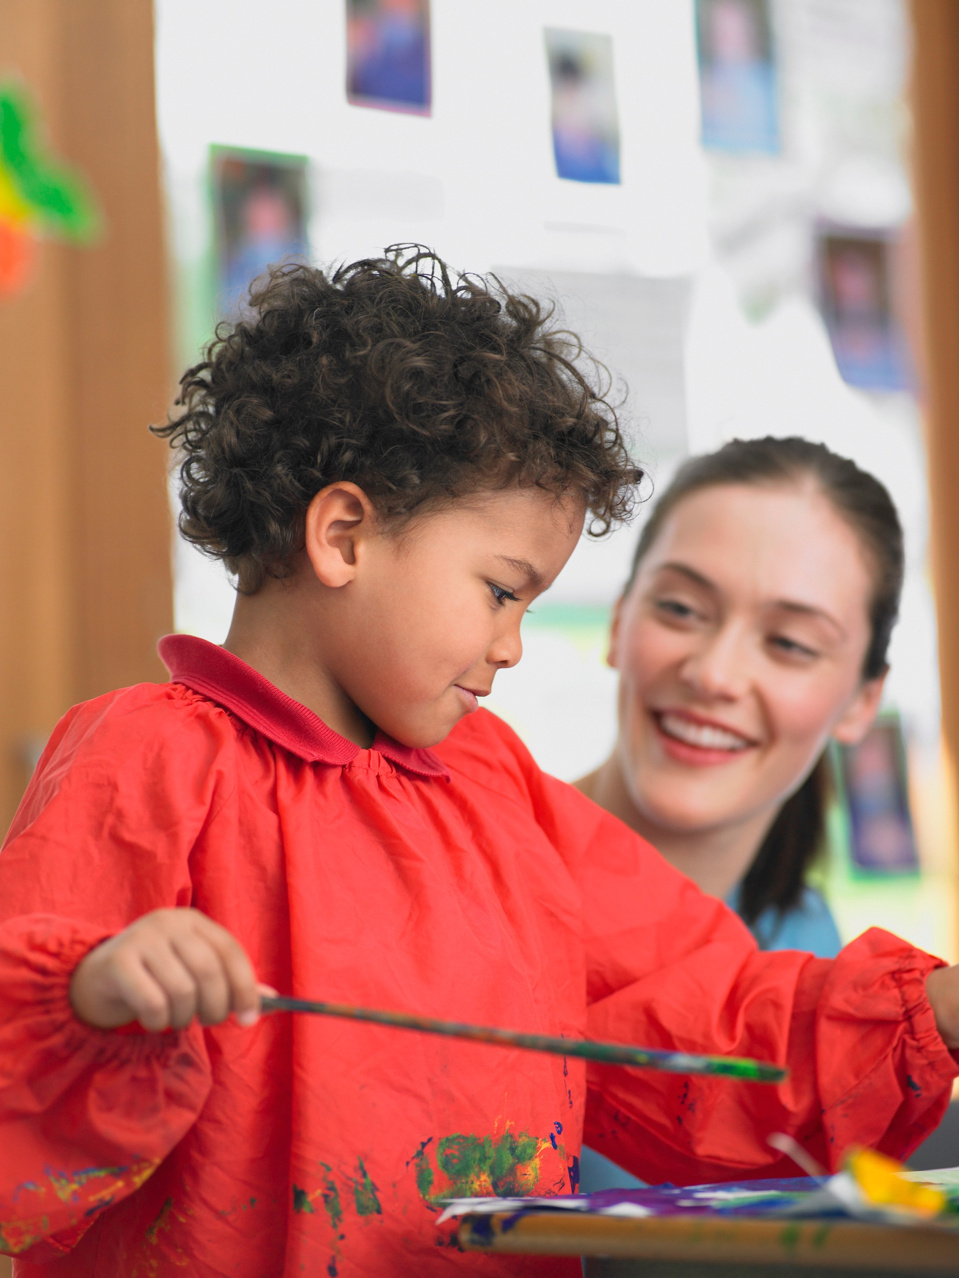
Expectations
Today we will be talking about our Expectations. Expectations help everyone know how to behave at School Name and how we will treat each other, children and adults.

Slide 4
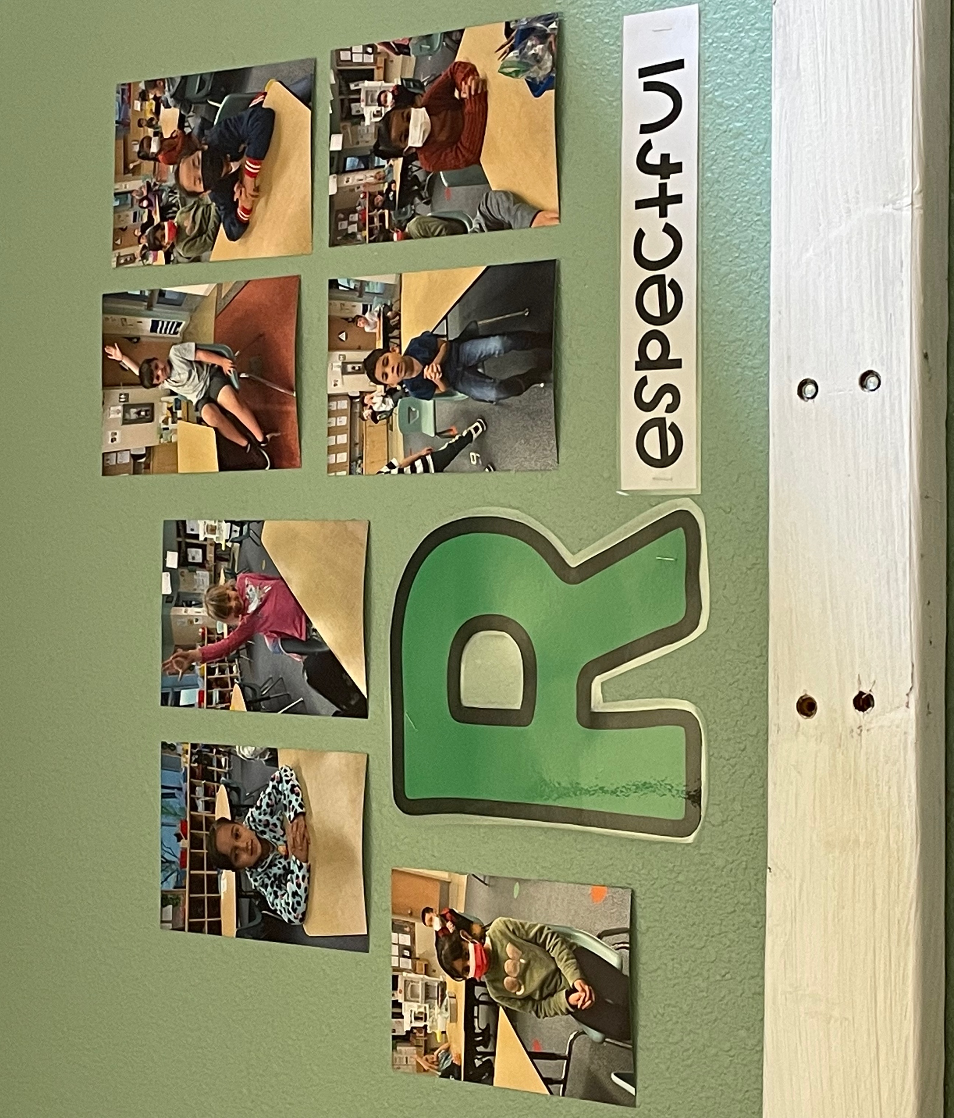
These are our Expectations:
We are Safe
We are Kind
We are Respectful
We are Responsible

Slide 5
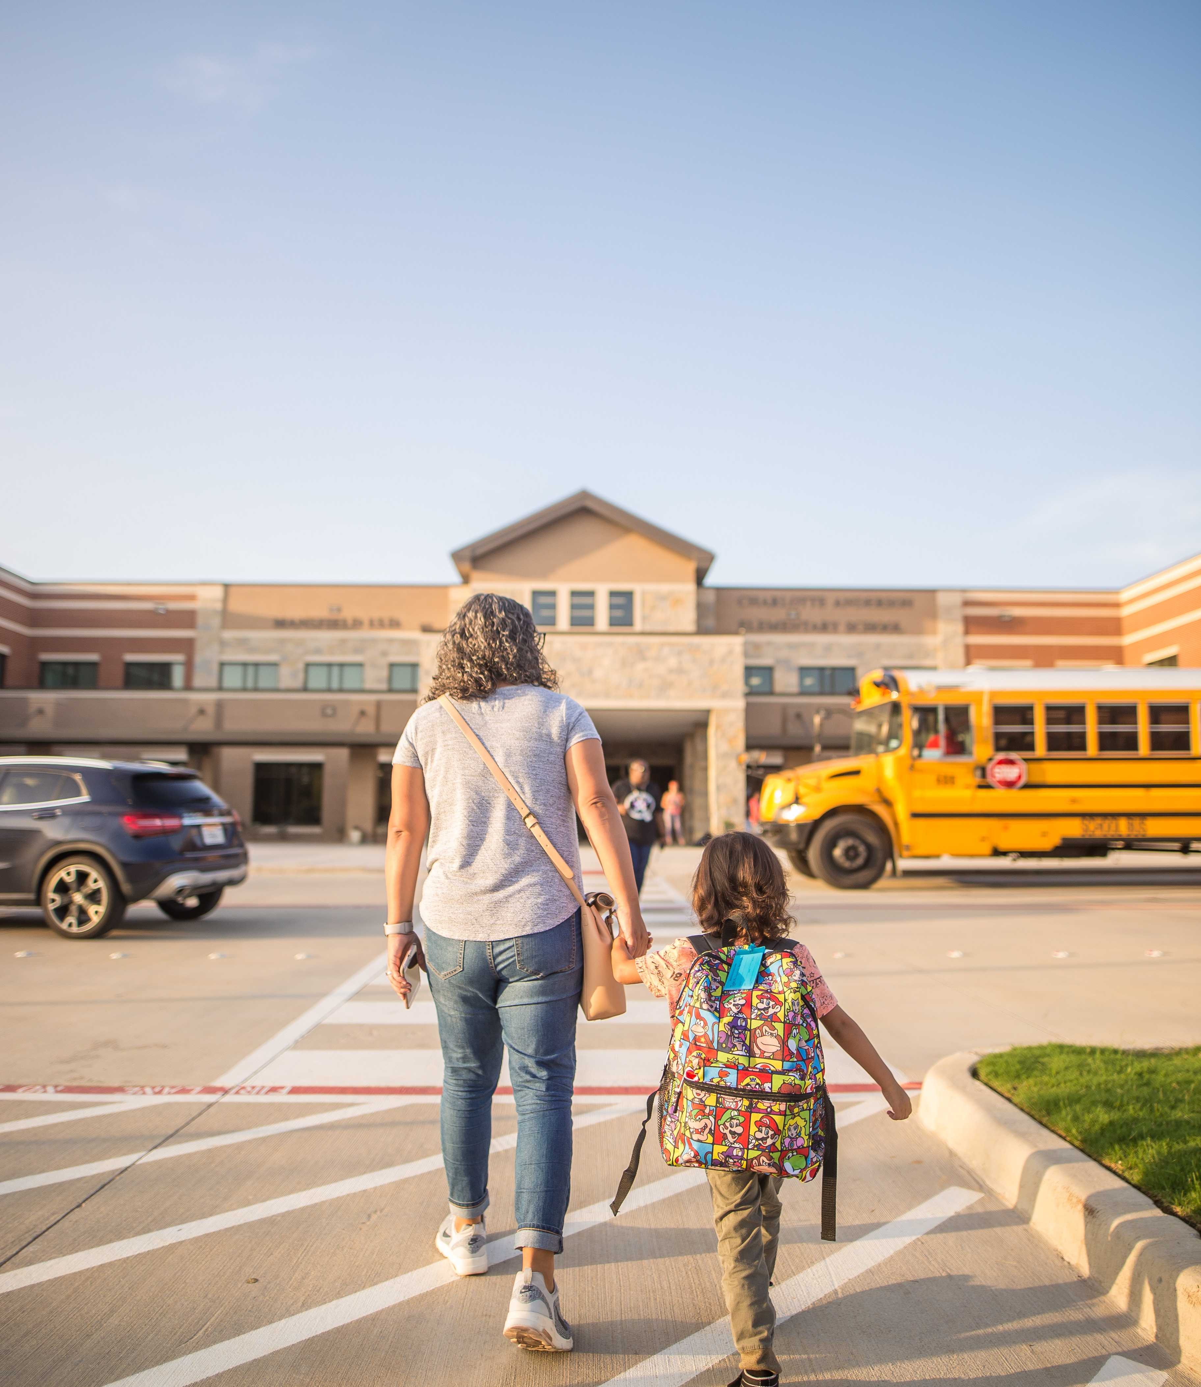
We are Safe
I am being safe when I hold an adult’s hand in
the parking lot.

Slide 6
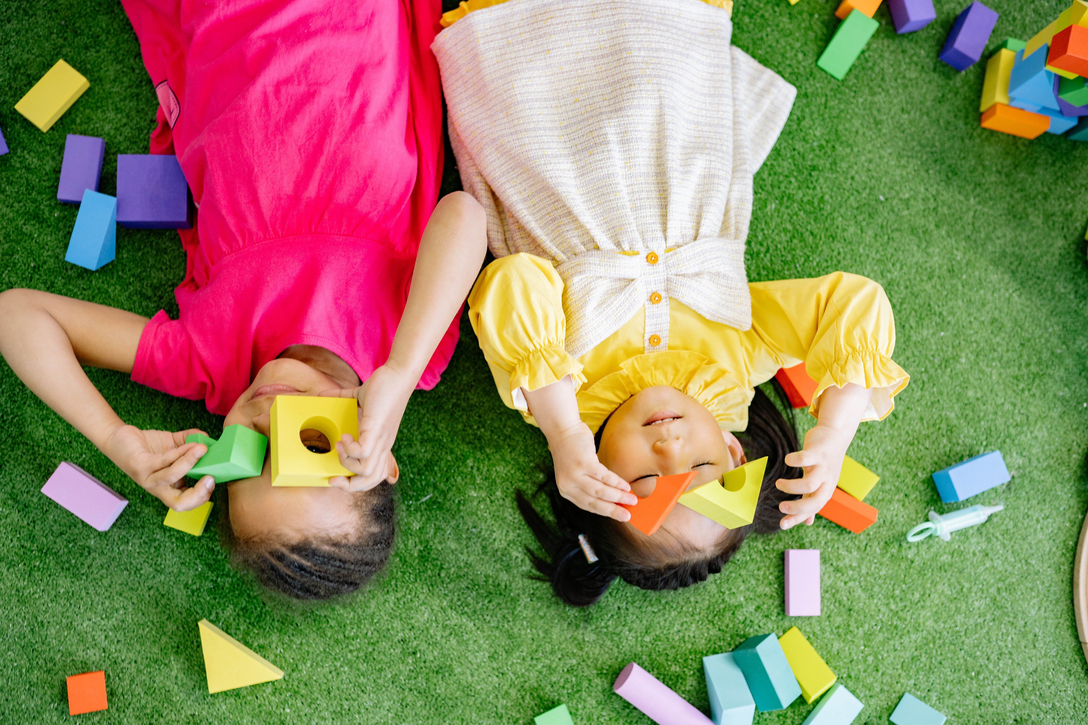
We are Kind
I am being kind when I share toys.

Slide 7
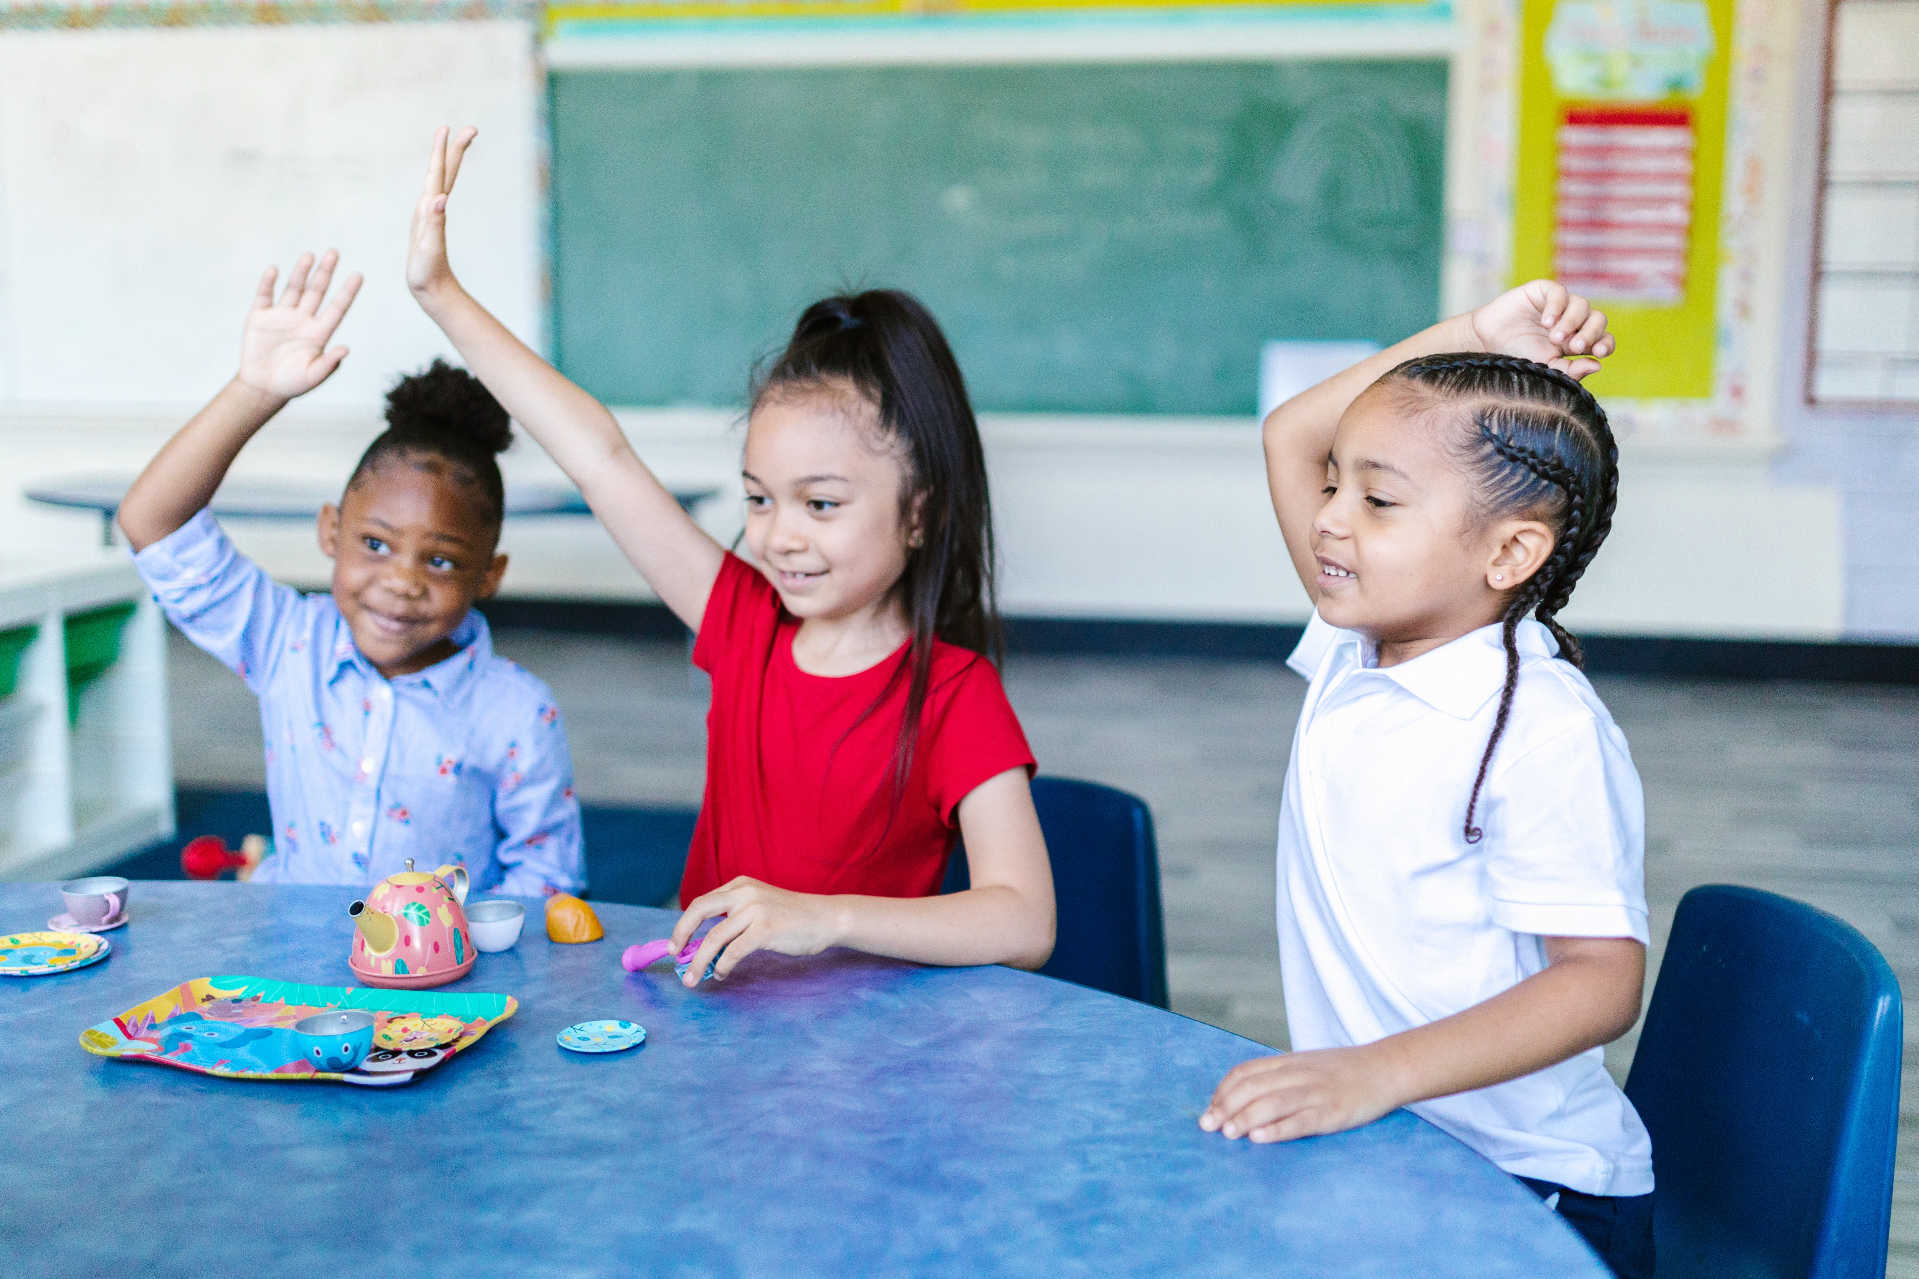
We are Respectful
I raise my hand when I want to talk, ask a question, or share an idea.

Slide 8
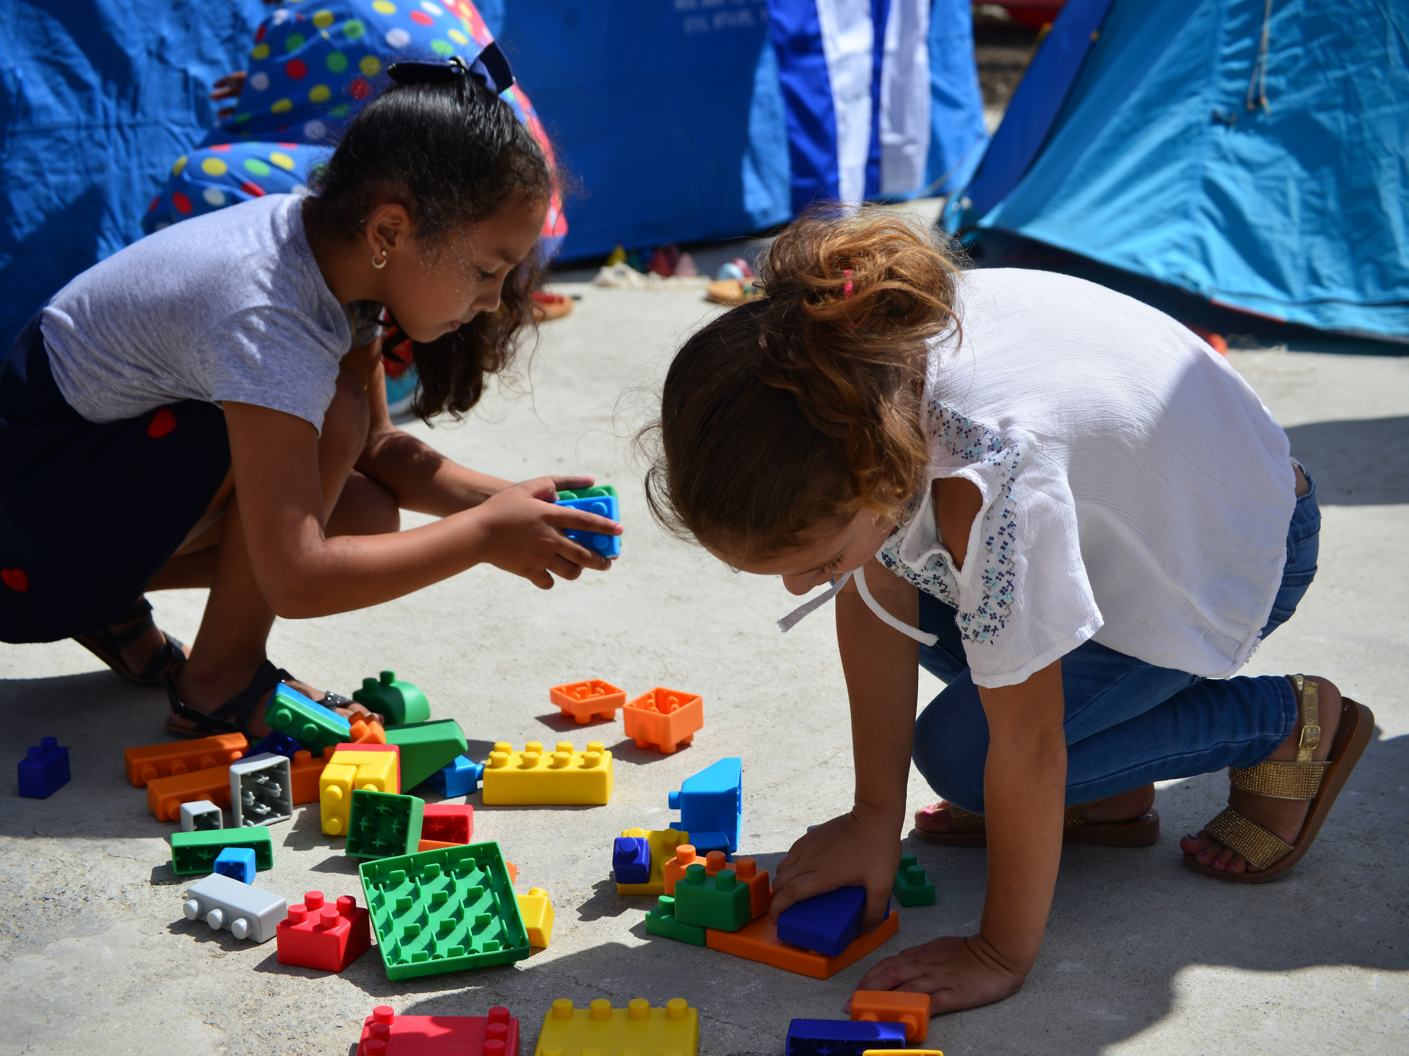
We are Responsible
I am being responsible when I help clean up the materials.

Slide 9
We Are Learning!
Learning how to be safe with myself and others, to be kind, responsible, and to treat others with respect are important for success in school and in life.
They are an important part of what your child is learning this year at School Name.

Slide 10
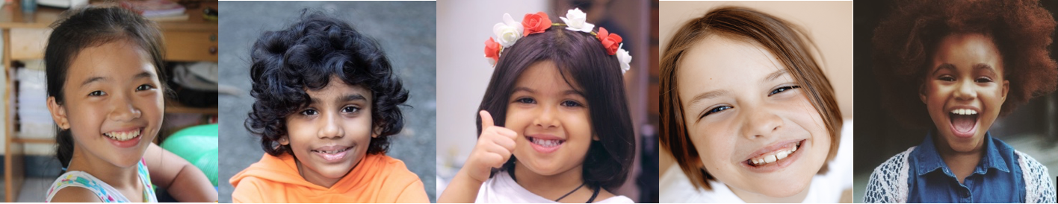
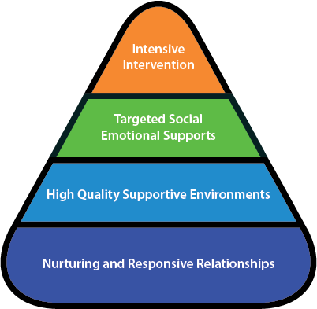
These Expectations are part of a special approach we have at School Name.
This approach is called the Teaching Pyramid.

Slide 11
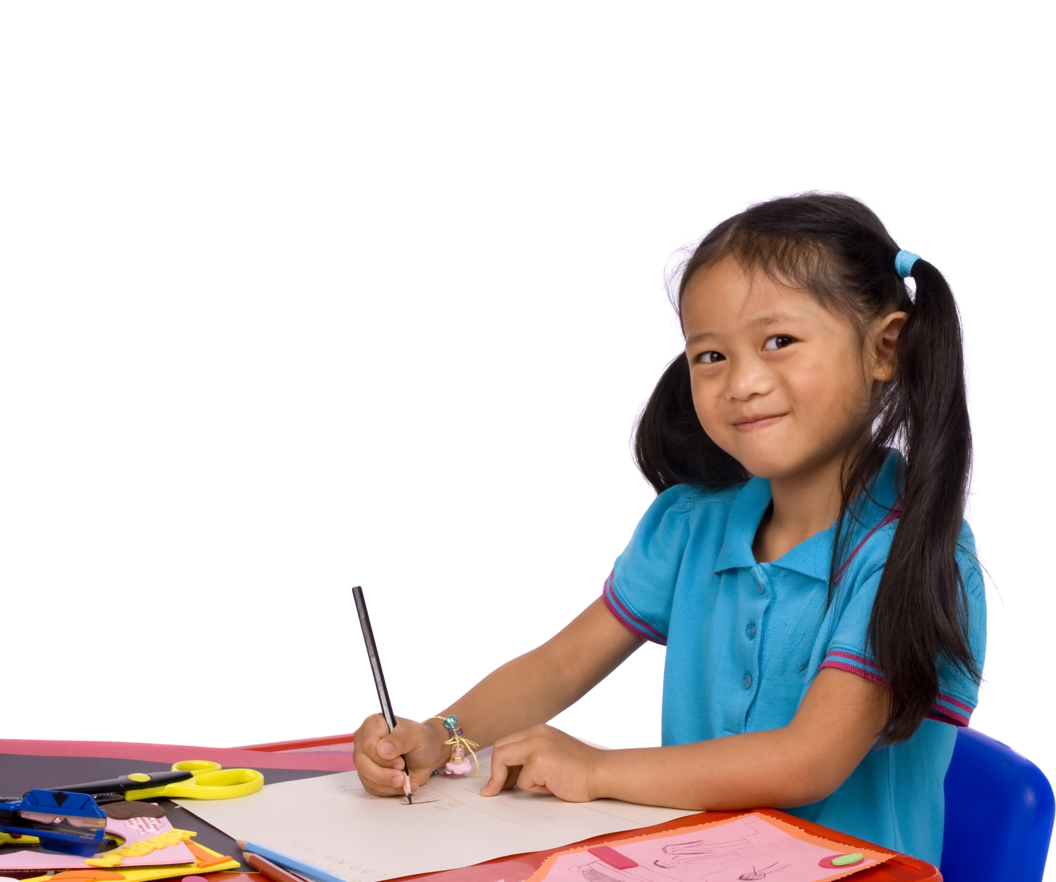
What is the Purpose of the Teaching Pyramid?
The purpose of the Teaching Pyramid is to promote healthy social-emotional development and to teach children the skills that will help them to succeed in school.

Slide 12

The Expectations are about creating and enjoying positive and caring social relationships.

Slide 13
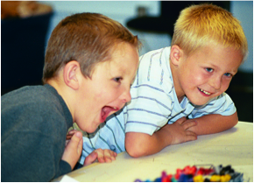
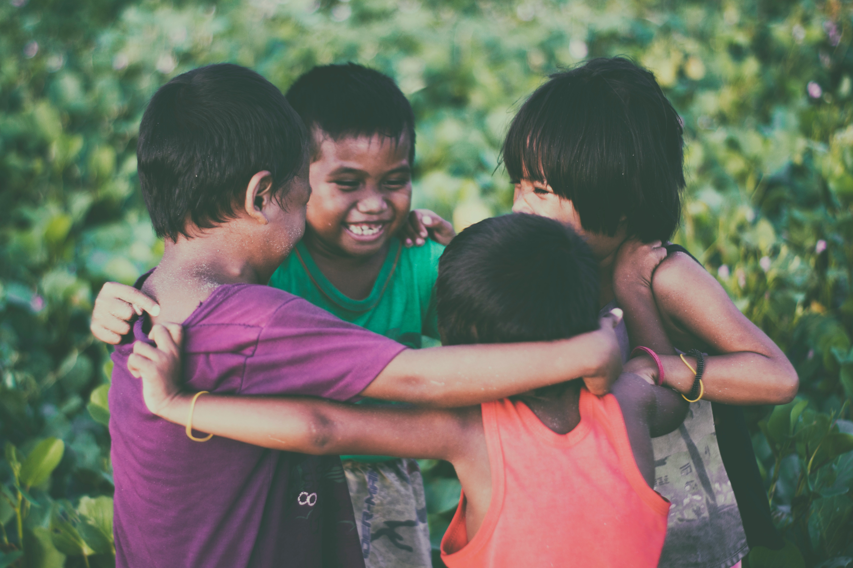
By following the Expectations, children will learn important social skills they will need in life.

Slide 14
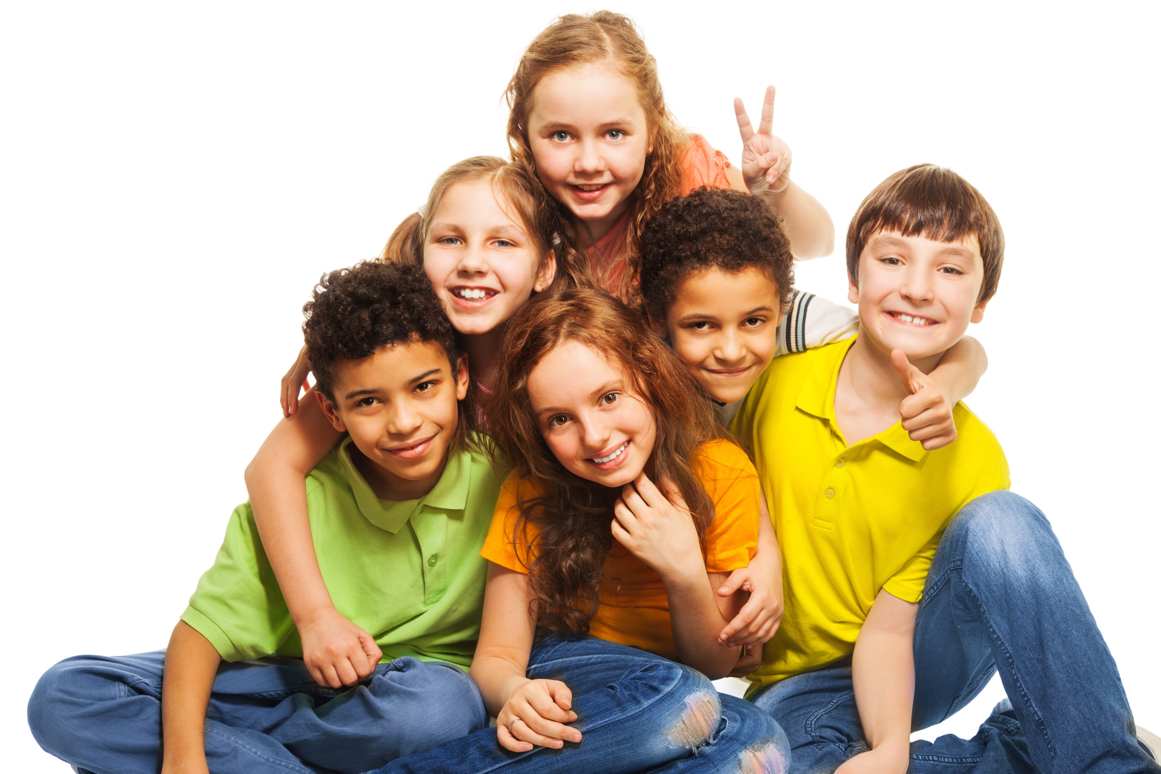
One last, but important, thing: The Expectations are for EVERYONE!

Slide 15
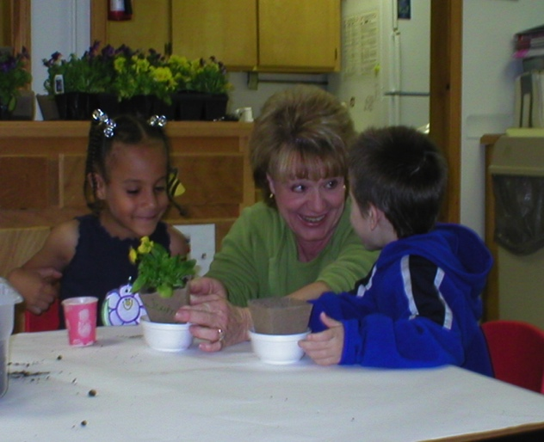
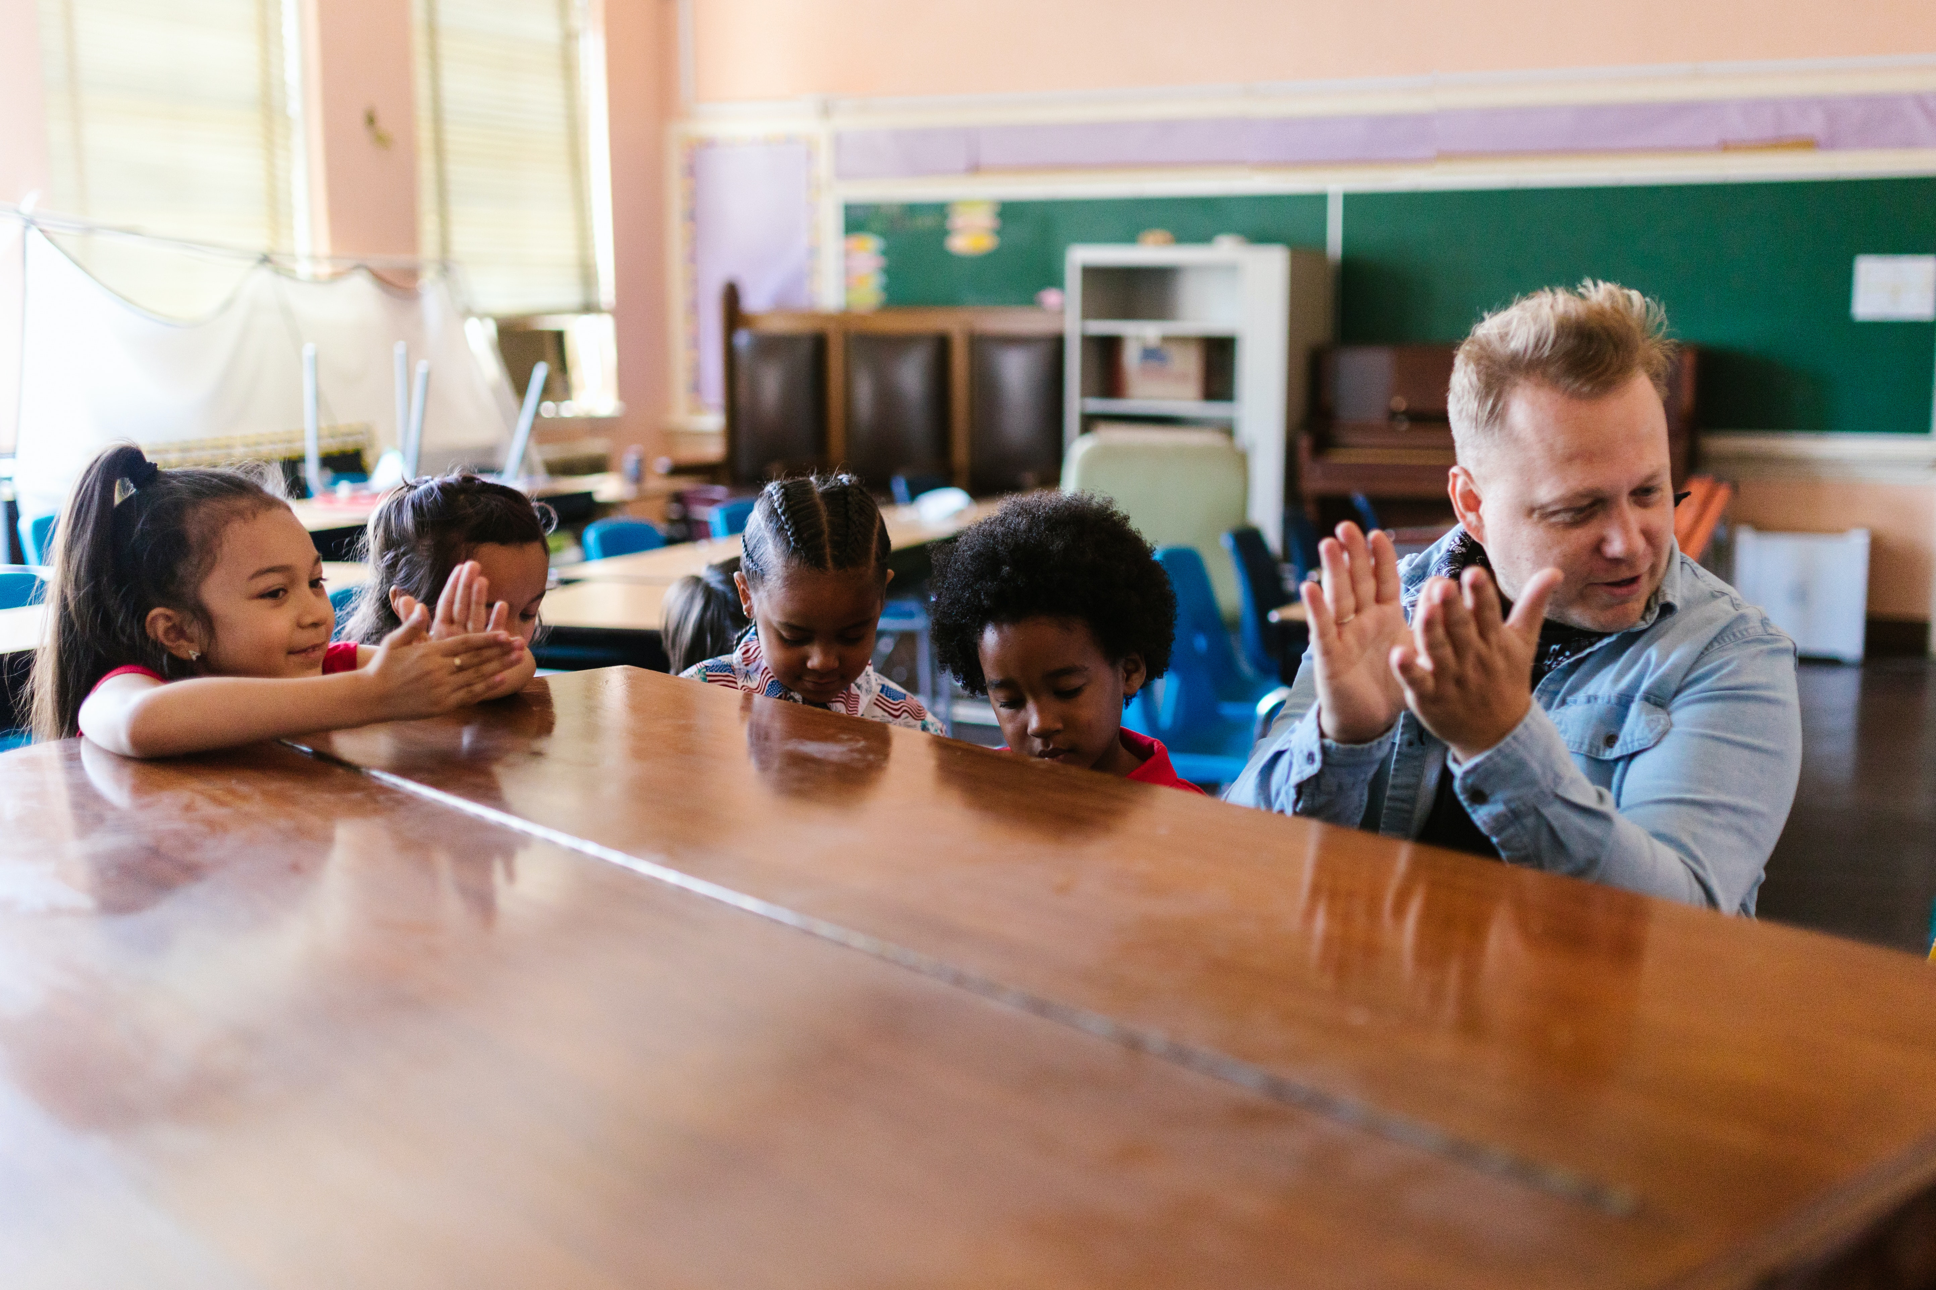
This means that the teachers will be kind to your child, keep your child safe, and treat your child with respect.
It means that the Teachers and Principals are responsible to you for taking the best care of your child.

Slide 16
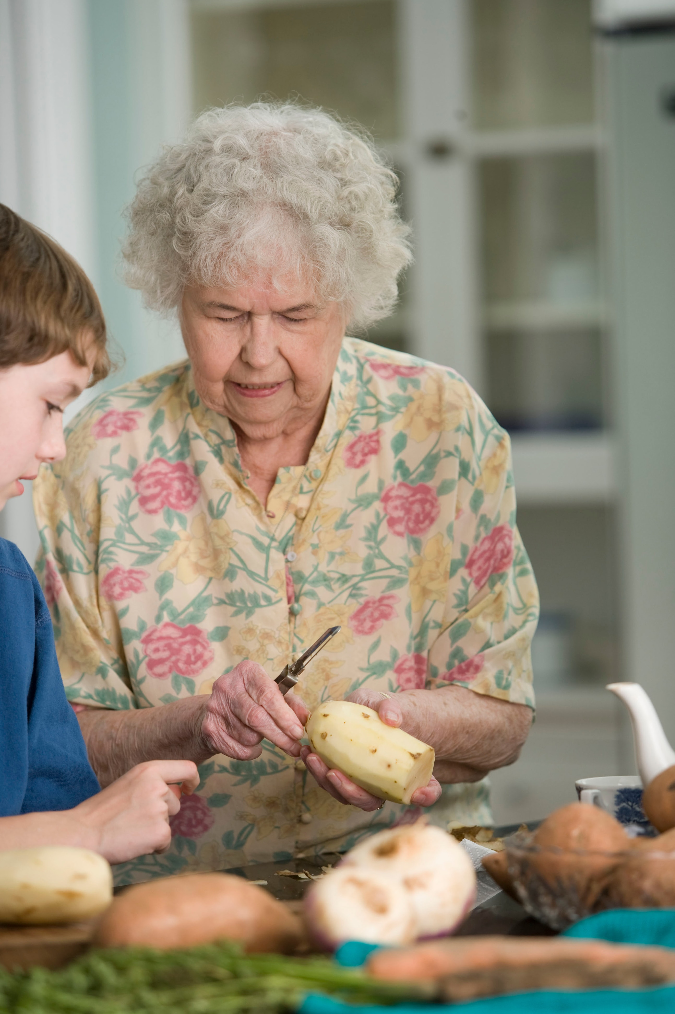
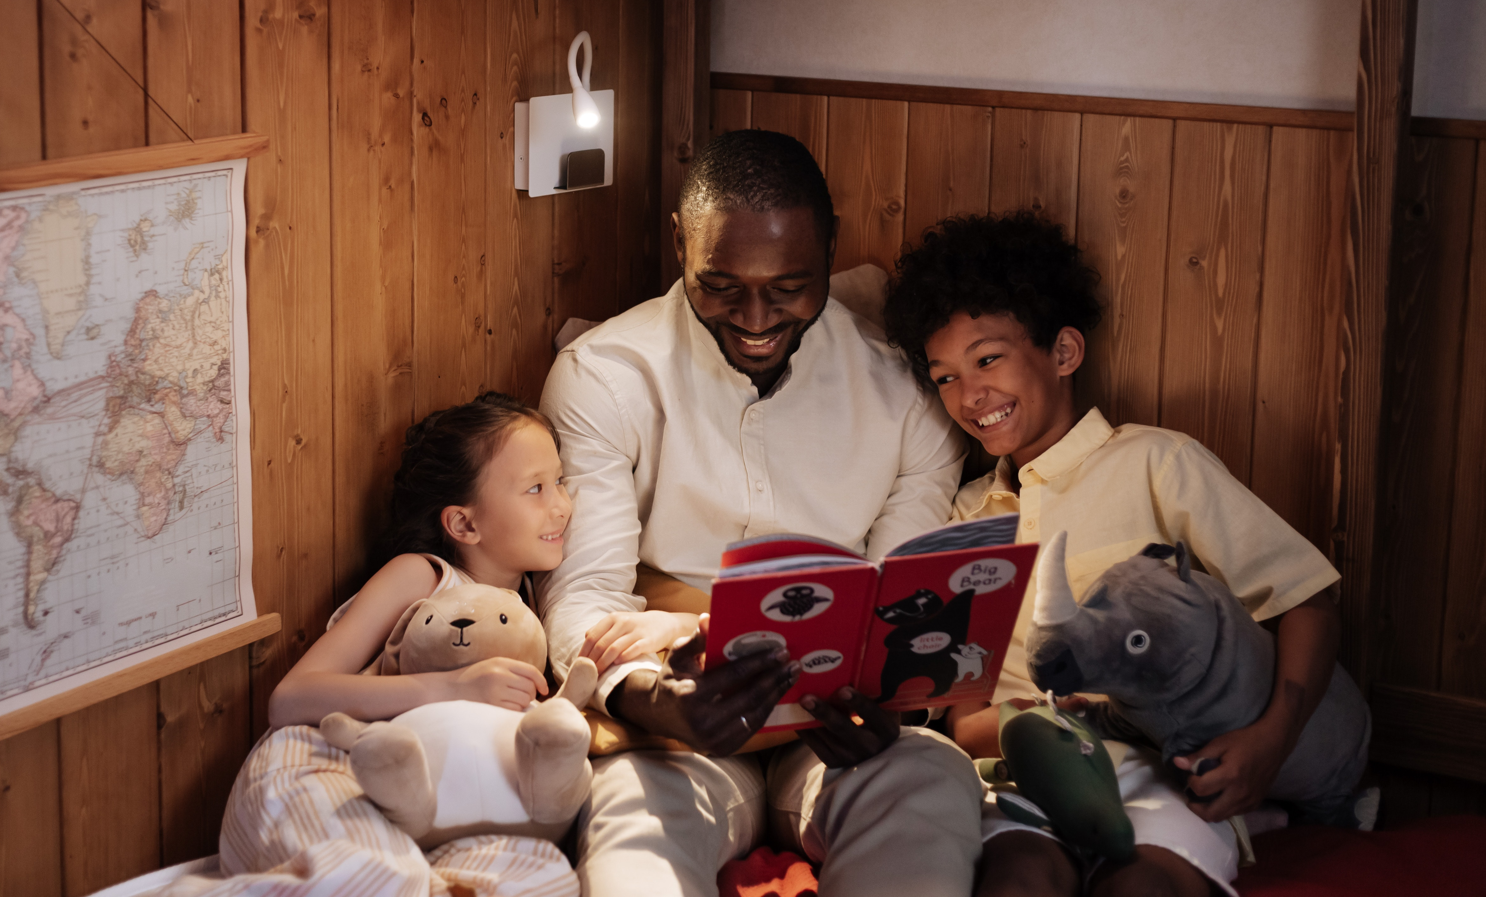
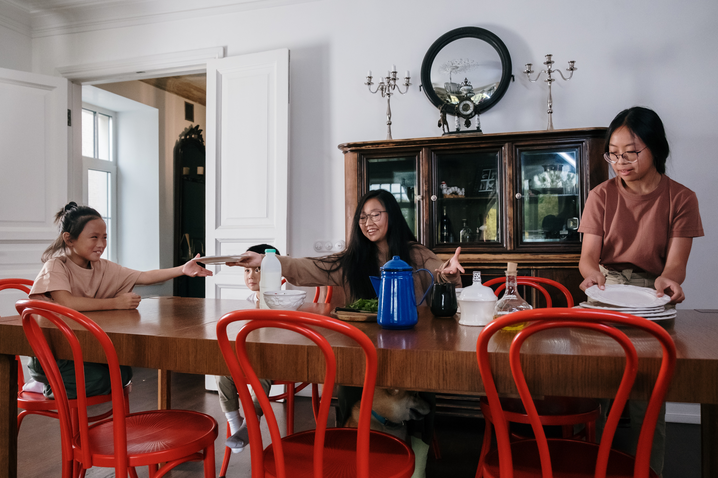
This means you can use similar Expectations with your child at home and communicating progress with your child’s teacher.

Slide 17
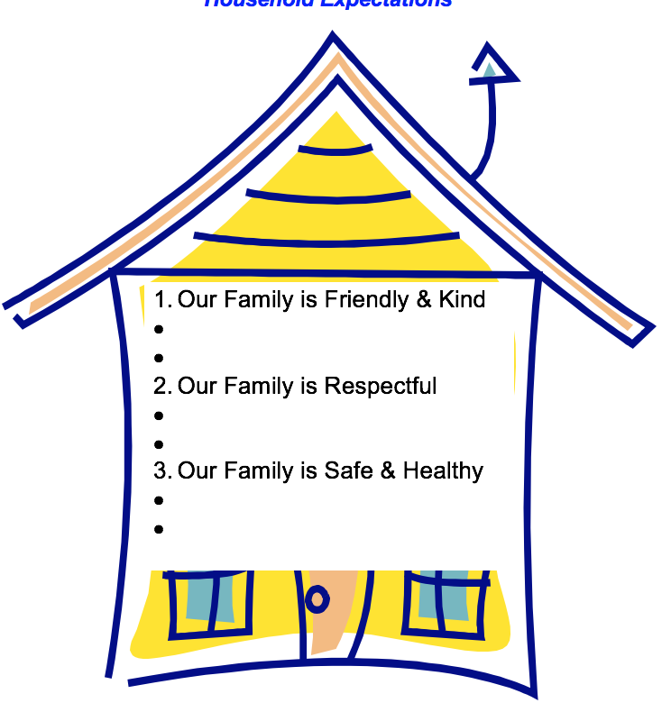
Expectation Examples
Our Family Is Kind
Let your sister have a turn with the book.
Our Family Is Respectful
Ask before you use something that belongs to someone else.
Our Family Is Safe and Healthy
Get to bed on time.
Our Family Is Responsible
Clean up when I make a mess.
Other ideas?
Add your ideas to your handout.

Slide 18
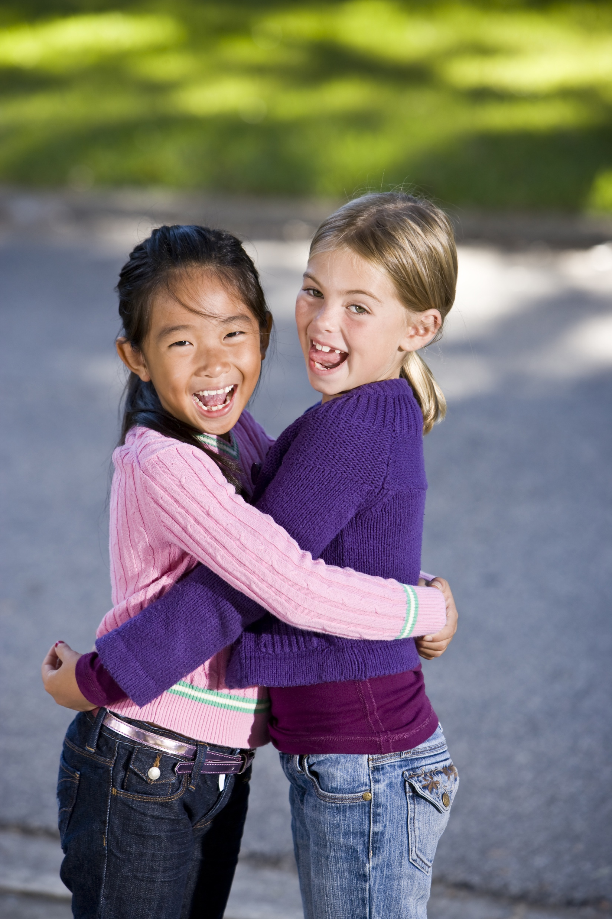
To fulfill these Expectations, we will all need to show kindness, treat each other with respect, and keep each other safe.

Slide 19
What Can You Do?
Make a commitment today to help your child learn the Expectations.
Model the Expectations for your child.
Read and discuss the handouts your child’s teacher will share with you—and try some of the ideas!

Slide 20

Thank You for Your Support!
For more information visit:
http://www.cainclusion.org/teachingpyramid/materials_family.html

