Slide 1
I Can Get Calm
Adapted by WestEd, San Marcos Office, 2022-23 Version
Originally developed by the Center on the Social and Emotional Foundations for Early Learning
Notes:
Nicole

Slide 2
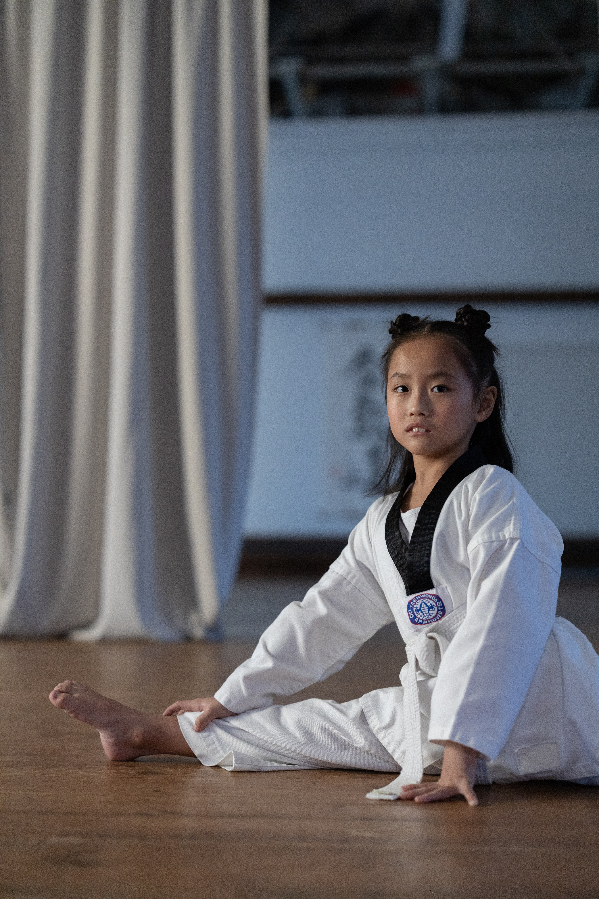
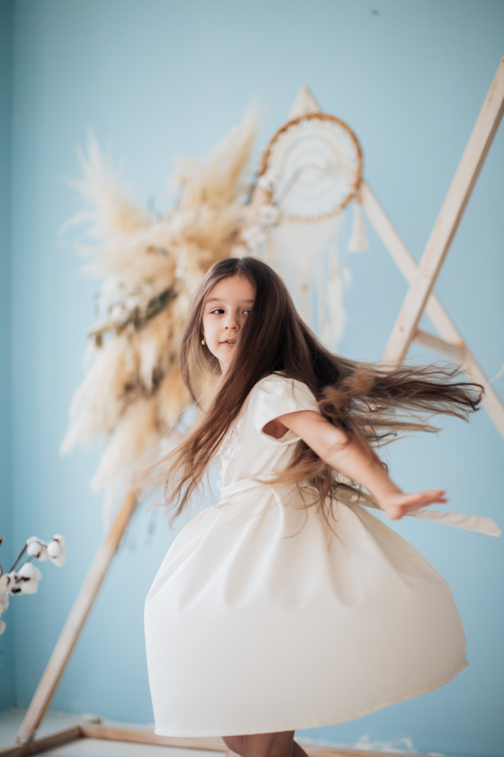
I can do many things
I can stretch, I can spin

Slide 3
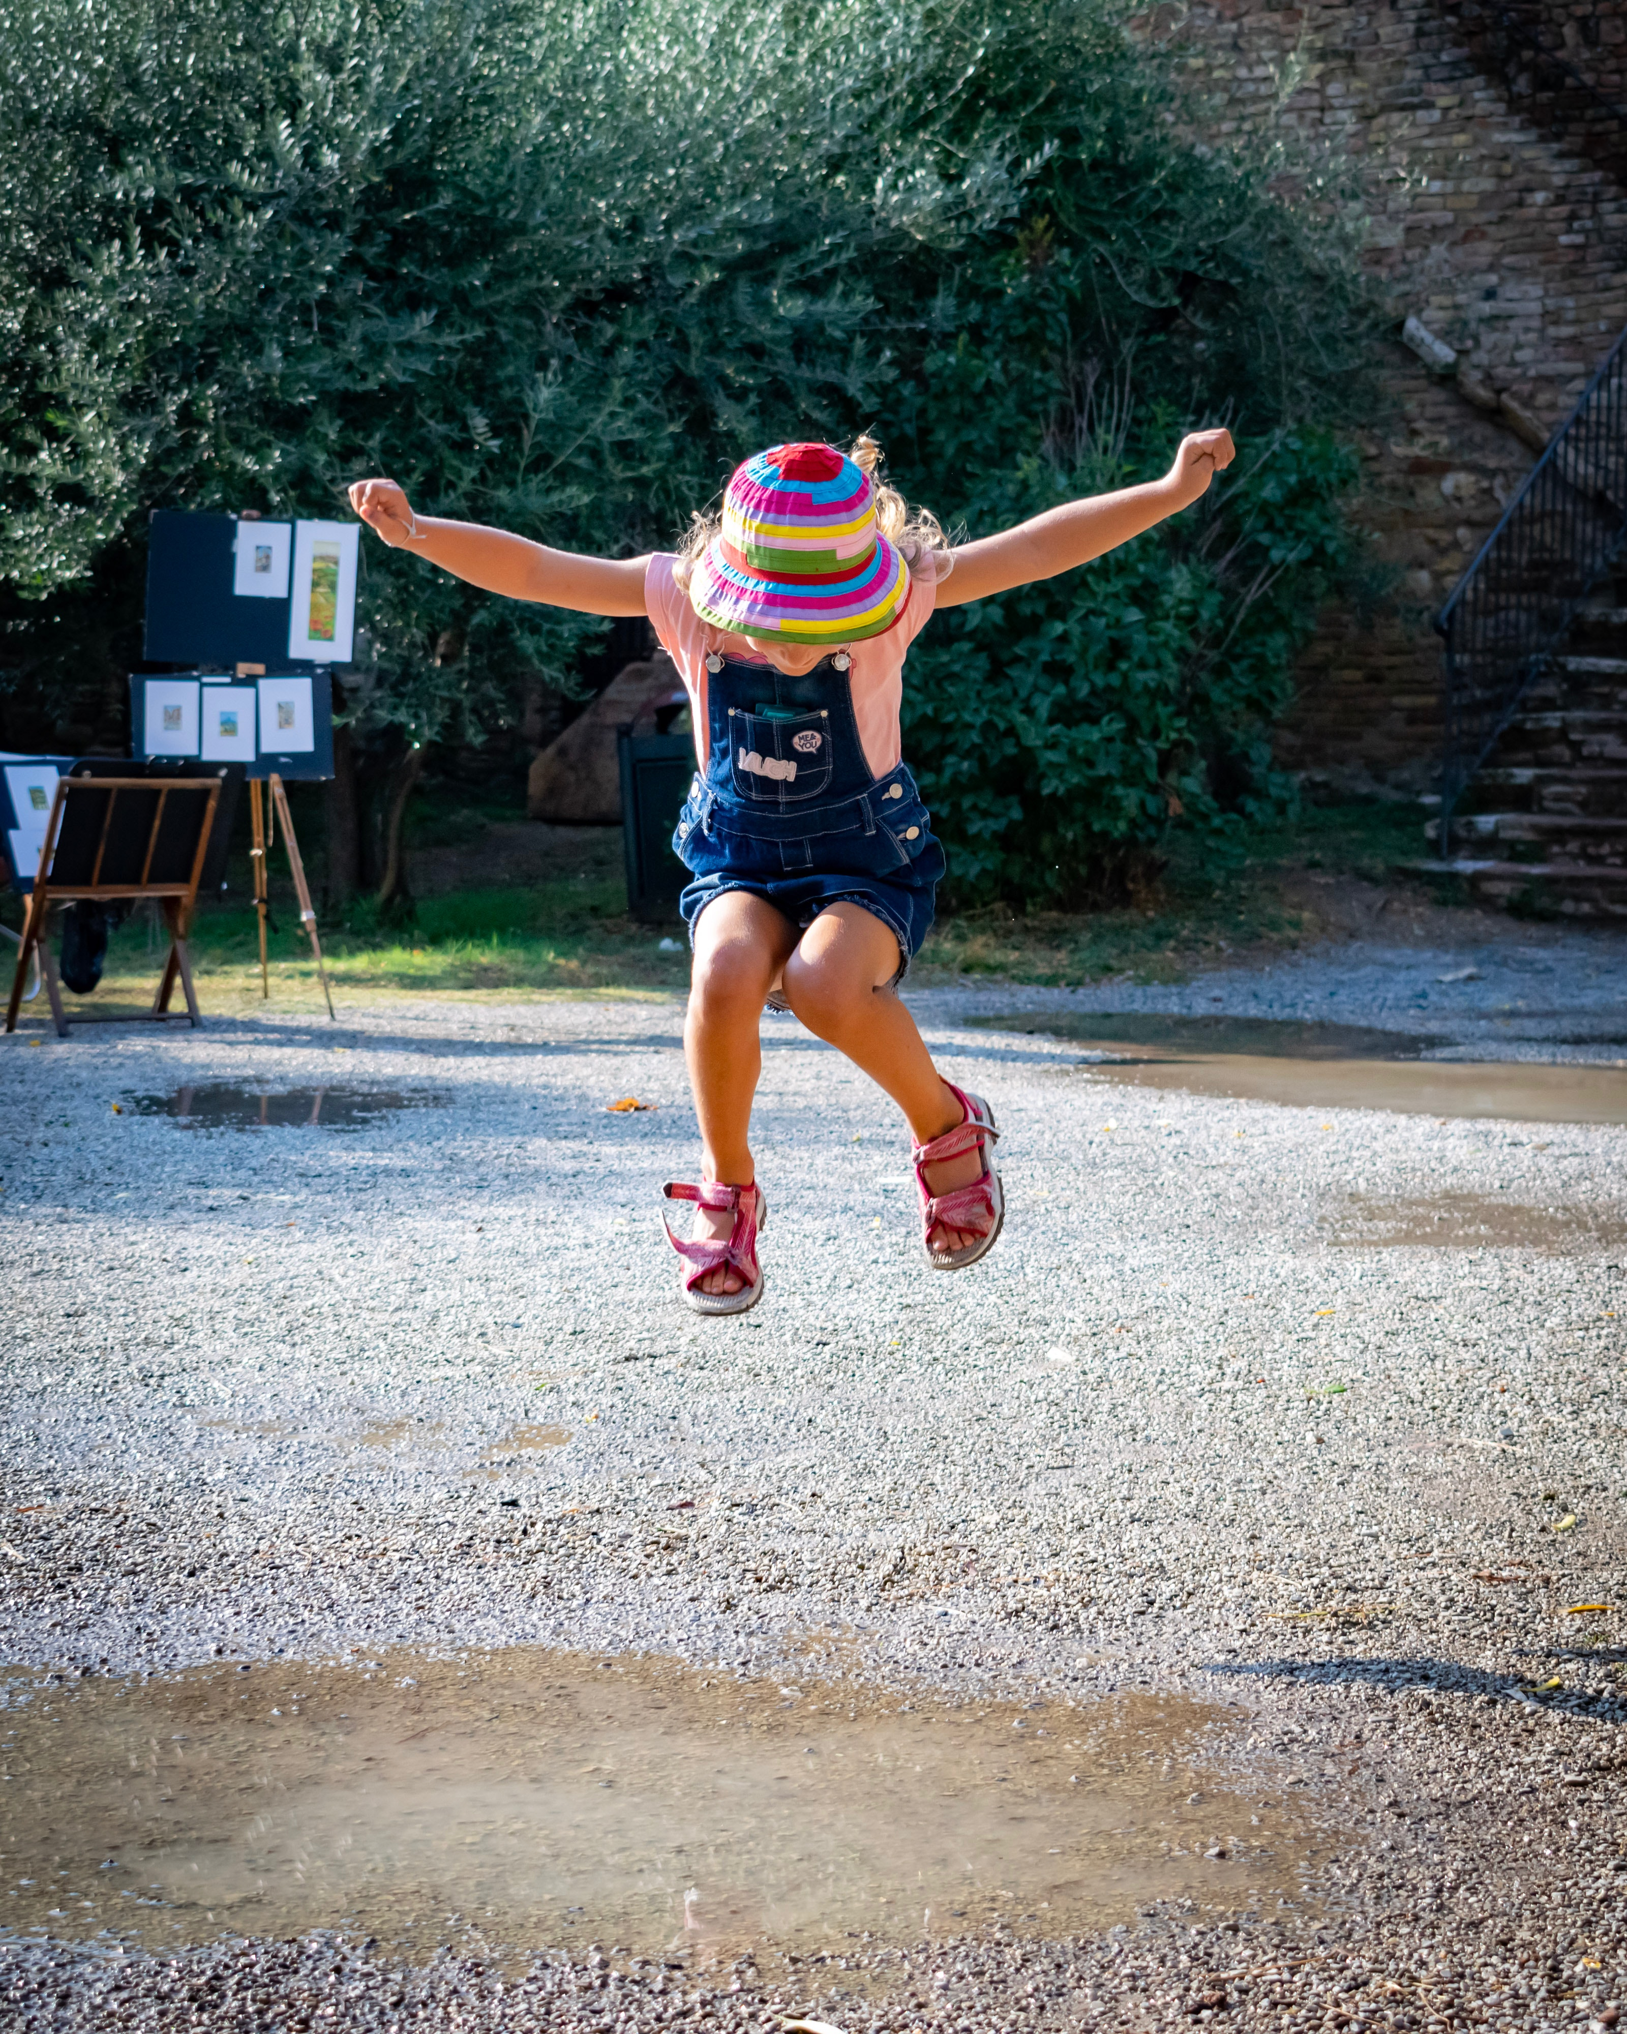
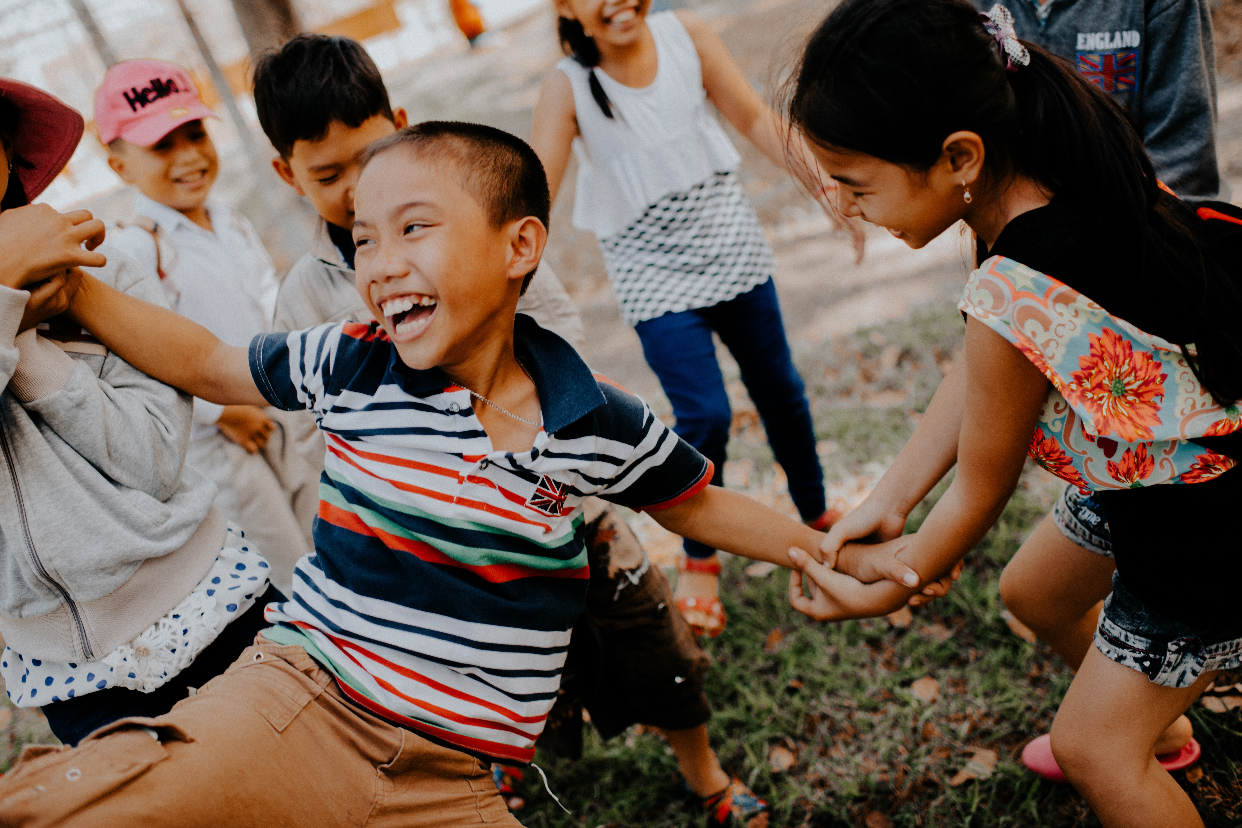
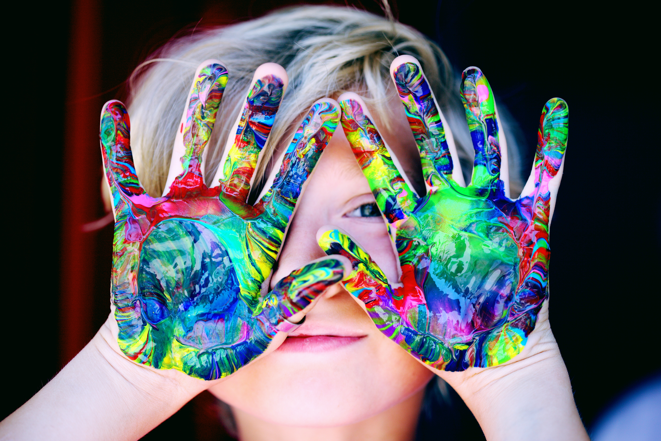
Sometimes I am wild and busy!

Slide 4
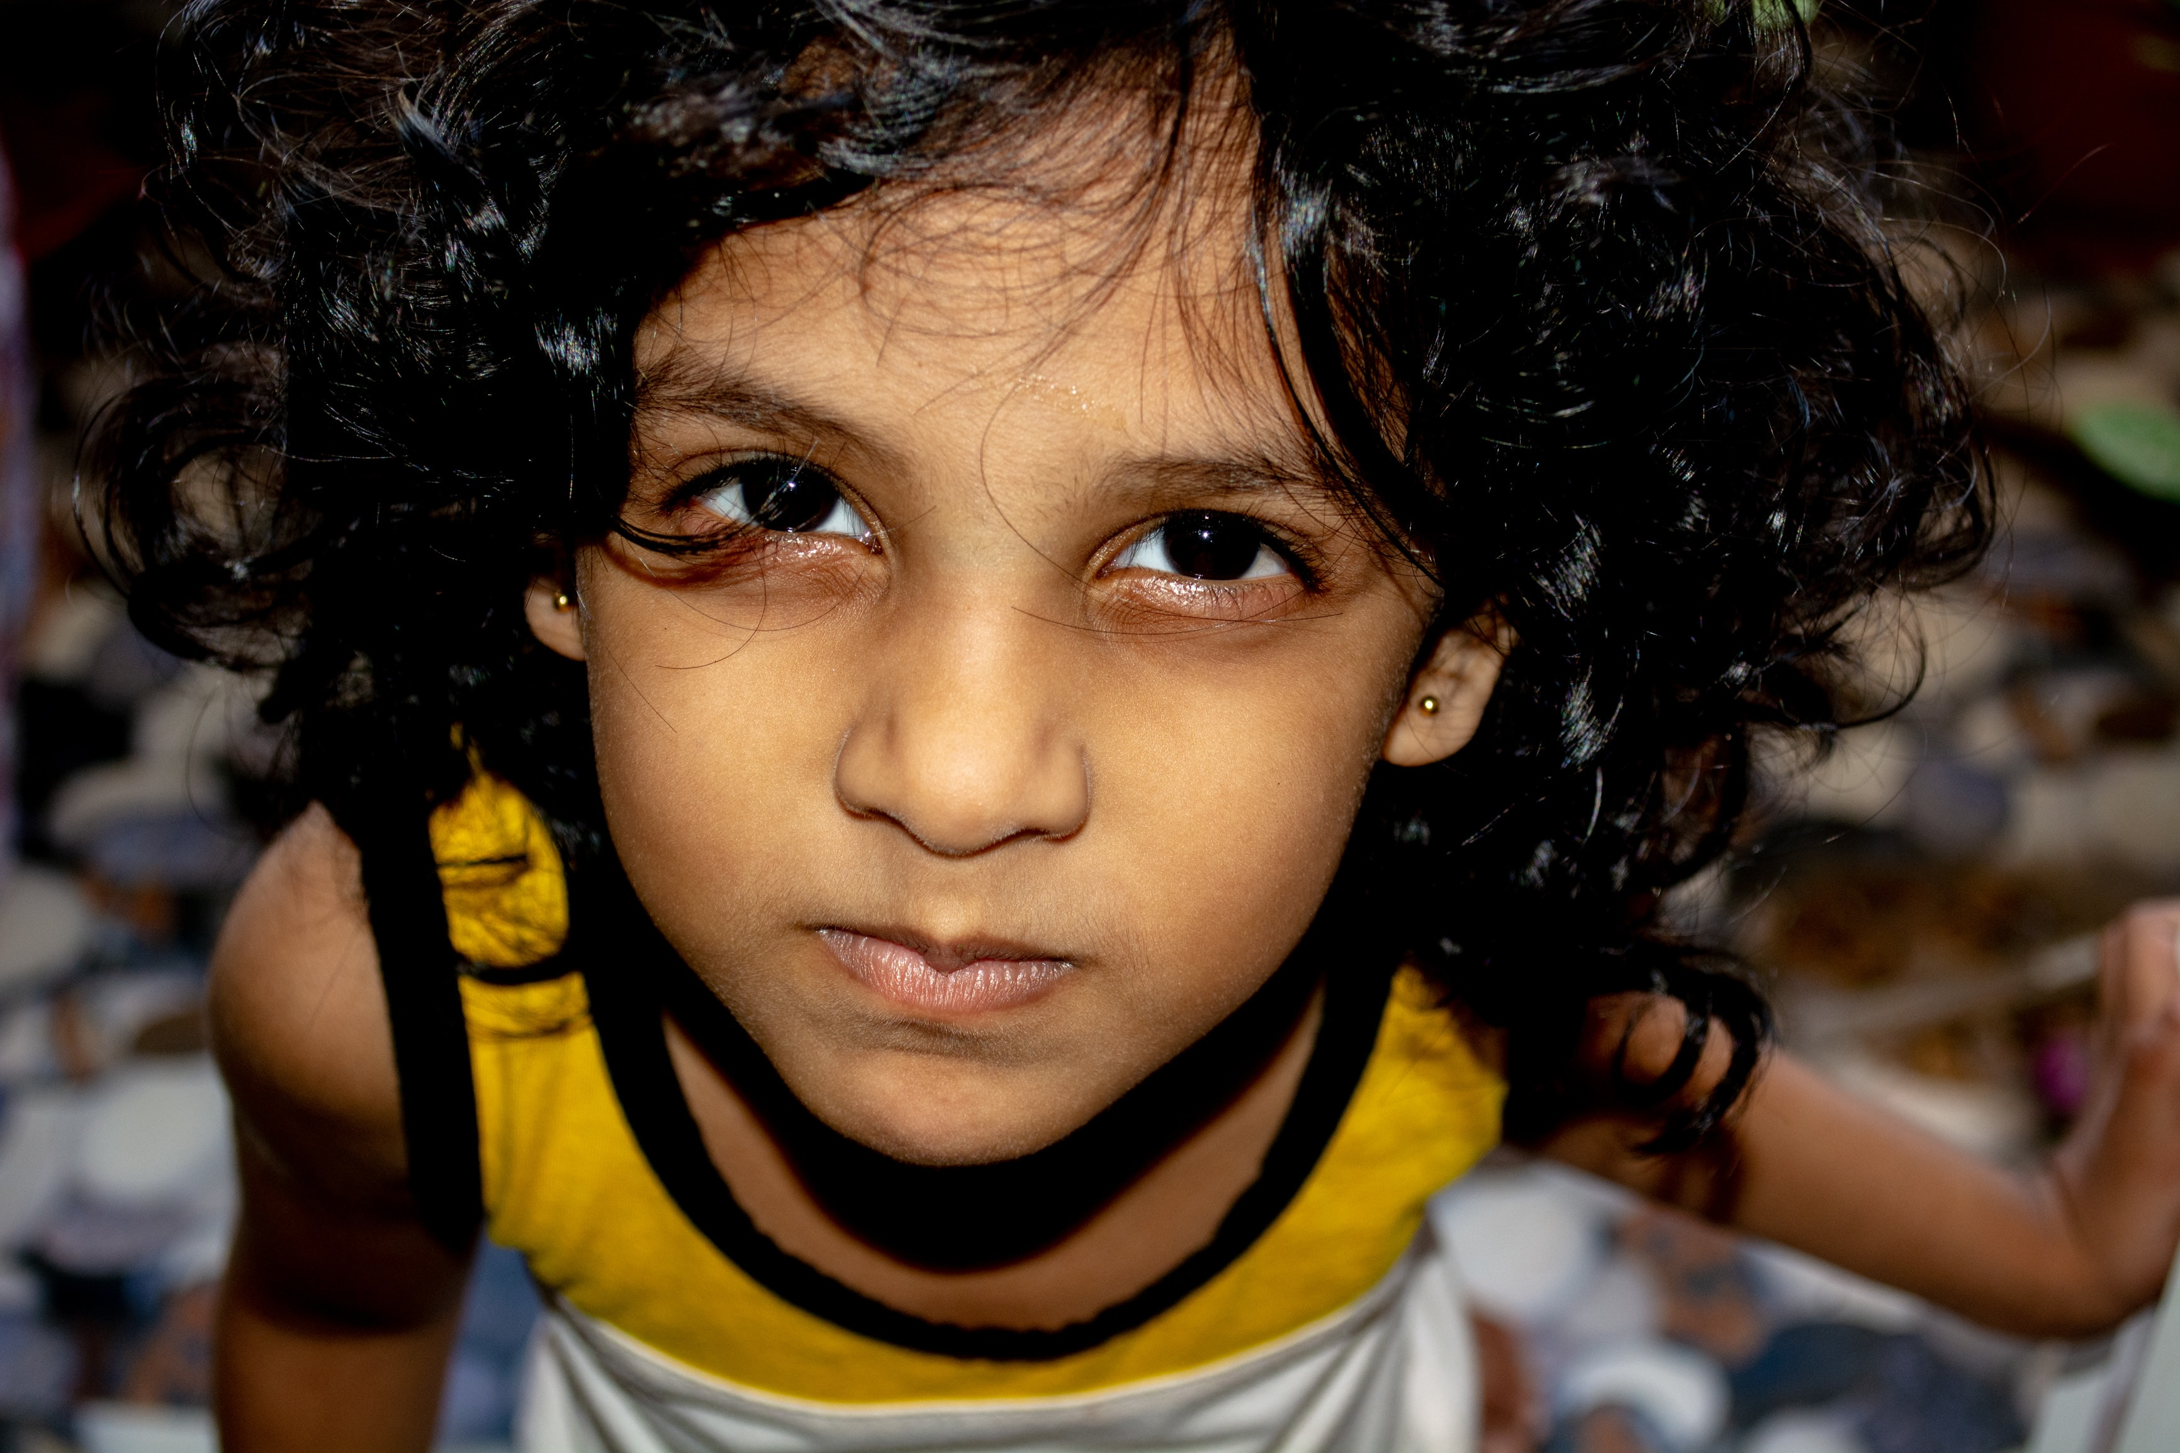
Sometimes I am mad…
Sometimes I need to get calm.

Slide 5
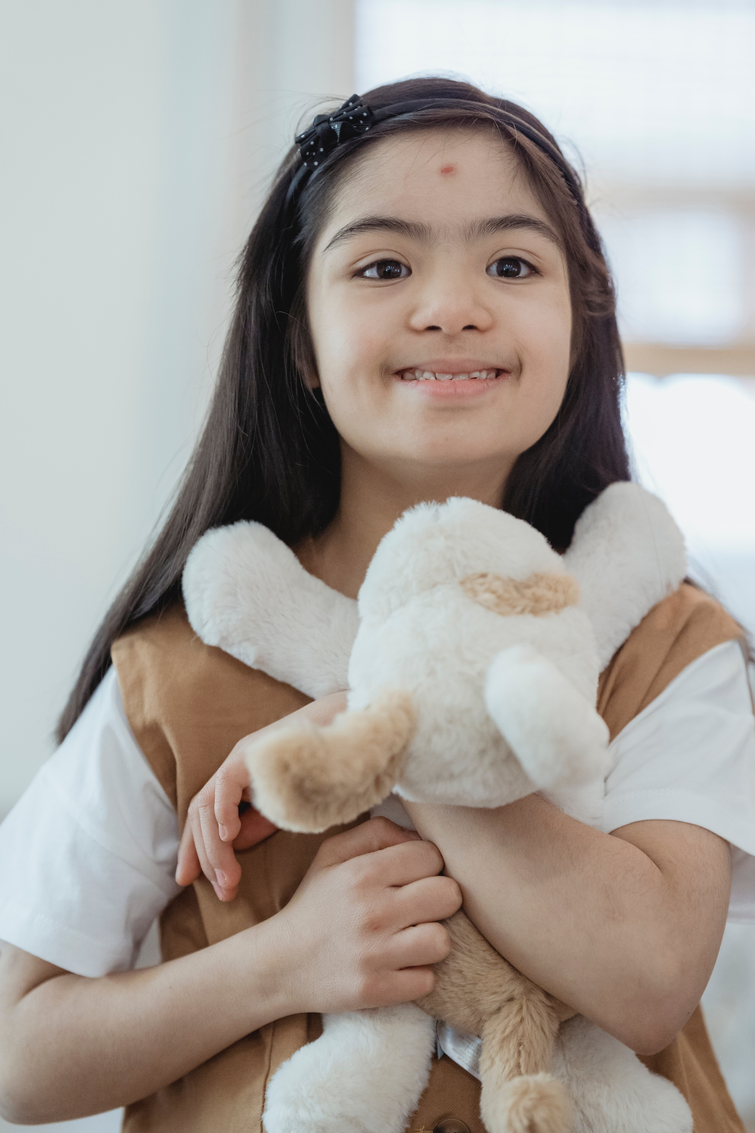
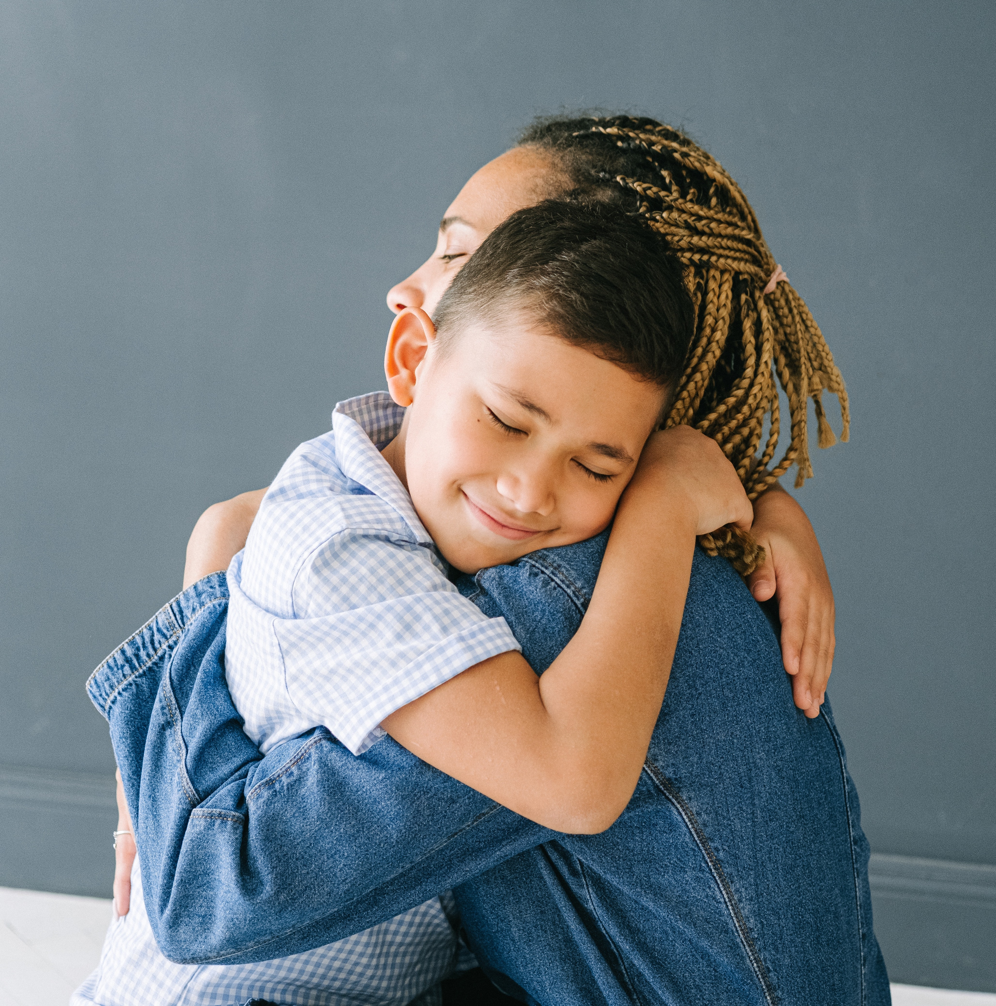
I Can Hug a Soft Plush or Teacher

Slide 6
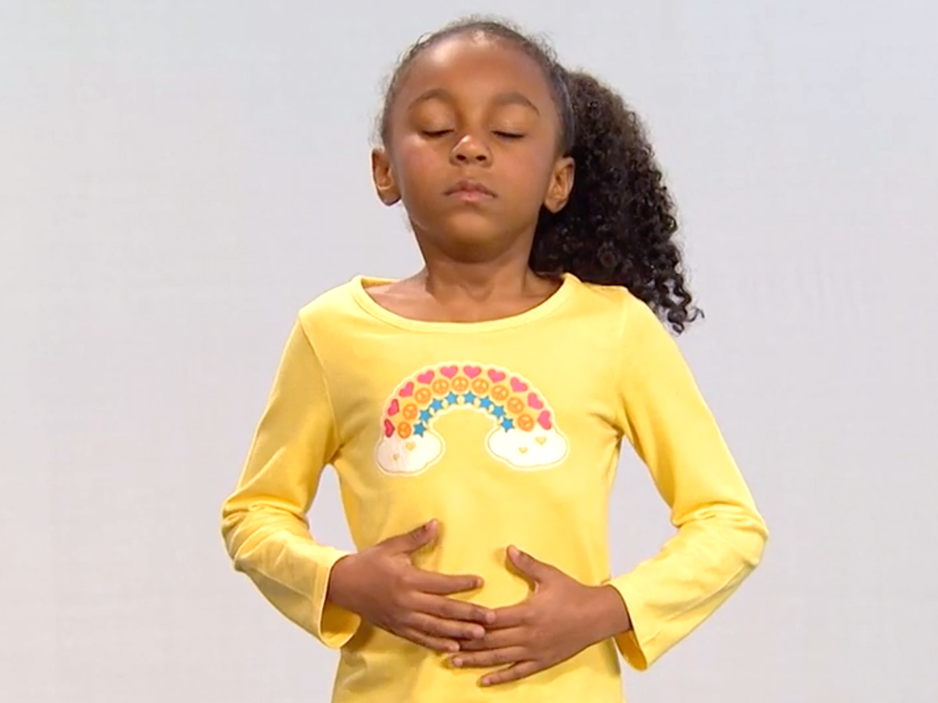
I Can Take Big Belly Breaths
Notes:
I don’t know if I can use this picture.

Slide 7
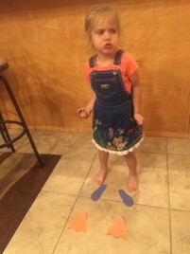
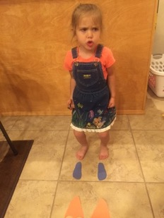
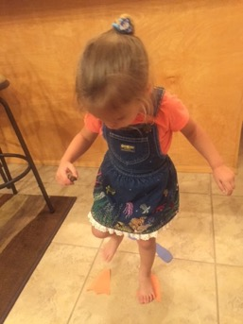
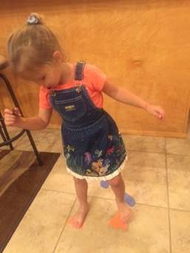
I Can Stomp My Feet Hard And Then Softer and Softer

Slide 8
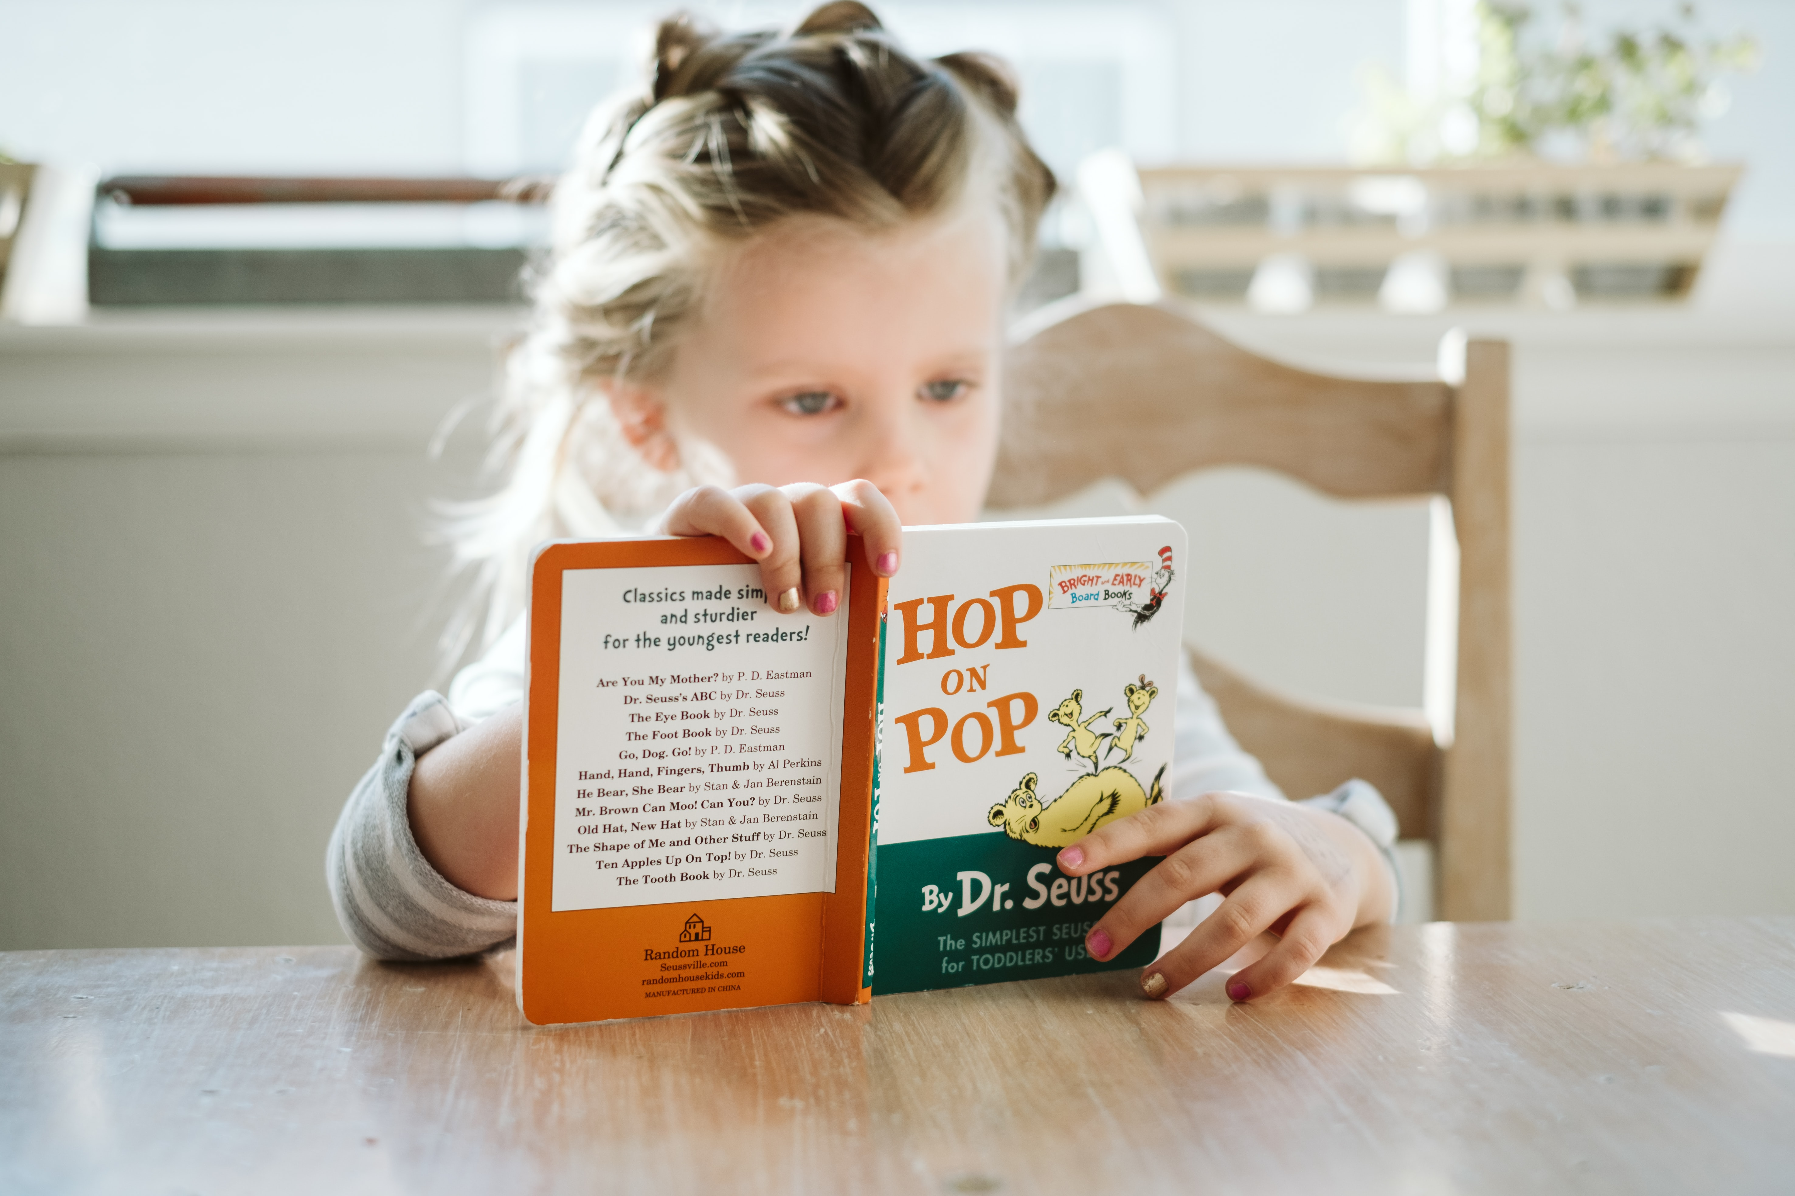
I Can Look at a Book

Slide 9
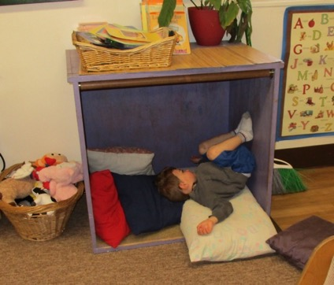
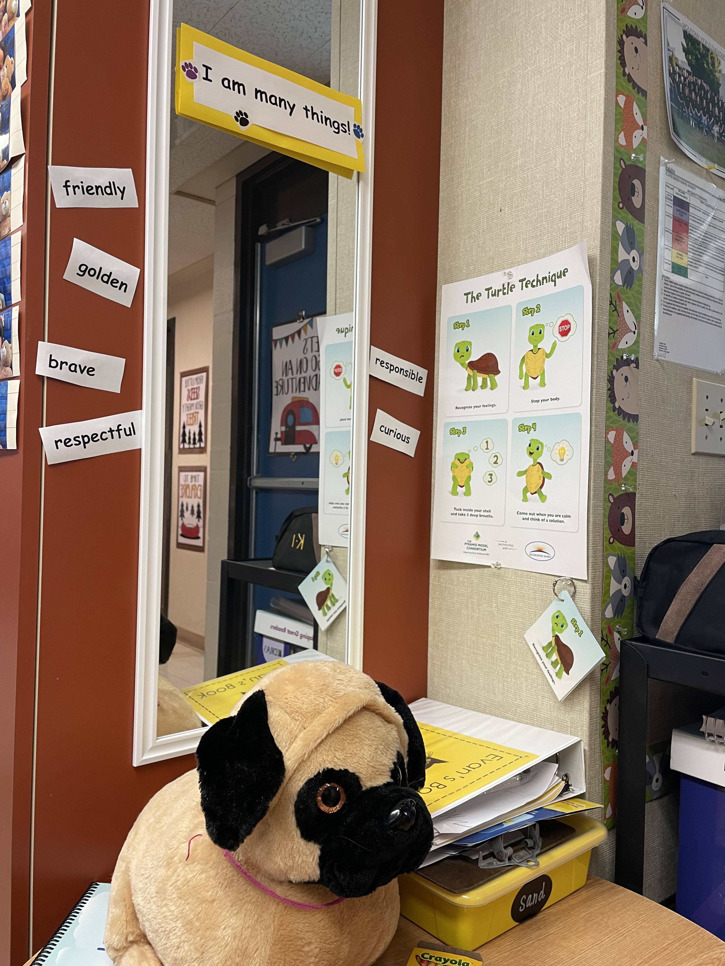
I Can Go to the Calming Corner

Slide 10
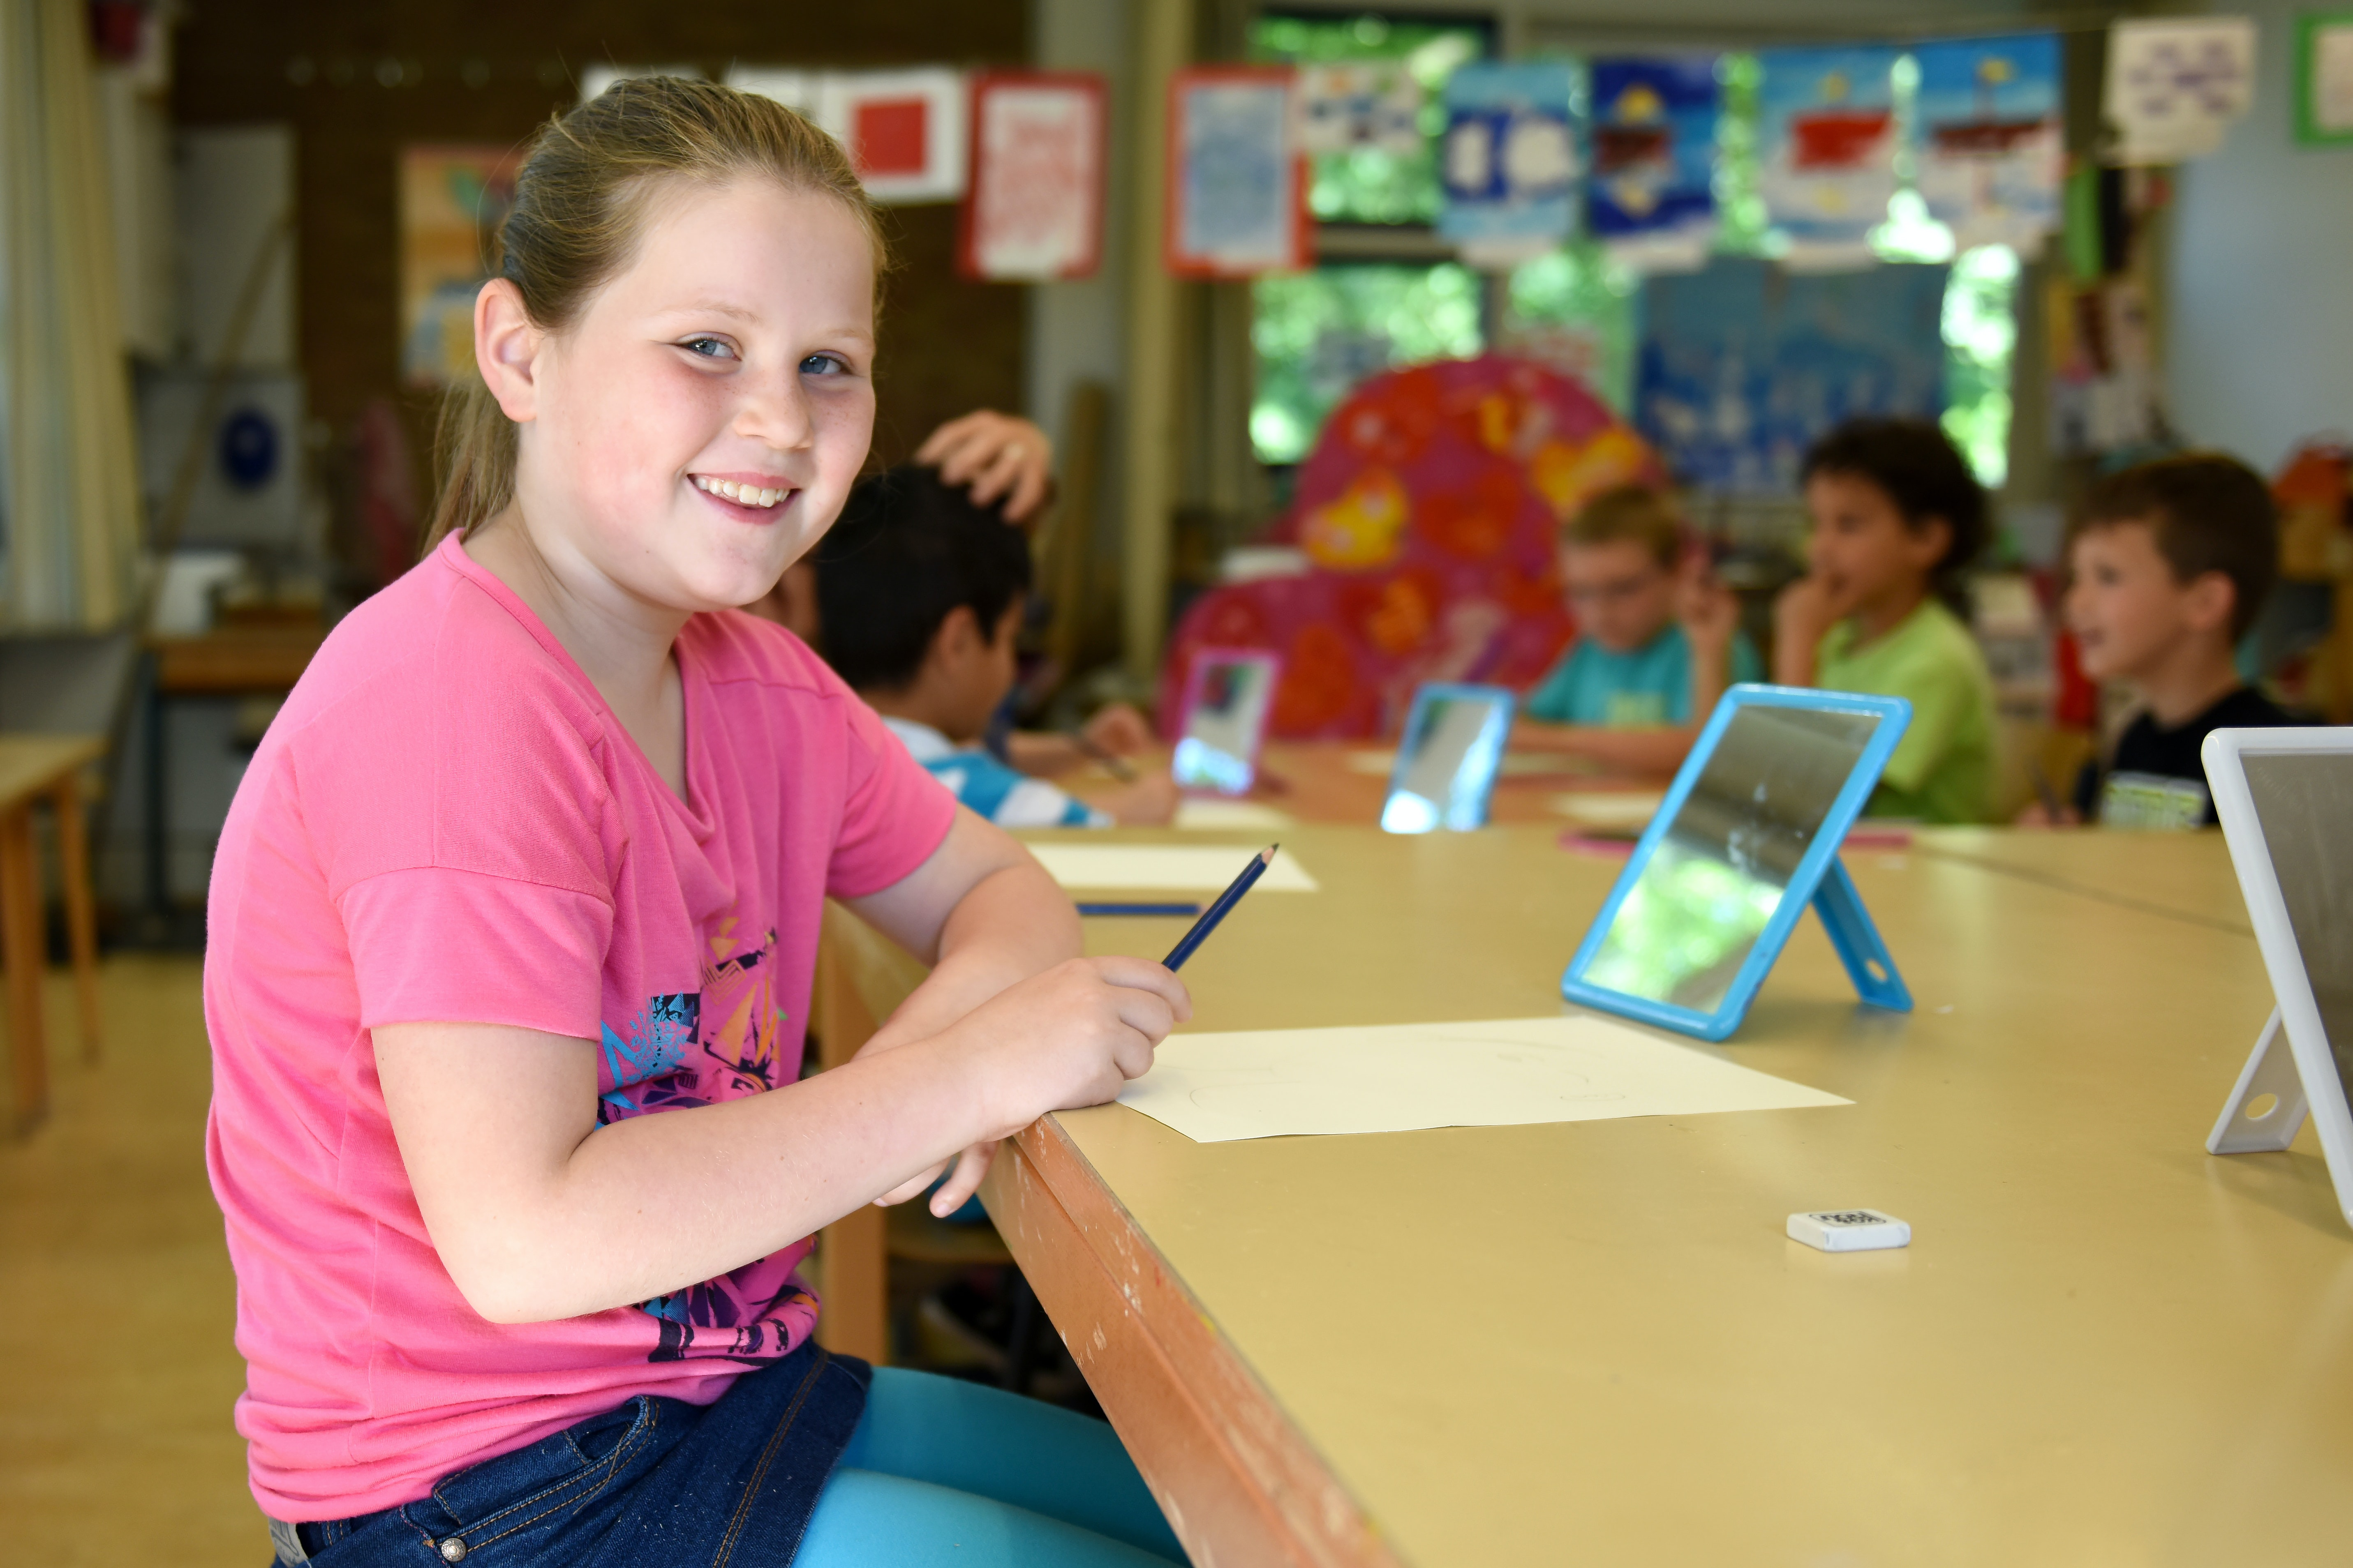
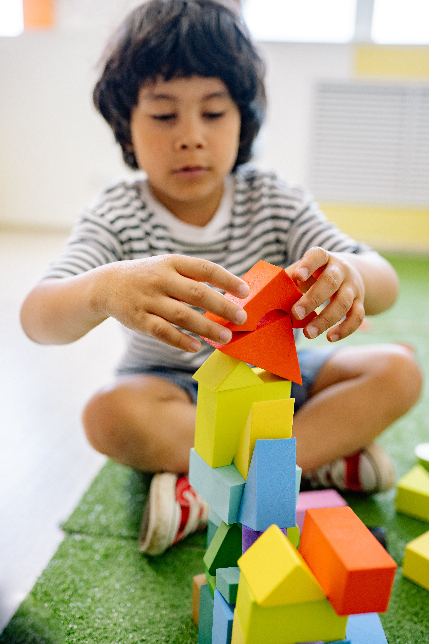
When I Feel Calm I am Ready to Play and Learn!

Slide 11
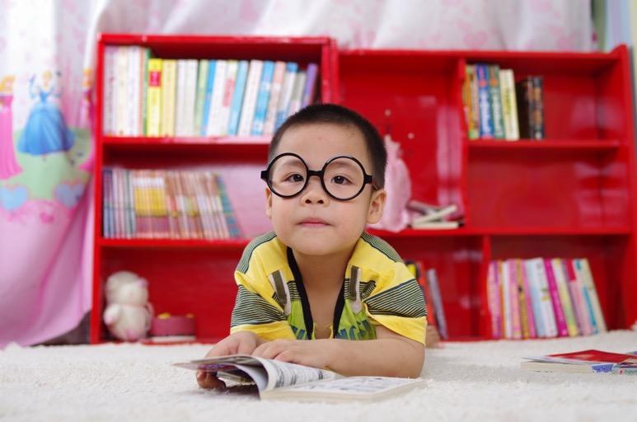
How Do You Like To Get Calm?
Created by WestEd Teaching Pyramid – www.CAinclusion.org/teachingpyramid

Slide 12
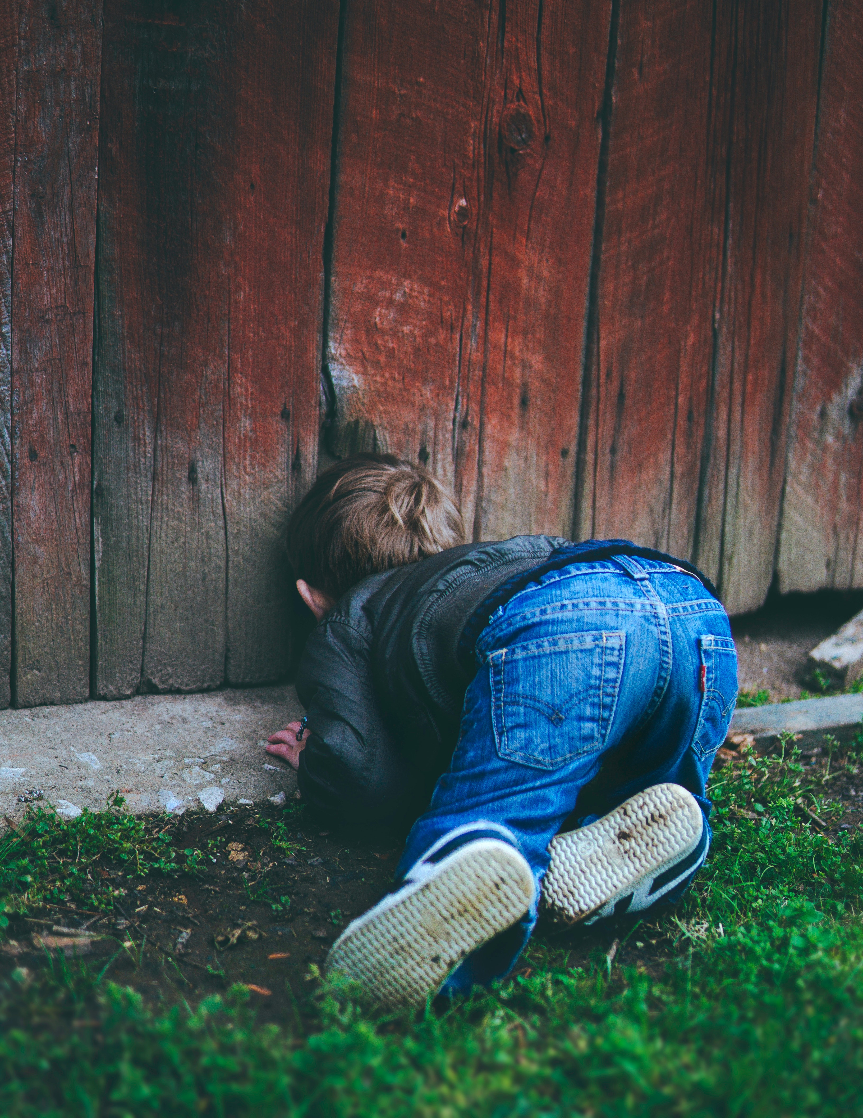
The End

