Slide 1
Session 3:
Behavior Has Meaning

Slide 2


What’s Happening Today?
Apply It and Try It Reflections
Affirmations
Determining the Meaning of Behavior
Being a Behavior Detective
Developing and Teaching Rules

Slide 3




Apply It and Try It Reflection
Keeping it Positive
Encouraging
Positive Behavior
How did your
child react?
How did it make
you feel?
Behavior you want to occur more?
Behavior you want to occur less?

Slide 4



Affirmations
Statements that are encouraging and motivating
Help us
feel strong
Help us feel optimistic about change
Make a note!
Reflect on the changes you have made or your efforts with your child.

Slide 5
Behavior Has Meaning
Challenging behavior works​!
It sends a powerful message:
  I want something (Get or Obtain)
  I don’t want something (Avoid or Escape)
Function = What a child is trying to communicate

Slide 6
The ABC’s of Behavior
A
B
C
Antecedent
____________
What happens BEFORE the behavior
Behavior
____________
The behavior
Consequence
____________
What happens AFTER the behavior.
Notes:
3 Min.
Trainer Notes. Depending on prior knowledge of participants, you may want to go more in depth. Use this script for detailed information:
When we’re trying to understand why children do what they do or trying to determine the meaning of behavior, you might have heard word this word before-function. The function of the behavior really is what the child is trying to communicate. The child either wants to obtain, or get, something (e.g., attention, toy, food) or is trying to avoid/escape something or someone (e.g., a demand, attention, stimulation).
In order to understand behavior, or be that behavior detective, we have to look for clues or as to what happens before and what happens after the behavior. Even though it can seem like it, behaviors do not happen “out of the blue.” Something always happens before a challenging behavior and something always happens after a challenging behavior. The more we observe the behaviors, and what happens before and after the challenging behavior, the more clues we will have to figure out why children do what they do!
Once you can identify the meaning, or the function, of the challenging behavior, you can identify a plan to change it.
Call participants’ attention to the graphic that is on the slide.
Let’s look at the ABCs:
You might have heard the term ABC’s of behavior. Clues to figure out the meaning of behavior can be found in 3 things:
A stands for Antecedent. Antecedent refers to what happened directly BEFORE the behavior happened. These are all things that can happen before behaviors that might turn on the child’s challenging behavior. Tell participants you will go into depth on the next slides.
B stands for Behavior. Behavior refers to what the child did. You want to ask yourself, “What did the child’s challenging behavior look like?”
C refers to the consequence of the child’s challenging behavior. Consequence simply means what happened AFTER the behavior. Tell participants you will go into depth on the next slides.

Slide 7
ABC’s and the Meaning of Behavior
A
B
C
You say they can have more time
to play
You tell your child to
clean up
Child cries and screams
Meaning of behavior:
I wanted more time to play.
Notes:
3 Min.
Trainer Notes. Depending on prior knowledge of participants, you may want to go more in depth. Use this script for detailed information:
When we’re trying to understand why children do what they do or trying to determine the meaning of behavior, you might have heard word this word before-function. The function of the behavior really is what the child is trying to communicate. The child either wants to obtain, or get, something (e.g., attention, toy, food) or is trying to avoid/escape something or someone (e.g., a demand, attention, stimulation).
In order to understand behavior, or be that behavior detective, we have to look for clues or as to what happens before and what happens after the behavior. Even though it can seem like it, behaviors do not happen “out of the blue.” Something always happens before a challenging behavior and something always happens after a challenging behavior. The more we observe the behaviors, and what happens before and after the challenging behavior, the more clues we will have to figure out why children do what they do!
Once you can identify the meaning, or the function, of the challenging behavior, you can identify a plan to change it.
Call participants’ attention to the graphic that is on the slide.
Let’s look at the ABCs:
You might have heard the term ABC’s of behavior. Clues to figure out the meaning of behavior can be found in 3 things:
A stands for Antecedent. Antecedent refers to what happened directly BEFORE the behavior happened. These are all things that can happen before behaviors that might turn on the child’s challenging behavior. Tell participants you will go into depth on the next slides.
B stands for Behavior. Behavior refers to what the child did. You want to ask yourself, “What did the child’s challenging behavior look like?”
C refers to the consequence of the child’s challenging behavior. Consequence simply means what happened AFTER the behavior. Tell participants you will go into depth on the next slides.

Slide 8

Behavior Detectives
Look for clues:
Before the behavior
What the child did
or the behavior
After the behavior

Slide 9

Angelo Before
(Antecedent)
A
What happened before his behavior?
What does that tell you?

Slide 10
Angelo During
(Behavior)
B
What did he do?

Slide 11
Angelo After
(Consequence)
C
What did Angelo eventually get?
Do you think he might try this behavior again?
What might be the meaning of Angelo’s behavior. What is he trying to tell his mother?

Slide 12
ABC Summary
A
B
C
Provided direction
Kicking and screaming
Got out of eating
Meaning of behavior:
Avoid dinner
Notes:
3 Min.
Trainer Notes. Depending on prior knowledge of participants, you may want to go more in depth. Use this script for detailed information:
When we’re trying to understand why children do what they do or trying to determine the meaning of behavior, you might have heard word this word before-function. The function of the behavior really is what the child is trying to communicate. The child either wants to obtain, or get, something (e.g., attention, toy, food) or is trying to avoid/escape something or someone (e.g., a demand, attention, stimulation).
In order to understand behavior, or be that behavior detective, we have to look for clues or as to what happens before and what happens after the behavior. Even though it can seem like it, behaviors do not happen “out of the blue.” Something always happens before a challenging behavior and something always happens after a challenging behavior. The more we observe the behaviors, and what happens before and after the challenging behavior, the more clues we will have to figure out why children do what they do!
Once you can identify the meaning, or the function, of the challenging behavior, you can identify a plan to change it.
Call participants’ attention to the graphic that is on the slide.
Let’s look at the ABCs:
You might have heard the term ABC’s of behavior. Clues to figure out the meaning of behavior can be found in 3 things:
A stands for Antecedent. Antecedent refers to what happened directly BEFORE the behavior happened. These are all things that can happen before behaviors that might turn on the child’s challenging behavior. Tell participants you will go into depth on the next slides.
B stands for Behavior. Behavior refers to what the child did. You want to ask yourself, “What did the child’s challenging behavior look like?”
C refers to the consequence of the child’s challenging behavior. Consequence simply means what happened AFTER the behavior. Tell participants you will go into depth on the next slides.

Slide 13

Apply It and Try It
Why Do Children Do What They Do?
Observe your child
Use the form to keep track of:
  What happened before the behavior
  The behavior
  What happened after the behavior
Determine what your child is communicating:
  To get or obtain
  To escape or avoid
Activity 2

Slide 14
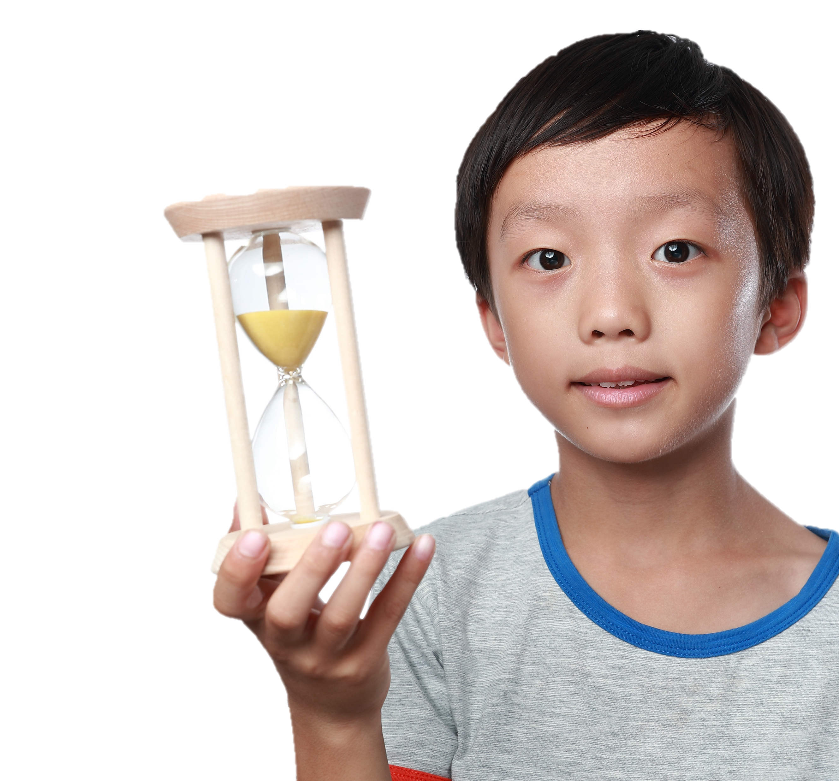
Time Out
Step 1: Stay Calm! Guide child to time-out.
Step 2: Set timer for 3-4 minutes. Tell child that when the timer goes off and they are calm, they can get up.
Step 3: When time is over, allow
child to return to activity.
Provide encouragement and
positive feedback for appropriate
behavior in the activity.

Slide 15
Common Time-Out Mistakes
Angrily threatening child with time-out
Allowing other children to tease the child in time-out
Talking to your child during time-out
Applying time-out long after behavior occurred
Scolding or shaming when putting child in time out.
Using it as the only approach

Slide 16

Household Rules
Rules for Rules:
Keep it simple (3 to 5 rules).
State the behavior you want to see.
Pick rules that can be applied in a lot of situations.
Use visuals to explain the rule.

Slide 17
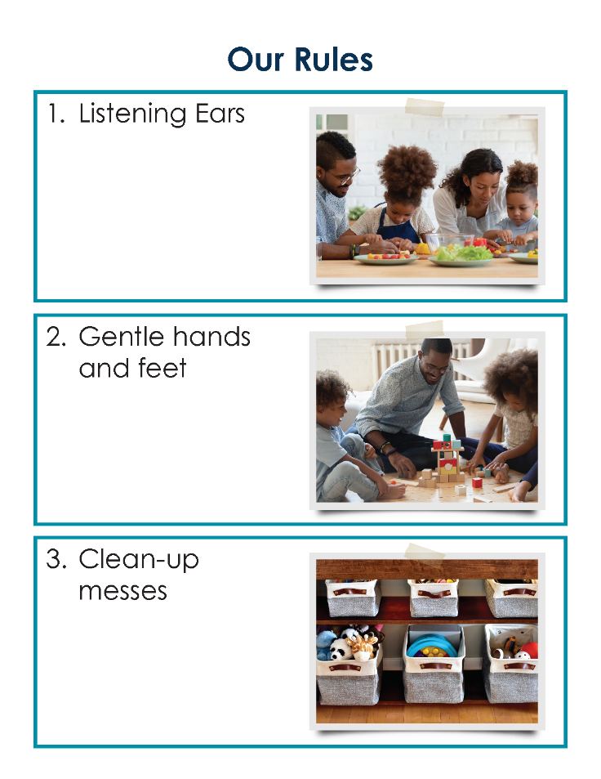
Rule Examples
Clean up after yourself
Use an inside voice
Ask before you use something that is not yours
Use words to solve problems

Slide 18

What Do You Think of These Rules?
Be nice to everyone
Don’t tease or hit
Put your laundry in the hamper
Is this a
good rule?
Would your child know what this means?
Does it state the behavior you want to see?

Slide 19
Apply It and Try It
Family Rules
Develop your own family rules
Use the template and write the rules down
Let your child help you!
Activity 3

Slide 20
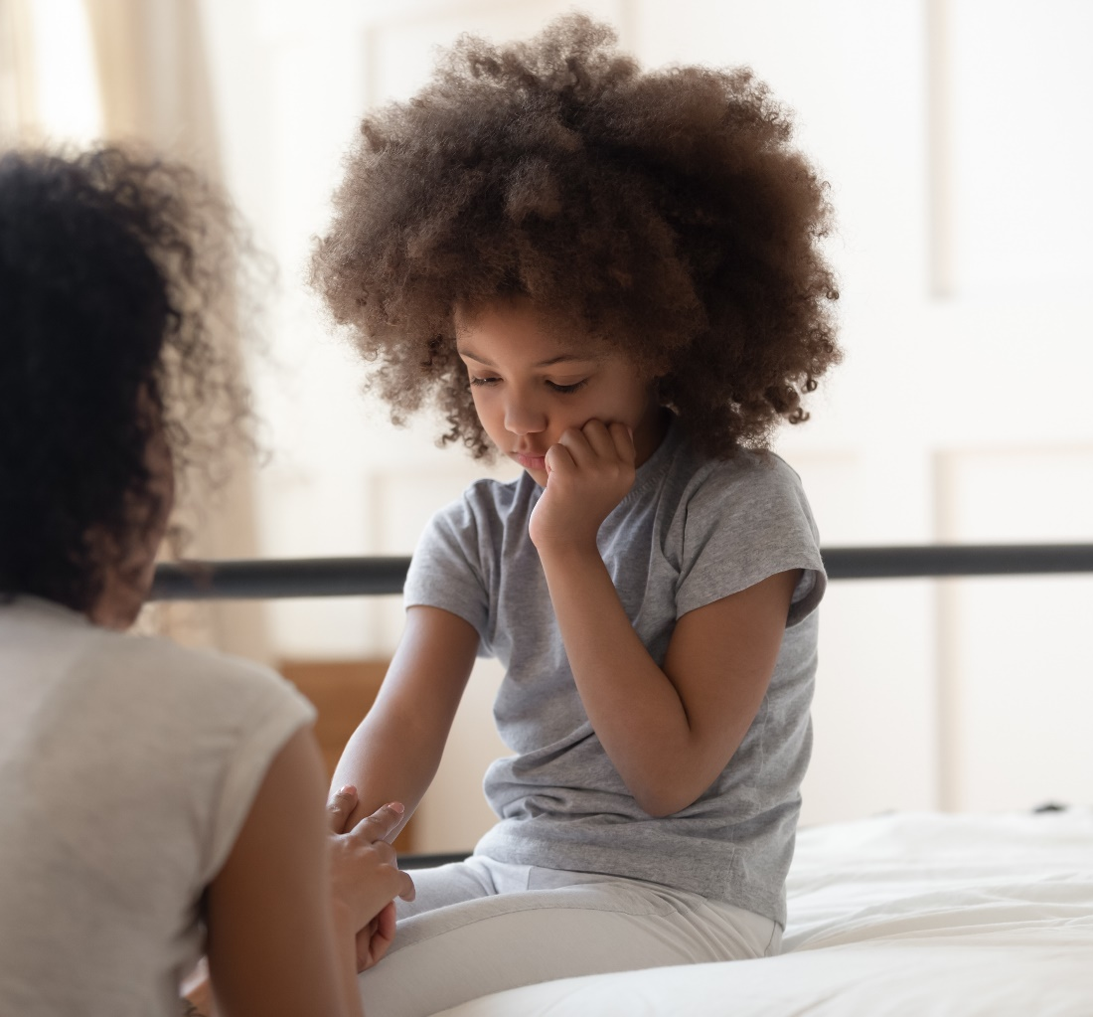

Teachable Moments

Slide 21
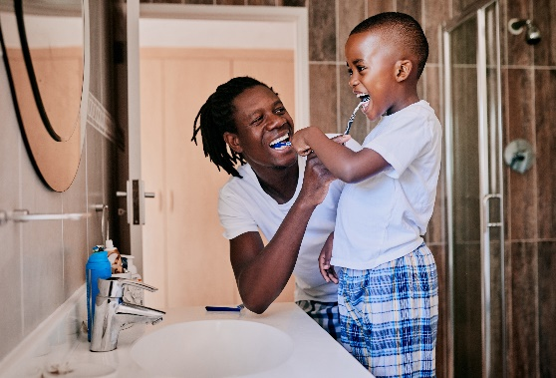
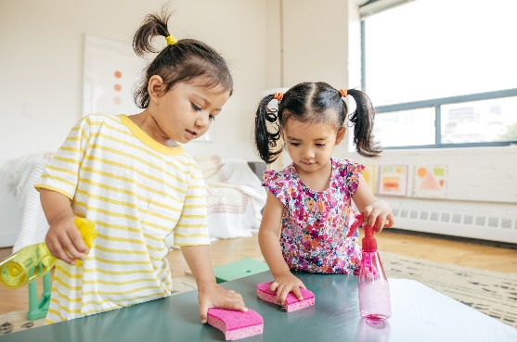
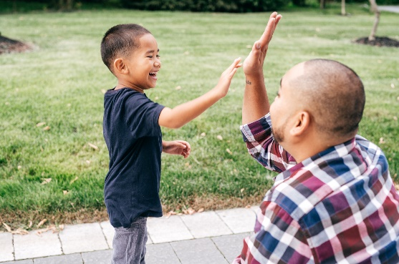
More on Teaching the Rules
Teach Children What to Do!
Show and Tell
Practice Makes Perfect
You Got It!

Slide 22

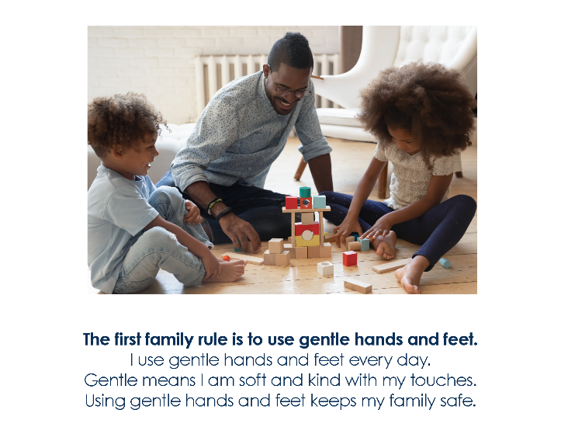
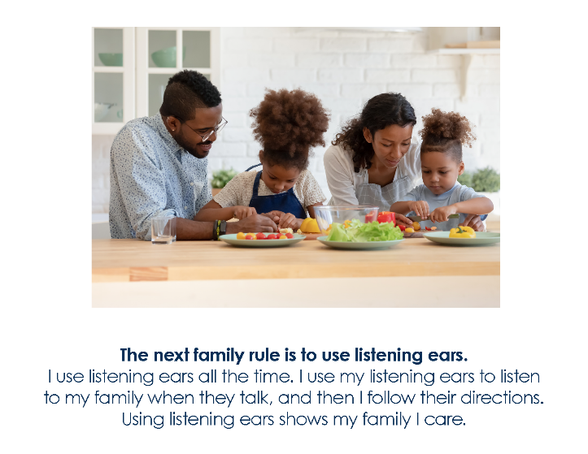
Fun Ways to Teach
Use photographs
  Take a picture of your child doing what you want them to do
Write a story
  Use scripted steps and photographs
  Walk your child through the steps of following the rules
Make it fun!
  Get creative. Sing a song, act it out, make rules poster together.

Slide 23
Apply It and Try It Review
Things to Try at Home:
Observe your child using a challenging behavior using the Why Children Do What They Do form (Handbook Activity 2)
Create a family rules chart or poster (Handbook Activity 3)

Slide 24
Thank You

