Slide 1
Session 4: The Power of Routines

Slide 2


What’s Happening Today?
Apply It and Try It Reflections
Affirmations
Components of a Successful Routine
Prevention Strategies
Tips for Transitions

Slide 3




Apply It and Try It Reflection
Why Children Do What They Do
Family Rules
What did you learn by observing your child?
What rules did you create?
How did your child react?

Slide 4
Affirmations
Statements that are encouraging and motivating
Help us feel strong
Help us feel optimistic about change
Make a note!
Reflect on the changes you have made or your efforts with your child.

Slide 5


Routines: What are they and why are they important?
Routines are predictable and naturally occurring activities that occur in a child's day.
Routines include caregiving, daily tasks, meals, play, community, and social activities.

Slide 6
Possible Family Routines
Getting dressed/undressed
Brushing teeth/hair
Mealtime
Playing outside
Cleaning-up
Going to school
After school activities
Taking a nap
Riding in the car
Going to the park
Going shopping
Going to a restaurant
Going to the doctor or dentist
Taking medication
Taking a bath or shower
Getting ready for bed

Slide 7
Components of a Successful Routine
Have a clear start and finish.
Teach your child the steps of the routine.
Follow the steps of the routine consistently.
When changes happen, prepare your child ahead of time.
Use visuals.
Provide positive feedback and encouragement.

Slide 8
Breaking Down the Steps of a Routine
Getting Ready for Bed
Take a bath
Put on pajamas
Brush hair
Brush teeth
Get into bed
Read 2 stories
Snuggle and say goodnight
Steps within Routine
Go to the toilet

Slide 9
Family Routine Guide: Strategies
Prevent the Behavior
Respond
Teach New Skills
What can I do to prevent challenging behavior?
When we prevent:
More opportunities to teach skills!

Slide 10
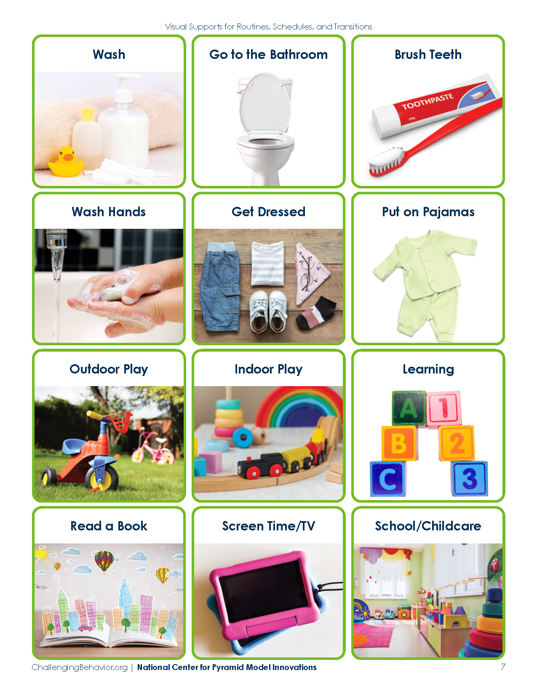
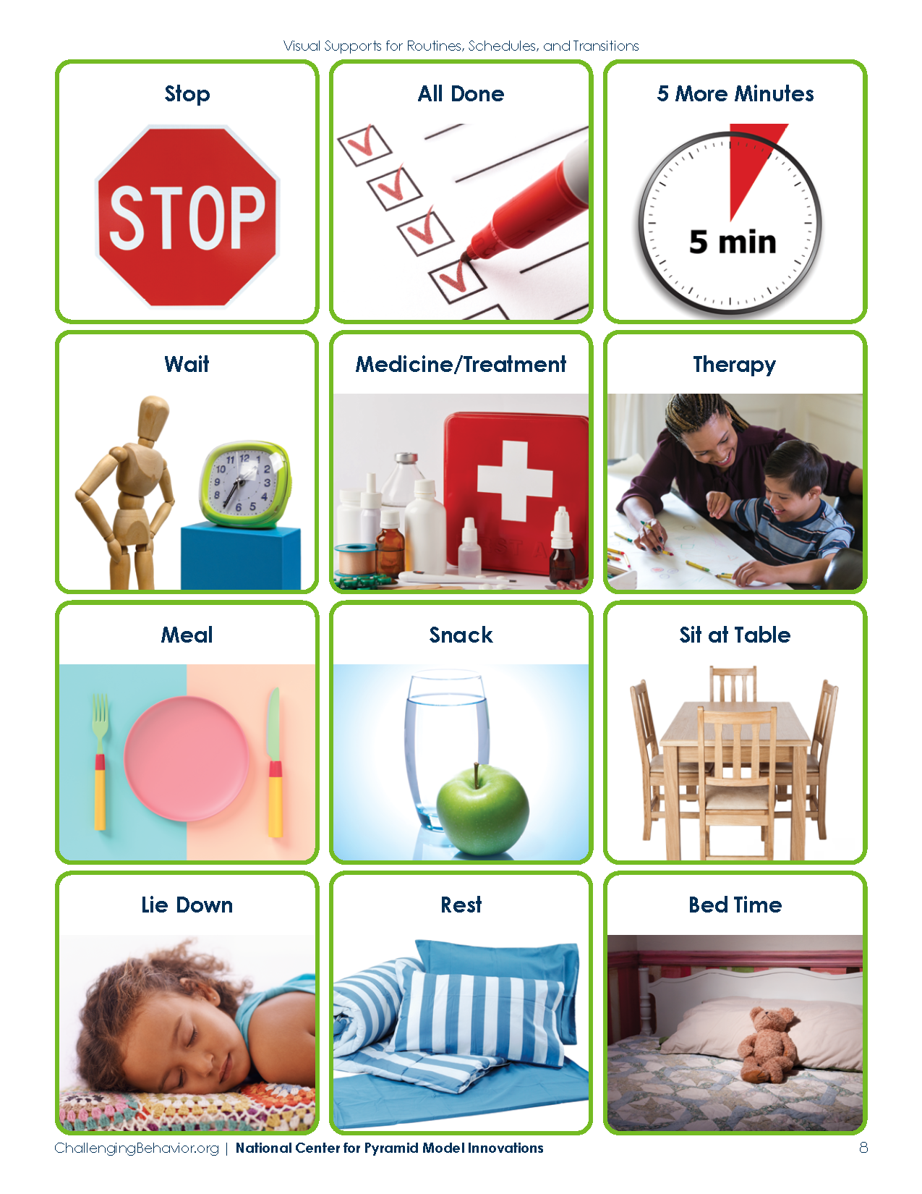


Visual Supports
Visuals: photographs, drawings, objects, written words, or lists

Slide 11
Scripted Story
Short and descriptive
Includes each step in the routine
Written in first person as if child is talking:
“I will…”
“When I do….”
“My family will…”
Include photos of child or related images
Read the story often:
Before the routine
During the routine to show steps
After the routine

Slide 12

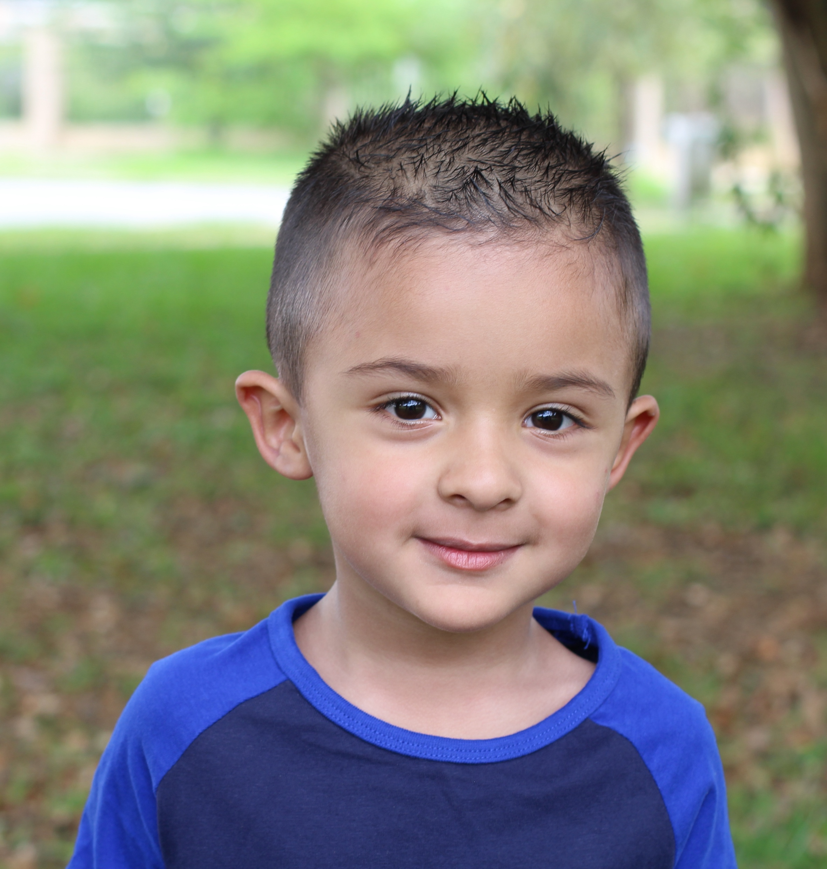


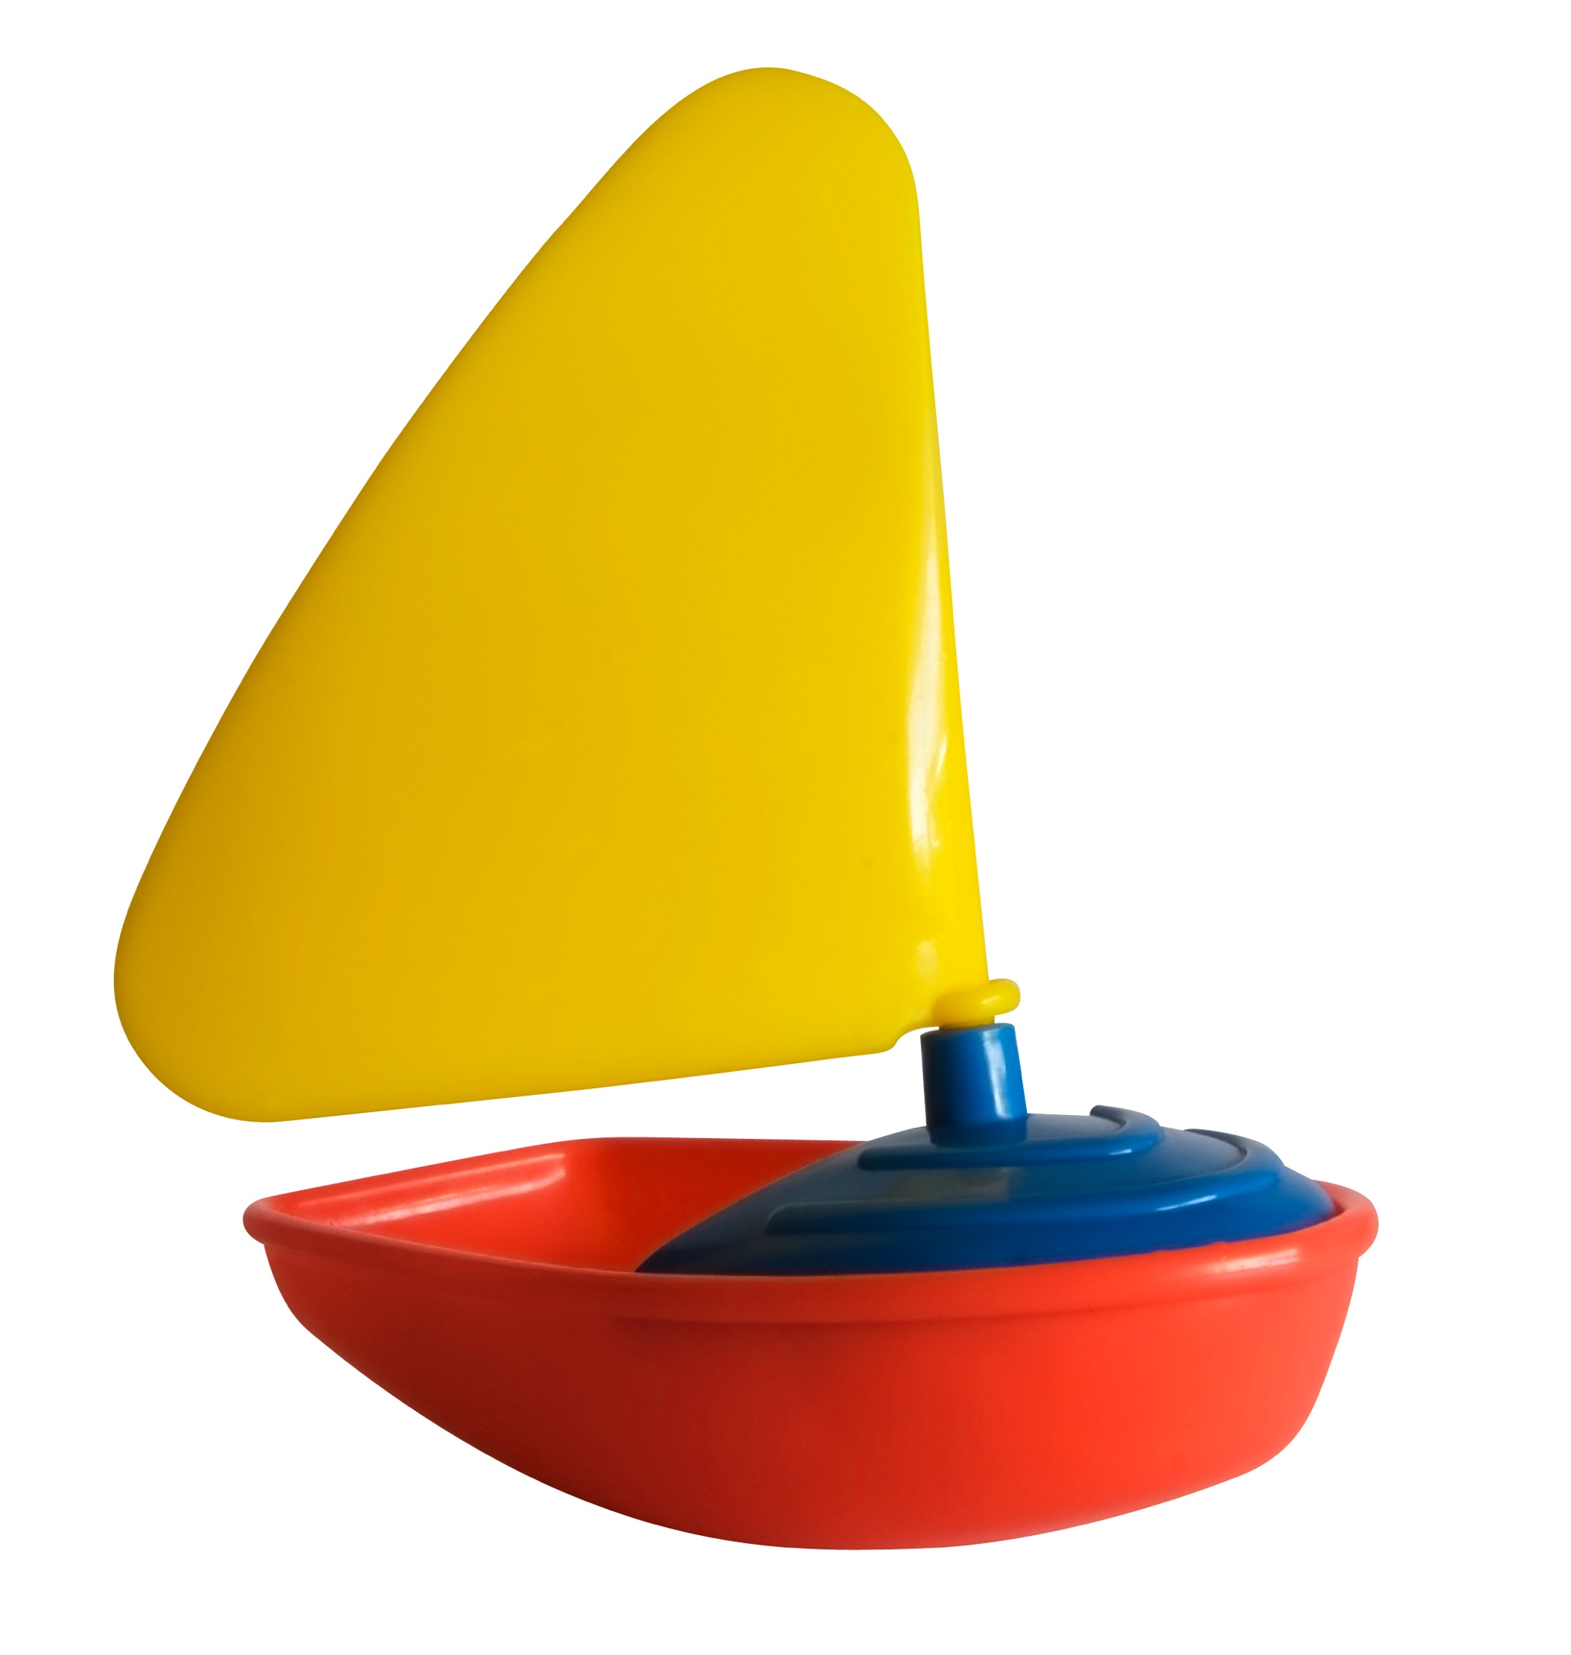

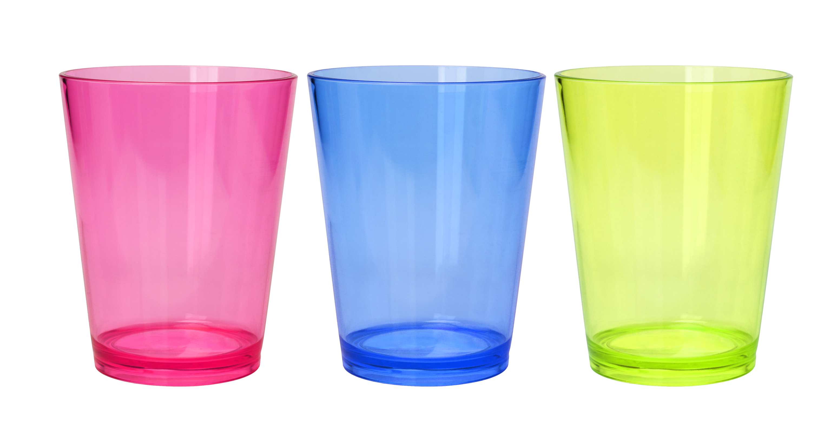





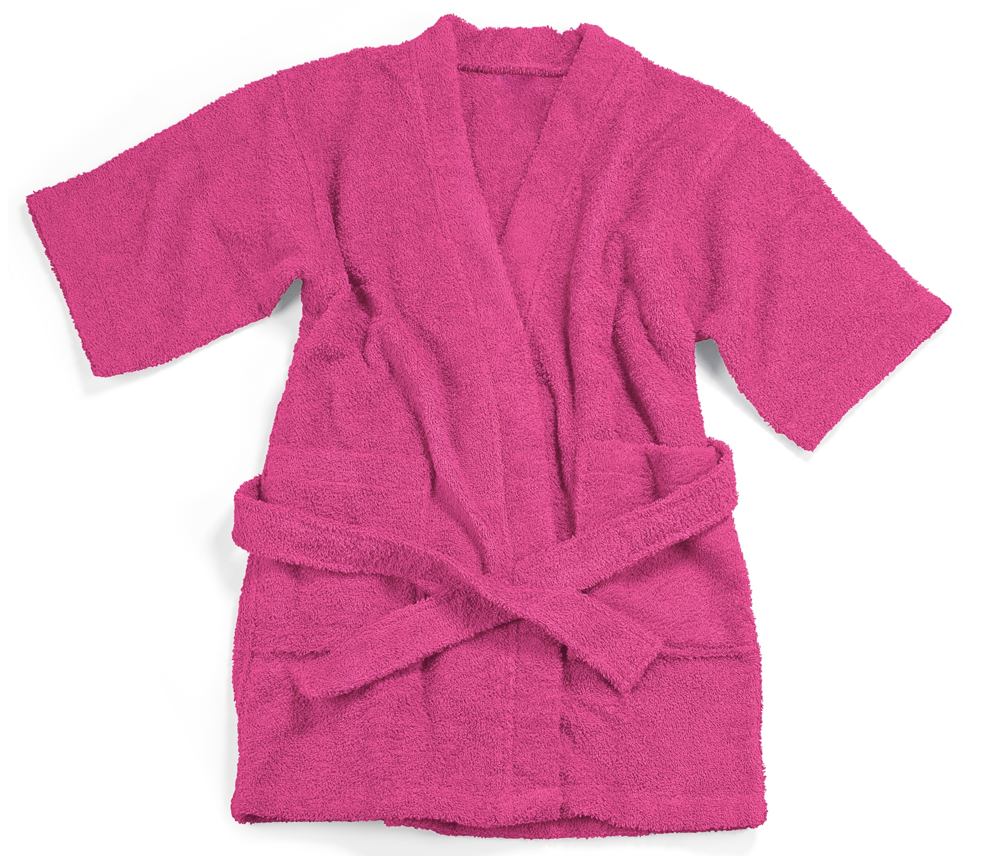

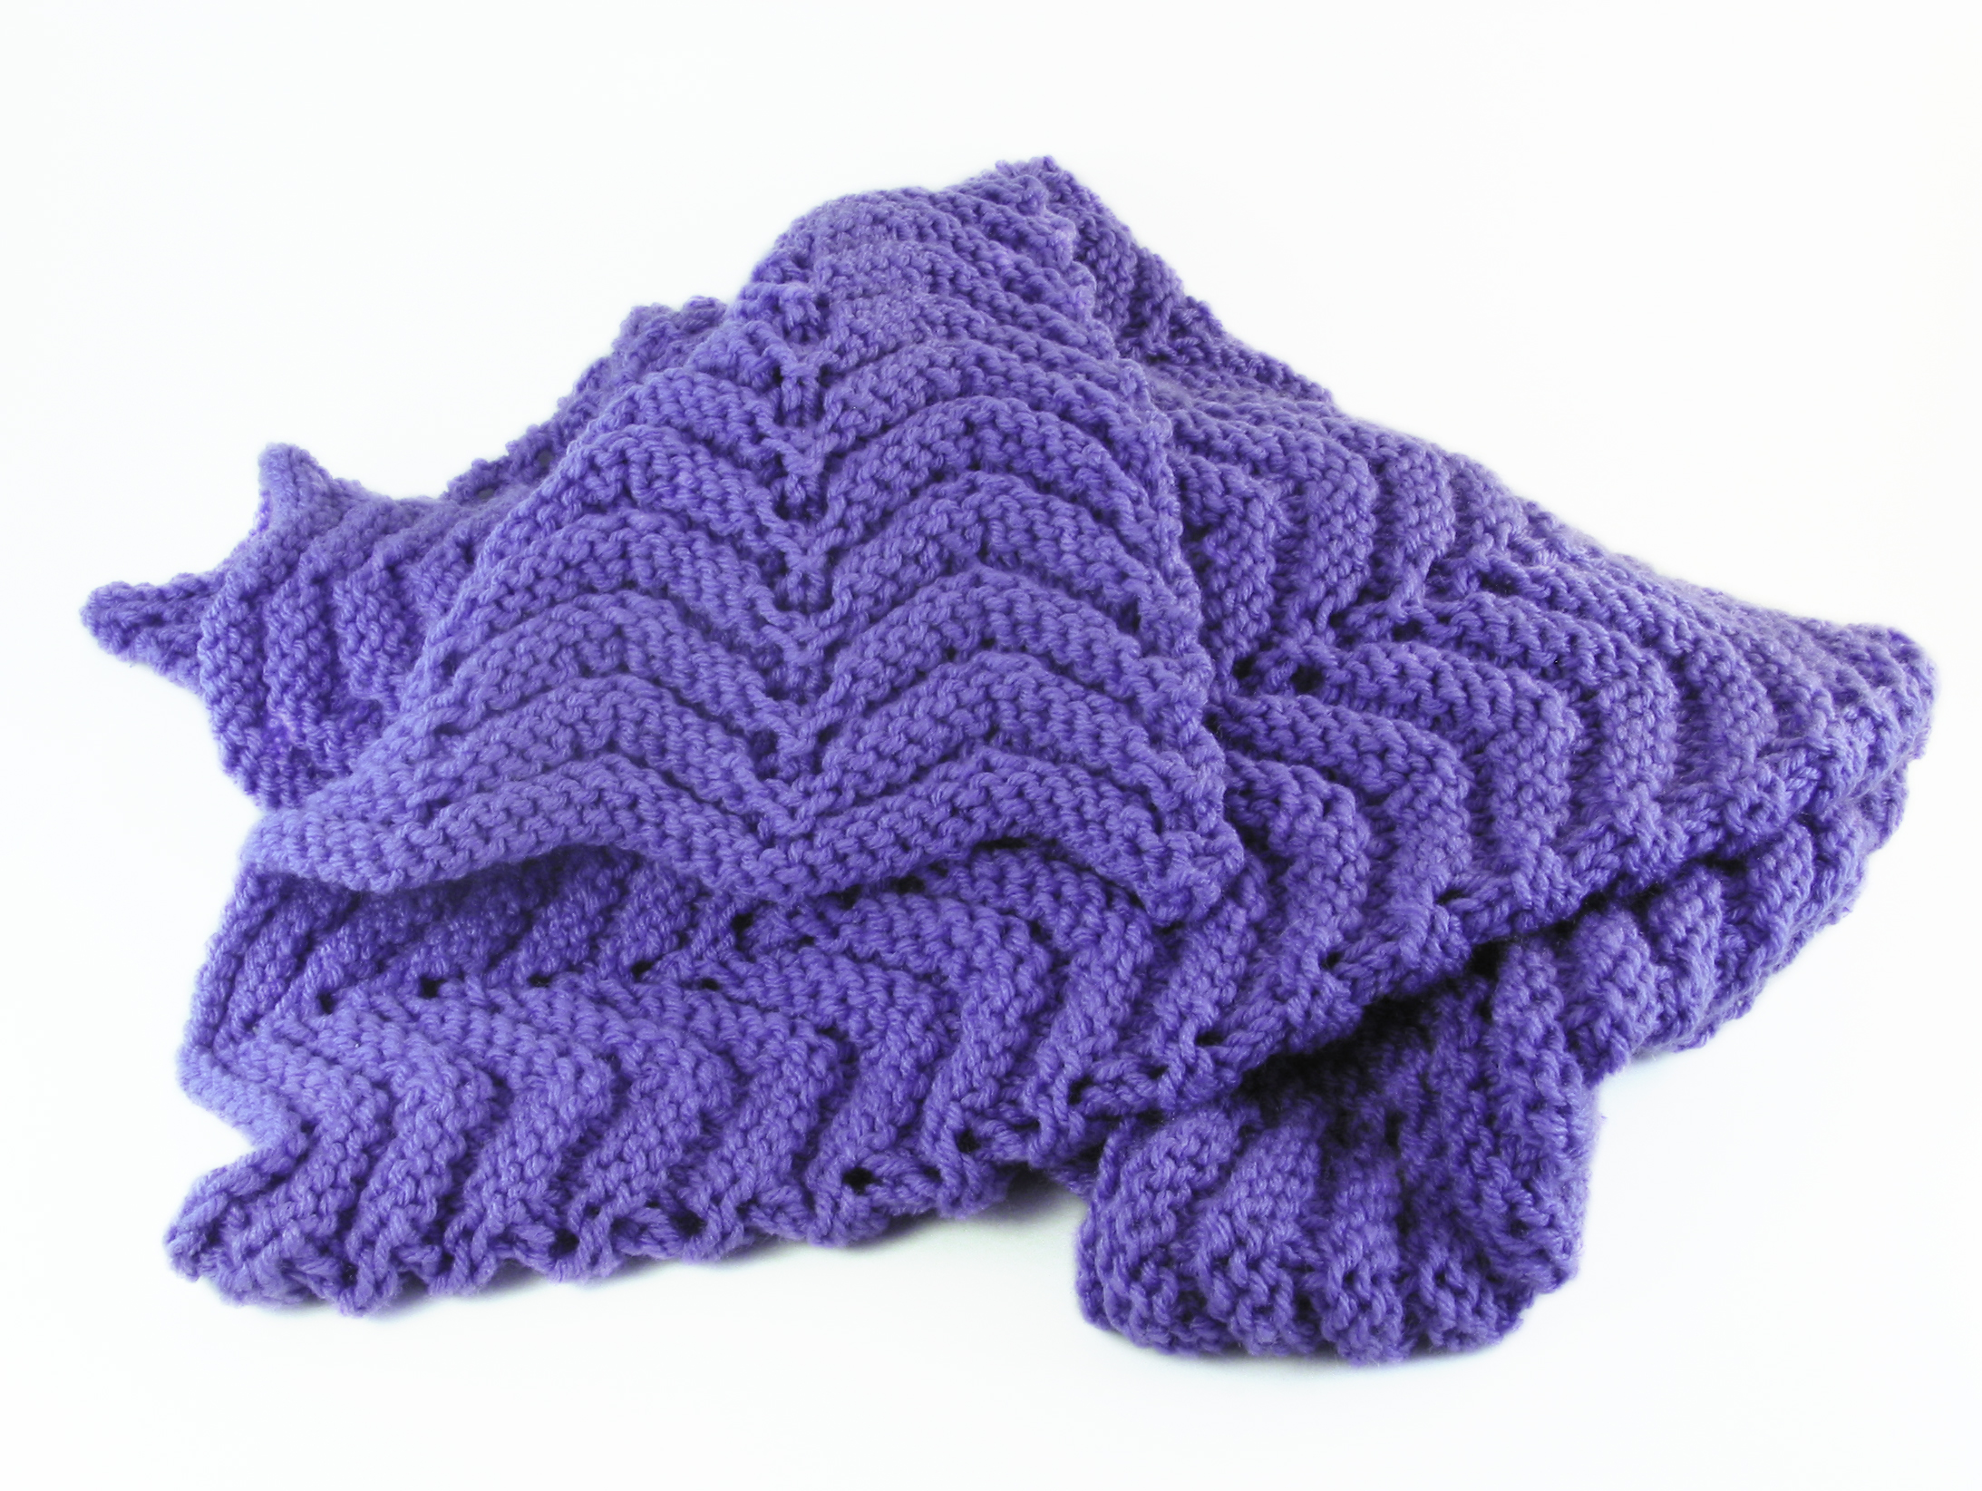
Choice
Mealtime
Riding in the car
Bath

Slide 13
Tips for Offering Choice
Offer choice throughout day or when you anticipate challenging behavior
Only offer two choices
Options are reasonable and available
Offer choice verbally (words) or visually (pictures or objects)
Honor the child’s choice immediately

Slide 14
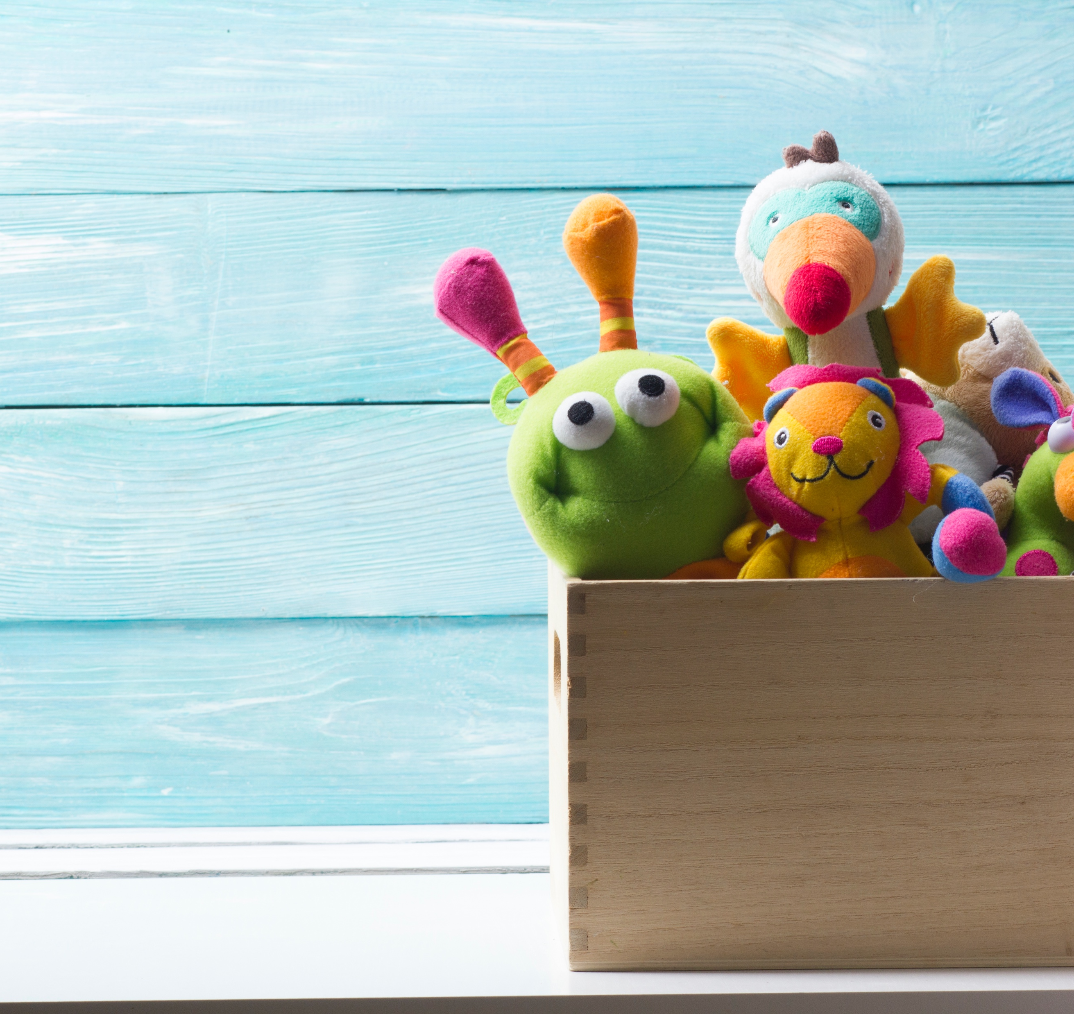
Embed Preference
People
Objects
Locations
Activities
What are some of the preferences and interests your child has?

Slide 15
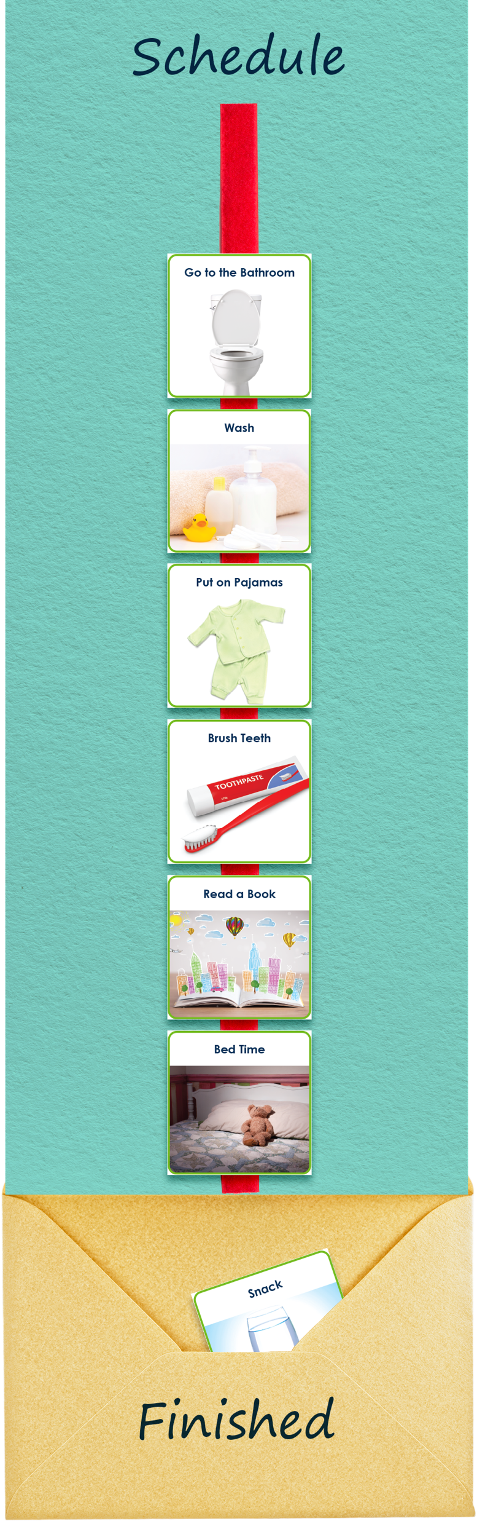
Consistency is Key

Slide 16


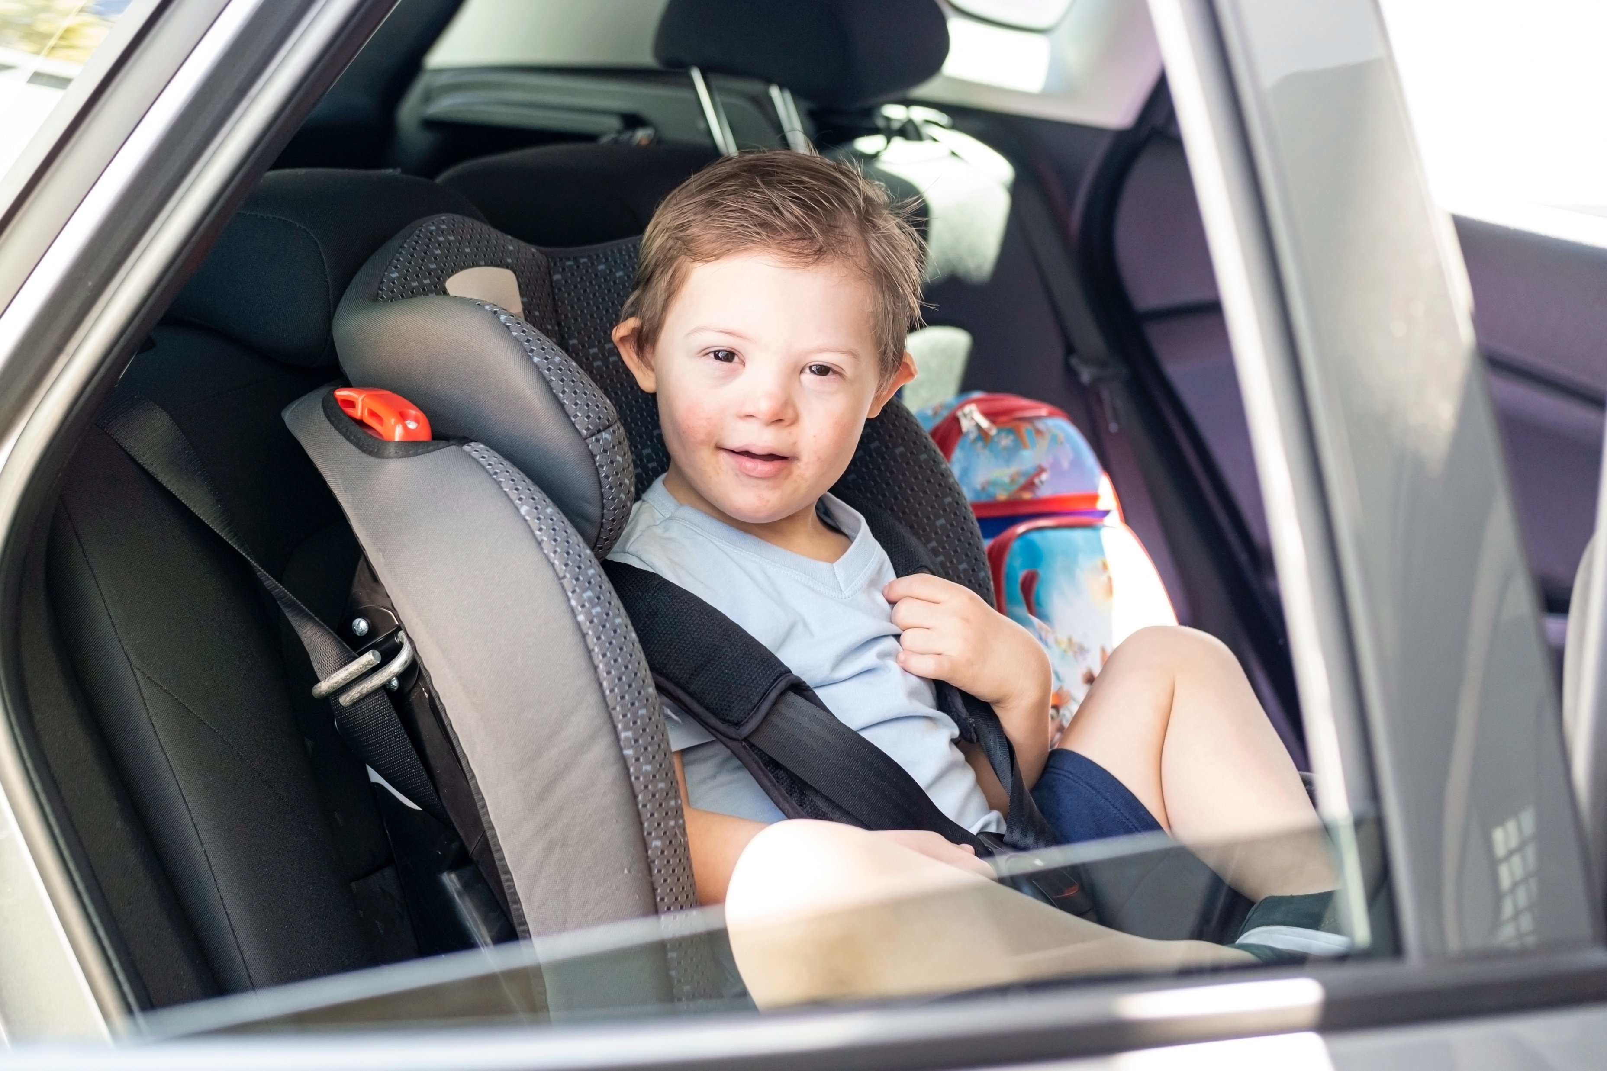
Transition as Routines
Transition Strategies
Use a timer
Give a verbal warning
Use a transition object
Use a visual cue
Make the transition fun
Sing a song
Give the child a job to do

Slide 17




Timers and Warnings

Slide 18
Transition Cues

Slide 19
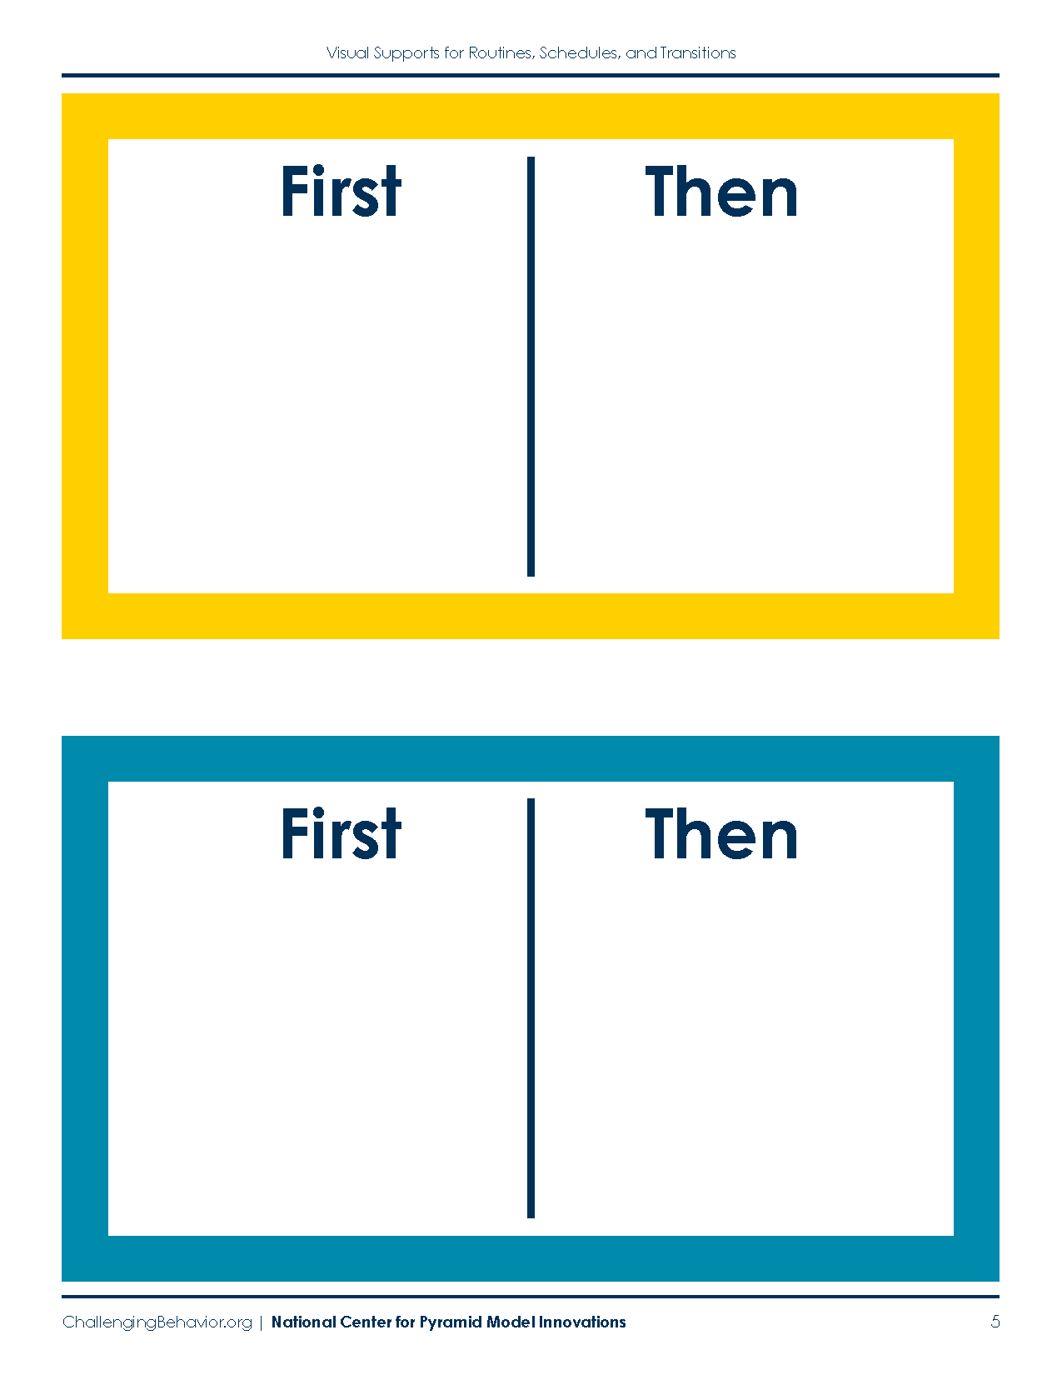
First/Then

Slide 20

When Routines Go Well
Acknowledge and encourage children for following a routine:
Use positive, specific feedback
Encourage all attempts during the routine

Slide 21

Apply It and Try It
Powerful Routine: Handbook Activity 2 and 3
Go back to the routine you selected the listed steps to the routine
List visual you want to use
Using the Family Routine Guide, select 3 strategies to teach the routine
Activity 2 and 3

Slide 22
Apply It and Try It Review
Things to Try at Home:
Focus on one routine or transition. Use visuals and try at least 3 strategies. (Handbook Activity 2).

Slide 23
Thank You

