Slide 1
Session 5: Teach Me What to Do

Slide 2


What’s Happening Today?
Apply It and Try It Reflections
Affirmations
Teach Me What to Do: Why, When and How
Emotional Literacy
Controlling Anger and Handling Disappointment
Problem Solving

Slide 3





Apply It and Try It Reflection
Routine or Transition
How did your child respond?
How did you feel about trying the strategies?
Was any part of this challenging?

Slide 4
Affirmations
Statements that are encouraging and motivating
Help us feel strong
Help us feel optimistic about change
Make a note!
Reflect on the changes you have made or your efforts with your child.

Slide 5
This is When We Teach
Teach before there is problem behavior
Prompt Here
Practice Here
Practice Here
Notes:
3 mins ** slide is animated
We are going to talk about “when” during the day we might teach these skills.
Describe a typical situation that might happen in a classroom.
For example, Trey is drawing a picture with markers. Blair comes to Trey’s desk and decides that she needs marker Trey is using. Blair grabs the marker, and Trey’s picture gets a marker line across it. Trey hits Blair and Blair starts to yell to get the teacher’s attention. Ask participants to generate ideas about what teachers might say to Trey and Blair at this point
e.g., “Use your words.” “Say you’re sorry.” “Ask nicely if you want something.” “Get an adult if you need help.” “Calm down.”
Point out that it is often at the crisis (red arrow) point that teachers try to teach new social skills. Discuss that while this is a teachable moment, and can be a social skills lesson for Trey and Blair, this might not be the most effective teachable moment because:
The incident has already happened.
Both children are upset.
Blair may find the teacher reinforcing (“Wow, I might do this again so I can get the teacher’s attention!”).
Discuss effective teachable moments (referring to the green arrows at the left-hand side). The main point here is that we want to make sure that these “crisis moments” are not the only time that we are “teaching” social skills! Social skills can be embedded into almost any part of the daily schedule—Intentional, planned times as well as taking advantage of naturally occurring moments throughout the day.
Emphasis is on practicing during calm, everyday routines. Prompt child with those skills before they reach (anger, frustration, challenging behavior occurs). The teacher could provide a verbal prompt to Blair, “Remember, if you want to use a marker, how can you ask you friends?” or if the teacher noticed that Blair was starting to need more support, she could prompt the entire small group with a review of the solution kit”

Slide 6

Emotional Literacy
The ability to recognize, label, and understand feeling in one’s self and others.

Slide 7
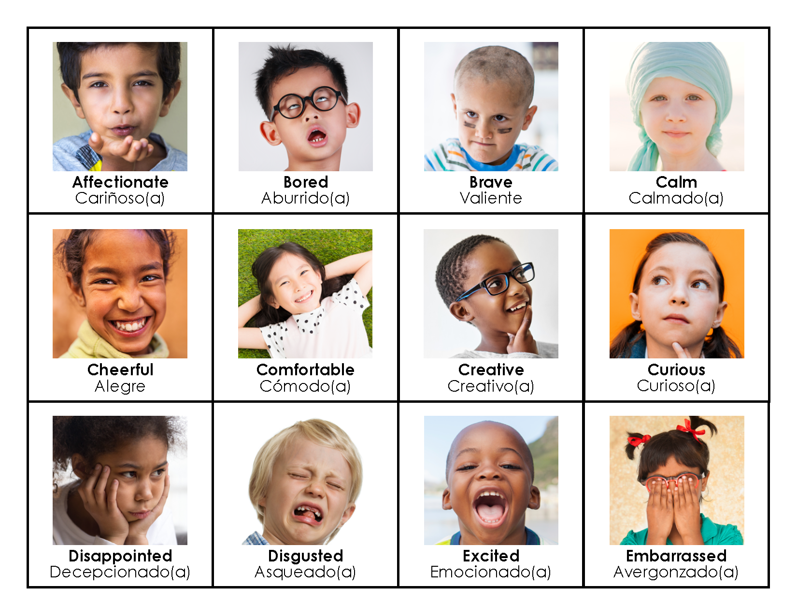
What Emotion Words Does Your Child Know?

Slide 8

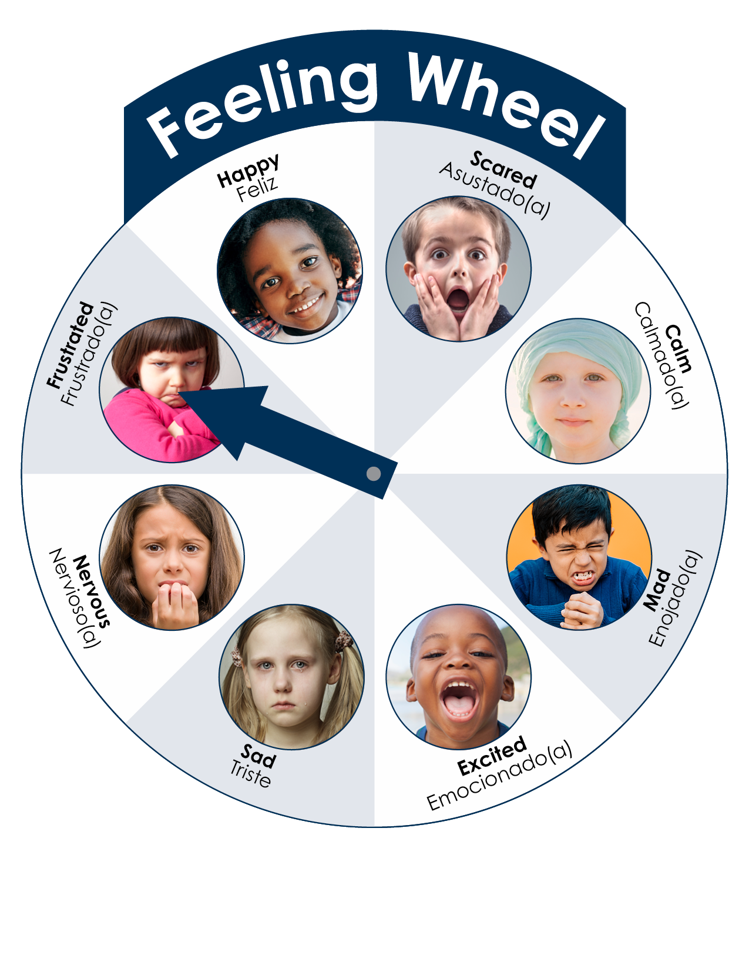
Feeling Faces

Slide 9
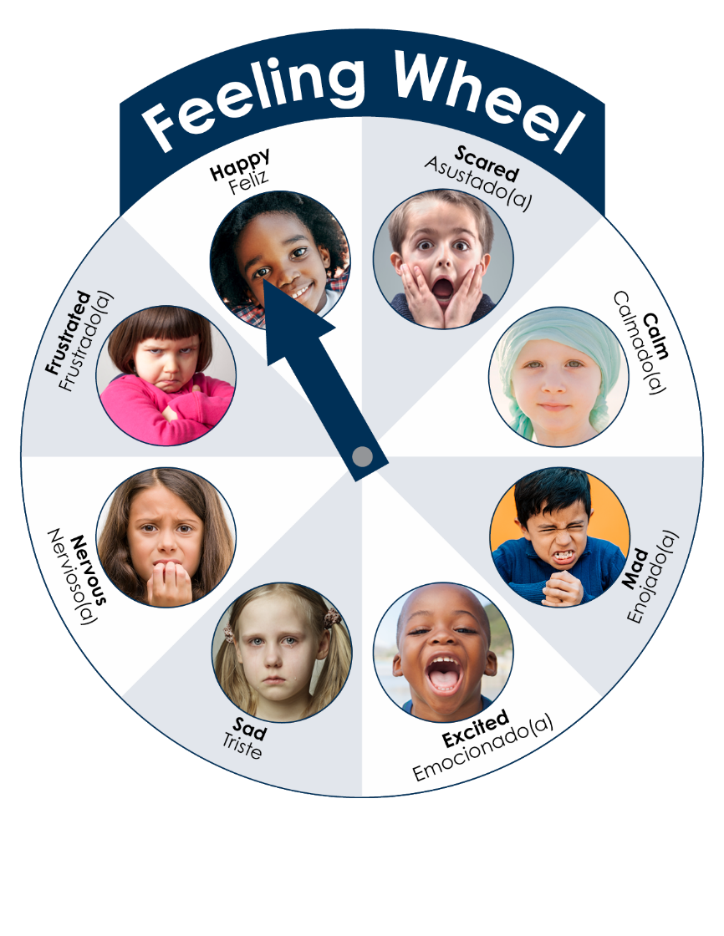
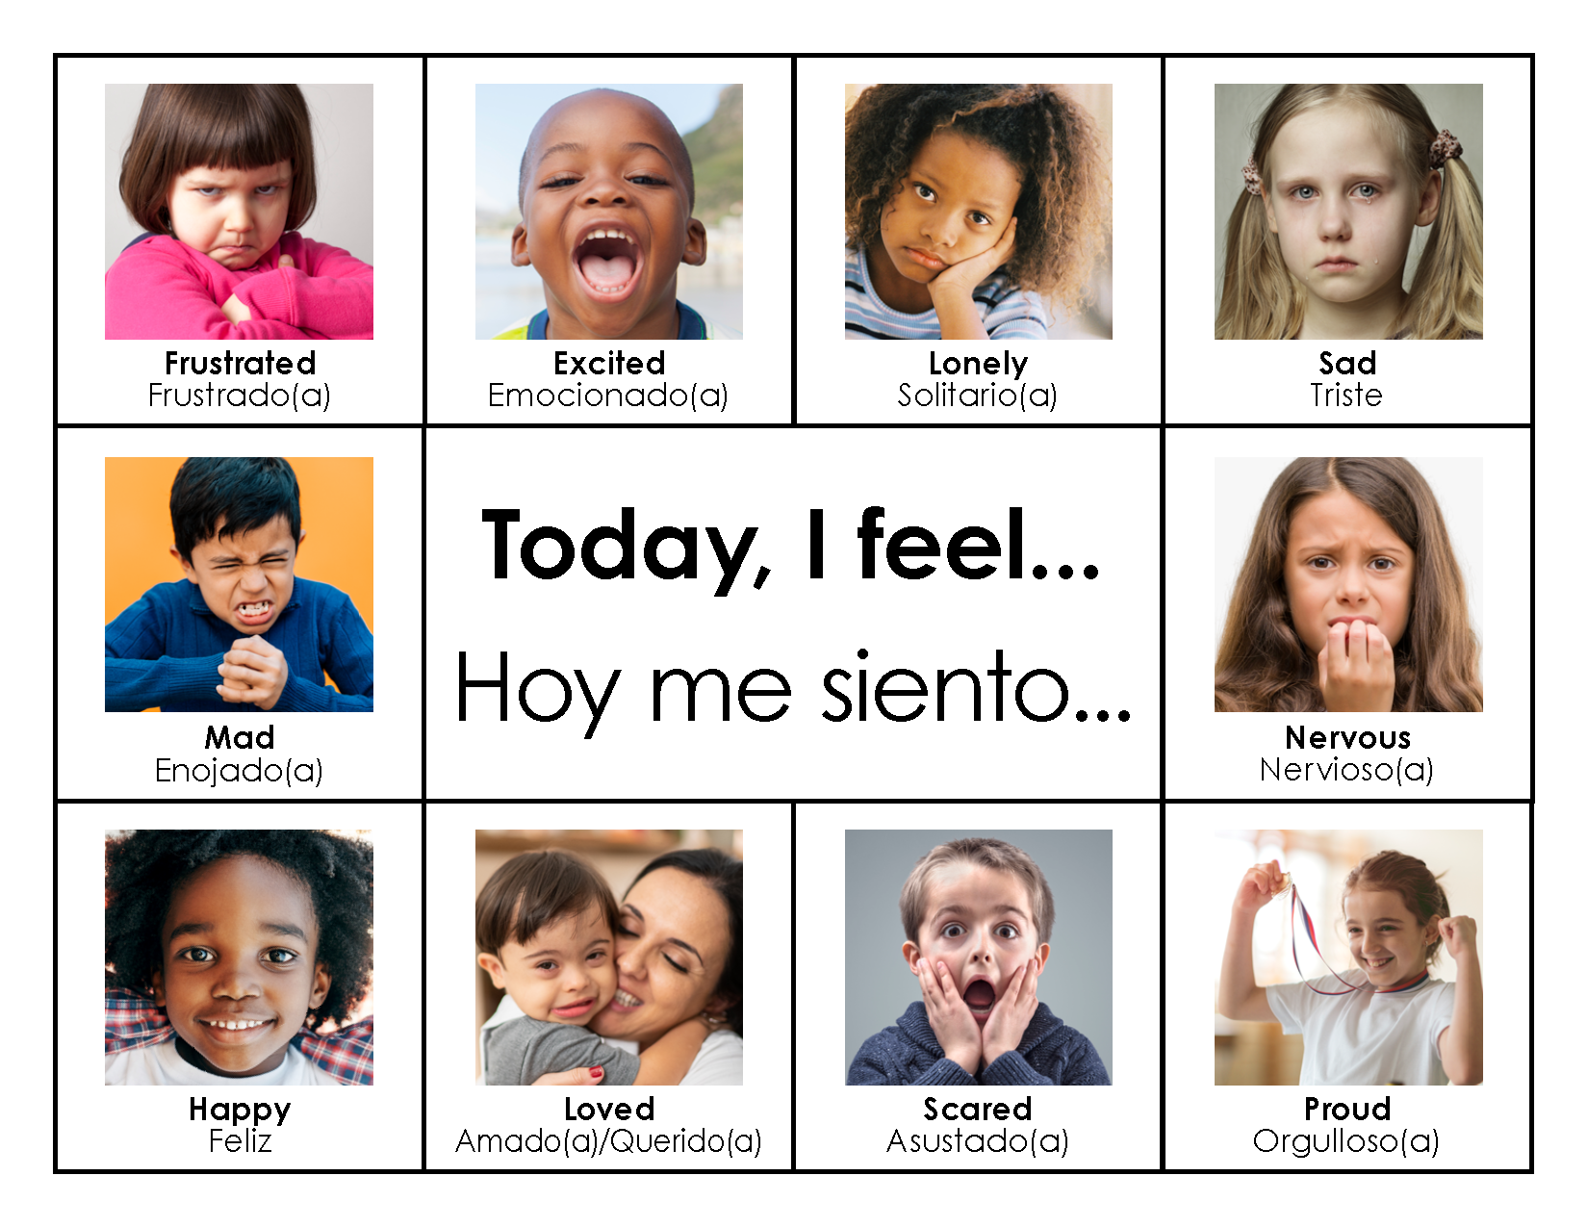
This Is How I Feel Today

Slide 10


Read a Book
Use fun voices to show emotion
Have your child point out emotions on characters
Ask questions and talk:
How did the boy feel?
What makes you scared?
Show me your scared face.

Slide 11

Apply It and Try It
Select 2-3 new emotions you want to teach
Add a few ideas of how you will teach them
Activity 2

Slide 12

Self-Regulation and Anger Management
Help your child:
Recognize big emotions, like anger, in themselves and others
Learn to calm down
Understand appropriate ways to express big emotions like anger

Slide 13
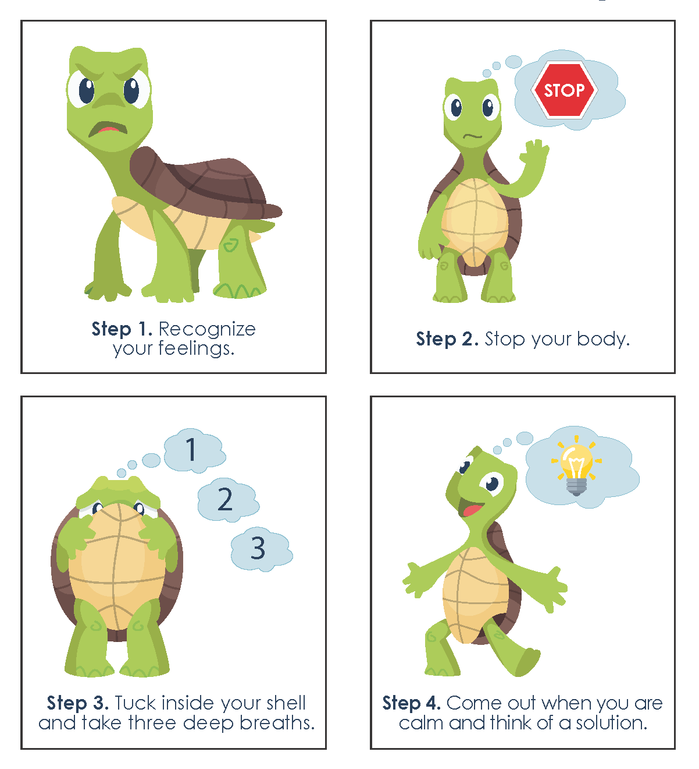
Turtle Technique

Slide 14
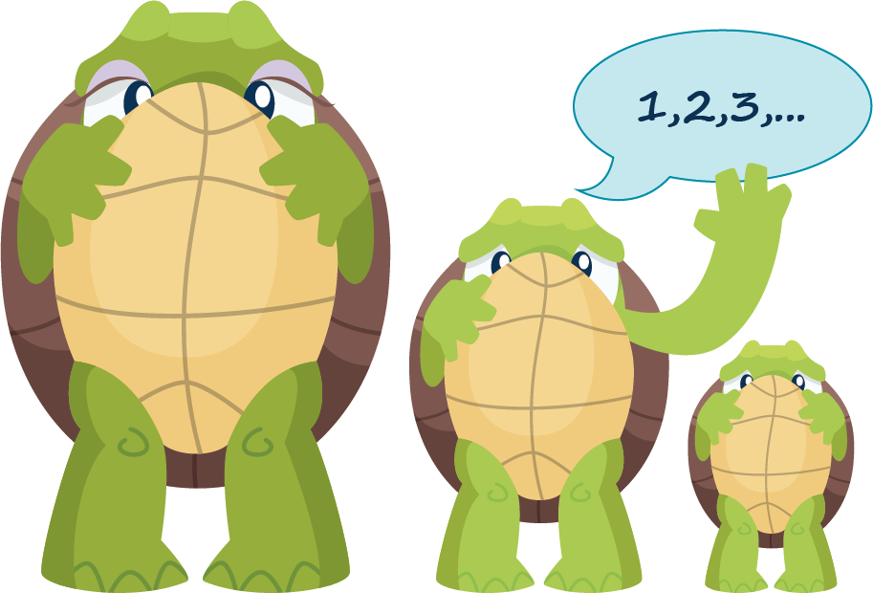
Practice, Practice, Practice!
Teach the Turtle Technique, step-by-step
Provide lots of opportunity for review
Encourage your child to “tuck like a turtle”
Celebrate their success!

Slide 15
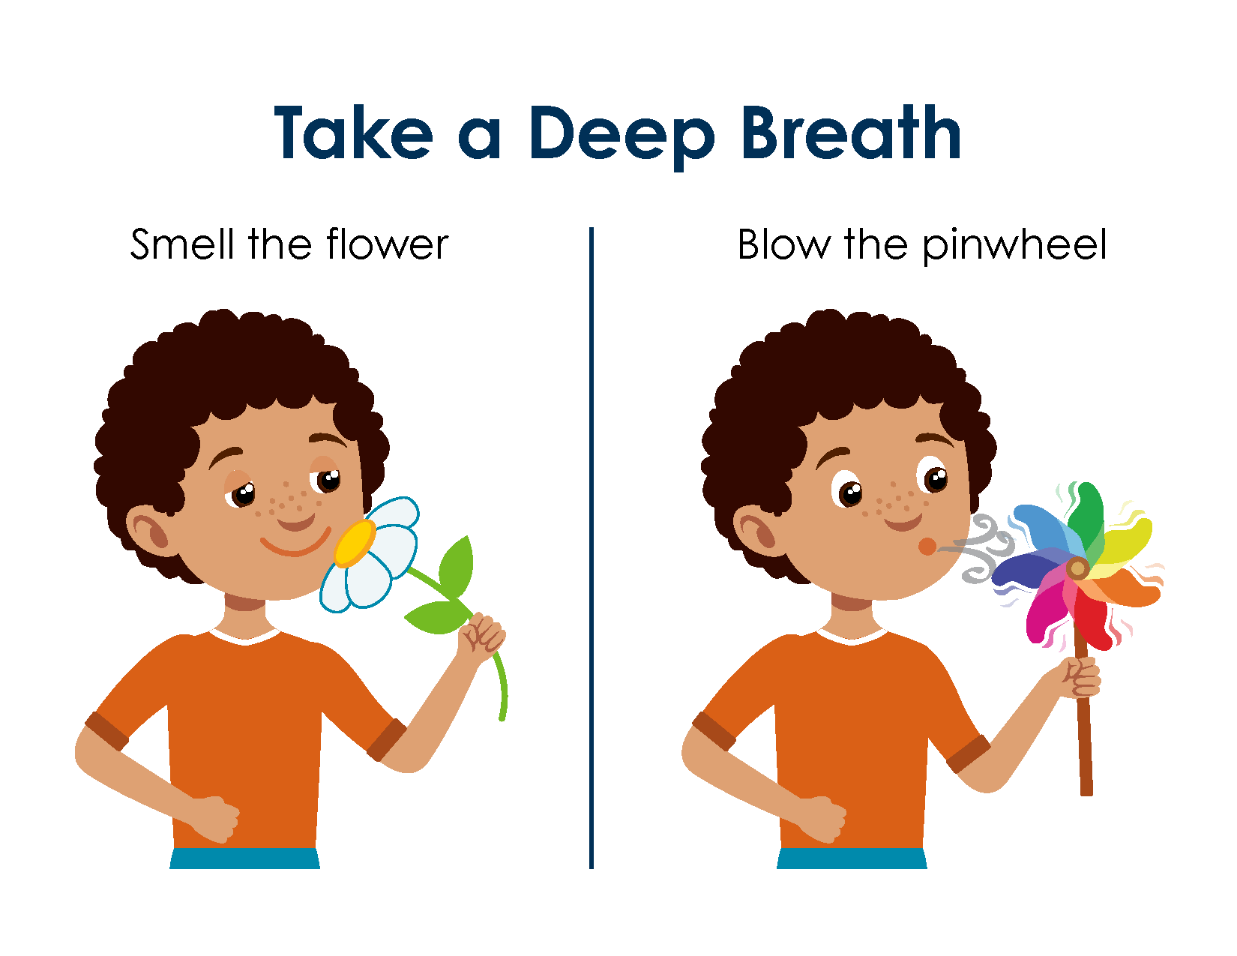
Belly Breathing

Slide 16
Not Just for Anger

Slide 17

Taking a Break: Using a Calm Down Area at Home
How does a calm down area work for you?
This is different from a time-out, what do you think those differences are?
How is this a helpful life skill for your child?

Slide 18
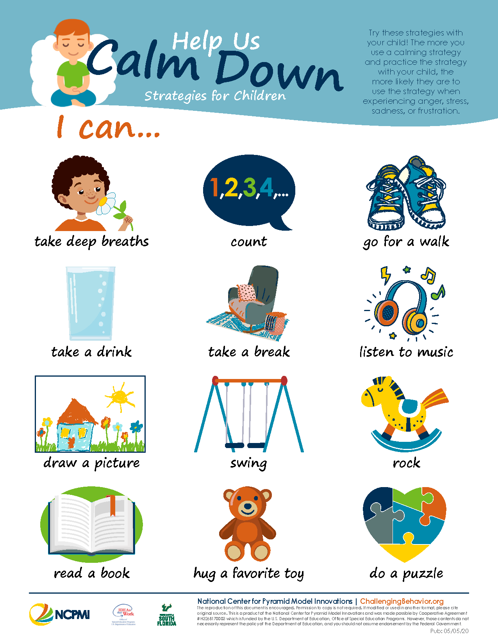
Help Us Calm Down

Slide 19
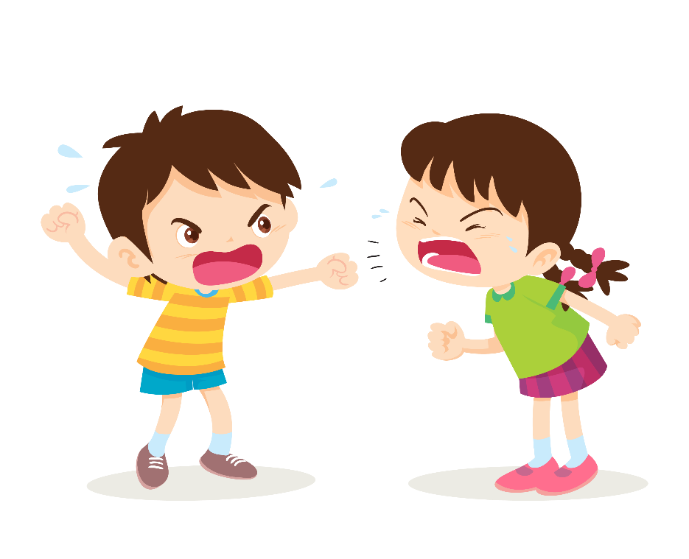


Problem Solving

Slide 20
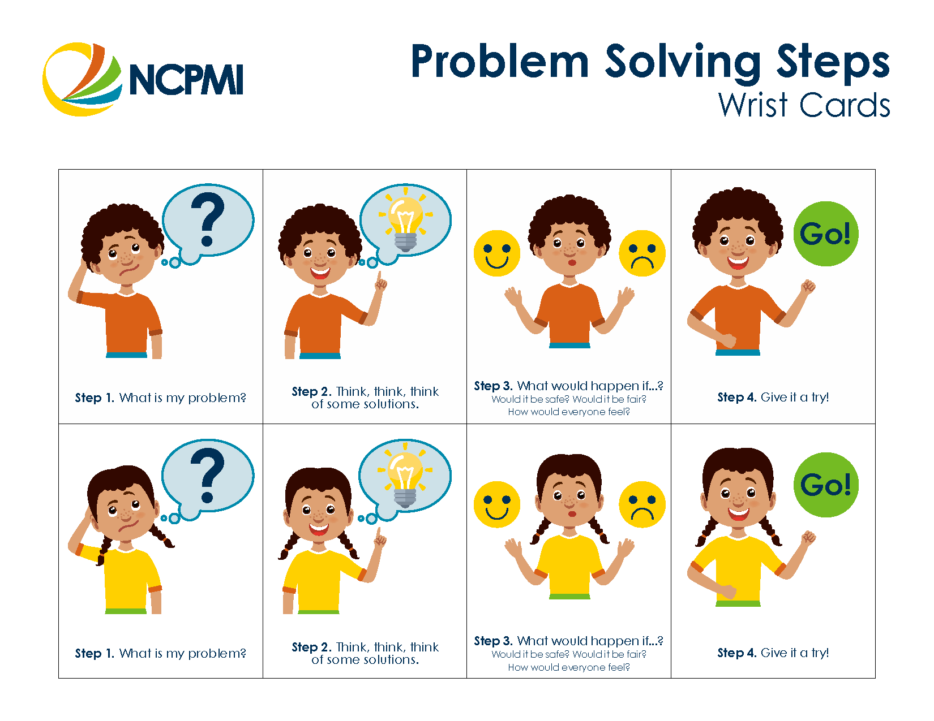
Problem Solving Steps Step 1: What is my problem?

Slide 21
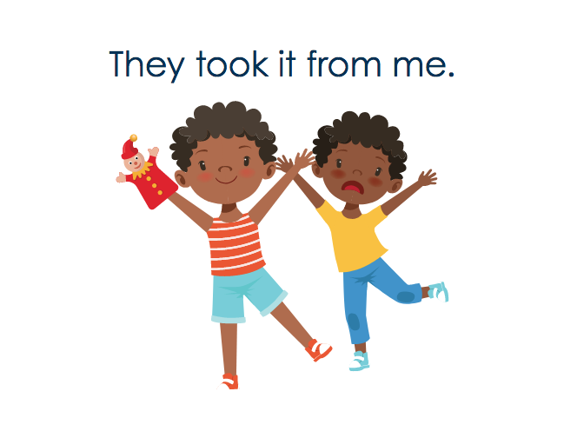
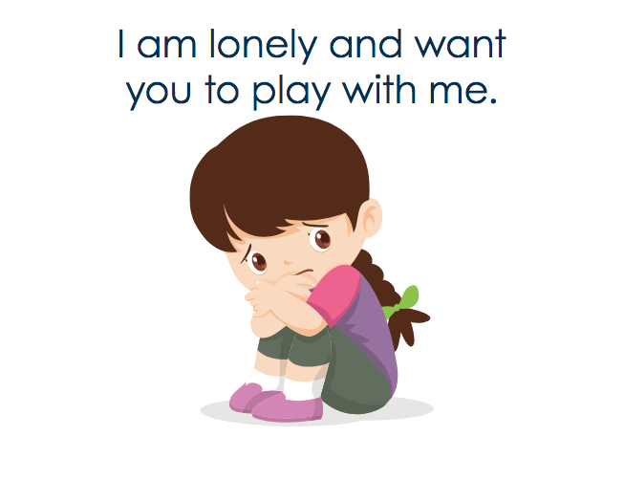
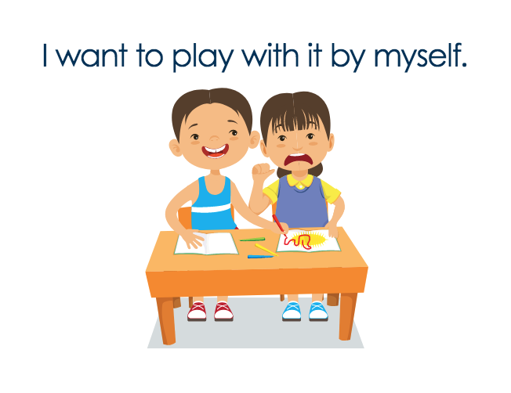
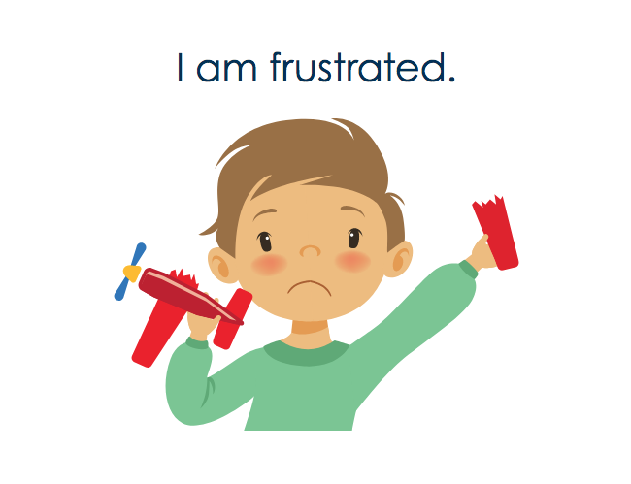
I Can Be a Problem Solver at Home

Slide 22
Home Solution Kit Step 2 :Think, Think, Think of Solutions

Slide 23
Problem Solving Steps 3 and 4
Step 3: What would happen if I tried my solution
Step 4: Give it a try!

Slide 24

Setting the Stage for Success
Try to anticipate problems
Stay near your child
Support your child
Encourage your child

Slide 25
Apply It and Try It
Select Anger Management and Calming Down OR Problem Solving:
What are your ideas for using the materials with your child?
Write down what and how you want to teach.
Example: Teach my child the problem-solving steps.
Read the scripted story.
Practice talking about problems using the scenario cards.
Hang a few of the solutions on the fridge so my child can refer to the solutions easily.
Activity 3

Slide 26
Apply It and Try It Review
Things to Try at Home:
Teach your child new emotion words (Handbook Activity 2)
Use calm down strategies or problem-solving strategies (Handbook Activity 3)

Slide 27
Thank You

