Slide 1
Session 6: Responding With Purpose

Slide 2


What’s Happening Today?
Apply It and Try It Reflections
Affirmations
Prevention is Powerful
Response Strategies:
Logical Consequences
Redirection
Keeping it Positive

Slide 3




Apply It and Try It Reflection
Emotions
Calm down or problem-solving strategy
How did you feel about trying the strategies?
What happened?
How did your child respond?
Was any of this challenging?
What emotion words did your child learn?

Slide 4
Affirmations
Statements that are encouraging and motivating
Help us feel strong
Help us feel optimistic about change
Make a note!
Reflect on the changes you have made or your efforts with your child.

Slide 5
Let’s Review the ABC’s
Antecedent
____________
What happens BEFORE the behavior
Behavior ____________ The behavior
Consequence ____________ What happens AFTER the behavior
A
B
C
Notes:
3 Min.
Trainer Notes. Depending on prior knowledge of participants, you may want to go more in depth. Use this script for detailed information:
When we’re trying to understand why children do what they do or trying to determine the meaning of behavior, you might have heard word this word before-function. The function of the behavior really is what the child is trying to communicate. The child either wants to obtain, or get, something (e.g., attention, toy, food) or is trying to avoid/escape something or someone (e.g., a demand, attention, stimulation).
In order to understand behavior, or be that behavior detective, we have to look for clues or as to what happens before and what happens after the behavior. Even though it can seem like it, behaviors do not happen “out of the blue.” Something always happens before a challenging behavior and something always happens after a challenging behavior. The more we observe the behaviors, and what happens before and after the challenging behavior, the more clues we will have to figure out why children do what they do!
Once you can identify the meaning, or the function, of the challenging behavior, you can identify a plan to change it.
Call participants’ attention to the graphic that is on the slide.
Let’s look at the ABCs:
You might have heard the term ABC’s of behavior. Clues to figure out the meaning of behavior can be found in 3 things:
A stands for Antecedent. Antecedent refers to what happened directly BEFORE the behavior happened. These are all things that can happen before behaviors that might turn on the child’s challenging behavior. Tell participants you will go into depth on the next slides.
B stands for Behavior. Behavior refers to what the child did. You want to ask yourself, “What did the child’s challenging behavior look like?”
C refers to the consequence of the child’s challenging behavior. Consequence simply means what happened AFTER the behavior. Tell participants you will go into depth on the next slides.

Slide 6
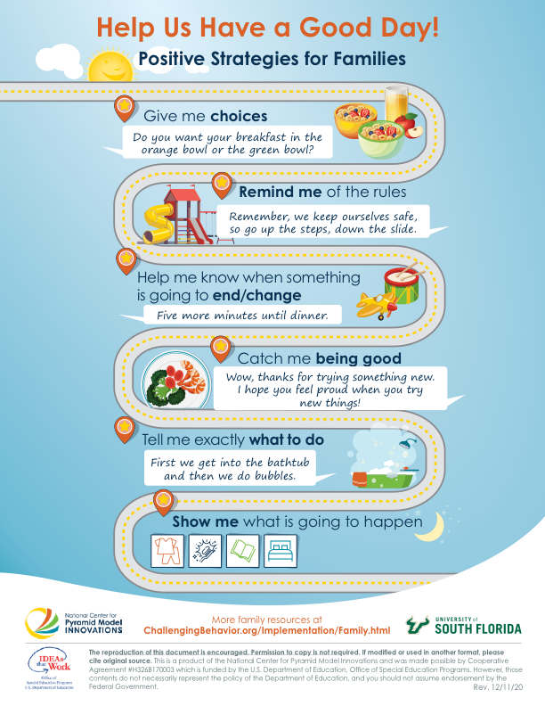
Help Us Have a Good Day

Slide 7
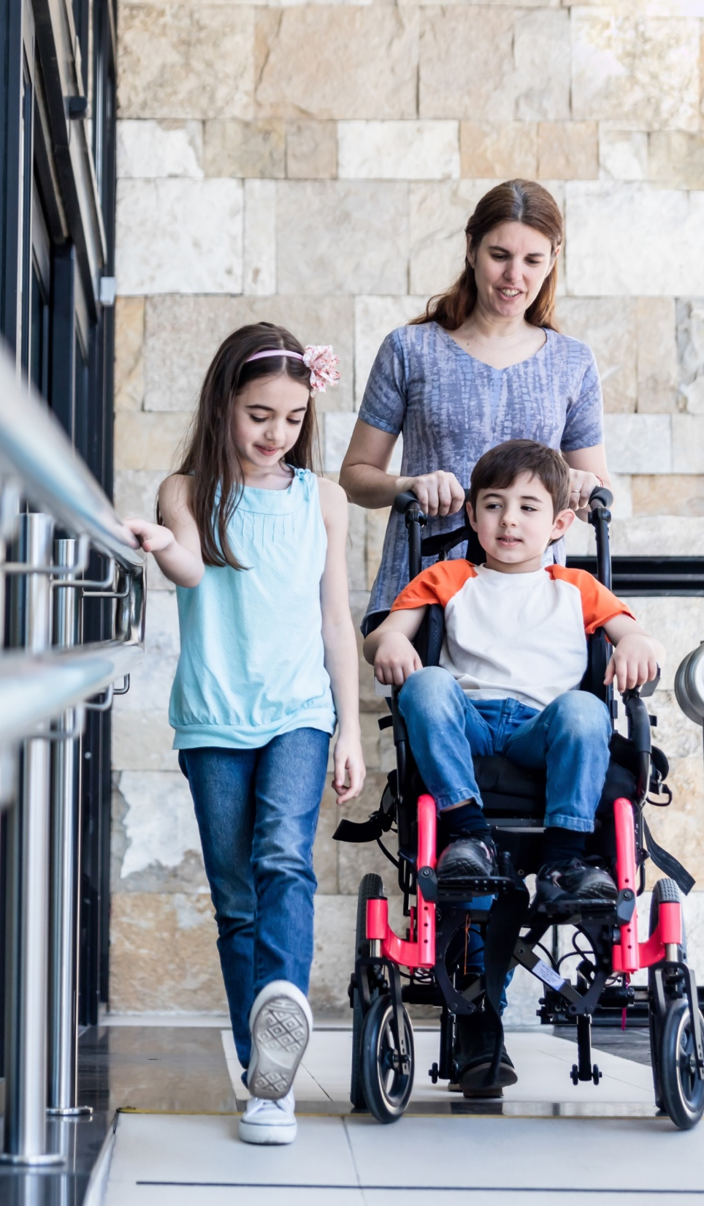
Plan Ahead
Try to anticipate what your child might do or might need
Talk with your child about upcoming events
Plan ahead to set your child up for success, including back-up plans
Hope for the best (but be prepared!)

Slide 8
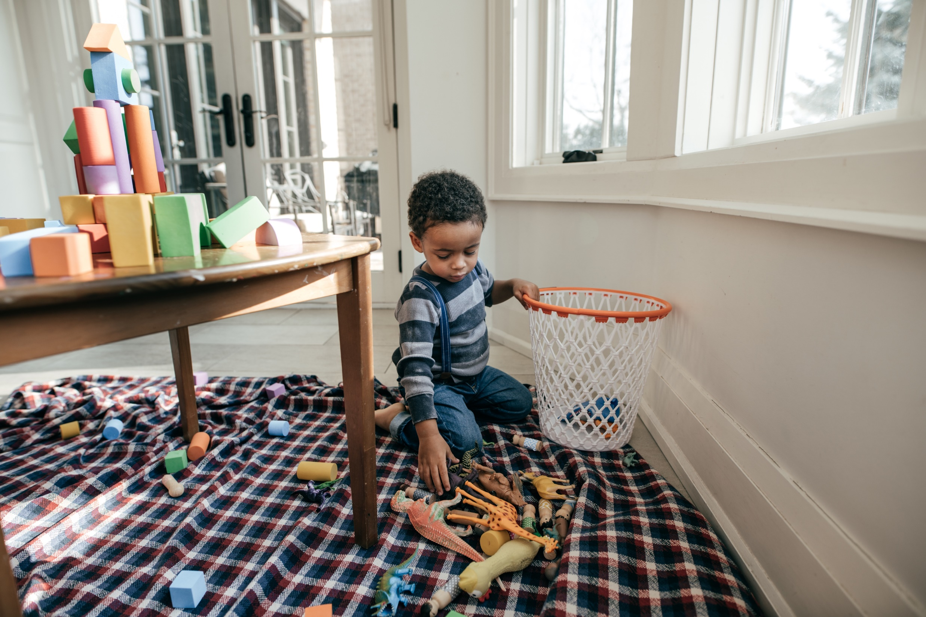
Know What is Reasonable
Know your child’s abilities and limitations
Does my child know what this means?
Is my child physically able to do this?
Keep expectations realistic
Do I have to remind them repeatedly?
Do I find myself getting frustrated?

Slide 9
Understanding Response Strategies
How we respond to challenging behavior
More likely to happen
Less likely to happen

Slide 10
Logical Consequences
Logical Consequences…
Tips
…are an alternative to punishment
…are logically-related responses to the child's behavior
…must be practical and enforced
Only select options you are willing to enforce
State choices calmy, clearly, and respectfully
Plan consequences ahead of time

Slide 11
Logical Consequences in Action
Scenario 1: Dustin refuses to wash his hands before snack
Dustin’s mother restates the rule to Dustin: “You must wash your hands to eat.”
Dustin continues to refuse.
His mother responds, “You can wash your hands and have a snack, or you can continue playing while your brothers have a snack. If you need my help with washing hands, I can help you.”

Slide 12
Logical Consequences in Action 2
Logical Consequences in Action
Scenario 2: Kyra throws blocks in the kitchen
Her dad reminds her of the rule, “Toys need to stay on the floor in the kitchen.”
When Kyra continues to throw the blocks, her dad provides her with a choice: “Blocks stay on the floor in the kitchen, or they will need to be put away.”

Slide 13
Logical Consequence Challenge
Child keeps dumping water out of the bathtub.
Child leaves their toys on floor.
Child paints the table and floor with finger paint.
Child does not put on their pajamas in time for their favorite show.
Child continues to bang a toy when asked to be quiet.

Slide 14

Apply It and Try It
List a few challenging situations
Write down possible logical consequences for each situation
Activity 2

Slide 15
Redirection
Interrupting a behavior and redirecting a child to another activity.
“Let’s go upstairs and read some of your new library books.”
Sit and begin to play with your child.
Gently guide your child away from the sink to a set of toys.

Slide 16
Redirection for Teaching
Redirection can also be used to prompt a child to use an appropriate skill
Example: A child begins to scream and hit because they are frustrated with putting a toy together.
Father to child: “Marcus, you can say ‘Help please.’”
Marcus: “Help please.”
Father puts the toy together
Example: A toddler begins to fuss while sitting in the highchair after dinner.
Mother to child: “Gabriella, you can say ‘All done.’” (using the all done sign while speaking)
Gabriella signs:
“All done.”
Mother helps her get down

Slide 17
Redirection Activity
Child grabs a toy from their sibling.
Child throws sand in the sand box.
Child pulls hair when patting the dog.
Child cries “I don’t want to clean up” when asked to pick up toys.
Child says, “This is yucky” and spits out food.
Child begins whining for attention when their parent is making dinner.

Slide 18
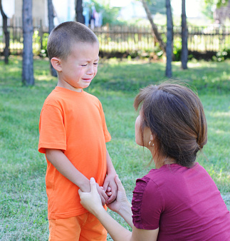
Ignore and Stay Calm
When a child’s behavior is challenging, you can either respond to it or ignore it.
If reaction is necessary, remember that less is usually best.

Slide 19
Keeping It Positive! The Power of Encouragement and Positive Comments
The more positive attention we give to a child following a behavior, the more likely they will engage in the behavior in the future.
This is called reinforcement; you are reinforcing the likelihood a behavior will happen again.
Reinforcer Inventory: What motivates your child to engage in new behaviors or learn new skills?

Slide 20
Safety Net Procedures
Respond in a way that makes sure your child and family are safe.
Block unsafe behaviors
Help your child to calm down, redirect, and re-engage

Slide 21
Apply It and Try It Review
Things to Try at Home:
Logical Consequence: the behavior, the logical consequence you attempted, and what happened next (Handbook Activity 2)

Slide 22
Thank You

