Slide 1
Session 7: Putting It All Together With a Plan

Slide 2


What’s Happening Today?
Apply It and Try It Reflections
Affirmations
Be a Detective
Developing a Plan
Meet Brendan
Making your Own Plan

Slide 3




Apply It and Try It Reflection
How things are going at home
Logical consequences
What strategies have you started using?
How are they working?
How did your child react?
How did it make you feel?

Slide 4
Affirmations
Statements that are encouraging and motivating
Help us feel strong
Help us feel optimistic about change
Make a note!
Reflect on the changes you have made or your efforts with your child.

Slide 5

Challenging Behavior: What We Know
Happens when children lack language or social skills
Happens when children are stressed (tired, hungry, ill, different expectations)
Challenging behavior works

Slide 6





Behavior Can Mean Many Things
“I want you to pay attention to me.”
“I want that (toy, food, paint, etc.).”
“I want to play with you.”
“I don’t want to stop what I am doing.”
“I don’t want to clean up!”

Slide 7
Developing a Plan
Three Essential Parts
Prevent
Use prevention strategies to keep challenging behavior from happening.
Teach
Teach your child new ways to communicate or new skills for participating in routines or expectations.
Responses or Reinforcers
New responses to make sure that your child’s challenging behavior does not work for them.
Reinforcers to strengthen behaviors you want.

Slide 8
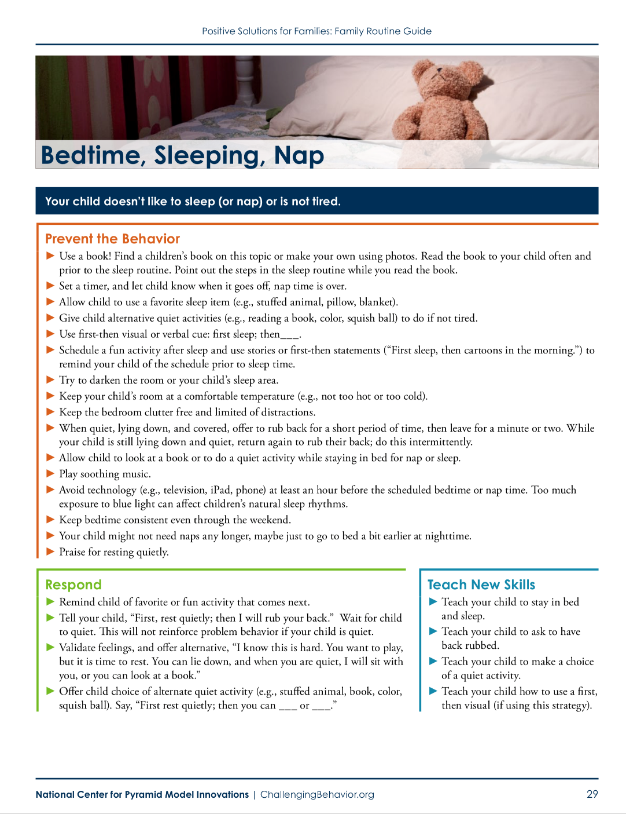
Prevention
Minimize the possibility that your child will have challenging behavior

Slide 9
Teach New Skills
Ask for a turn
Ask for an object
Ask for an activity
Ask for help
Ask for a hug
Ask to leave
Say, “No”
Say, “I don’t want to”
Make a choice
Follow a schedule

Slide 10
Strategies for Teaching New Skills
Prompt or model for your child what you want them to do (e.g., “Say, I want a turn.”)
Practice Makes Perfect! Practice multiple times a day, especially when the child is not having challenging behavior.
Provide praise or reinforcement for your child’s efforts and success.

Slide 11
New Responses: How Do I Respond When Challenging Behavior Occurs?
Say to your child, “You can use your words to tell me ____ or show me ____.”
Then give you child what they want.
Sometimes we can’t let children have what they want.
Validate emotions, restate rule, and follow with a choice.
"You must sit in your car seat, but you can hold your bear or hold your blankie.”

Slide 12
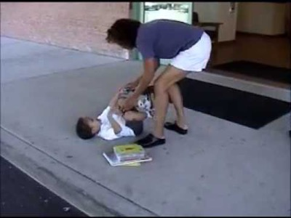
Brendan Before

Slide 13
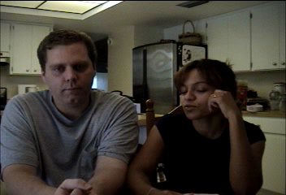
Life Before a Plan

Slide 14
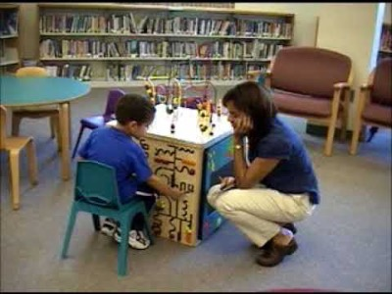
Routine with a Plan

Slide 15
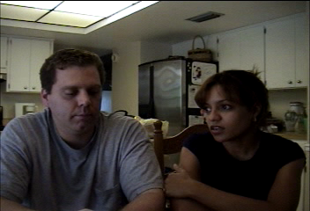
Life with a Plan

Slide 16

You Try It!
Get in Pairs
Identify the routine where your child has challenging behavior
Identify the function of the behavior (strategies need to match the function)
Select strategies (a few from each category):
Prevention
Teaching
Responding
Activity

Slide 17

Positive Solutions for Families- You Did It!

Slide 18
Thank You

