Slide 1
I Can Get Calm
A Toddler Tale
From CA CSEFEL
Created by WestEd Teaching Pyramid – www.CAinclusion.org/teachingpyramid

Slide 2
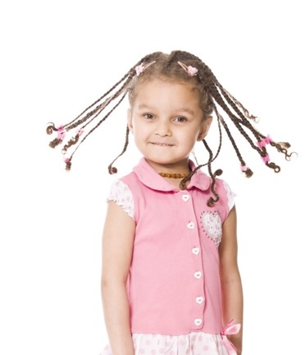
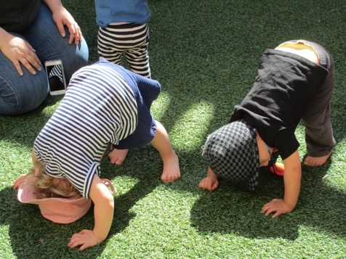
I can do many things
I can bend, I can spin

Slide 3
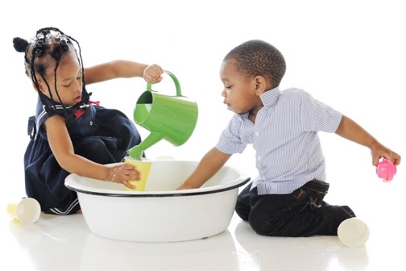
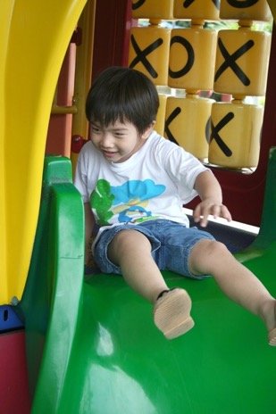
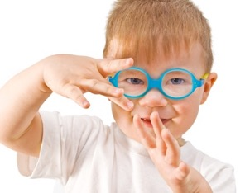
Sometimes I am wild and busy!

Slide 4
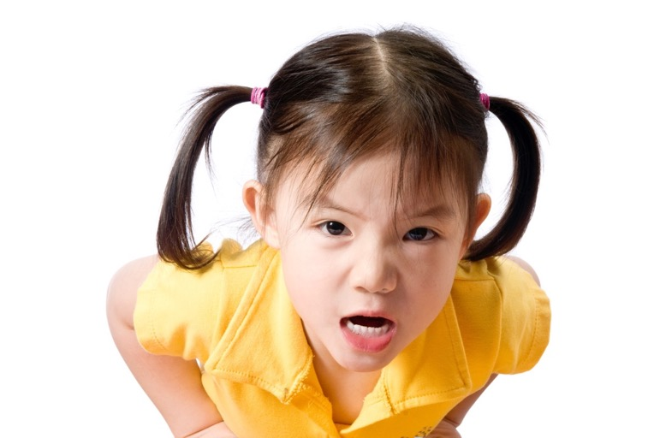
Sometimes I am mad…
Sometimes I need to get calm.

Slide 5
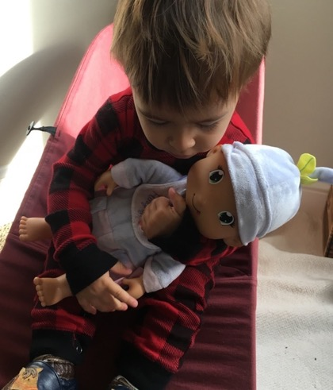
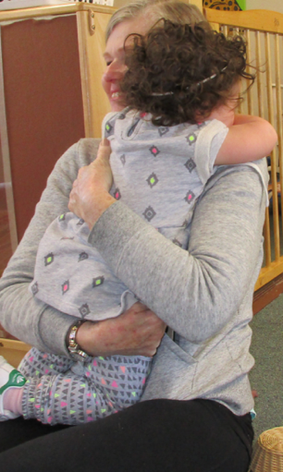
I Can Hug a Soft Toy or Teacher

Slide 6
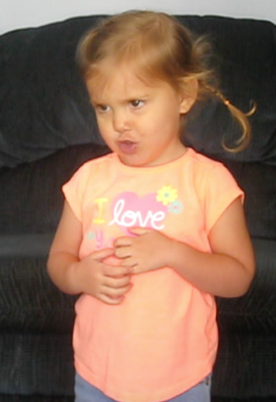
I Can Take Big Belly Breaths

Slide 7
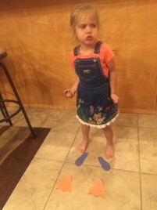
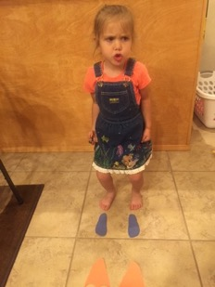
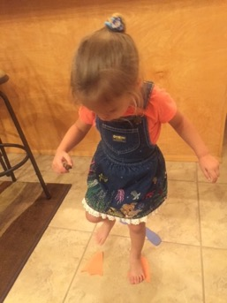
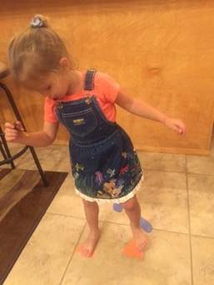
I Can Stomp My Feet Hard
And Then Softer and Softer

Slide 8
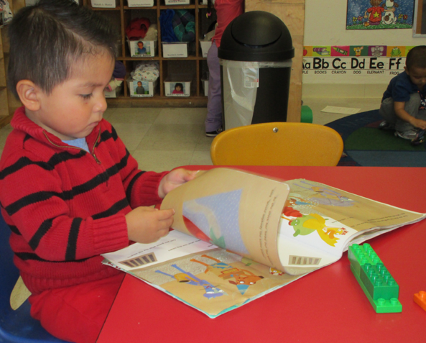
I Can Look at a Book

Slide 9
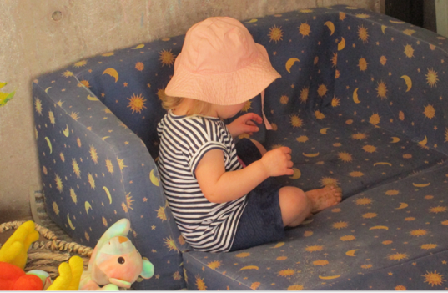
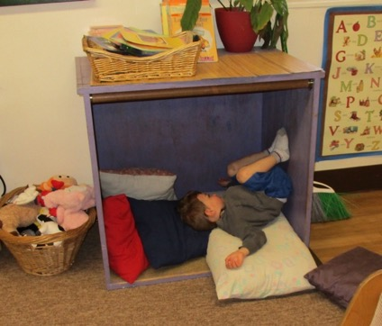
I Can Go to the Cozy Corner

Slide 10
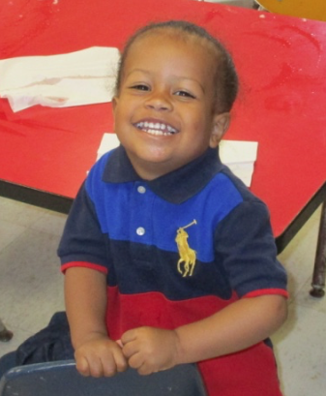
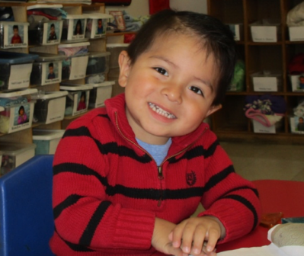
When I Feel Calm
I am Ready to Play!

Slide 11
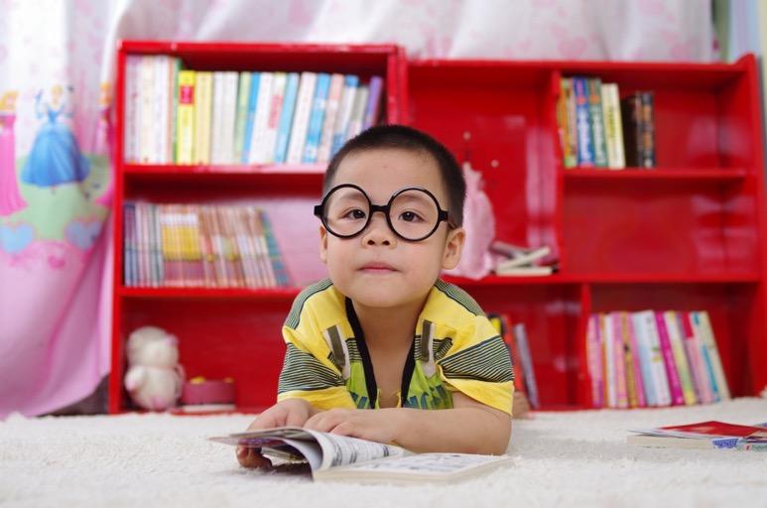
How Do You Like To Get Calm?
Created by WestEd Teaching Pyramid – www.CAinclusion.org/teachingpyramid

Slide 12
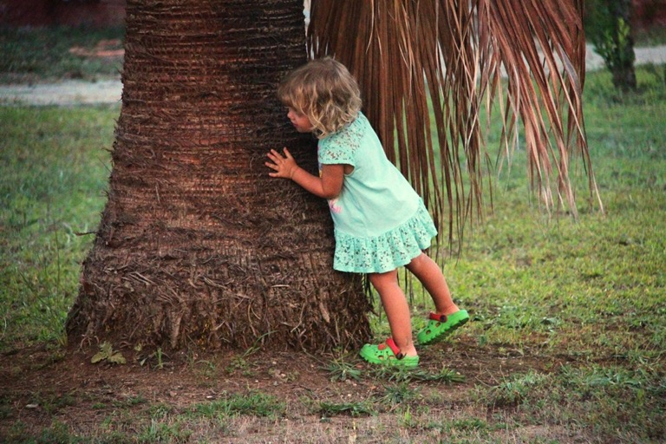
The End

