Slide 1
I Can Feel Different Feelings

Slide 2
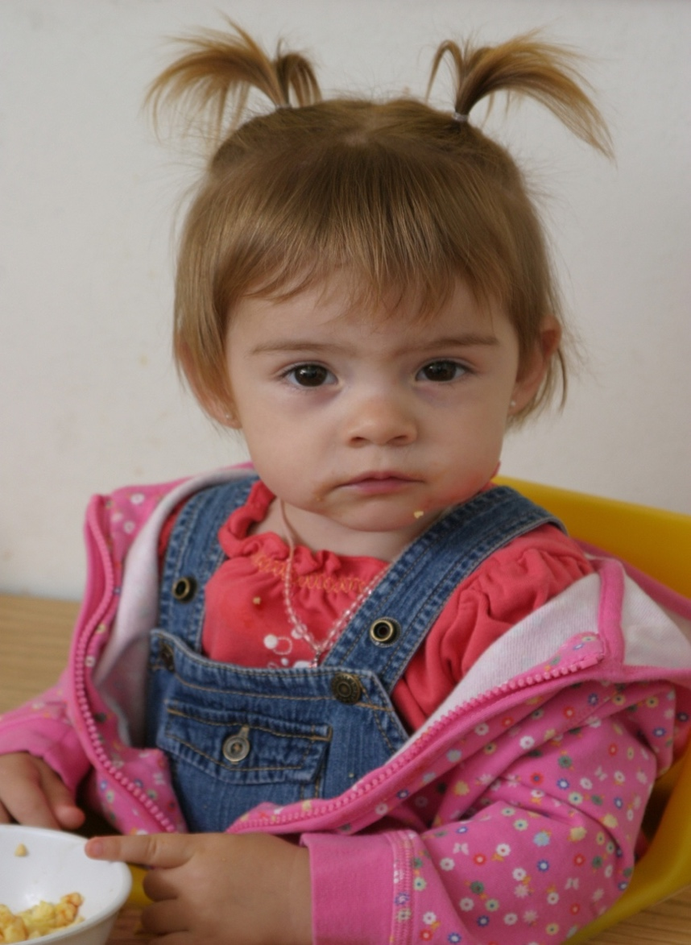
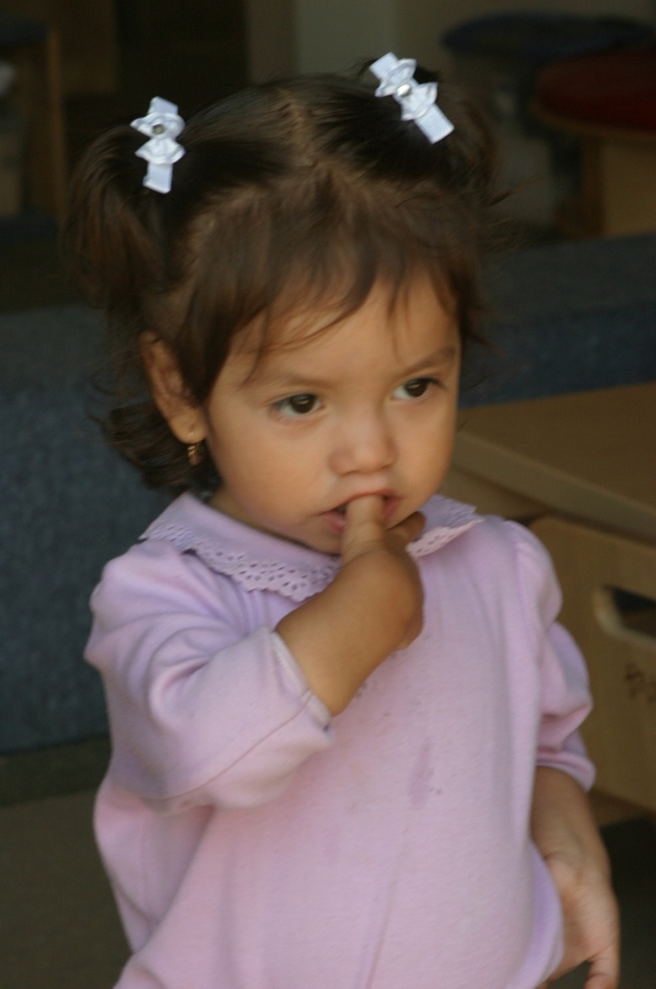
Sometimes I feel sleepy.

Slide 3
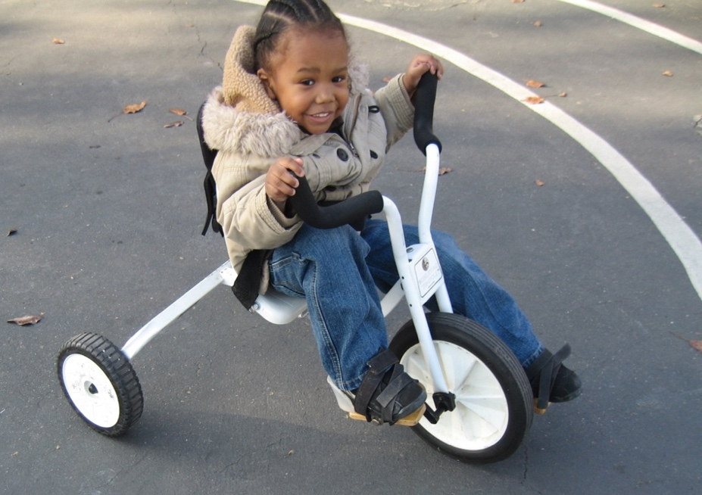
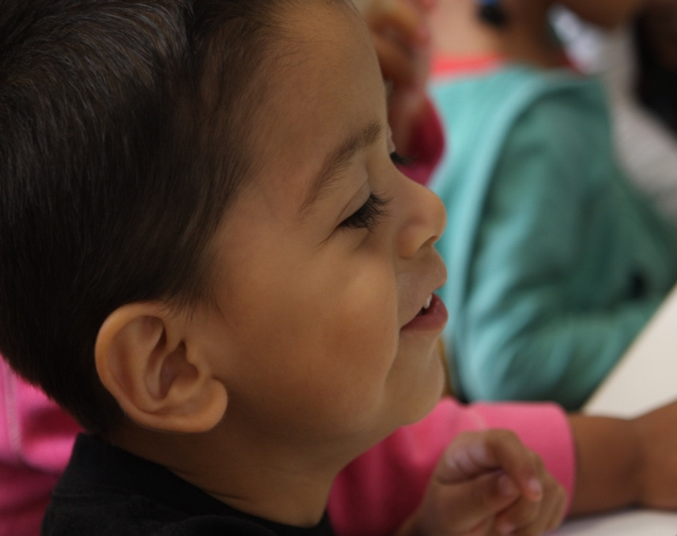
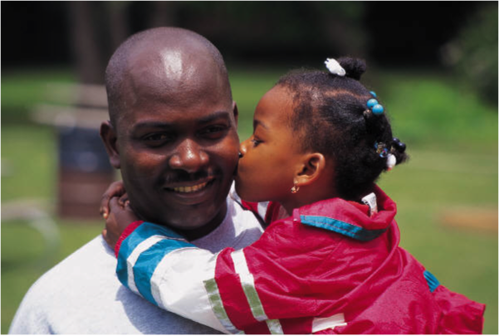
Sometimes I feel happy.

Slide 4
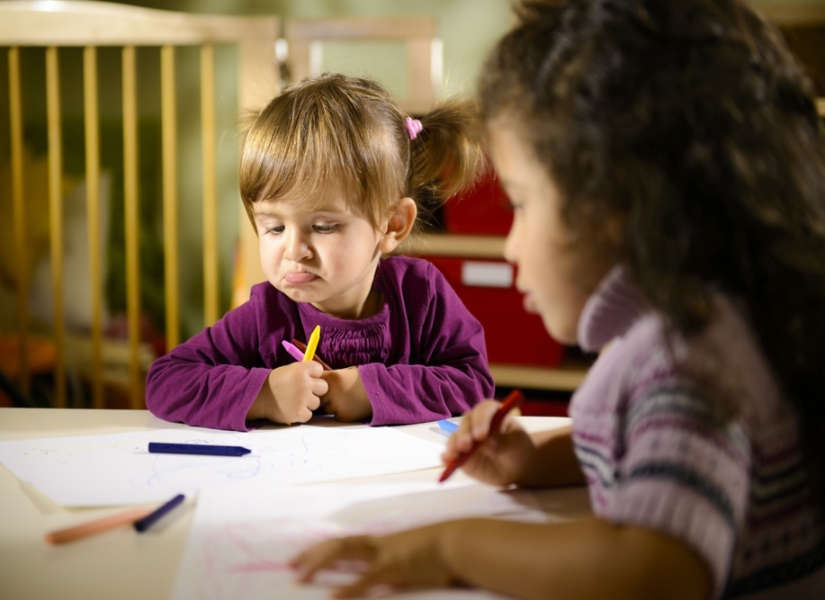
Sometimes I feel mad or angry.

Slide 5
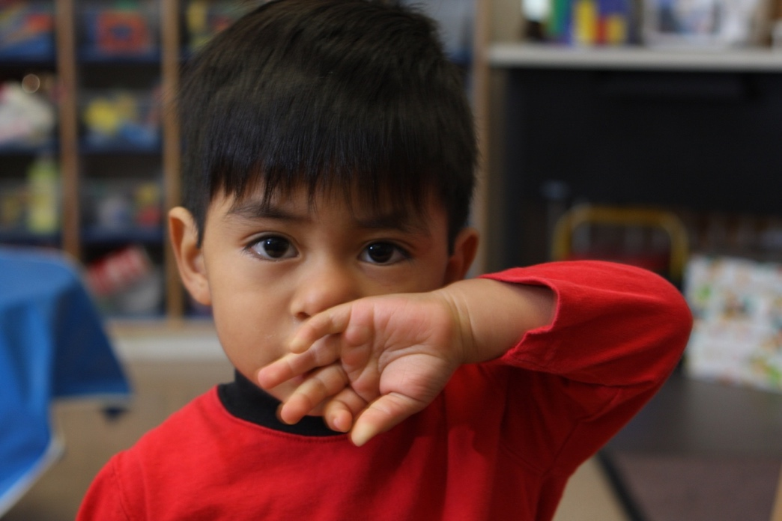
Sometimes I feel sad.

Slide 6
Sometimes I feel excited! Hooray!

Slide 7
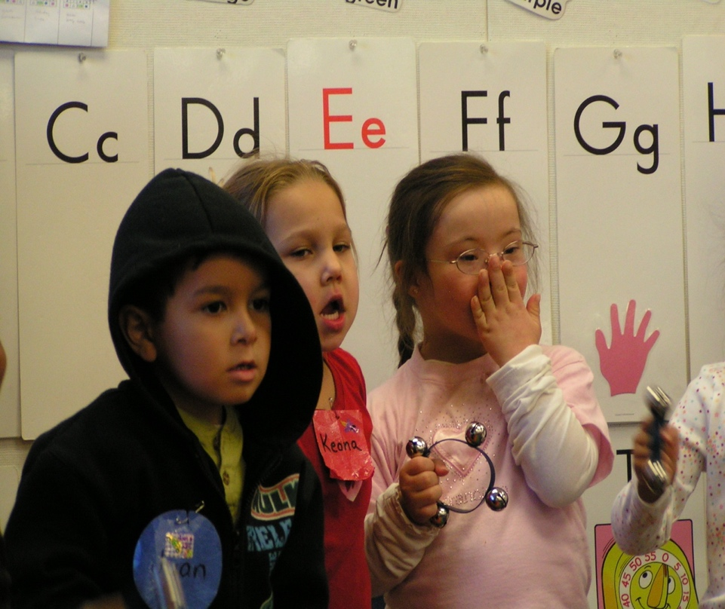
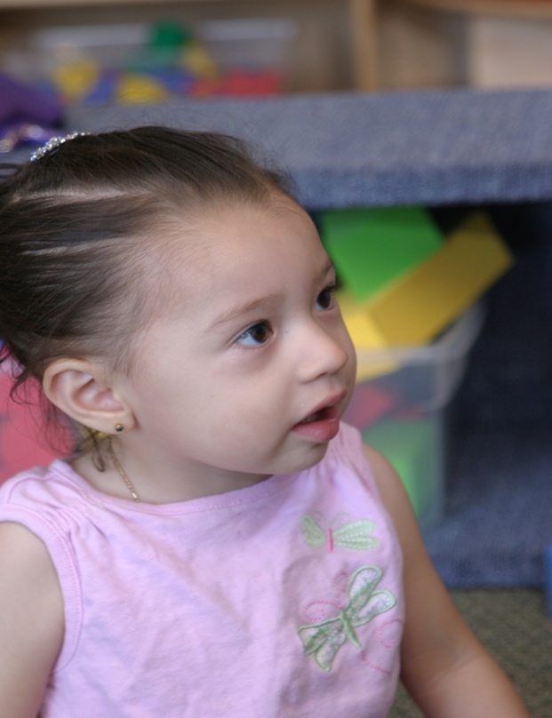
Sometimes I feel surprised.

Slide 8
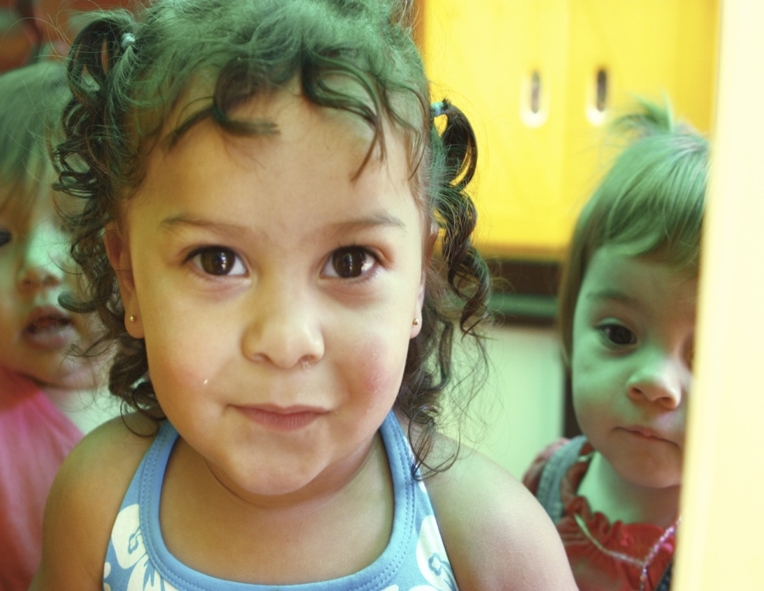
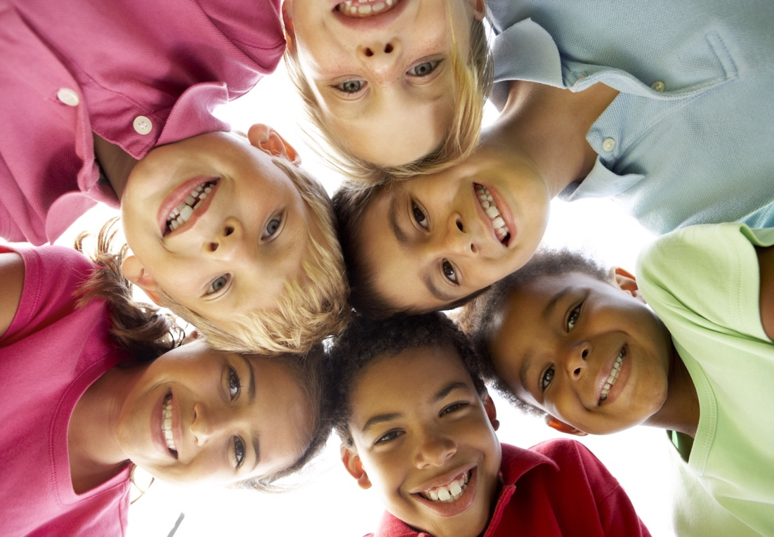
There are many feelings I can feel. How do I feel now?
Created by WestEd Teaching Pyramid – www.CAinclusion.org/teachingpyramid

