Slide 1
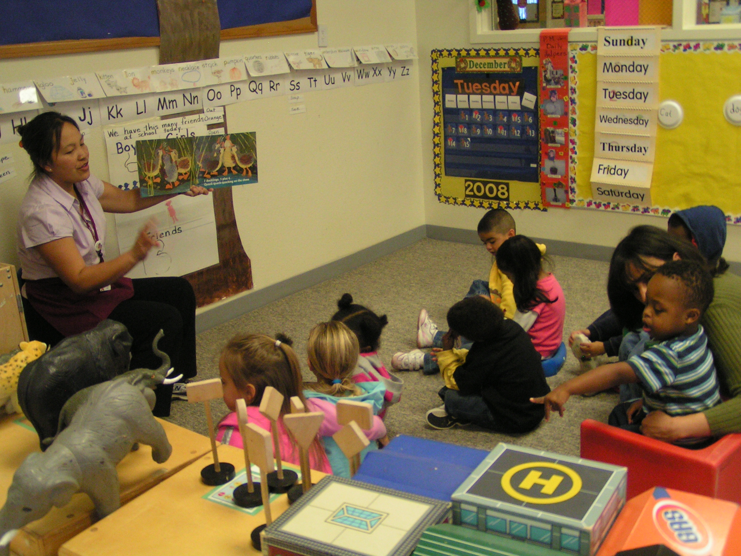
What Do We Do In Circle?

Slide 2
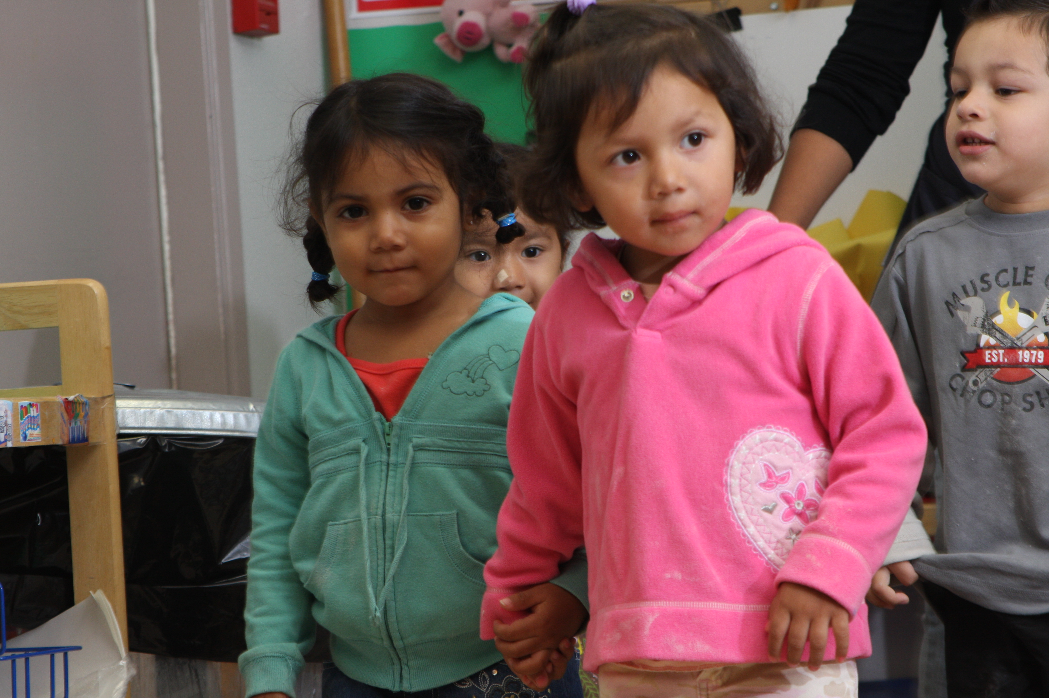
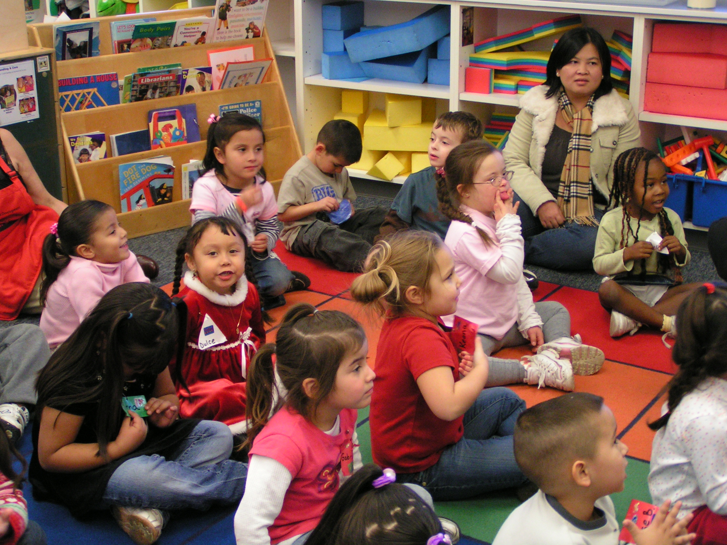
Everyone can go to circle and sit on their seat.

Slide 3
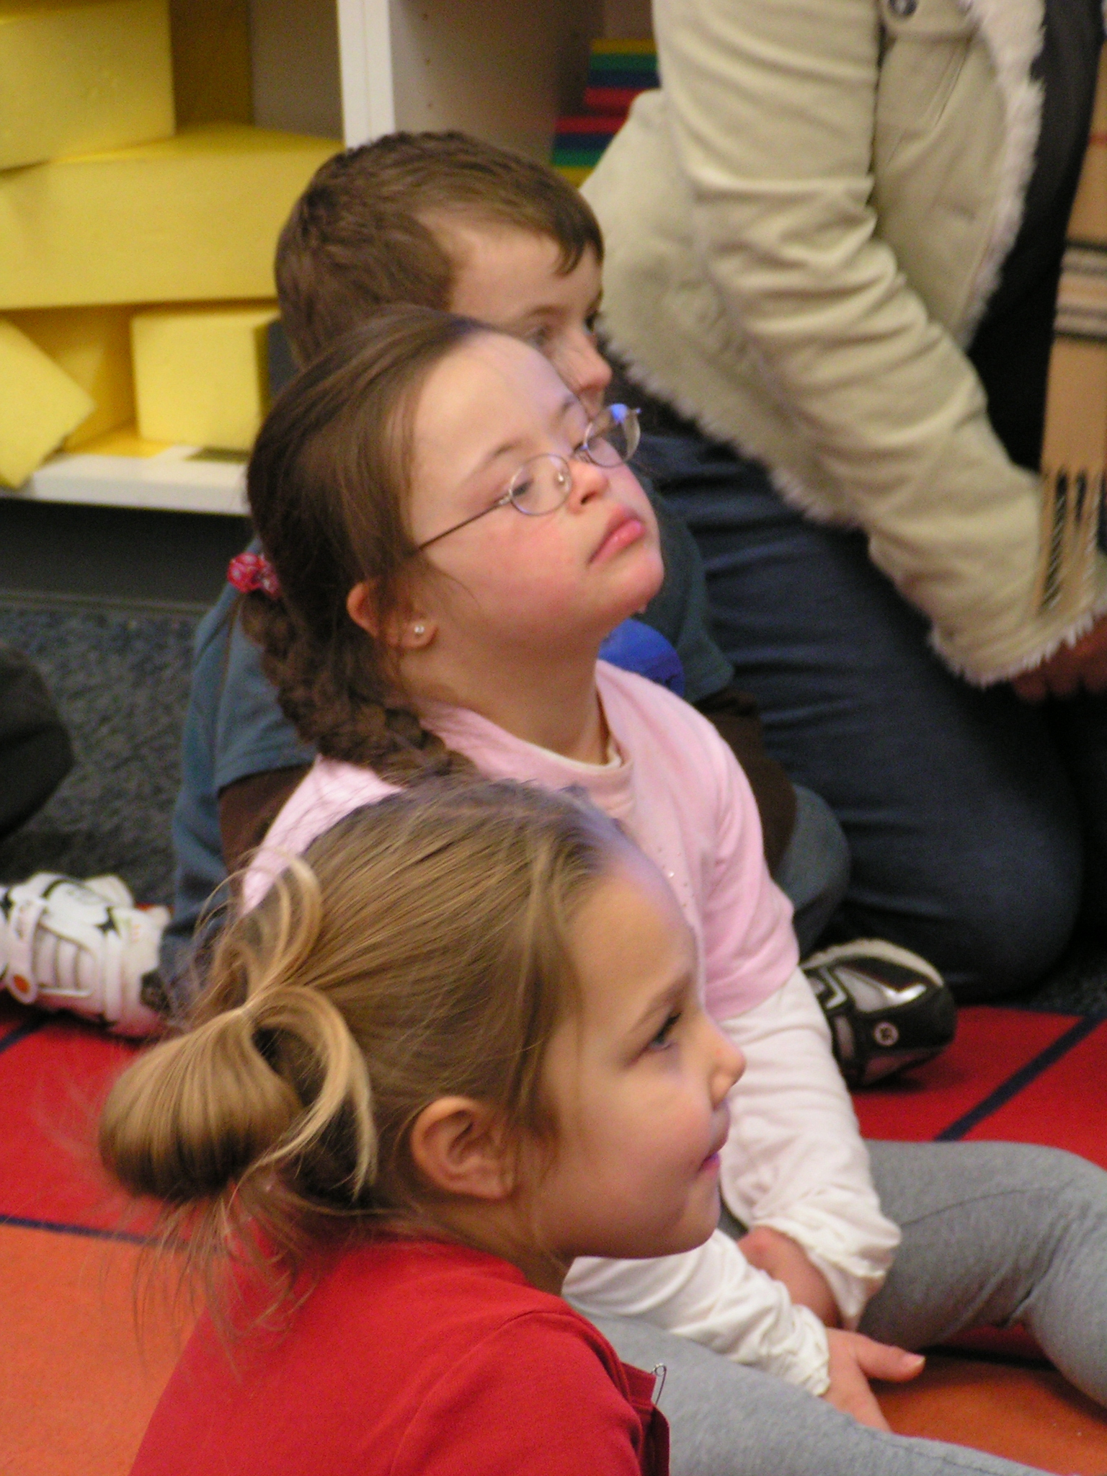
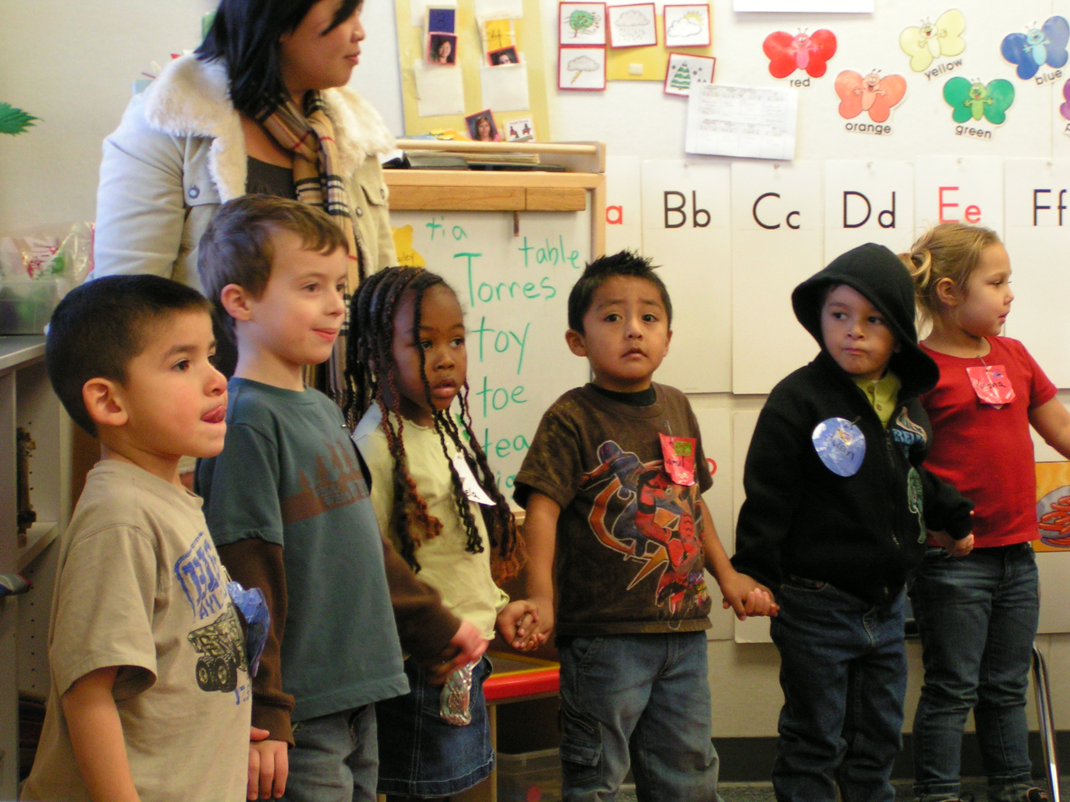
I can sit and look at the teacher.
I can also listen with my ears to
what the teacher says.

Slide 4
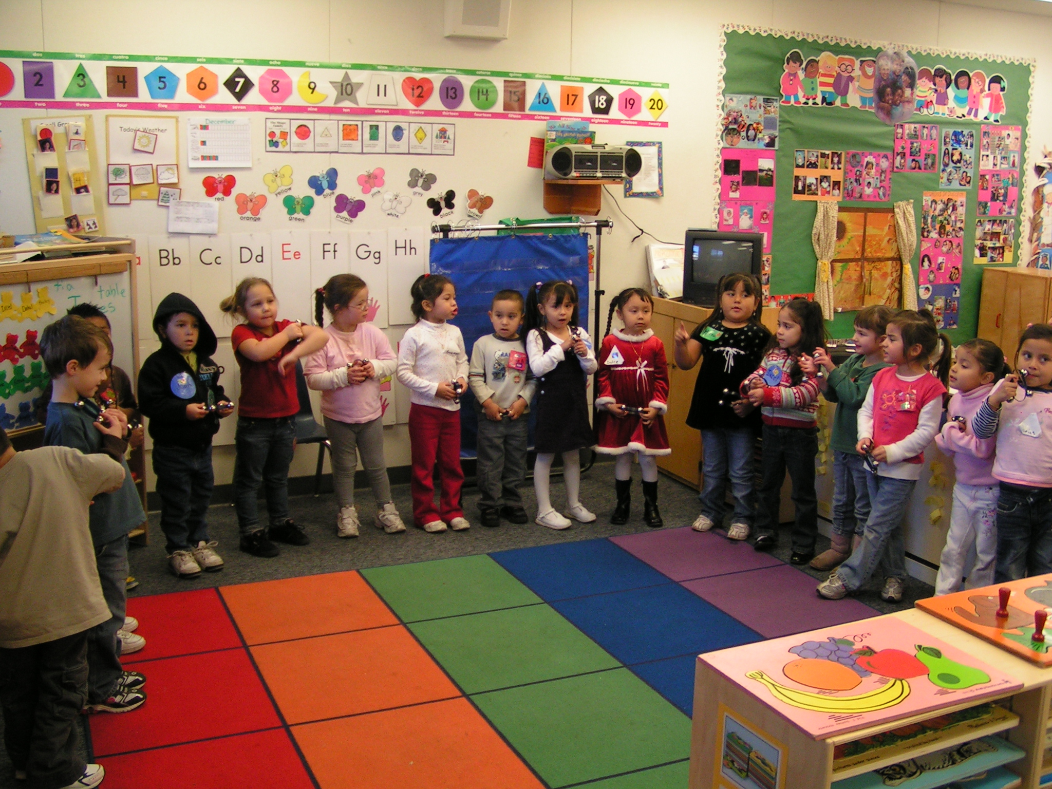
When we are in circle, I can keep my hands to myself.

Slide 5
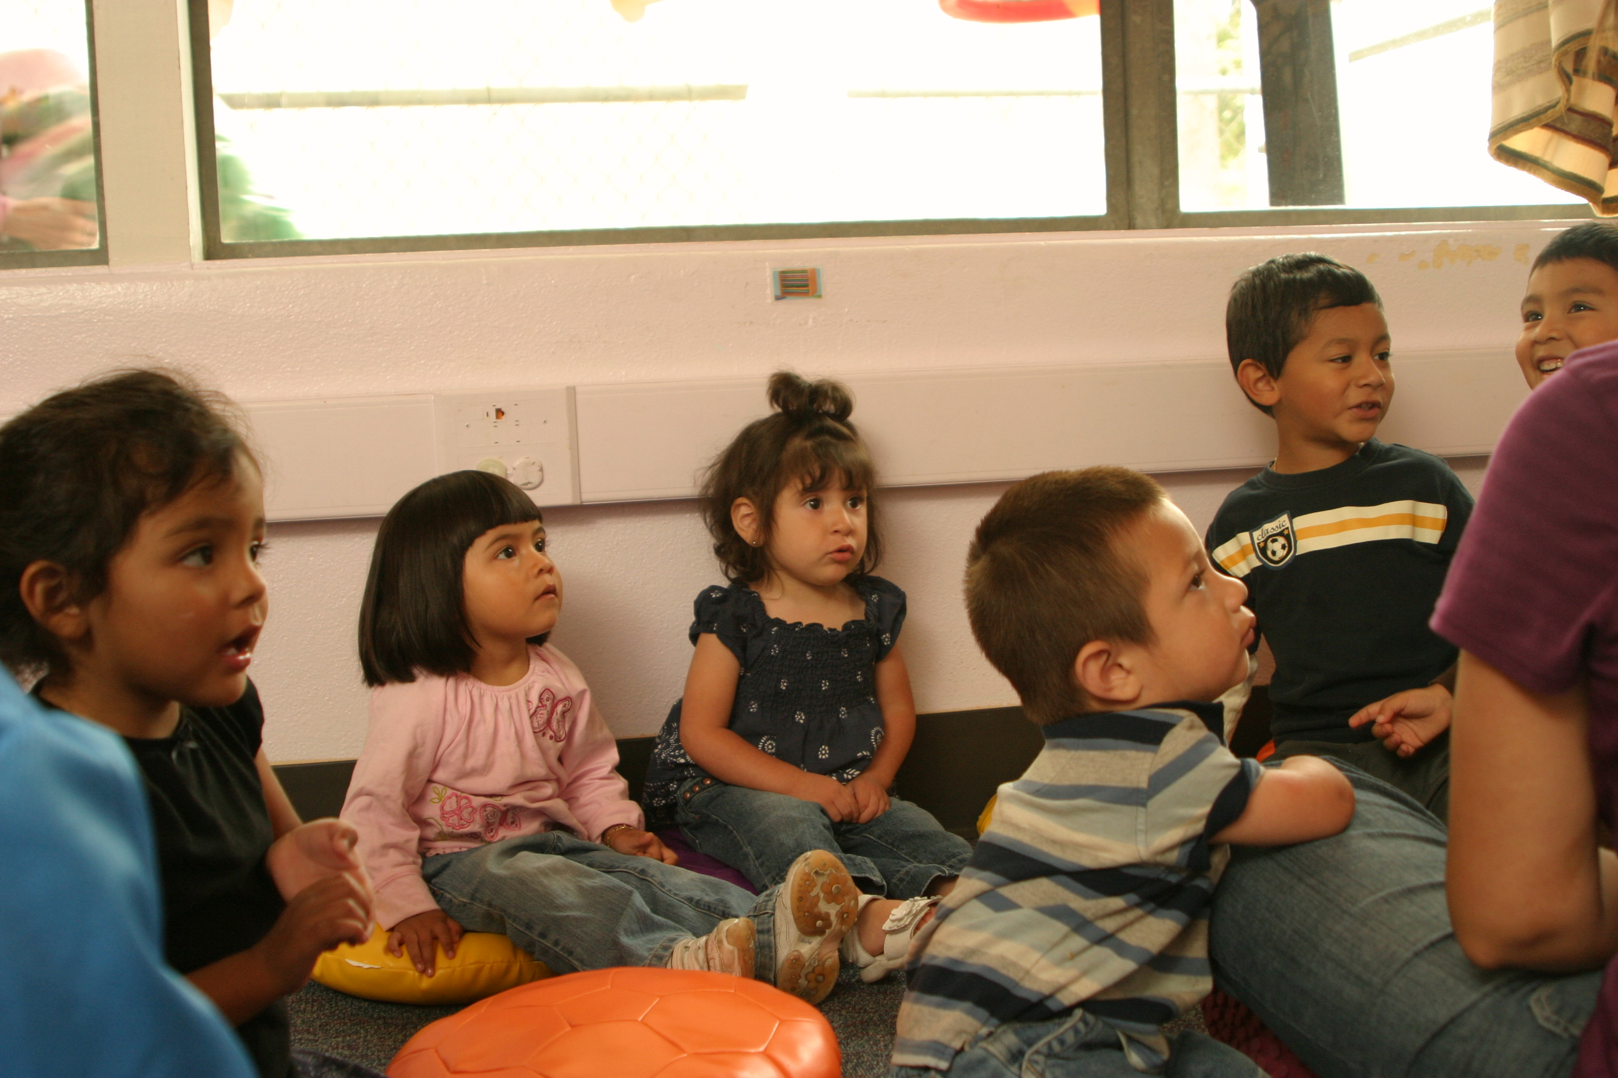
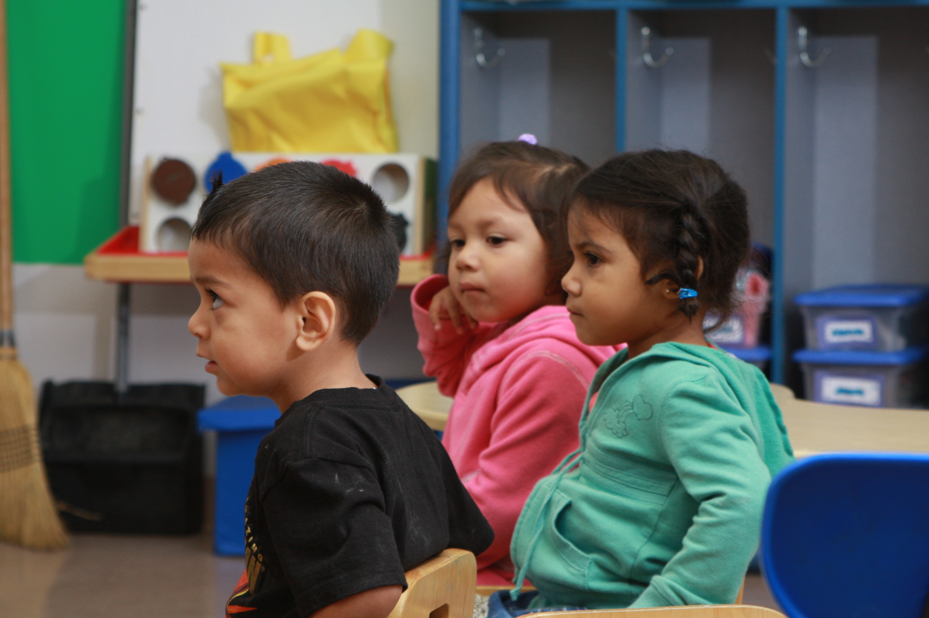
When the class listens, I can listen.

Slide 6
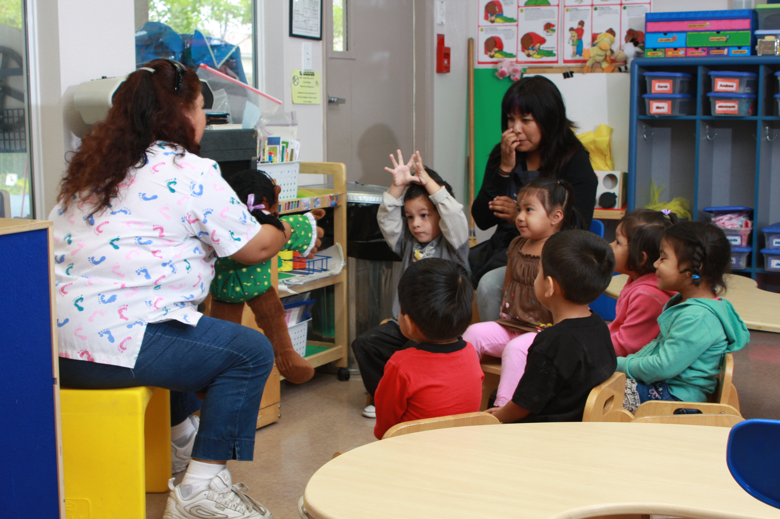
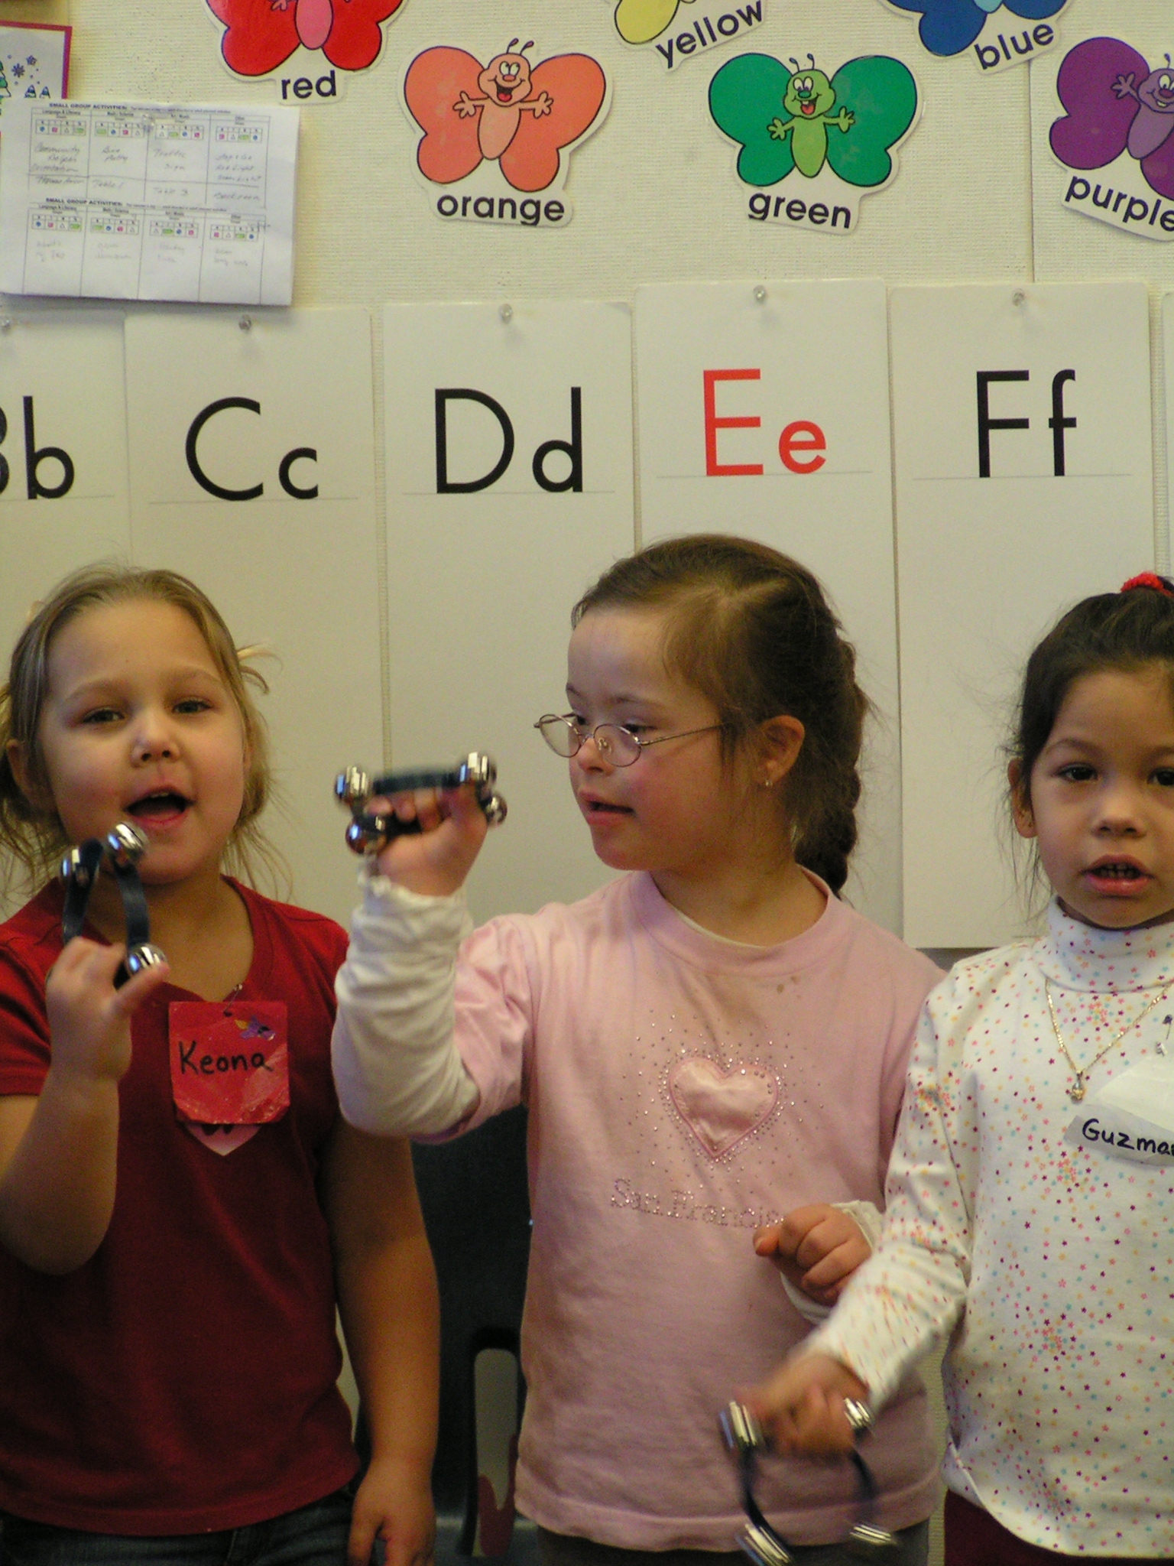
When the class sings, I can sing.

Slide 7
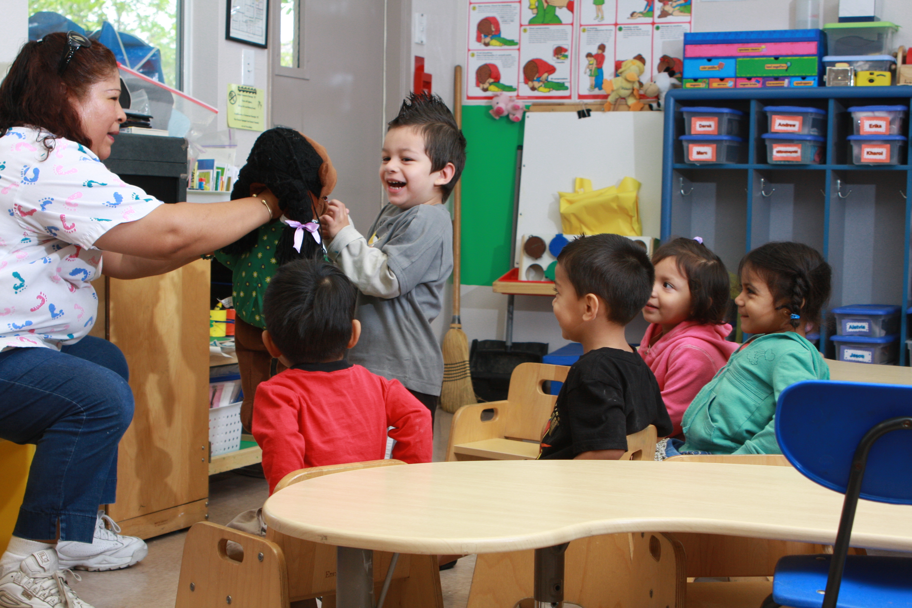
When the teacher shares new things I can learn

Slide 8
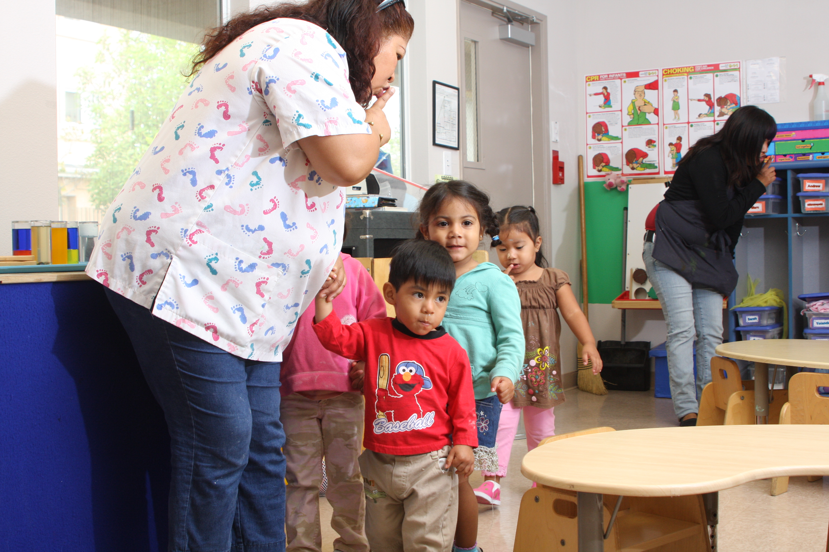
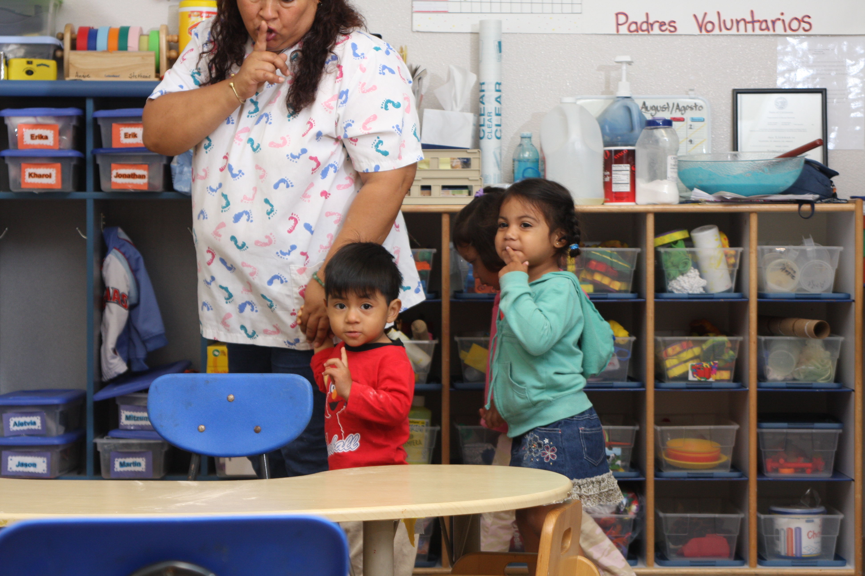
When the teacher wants us to be quiet, I can be quiet

Slide 9
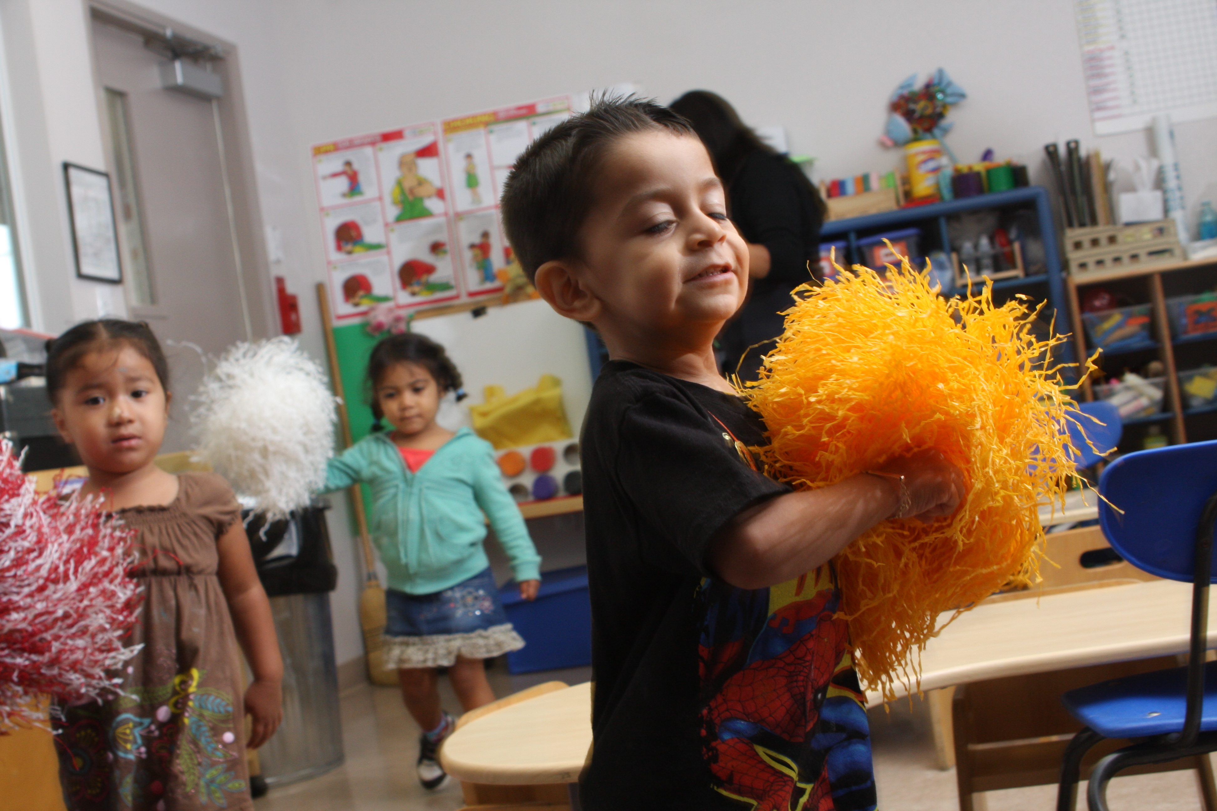
When the teachers says we can dance, I can dance

Slide 10
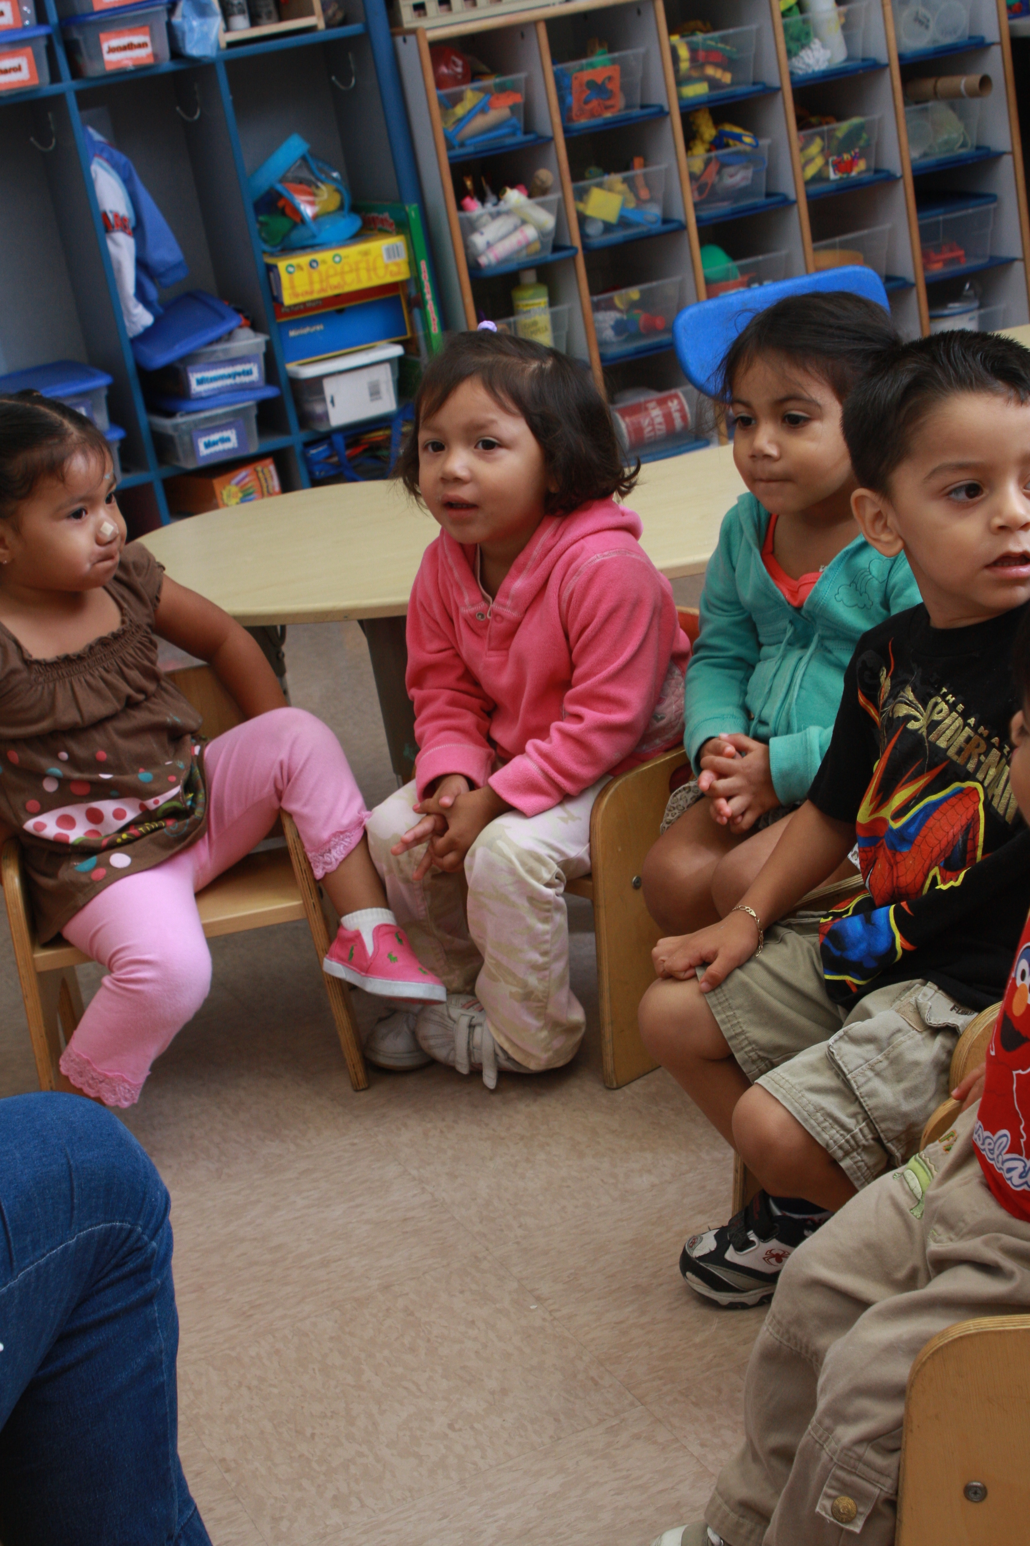
The Circle Rules are:
I sit on my seat.
I look at the teacher.
I listen.
I have quiet hands.

Slide 11
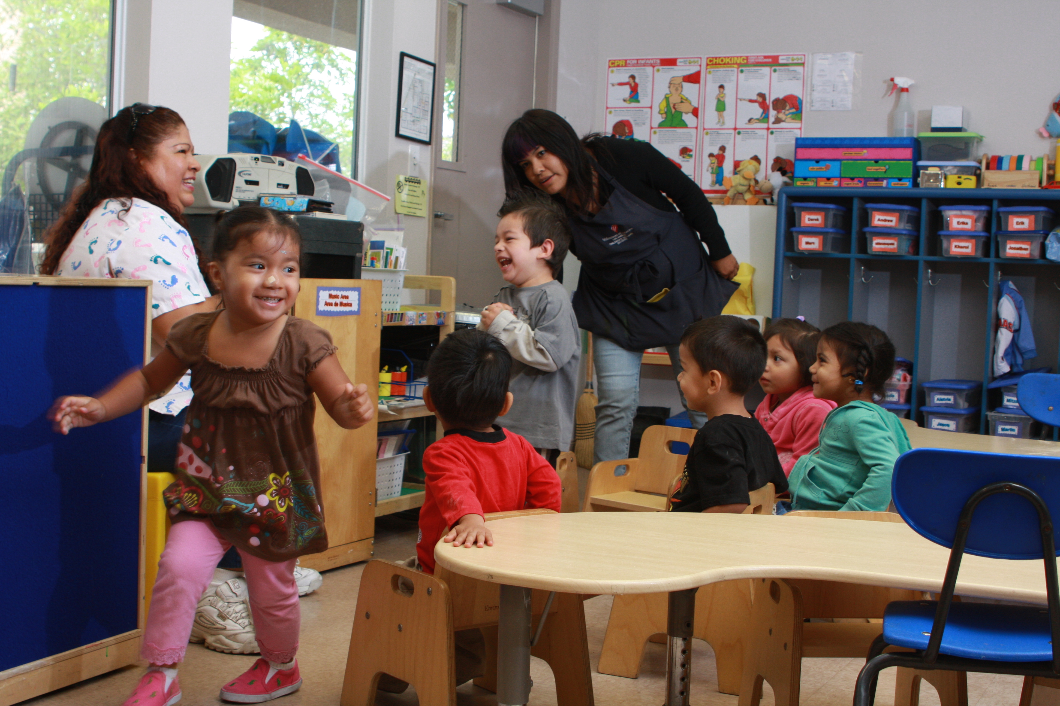
Circle is fun when we all try to follow the rules.

Slide 12
Cut out “sit picture”, laminate, place rough Velcro on back side, and Velcro to carpet in front of child’s seat in circle. This will act as a visual cue to the child.
OR
Sit.
Sit.

