Slide 1
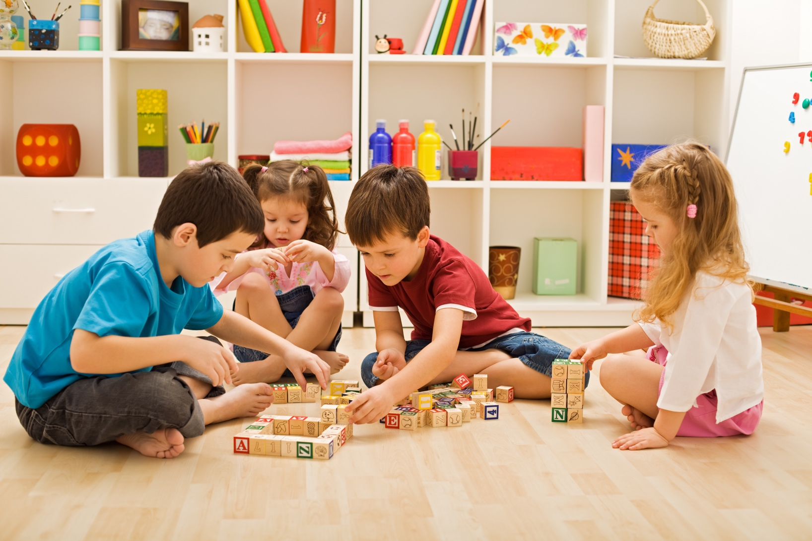
When I Need Space

Slide 2
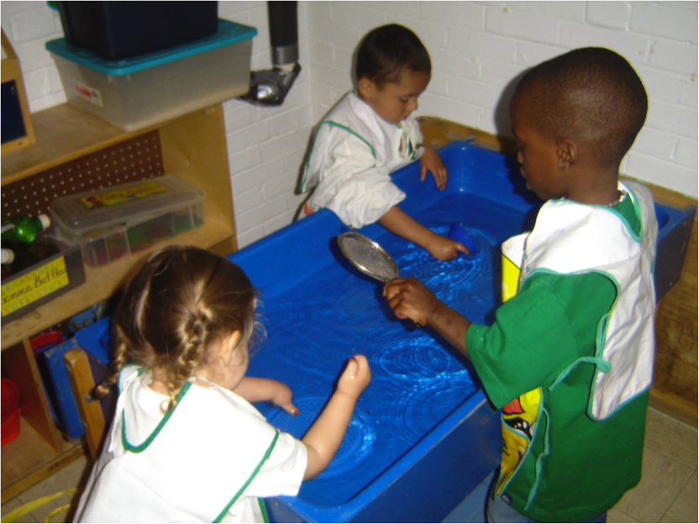
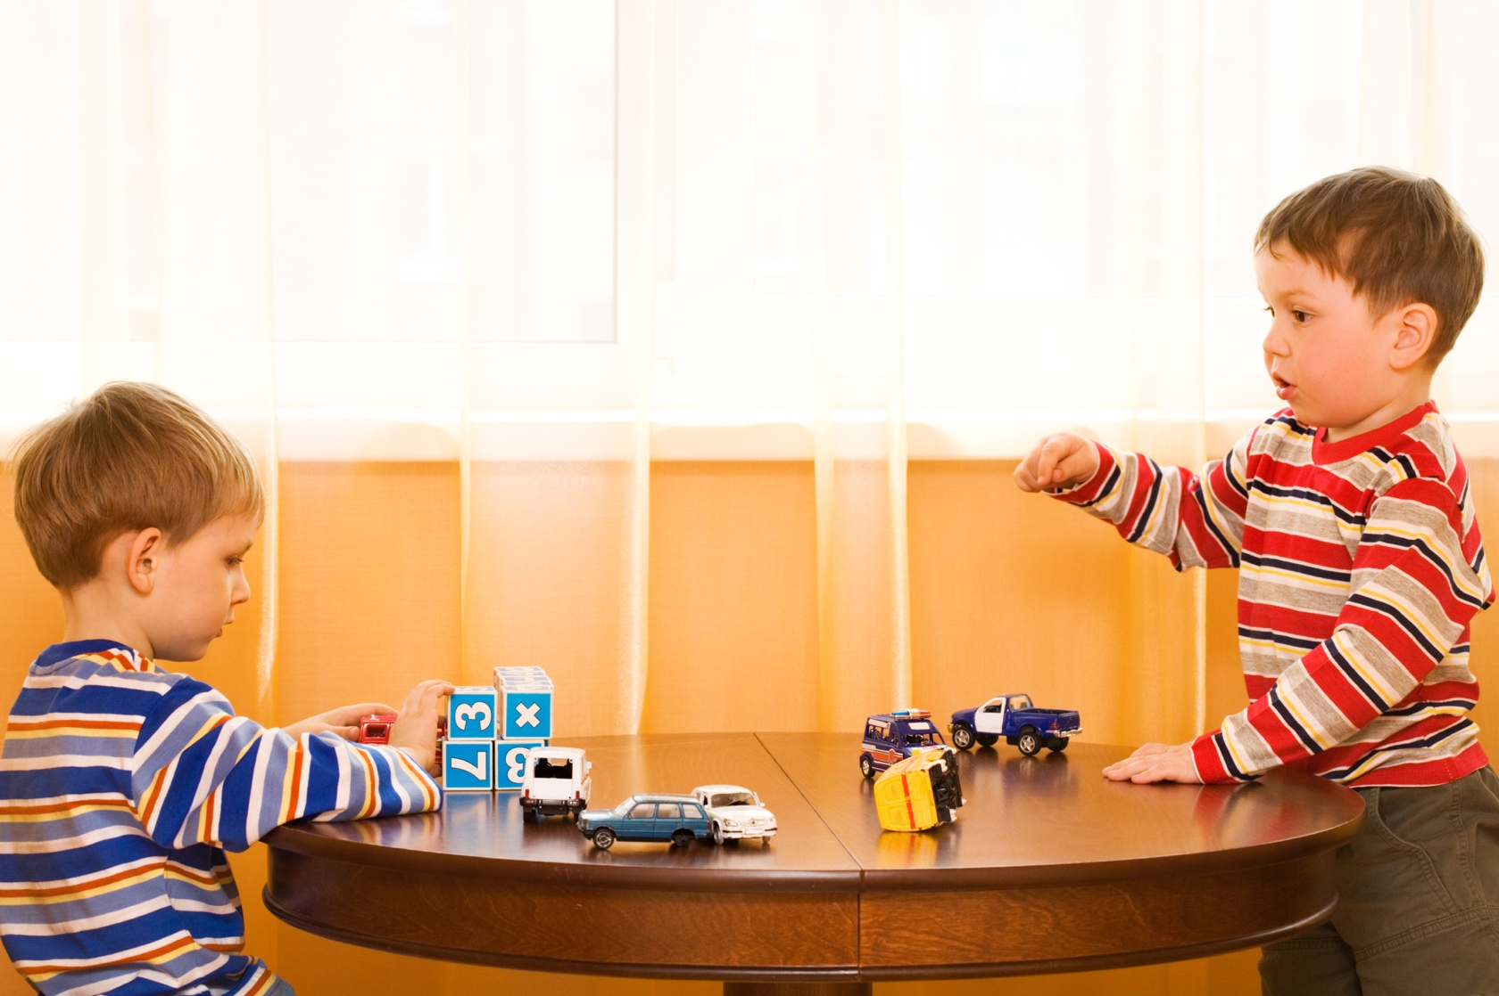
I like to play at school.

Slide 3
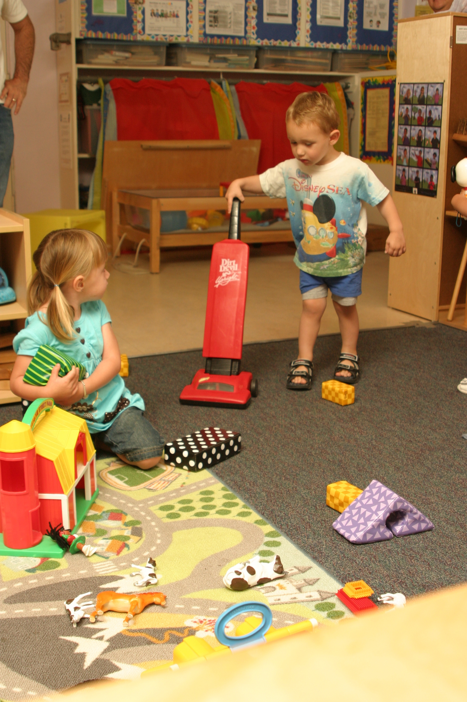
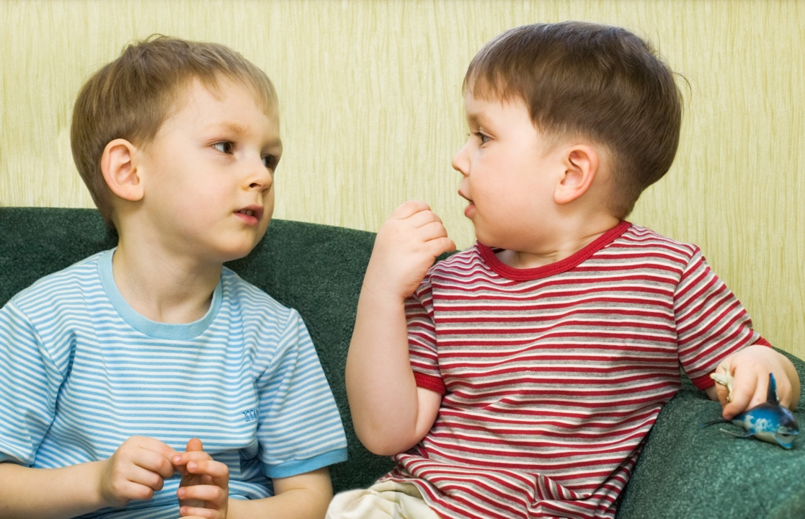
Sometimes I have a hard time.

Slide 4
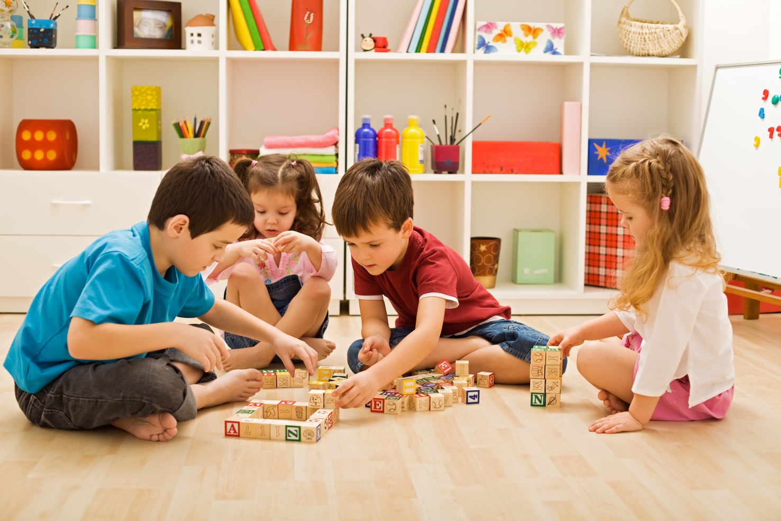
Someone may get too close to what I am working on.

Slide 5



This might make me feel angry, really angry.

Slide 6

Feeling angry is OK, however these are things I can do to get calm.

Slide 7
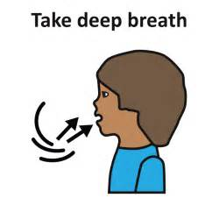
Take some deep belly breaths.

Slide 8
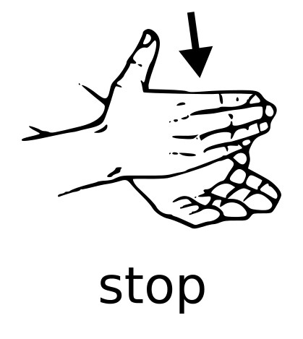

Use my words or signs to say what I need, like “Stop”.

Slide 9
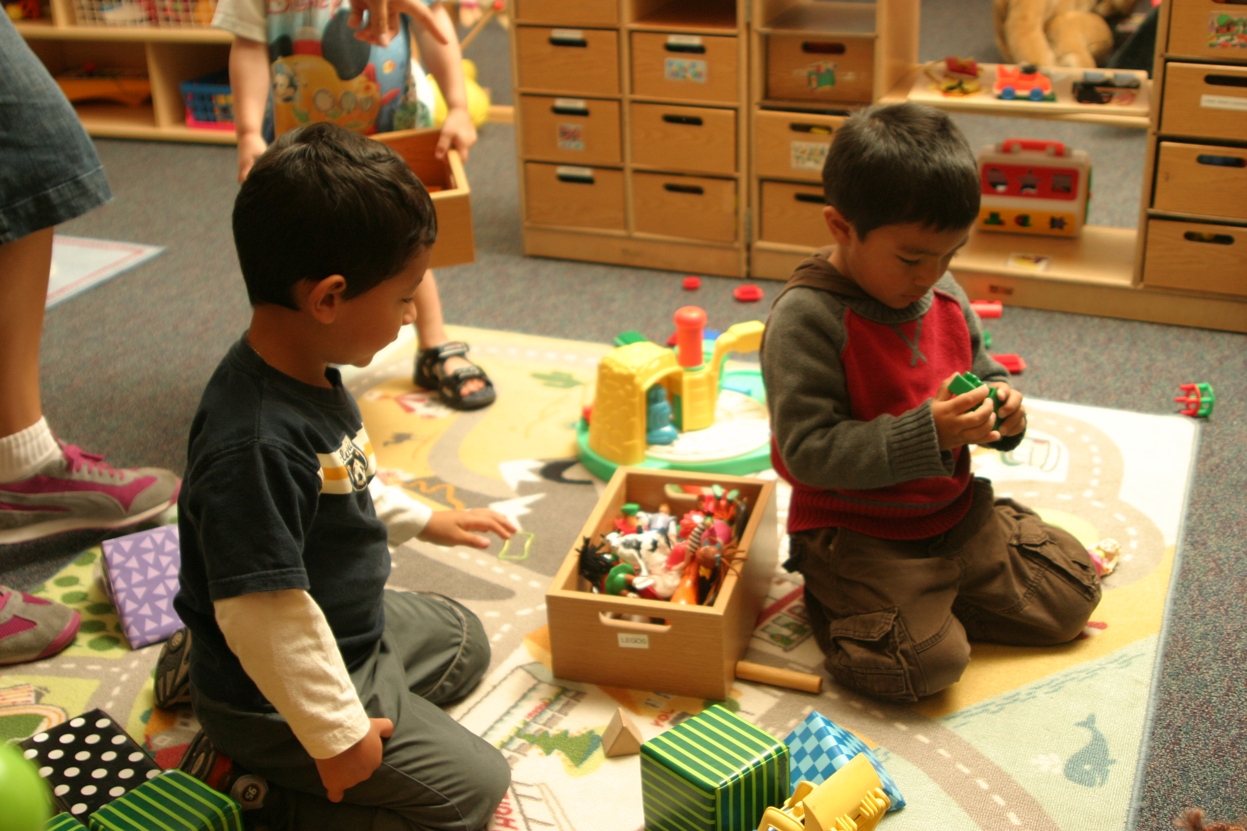
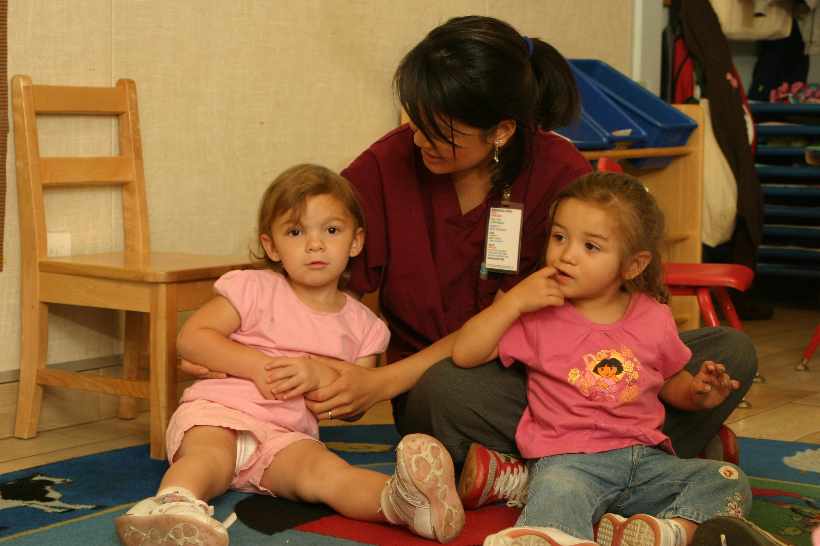
I can tell my friends, “I need space” please.

Slide 10
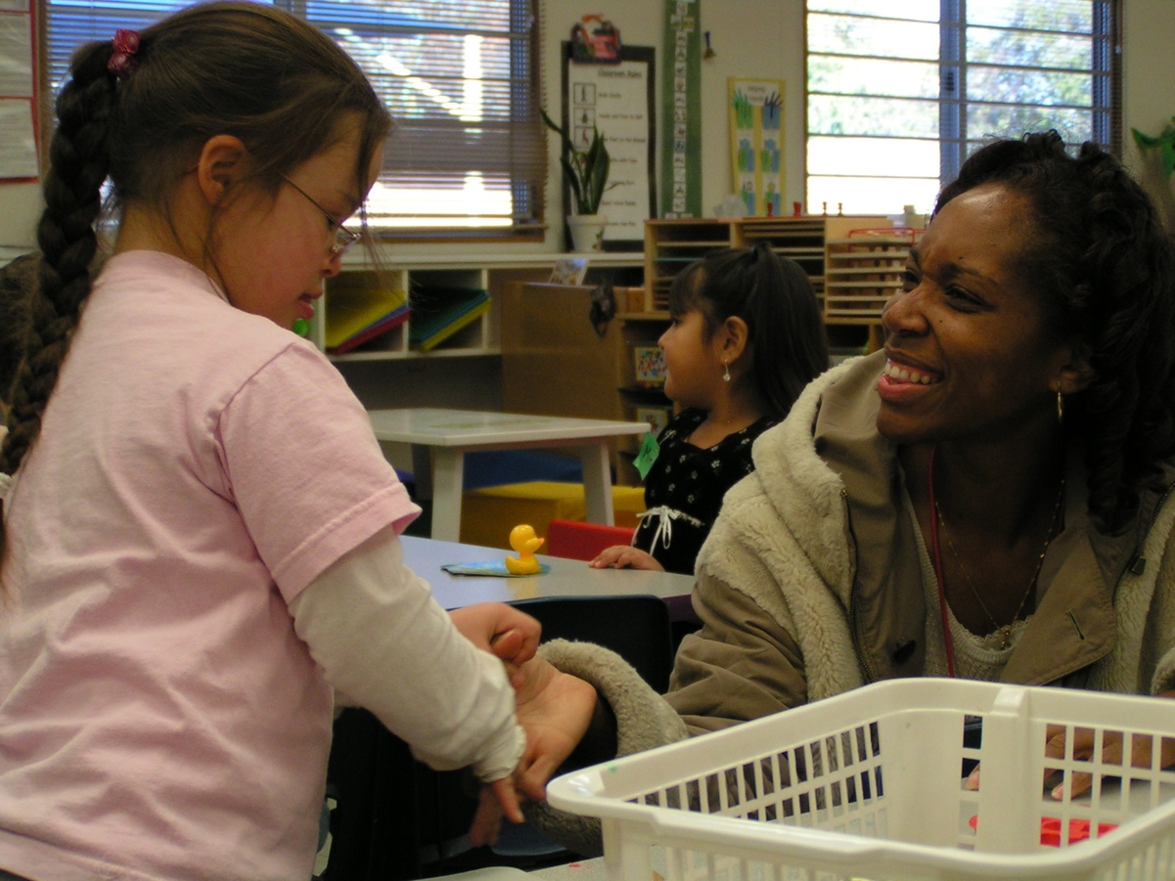

I can ask the teacher for “help”.

Slide 11


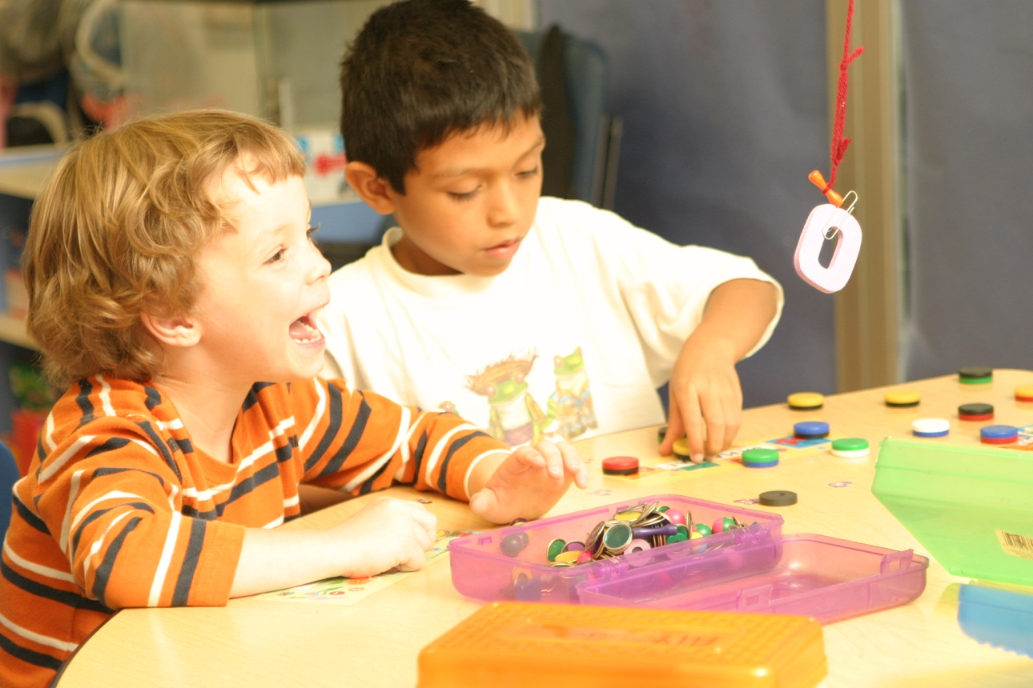
It feels good to know how to get space when I need it.
Created by WestEd Teaching Pyramid – www.CAinclusion.org/teachingpyramid

