Slide 1
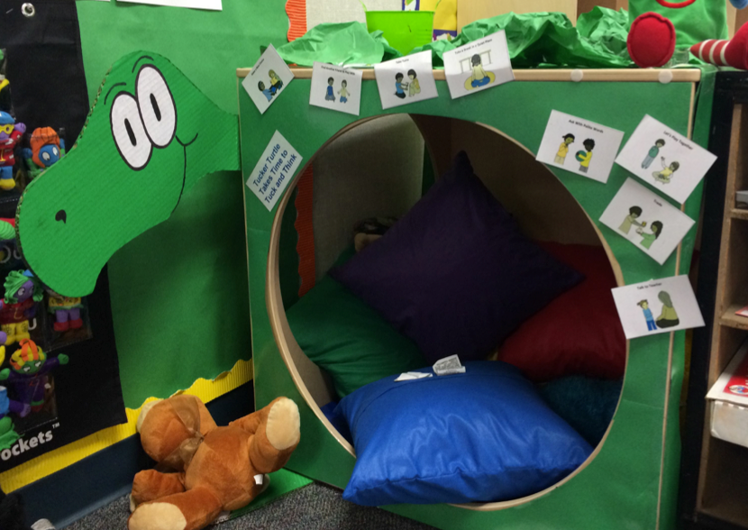
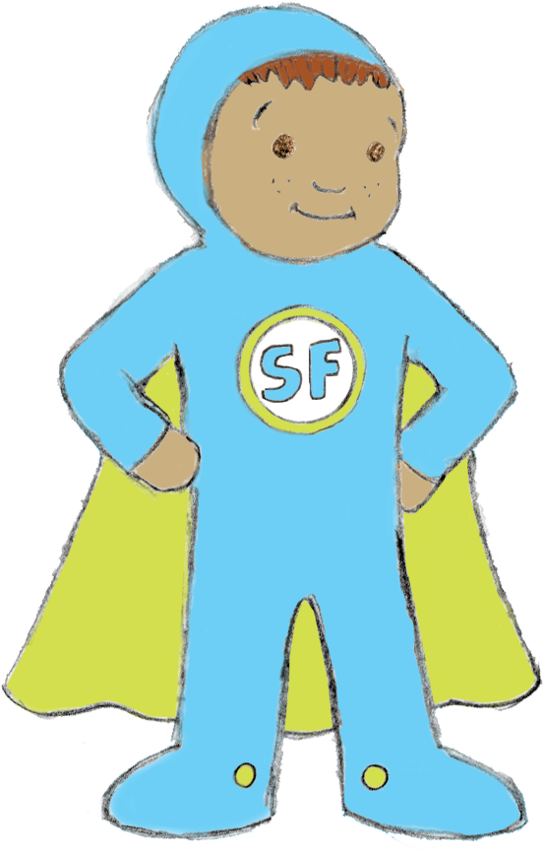
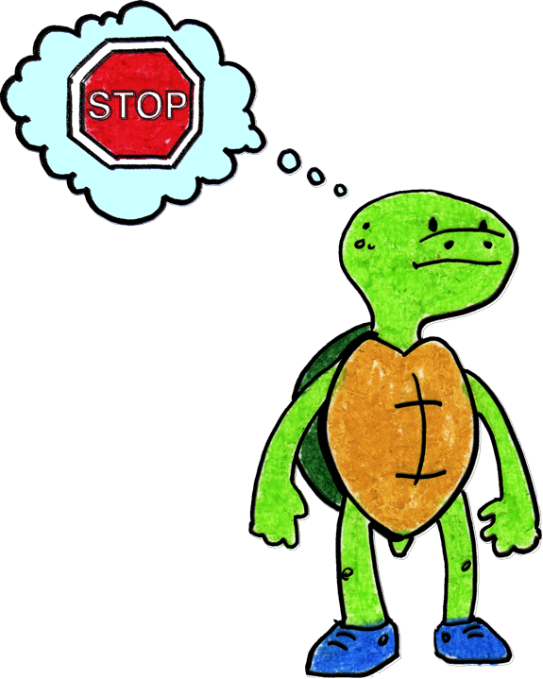
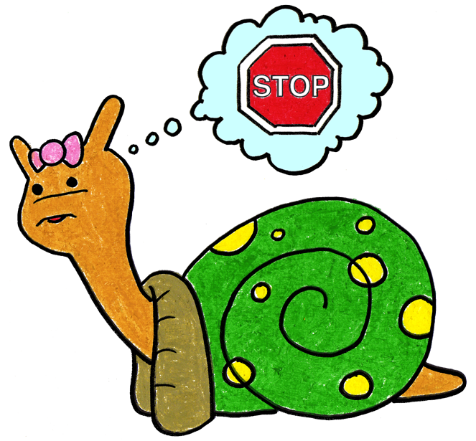
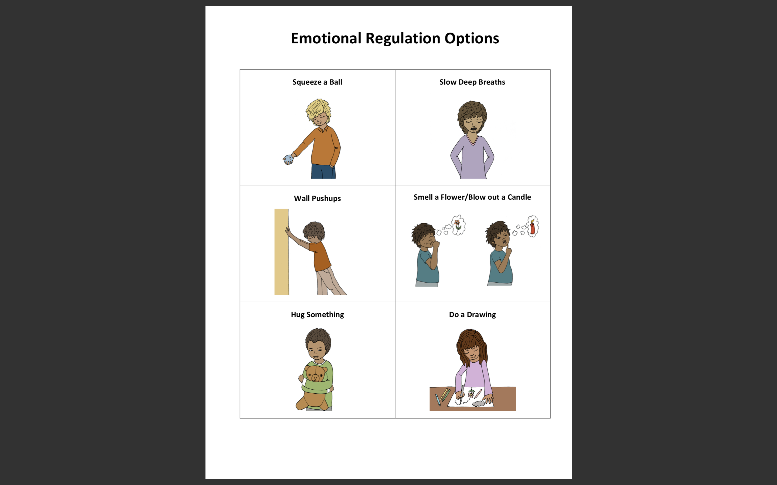
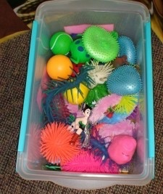
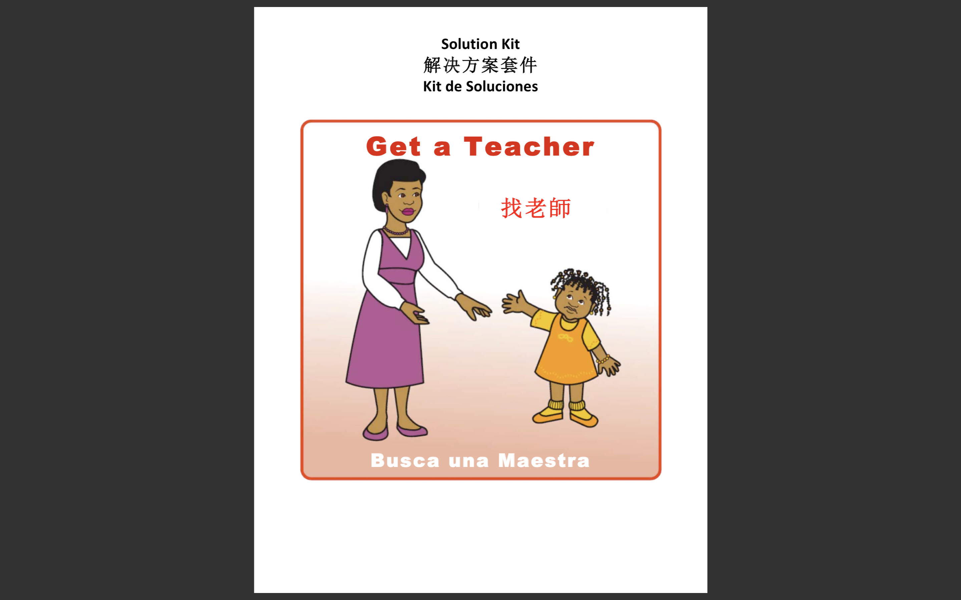
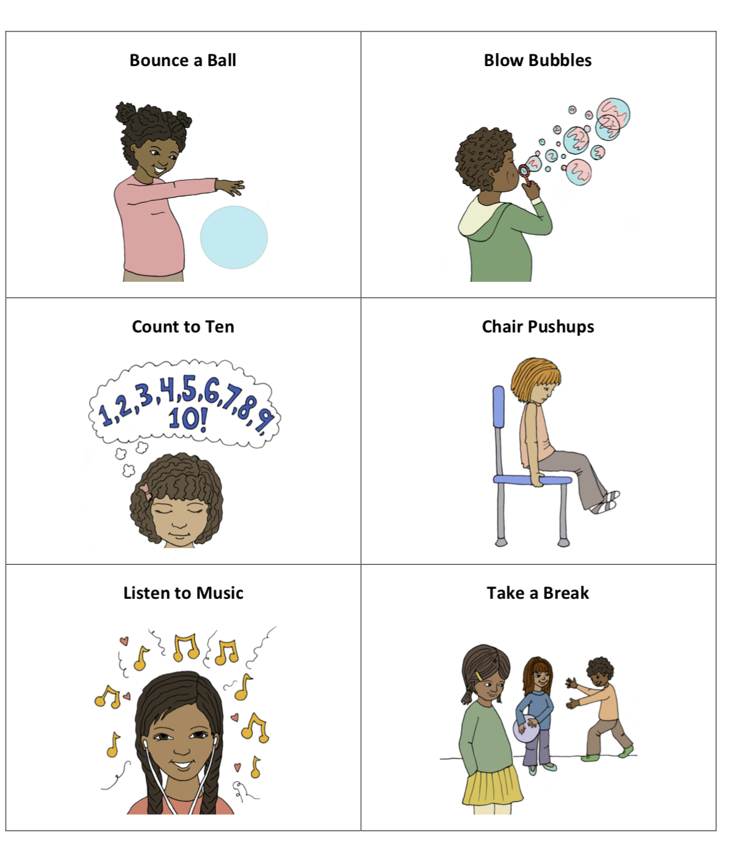
When I am at school and I need help to calm down, what can I do?

Slide 2
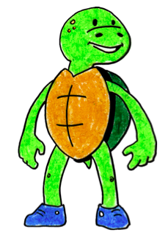
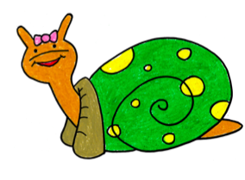
There are many safe ways I can help myself to calm down.

Slide 3
I can take 3 deep breaths like Tucker the Turtle and Sonia Snail and think calm thoughts.

Slide 4
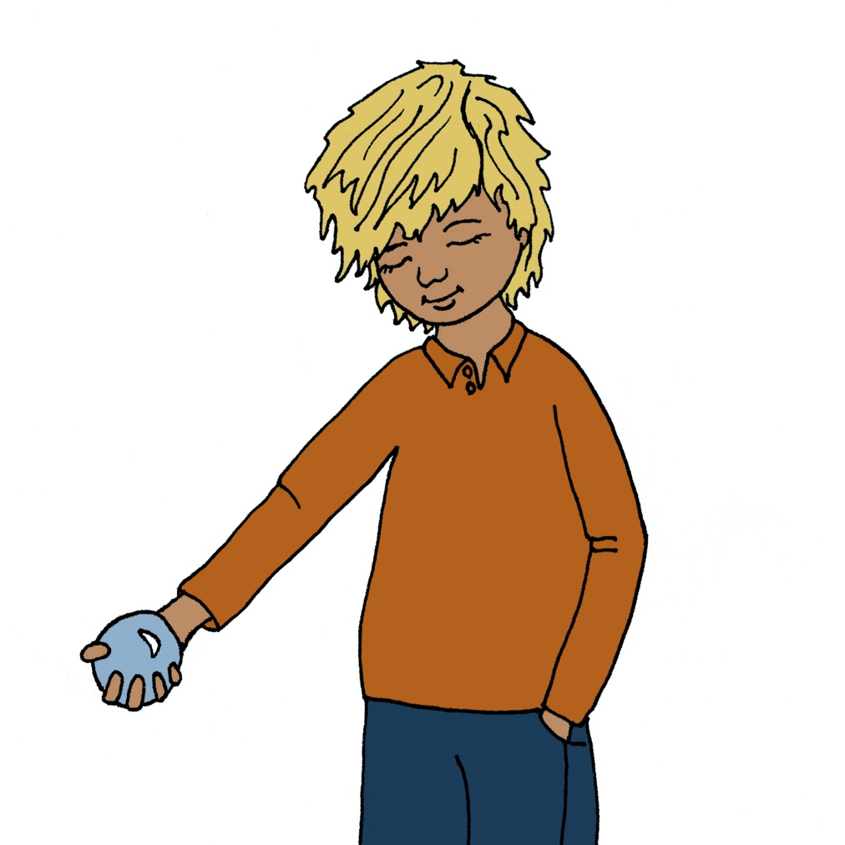
I can squeeze a ball.

Slide 5
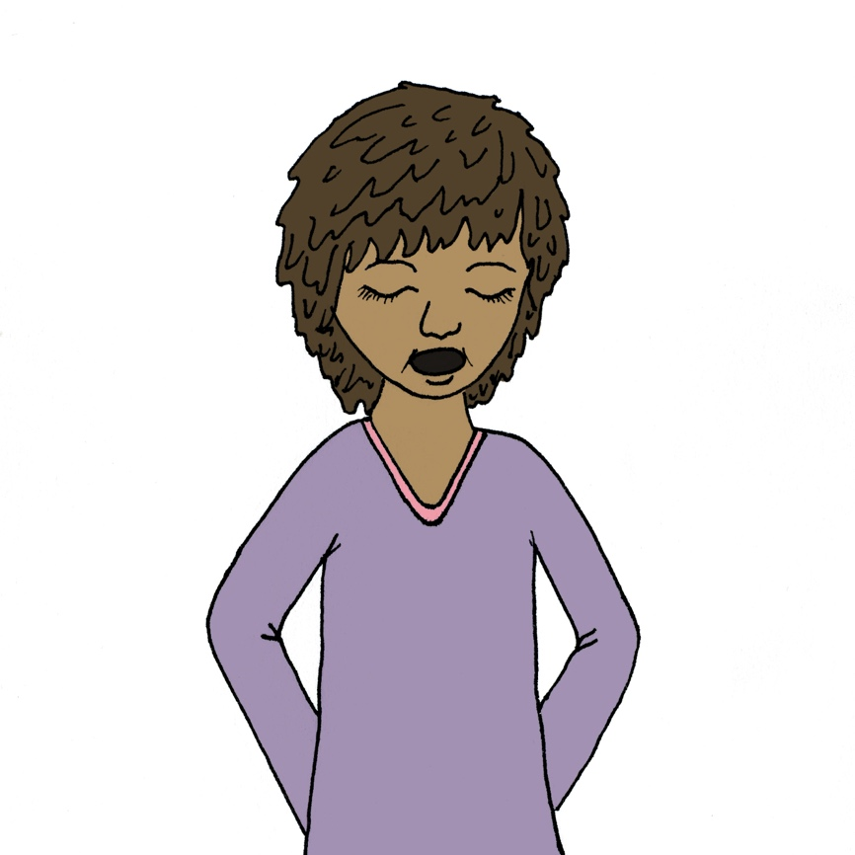
I can take slow deep breaths.

Slide 6
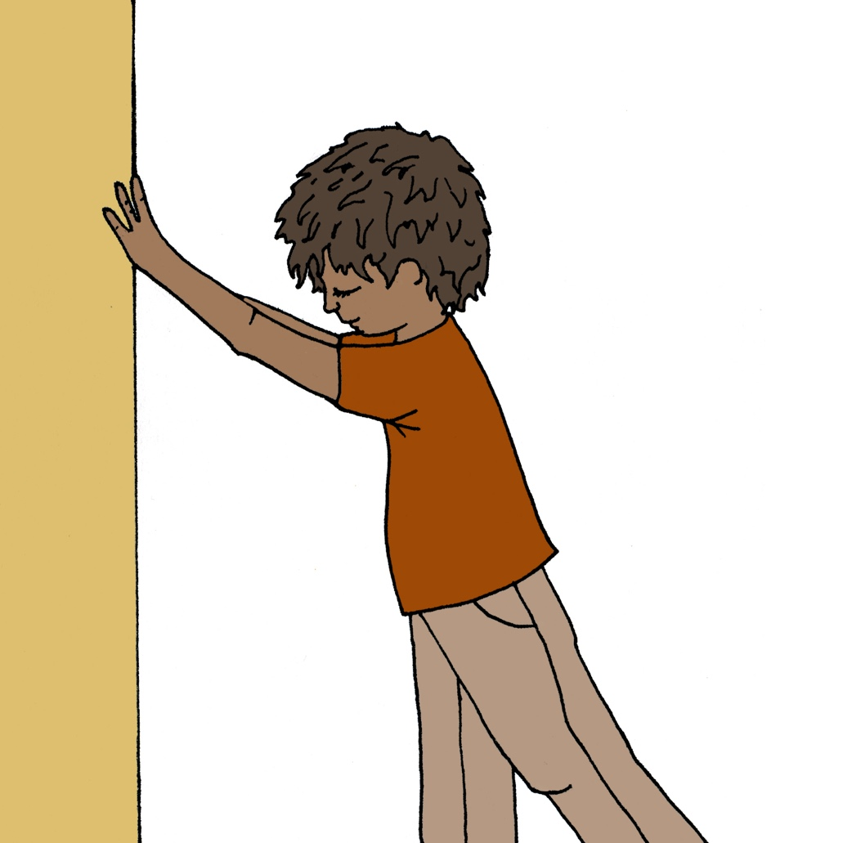
I can do a wall pushups.

Slide 7
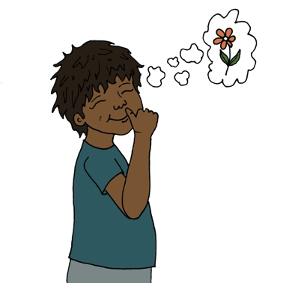
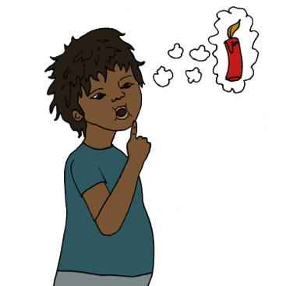
I can pretend to smell a flower and blow out a candle.
First
Then

Slide 8
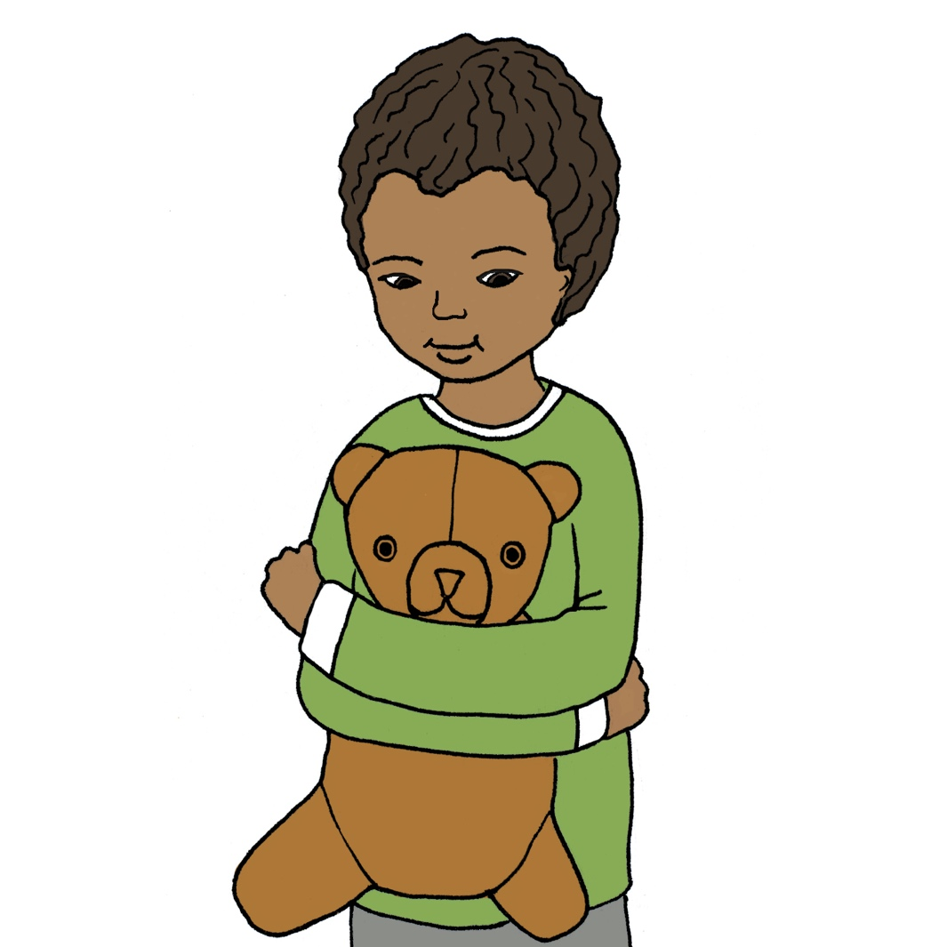
I can hug something.

Slide 9
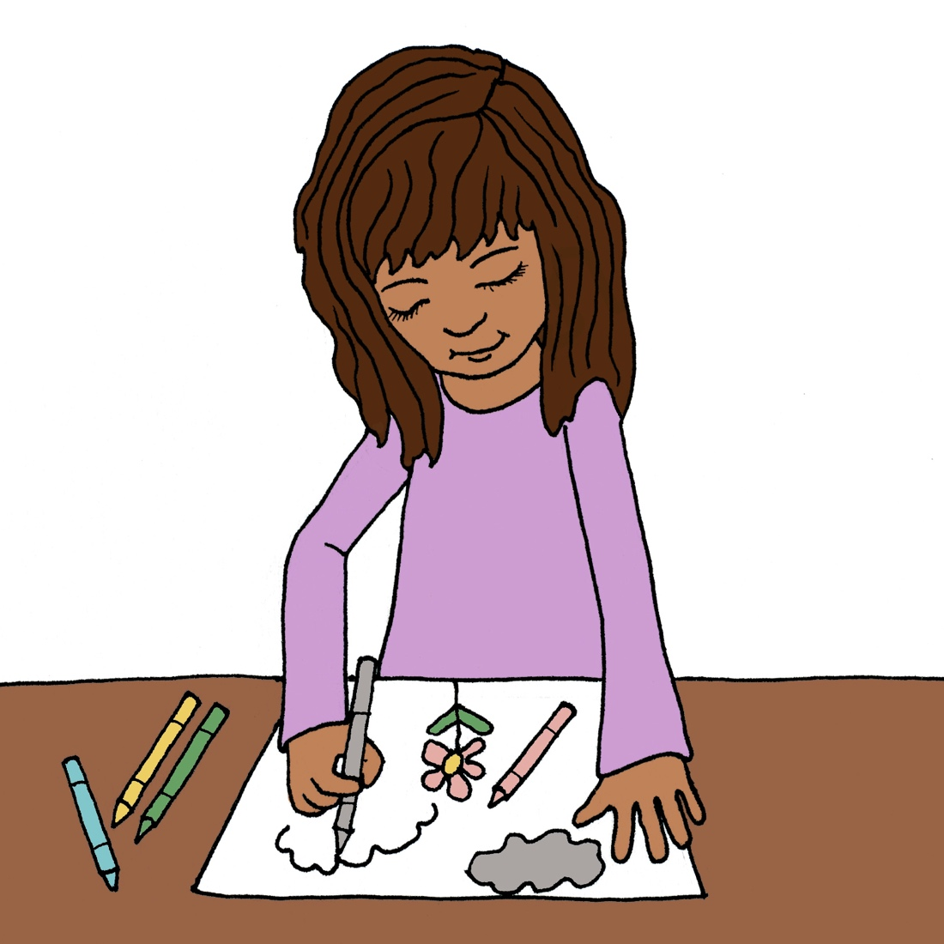
I can do a drawing.

Slide 10
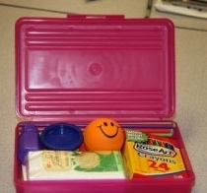
I can go to the cozy area for space. I can pick something from the cozy box to help me calm down.
This is a place the child self-selects to go to; s/he is not “sent” here.

Slide 11

I can listen to music.

Slide 12
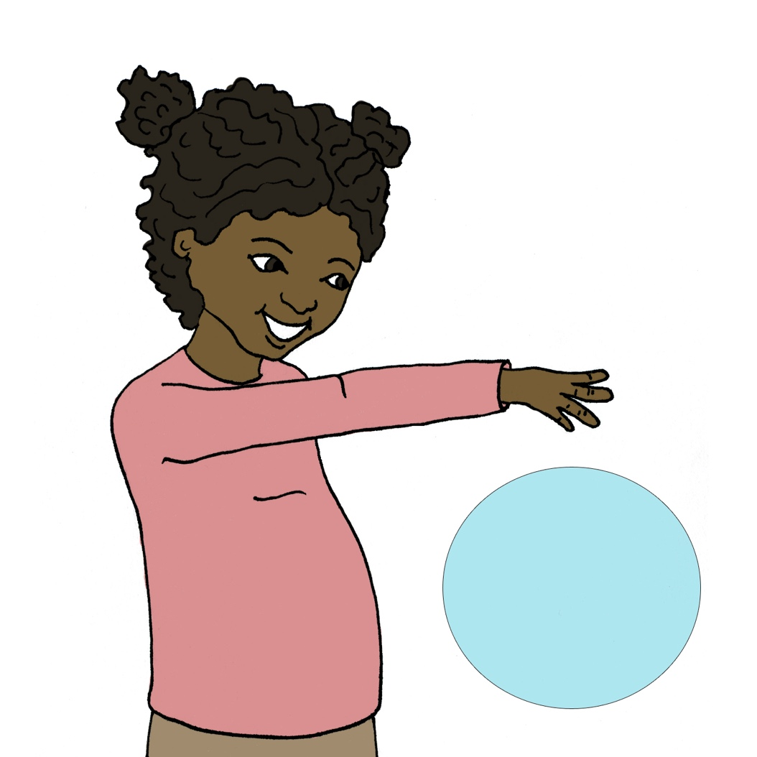
I can bounce a ball.

Slide 13
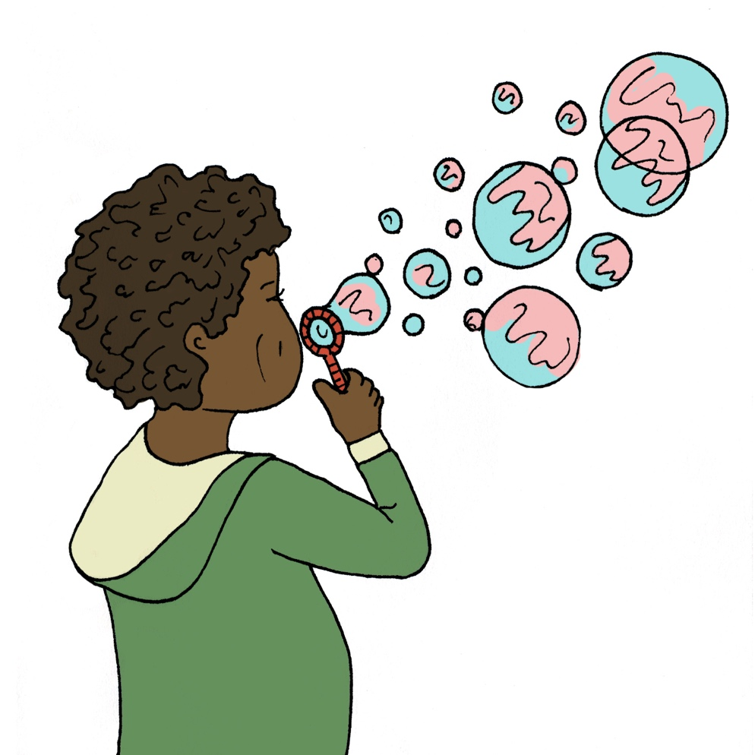
I can blow bubbles.

Slide 14
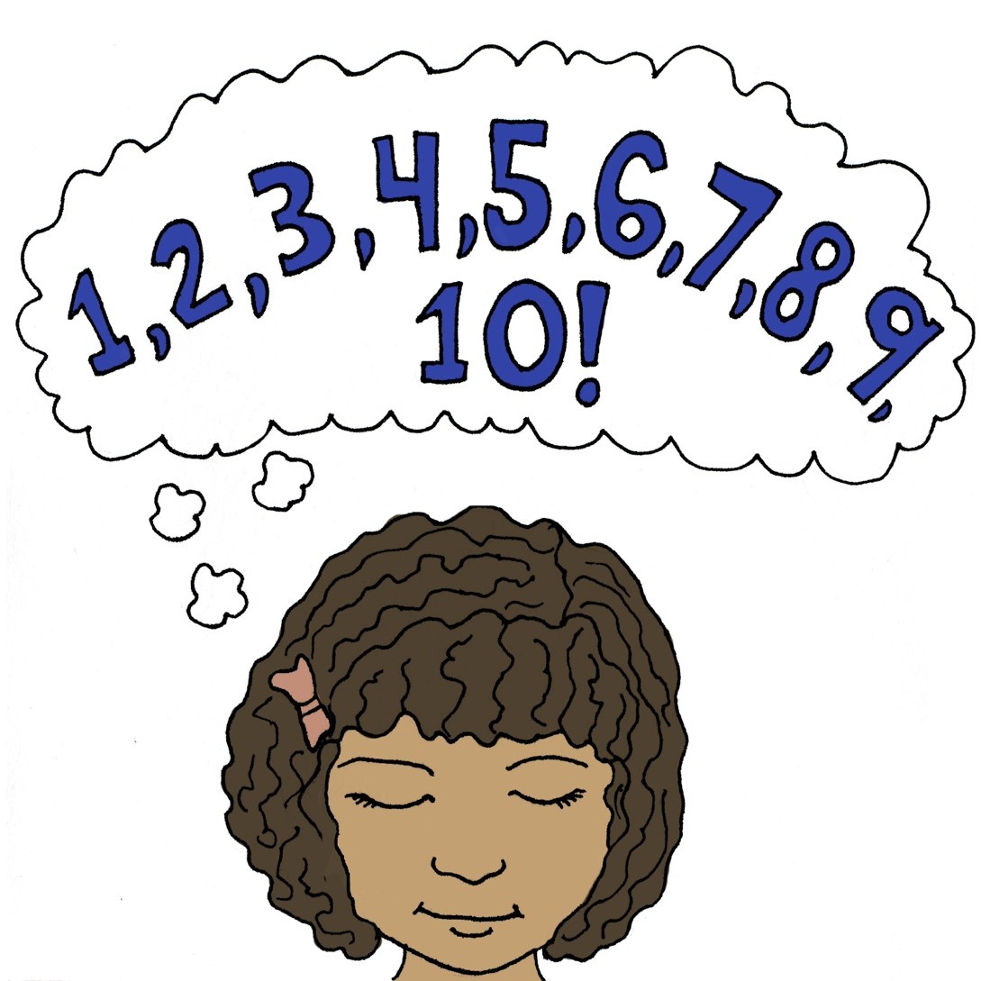
I can count to ten and take slow breaths.

Slide 15
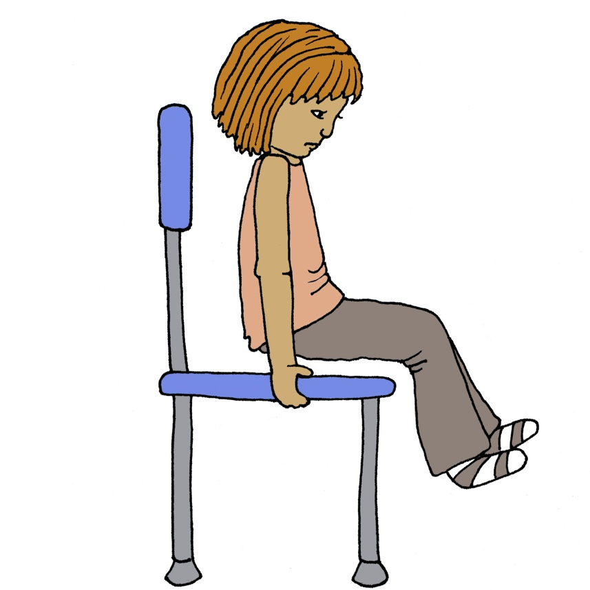
I can do chair pushups.

Slide 16
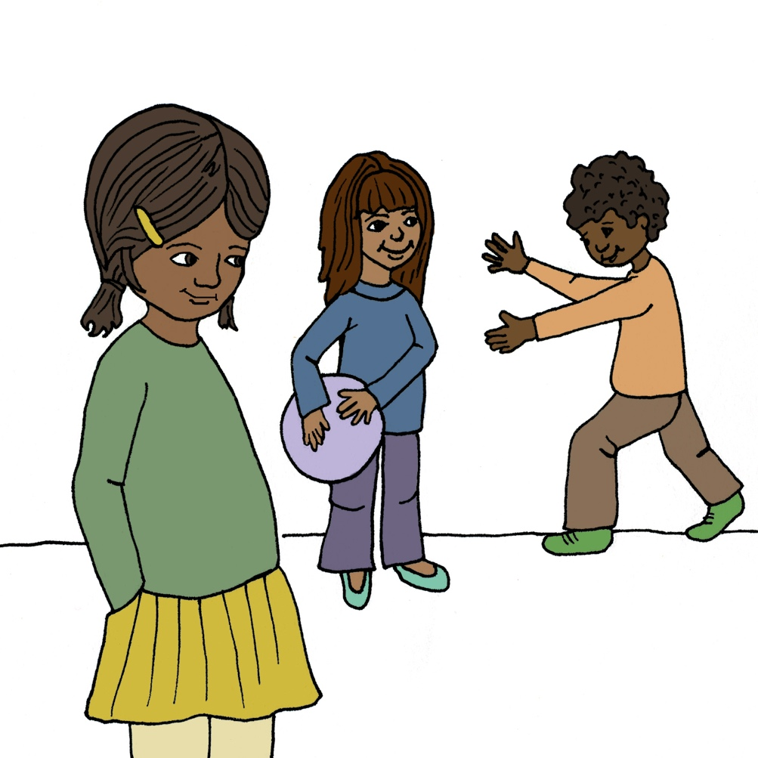
I can take a break and have some space.

Slide 17



I can stop and think, take 3 deep breaths and say to myself: “I can go with the flow”.

Slide 18
I can talk to my teacher.

Slide 19
What is something I can do to help me when I need help to calm down at school?
I will try my best to see what might work at the time.

