Slide 1
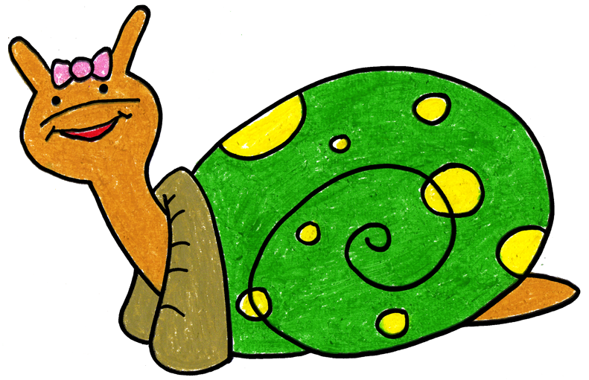
Sonia Snail Takes Time to Tuck and Think at Home
Adapted 2020 by WestEd Teaching Pyramid
from a scripted story to assist with teaching the “Turtle Technique”
Original By Rochelle Lentini March 2005
Artwork by Alejandro Castillon, 2011 WestEd

Slide 2
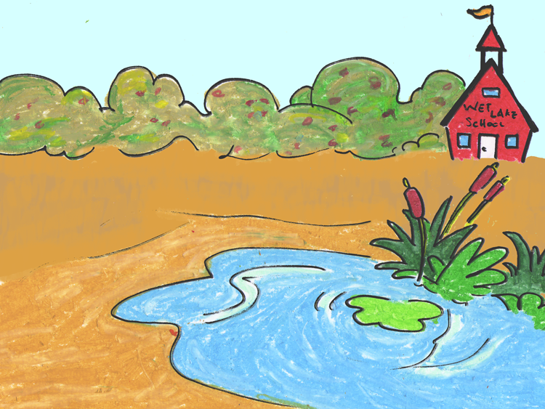
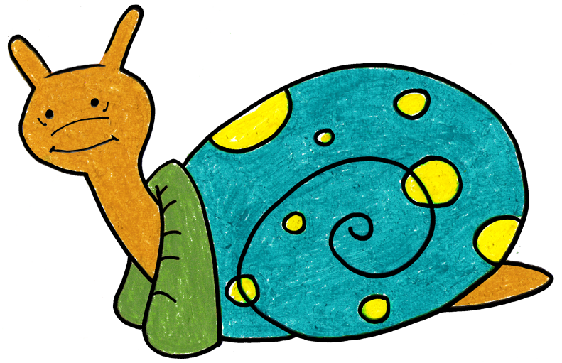
Sonia Snail is a terrific snail. She lives with her family near a small pond.

Slide 3
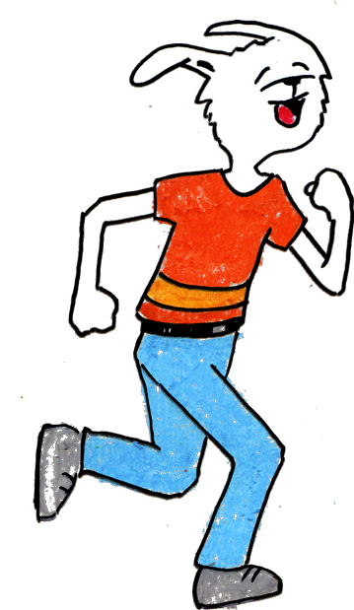
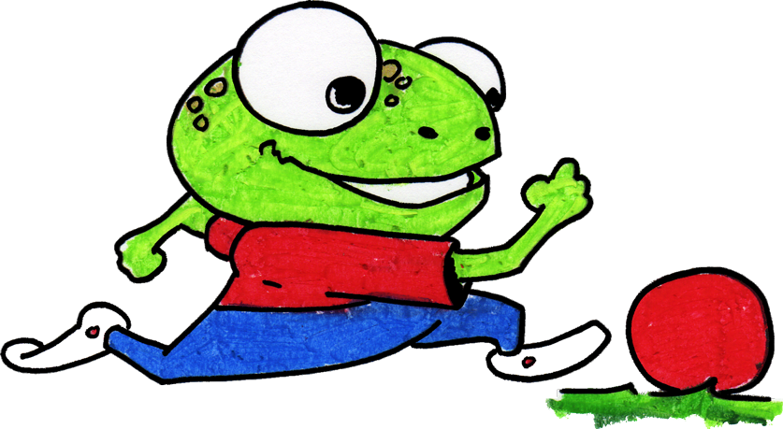

Sometimes, things happen that can make Sonia really mad.
You can’t play with us.
It’s time to stop playing and get ready for dinner.
That makes me MAD!

Slide 4
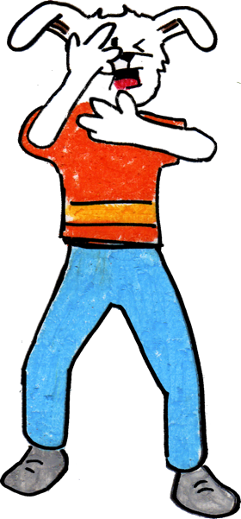
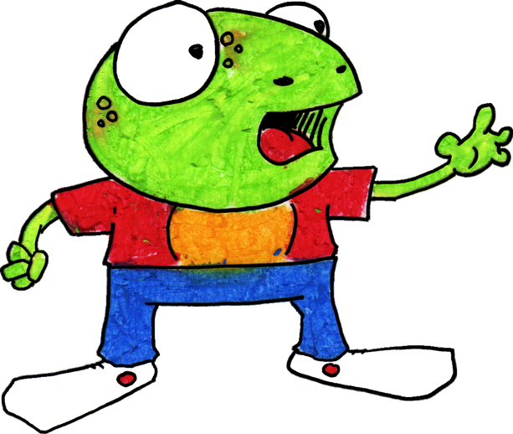
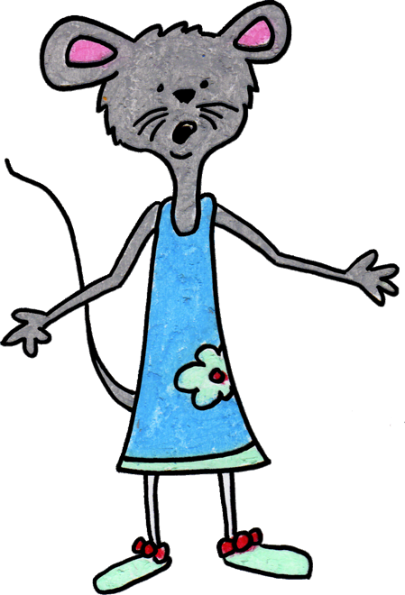
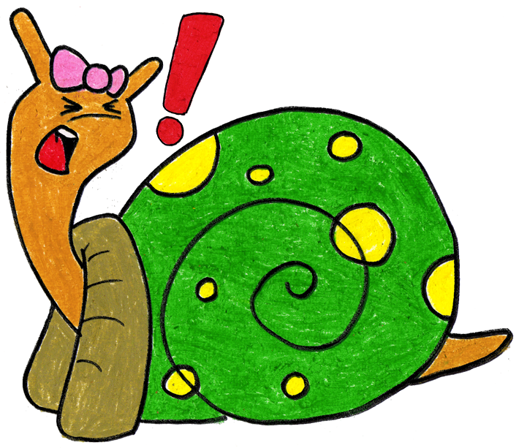

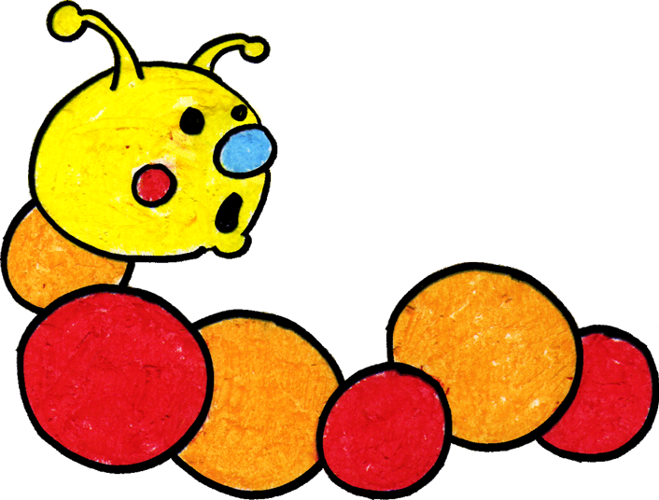
It used to be that when Sonia got mad, she would hit, kick, or yell at her family and friends. Her family and friends would get sad and scared.

Slide 5
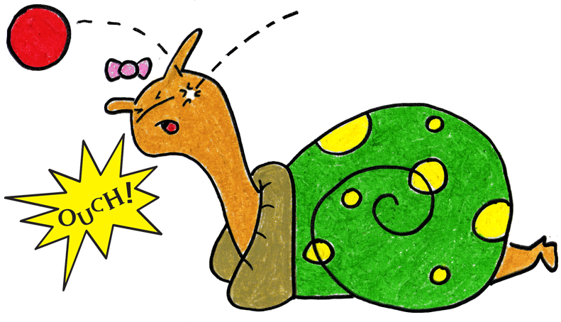
Sonia now knows a new way to “think like a snail” when something happens to make her mad.
Step 1

Slide 6
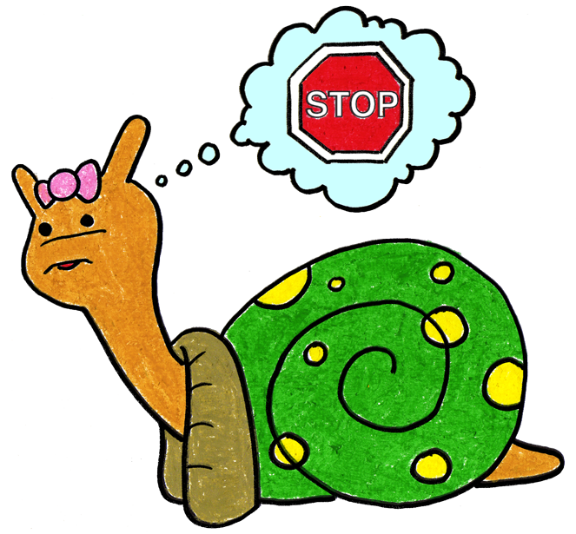
She can stop and keep her hands, body, and yelling to herself. She can think, “What am I feeling?” If she is angry, she can stomp her feet and say, “I’m mad!”
Step 2

Slide 7
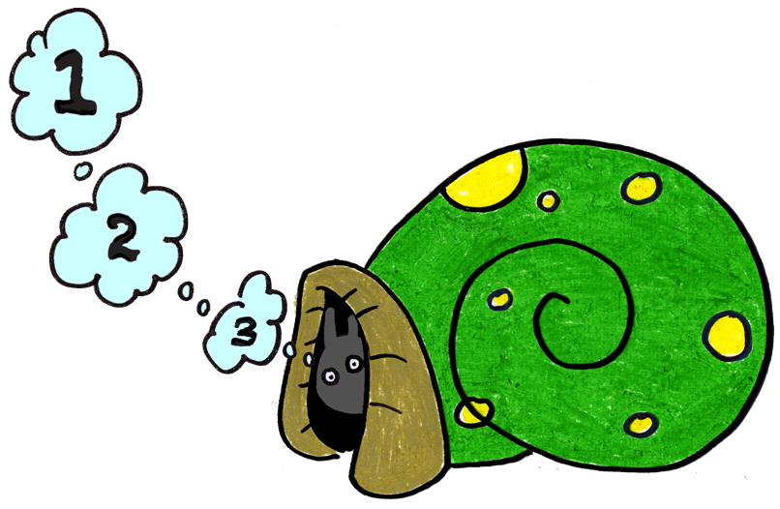
She can tuck inside her shell and take 3 deep breaths to calm down.
Step 3

Slide 8
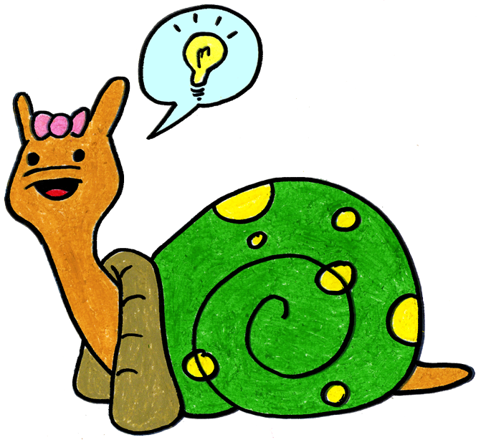
Sonia can come out of her shell, express her feelings, then think of a solution or a way to make it better.
Step 4

Slide 9
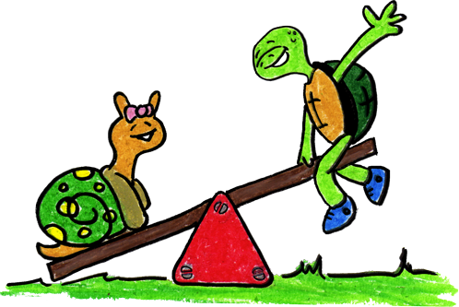
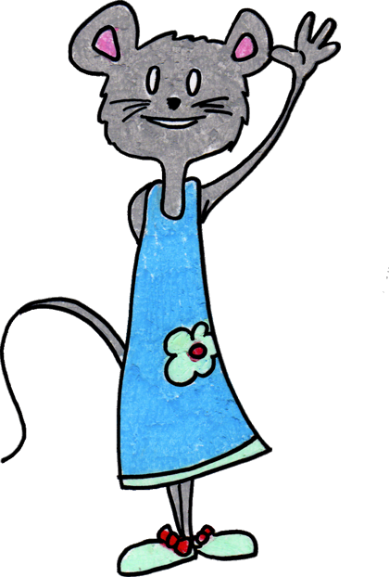
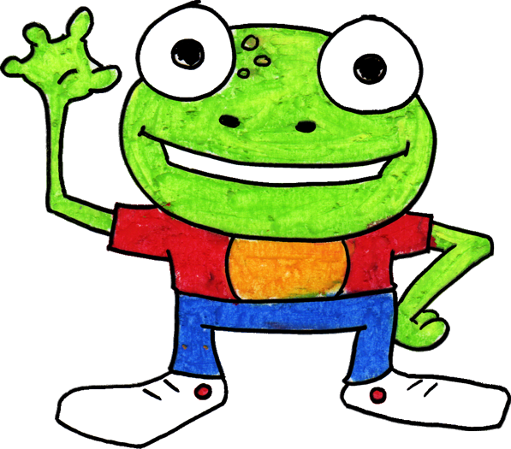
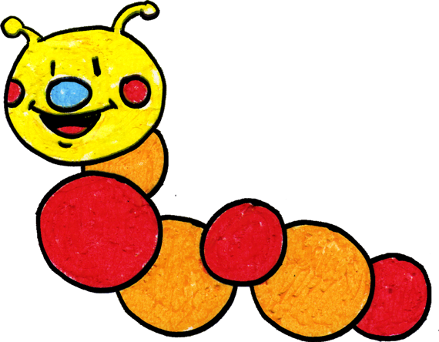
When Sonia stops and thinks, her body is calm and feels better. When she uses gentle touches and kind words with her family and friends, they feel happy and safe.

Slide 10
Sonia’s family practices stopping and thinking together using Sonia’s new way to calm down.
You can do it too! You can try your best. Goodbye!

Slide 11
Tucking Technique (CA CSEFEL)
Something happens.
Stop. Think: What am I feeling?
Step 1
Step 2
Go into your shell. Take 3 deep breaths and think calm thoughts.
Come out of shell, express your feelings and think of a solution.
Step 3
Step 4
Adapted by WestEd Teaching Pyramid – www.CAinclusion.org/teachingpyramid

Slide 12
Family Tips on the Tuckinhg Technique
Model remaining calm
Teach the child the steps of how to manage feelings and calm down (“think like a snail”)
  Step 1: Recognize that something happened.
  Step 2: Stop. Think: what are you feeling? Acknowledge your feeling and maybe do something physical to let that feeling out.
  Step 3: Tuck inside your “shell” and take 3 belly breaths to help you become calm.
  Step 4: Come out, express your feelings, and think of a solution.
Practice steps frequently (see cue cards outlining each step)
Prepare for and help the child handle strong emotions and to think of a solution (see “What Can the Child Do?” list)
Give encouragement and acknowledgement as children make efforts to do the steps
Families – teach the “Snail Technique”
Adapted from Webster-Stratton, C. (1991). The teachers and children videotape series: Dina dinosaur school. Seattle, WA: The Incredible Years.

Slide 13
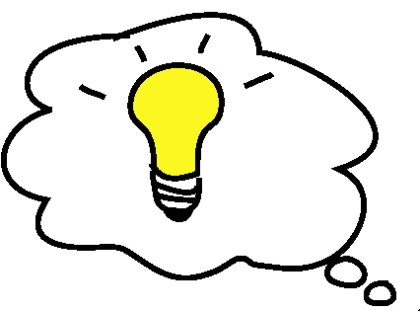
What Can The Child Do?
Help the Child Think of a Possible Solution:
(These are from the Solution Kit)
Get an adult
Ask in a friendly way
Ignore
Play
Say, “Please stop.”
Say, “Please.”
Share
Trade a toy/item
Wait and take turns
Set a Timer

