Slide 1
CA CSEFEL Teaching Pyramid for Preschool
Team Action Plans (Module 1a, 1b, 2)

Slide 2
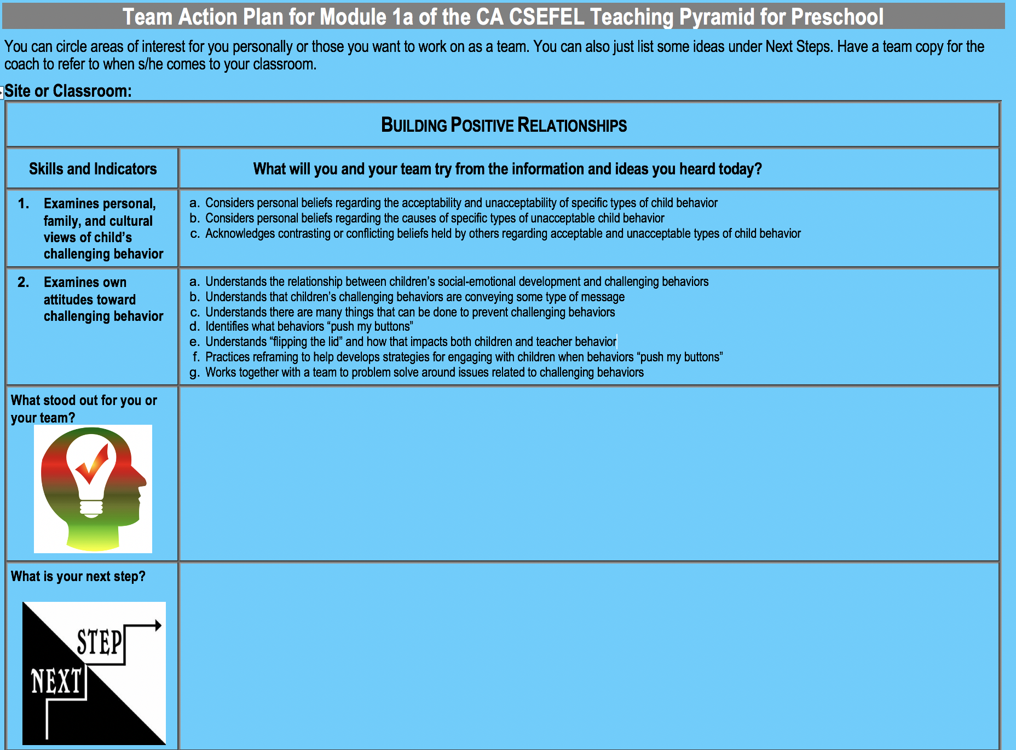
Building Positive Relationships

Slide 3
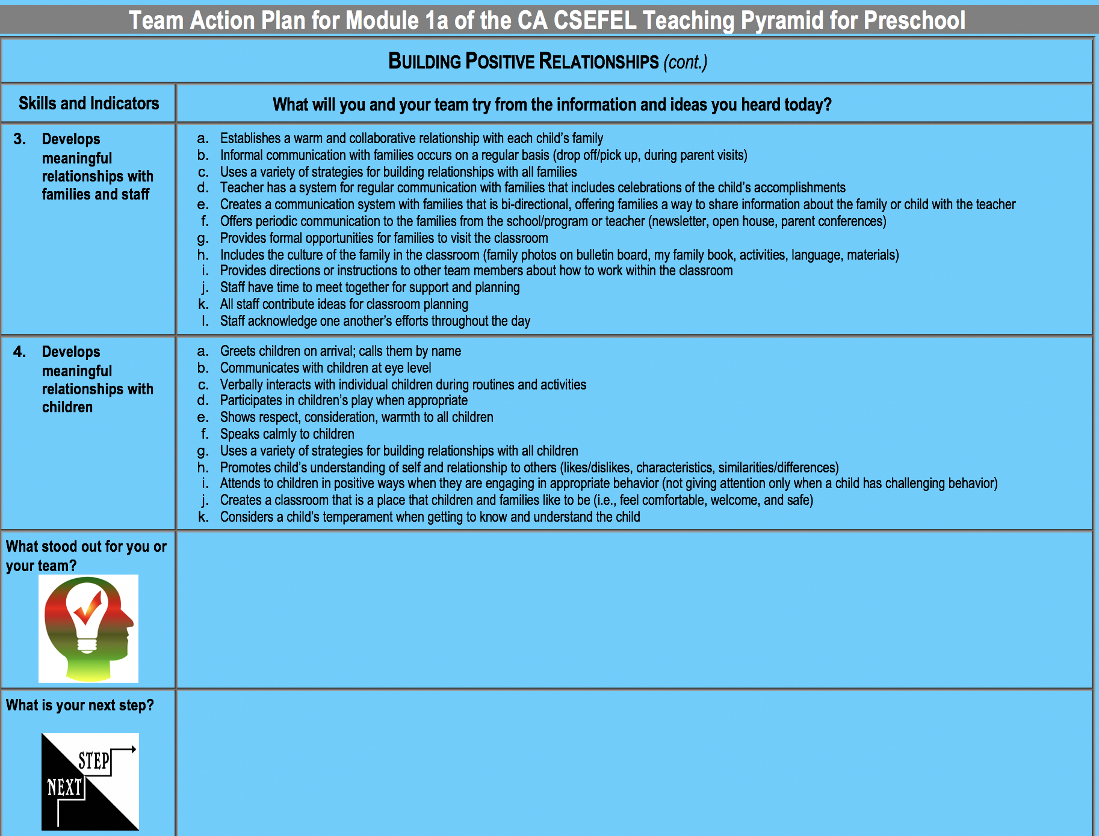
Building Positive Relationships (continued)

Slide 4
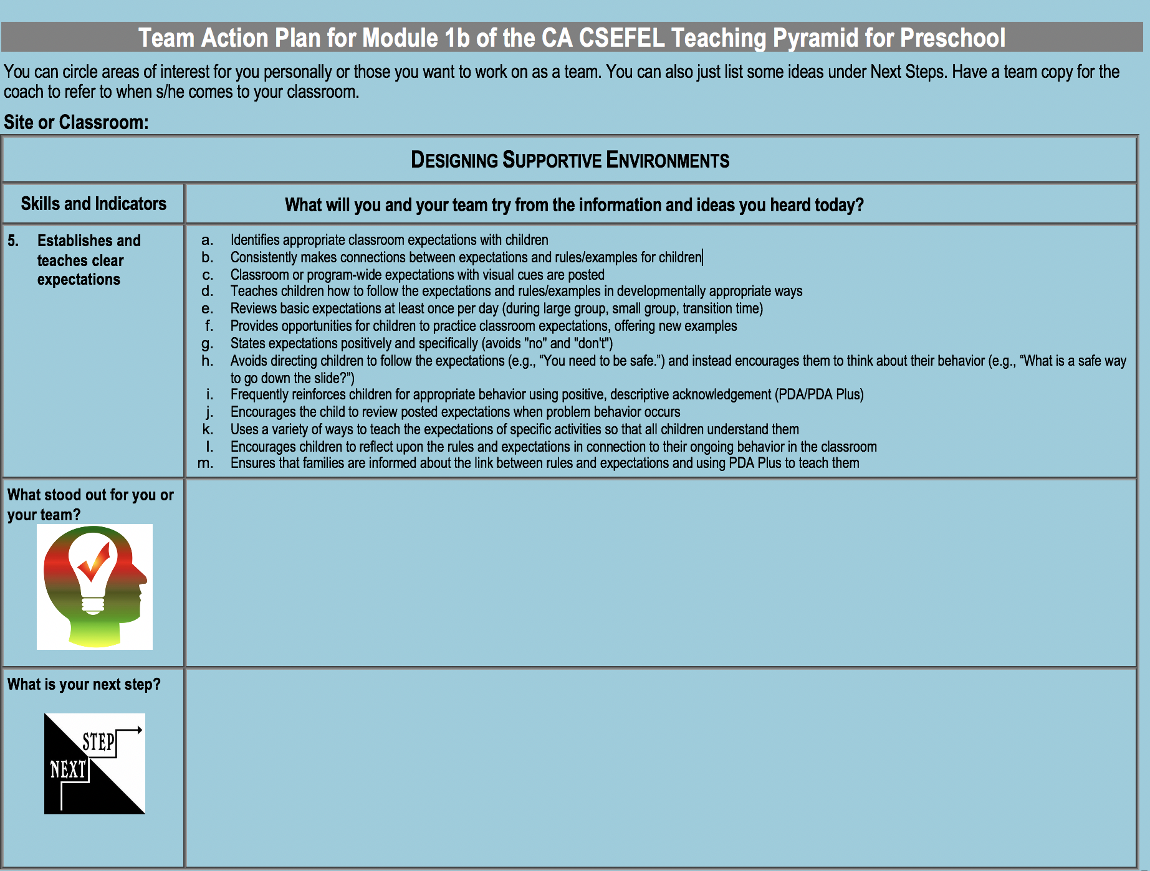

Slide 5
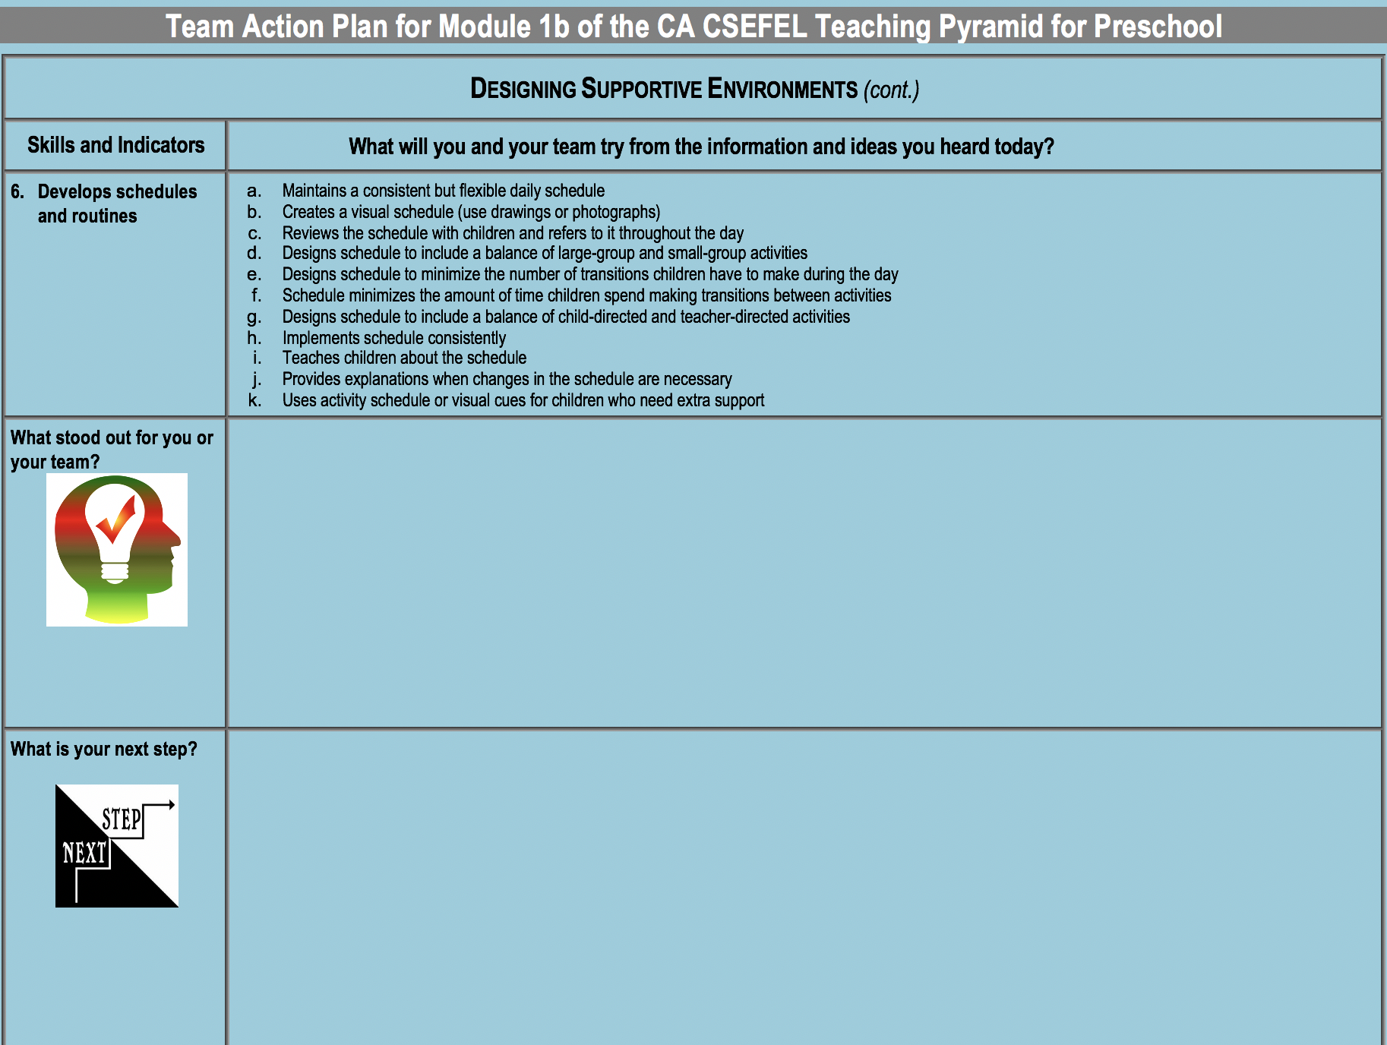

Slide 6
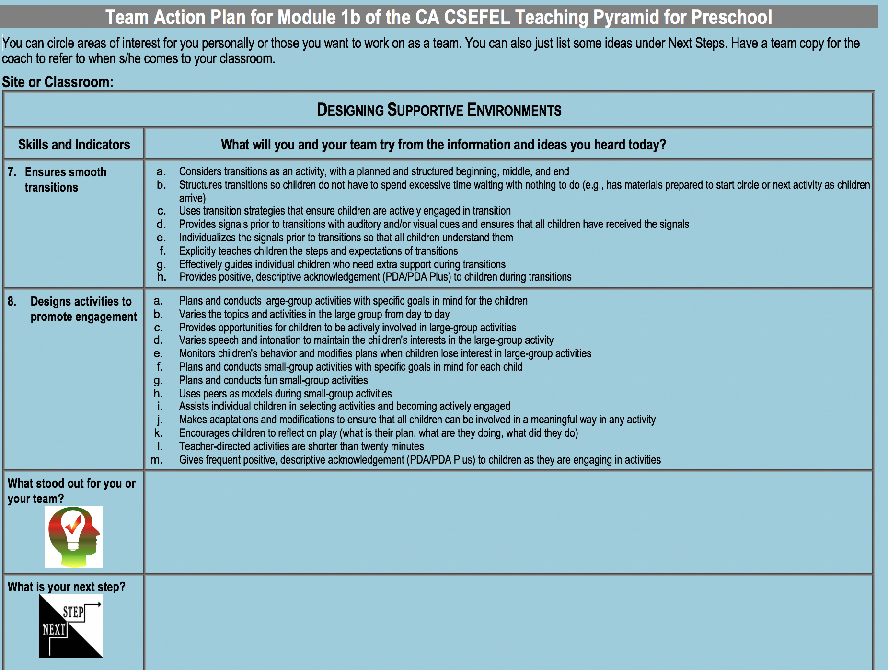

Slide 7
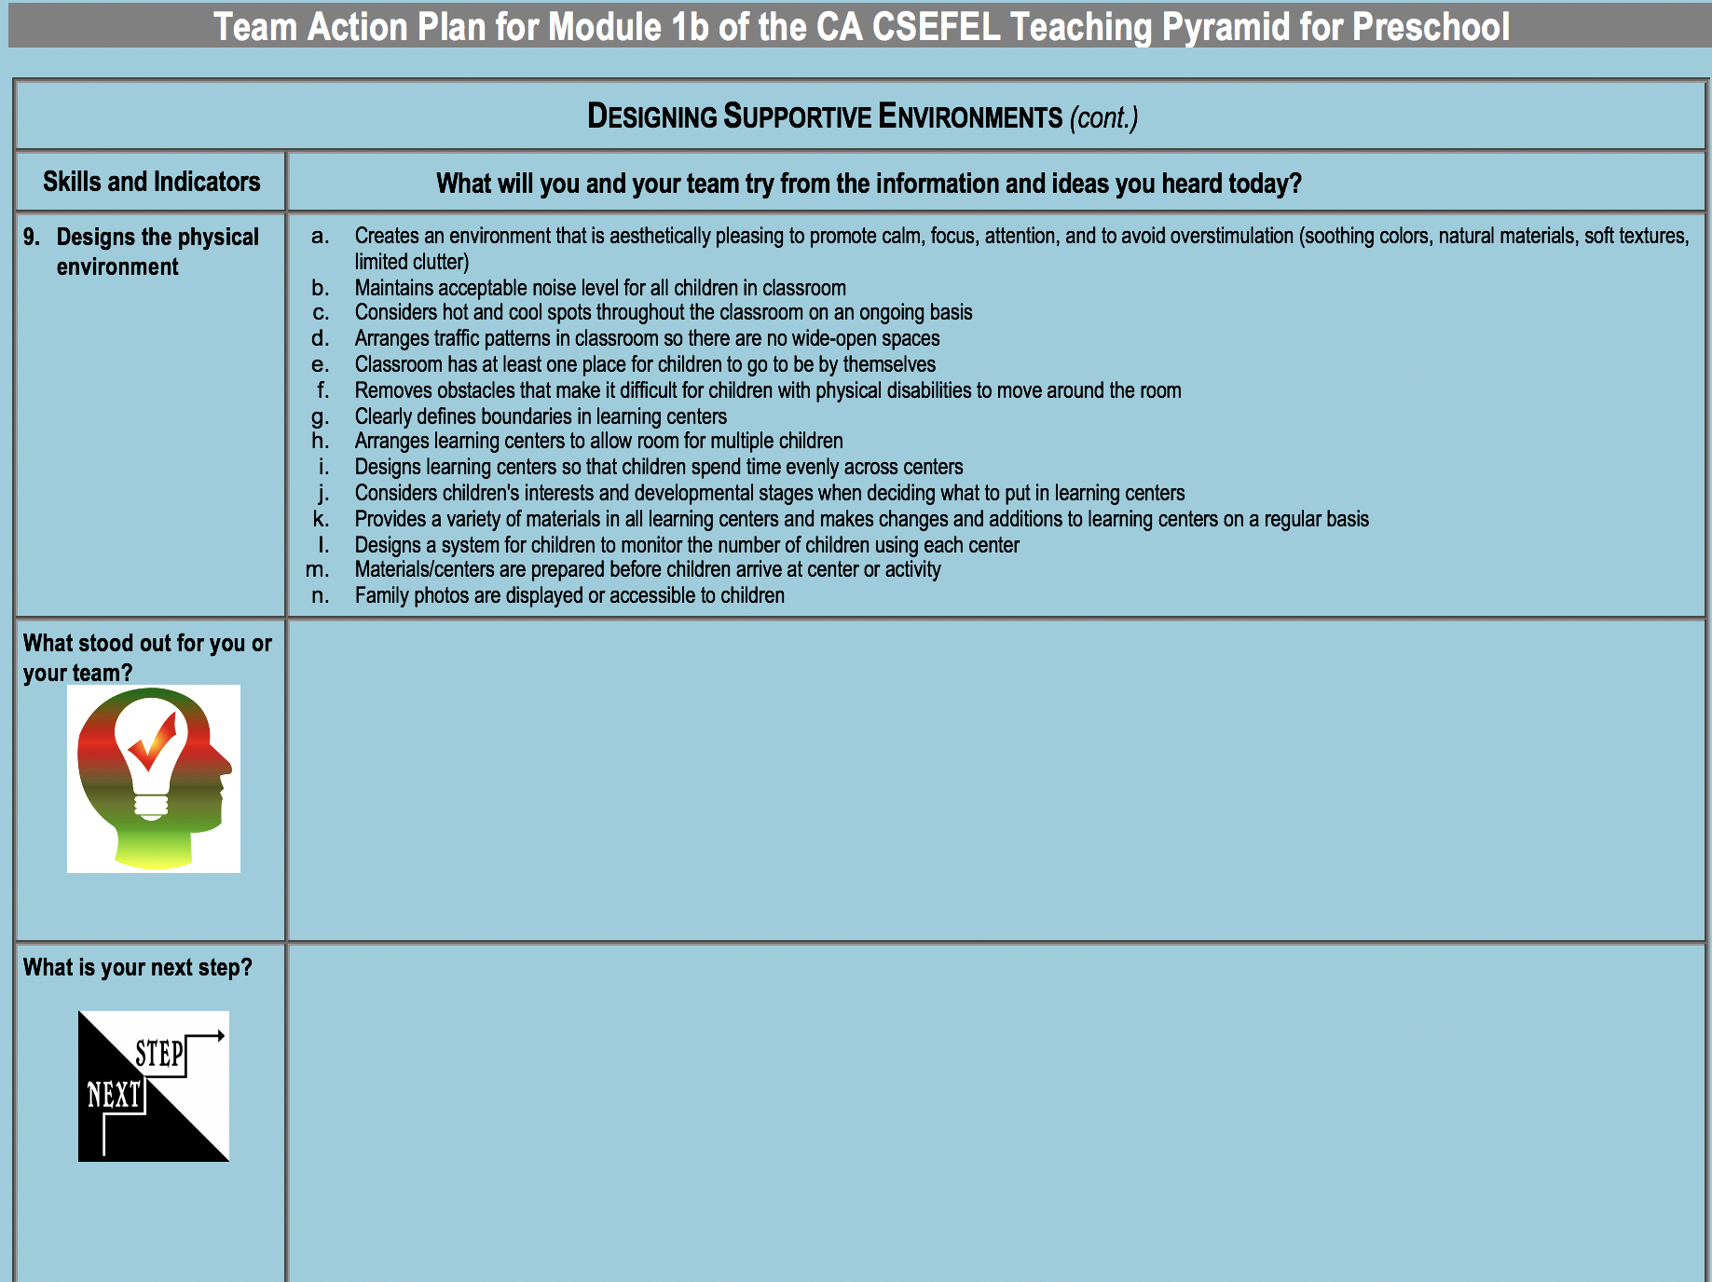

Slide 8
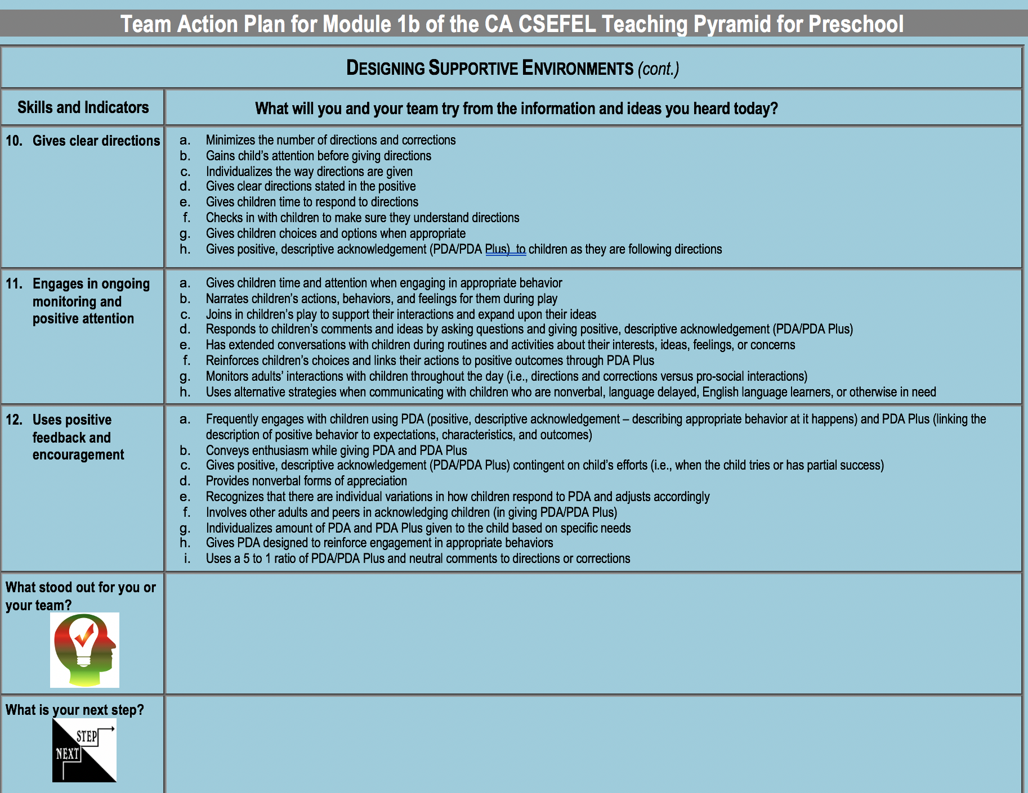

Slide 9
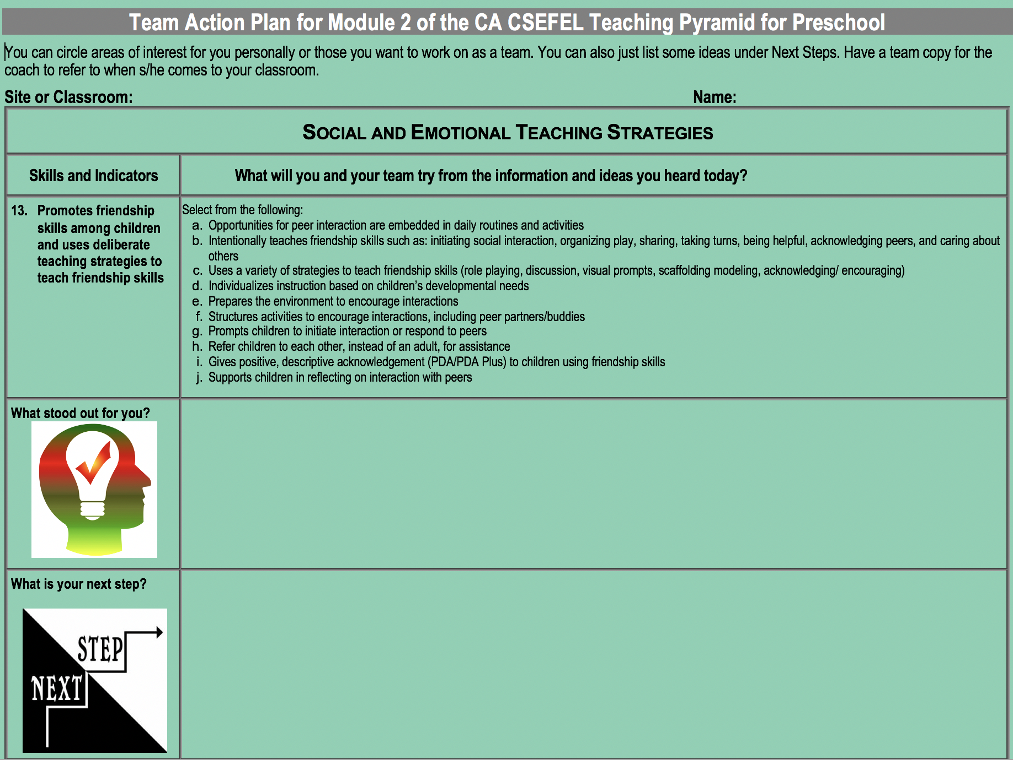

Slide 10
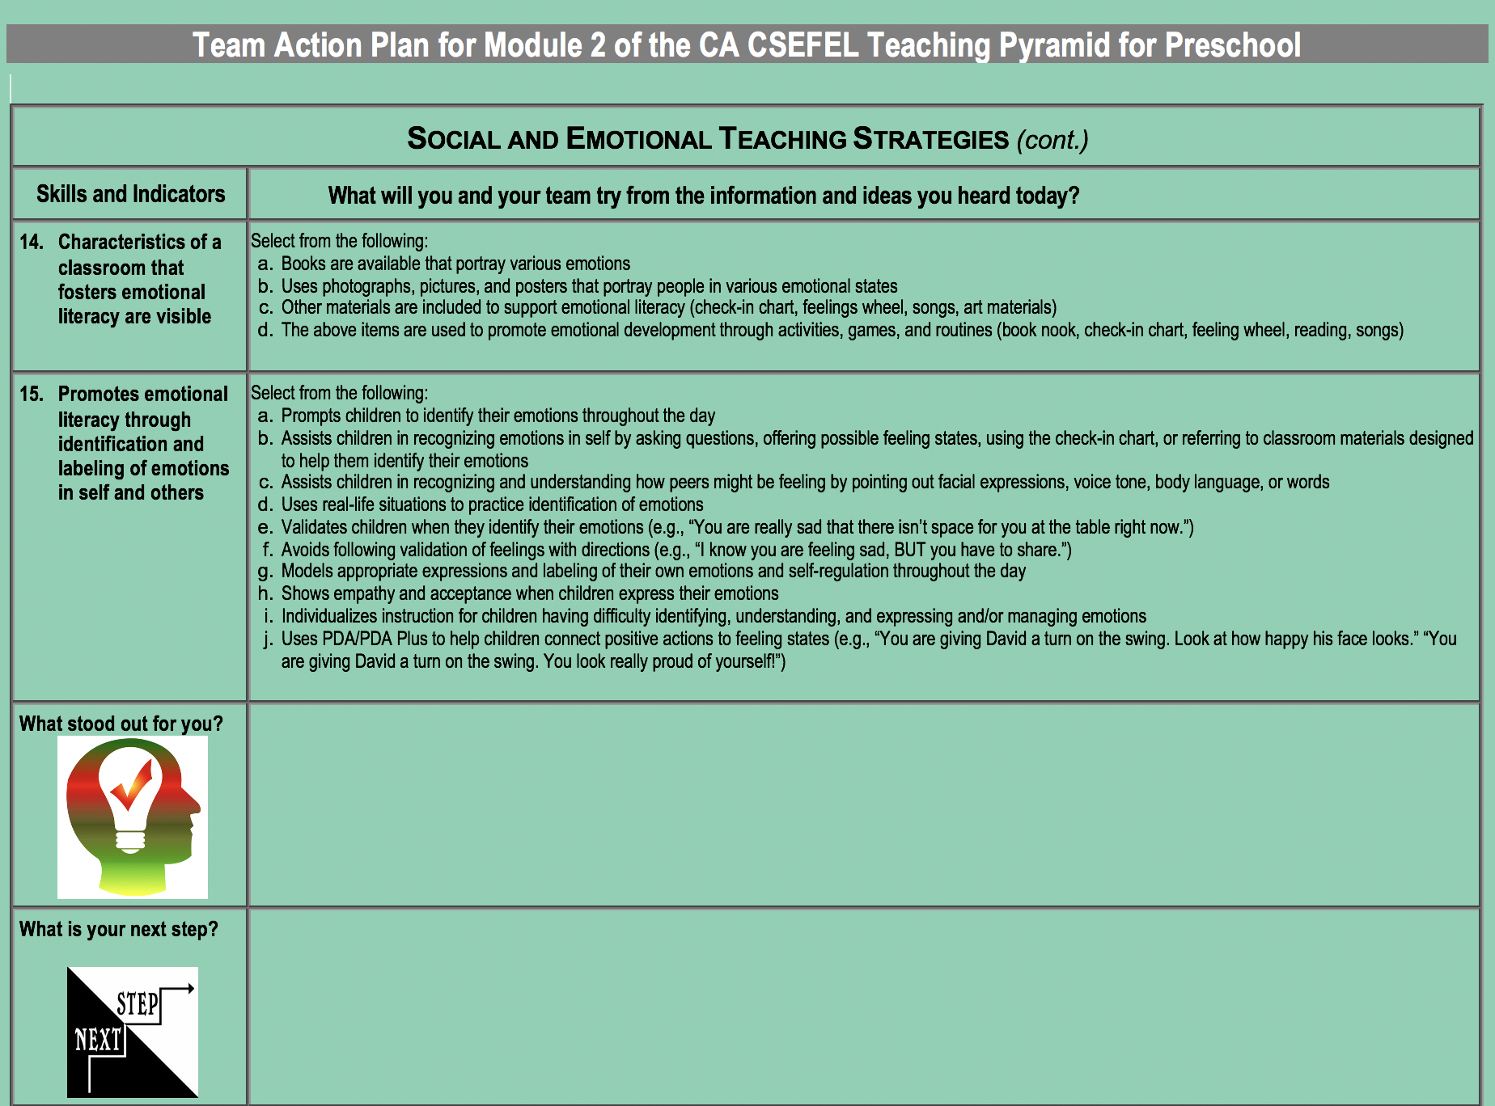

Slide 11
