Slide 1
Visit #

Slide 2


Slide 3
Coaching Action plan

Slide 4

As a team is there a Teaching Pyramid a skill/strategy from the last training that you would like to implement in your classroom to meet the current needs of the children?

Slide 5
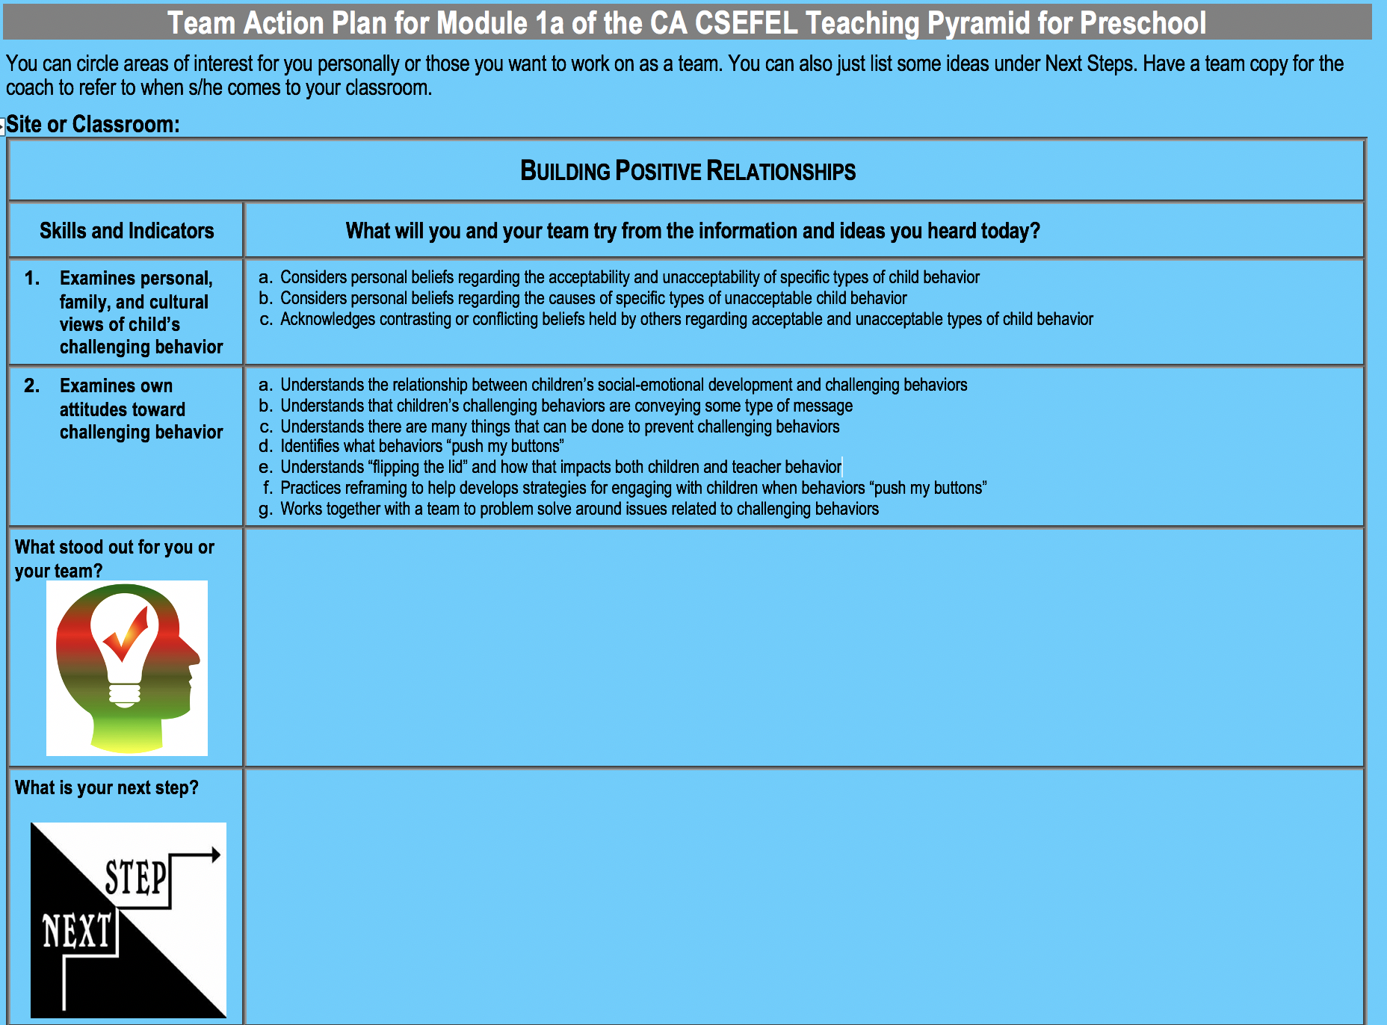

Slide 6
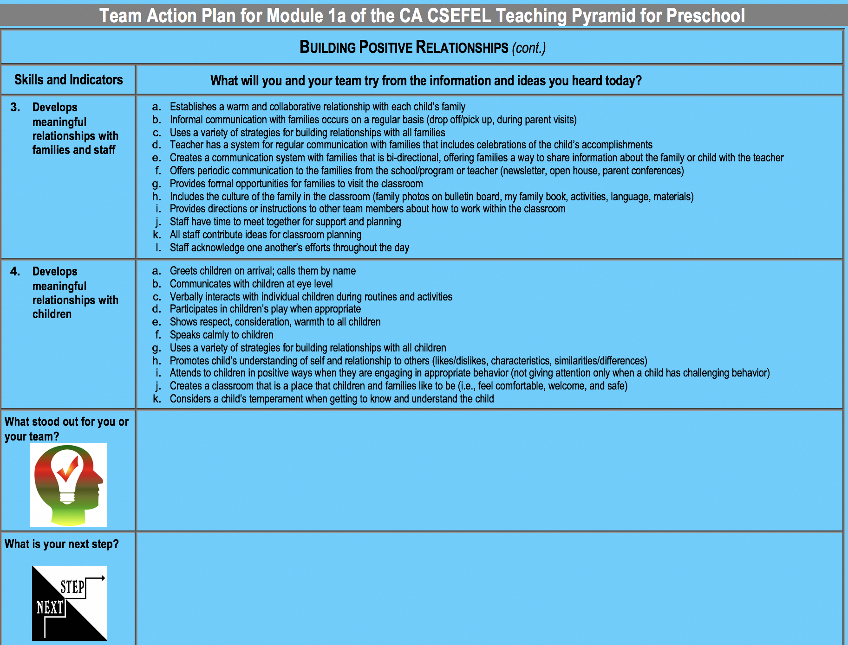

Slide 7
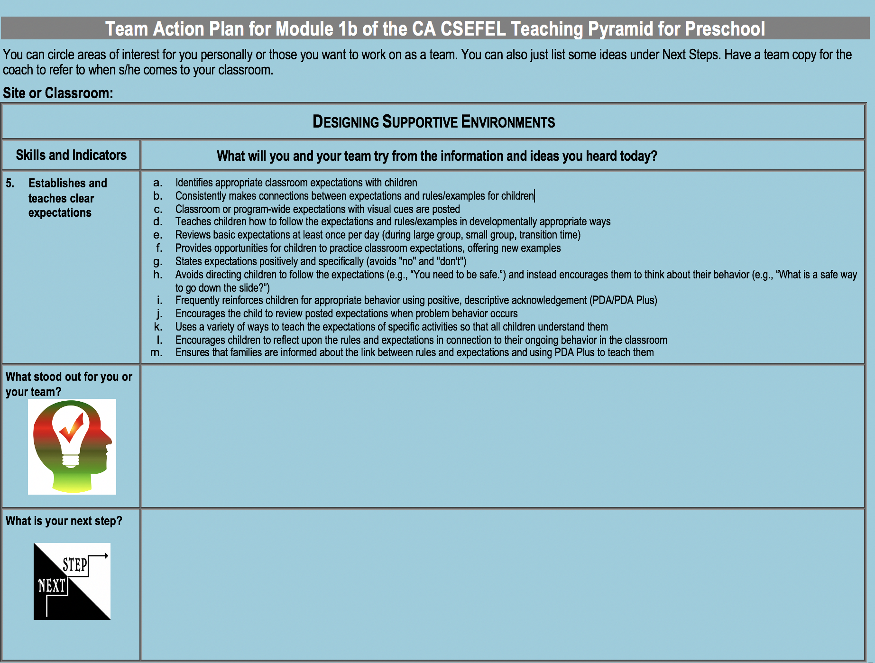

Slide 8
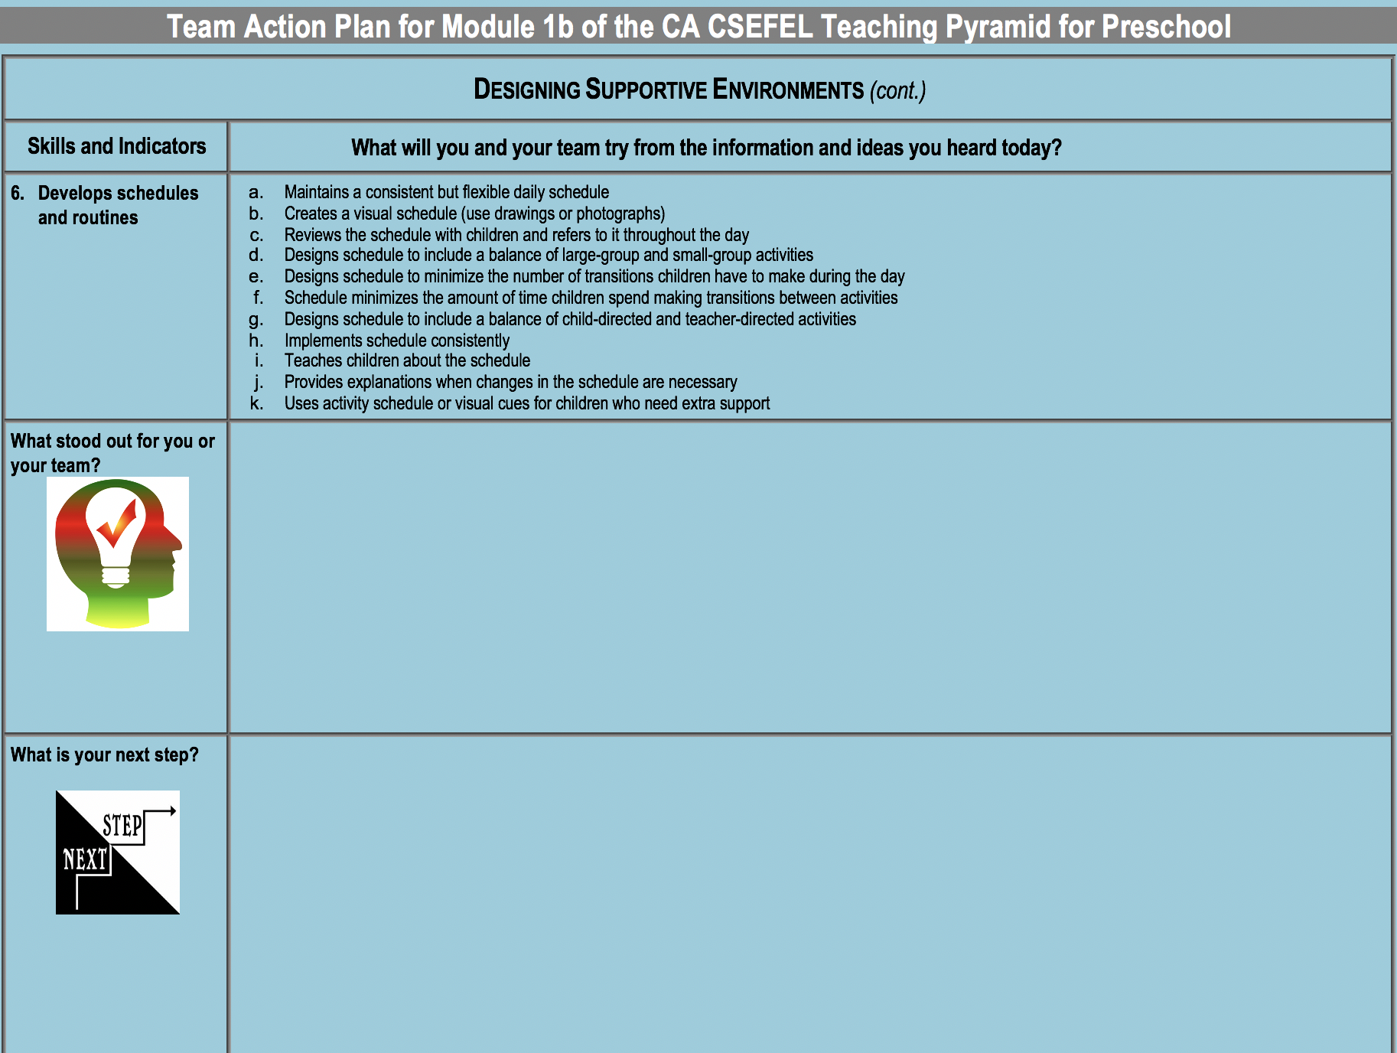

Slide 9
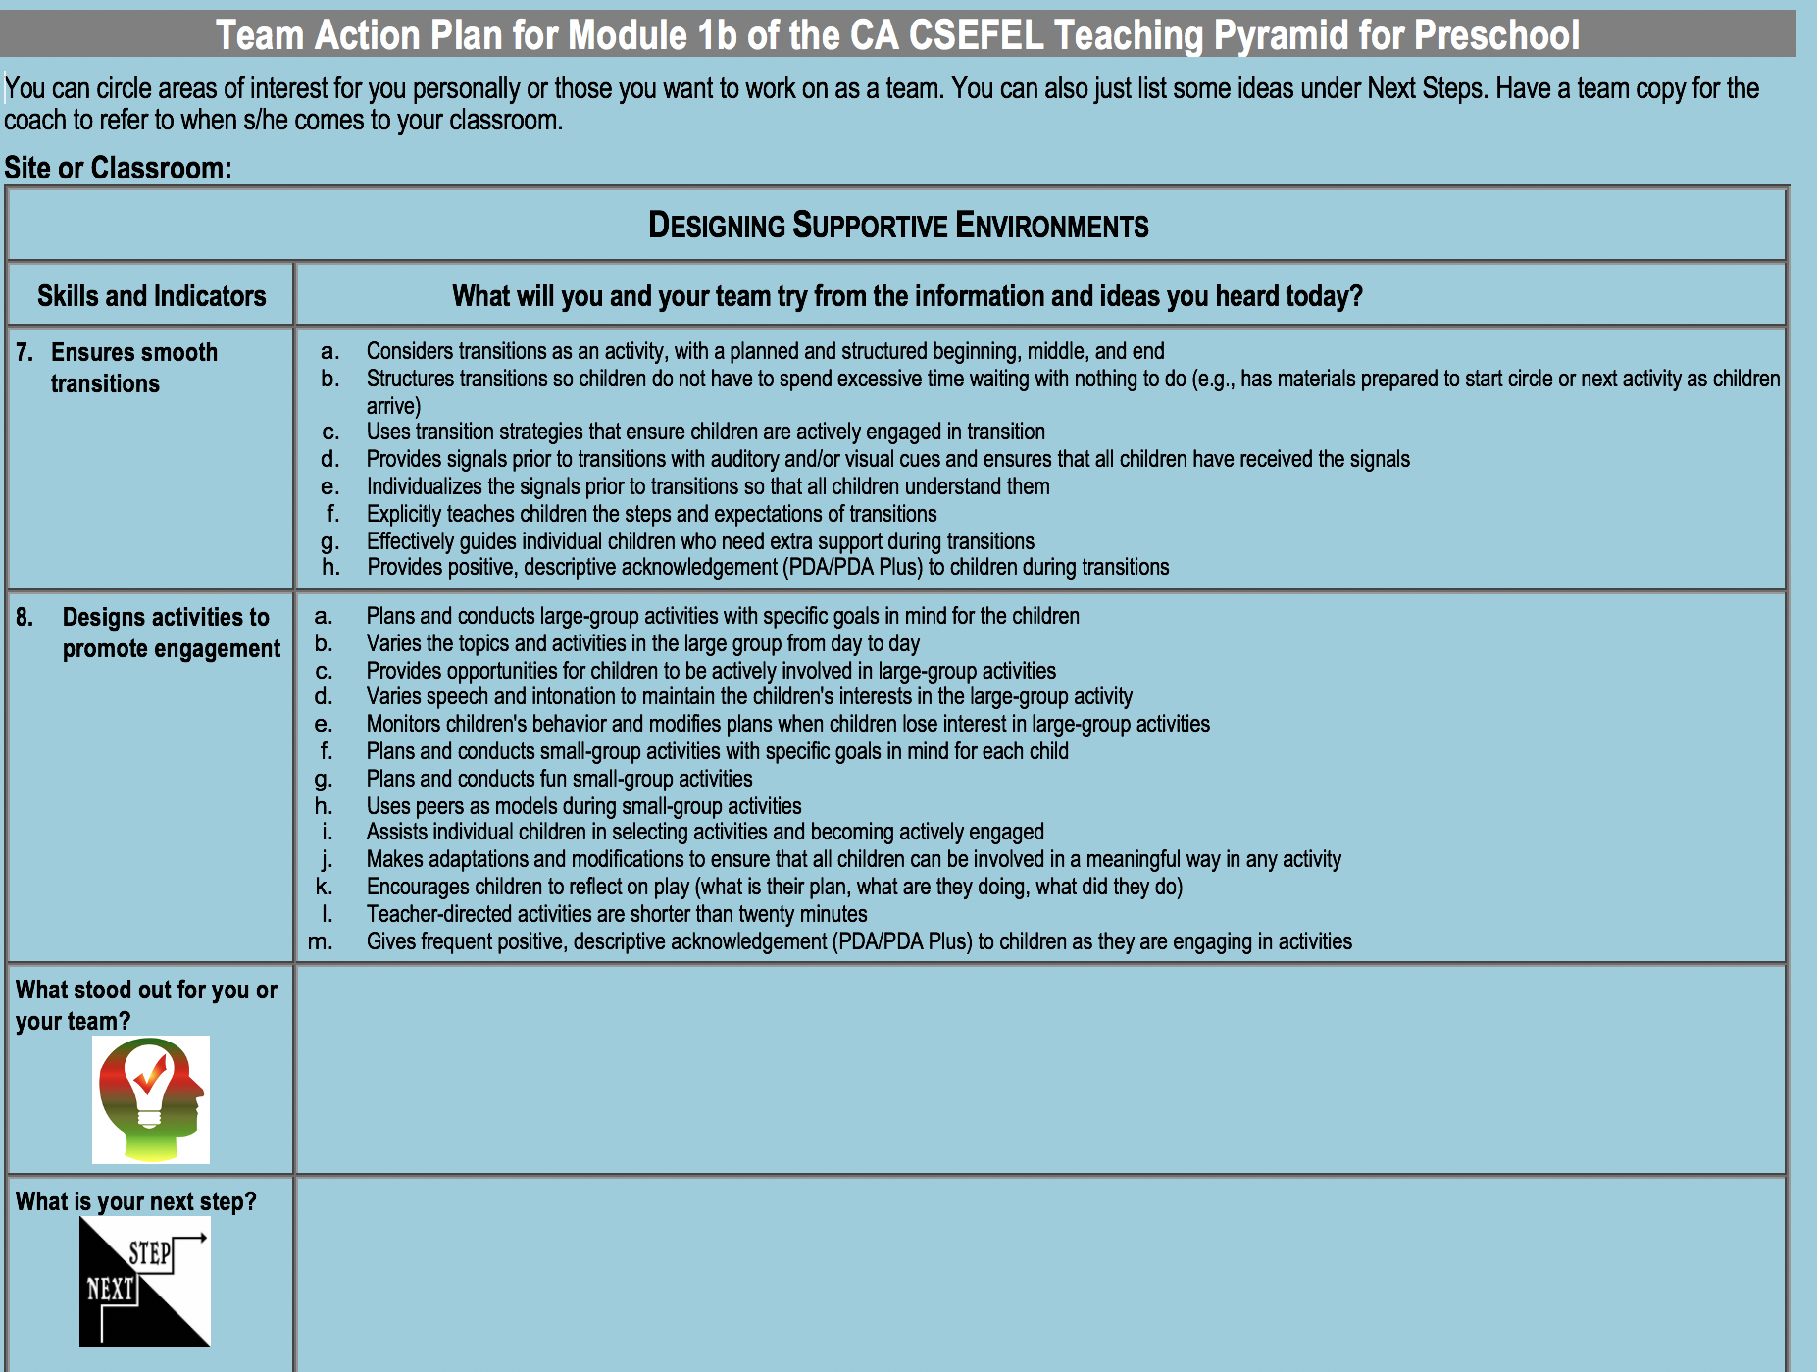

Slide 10
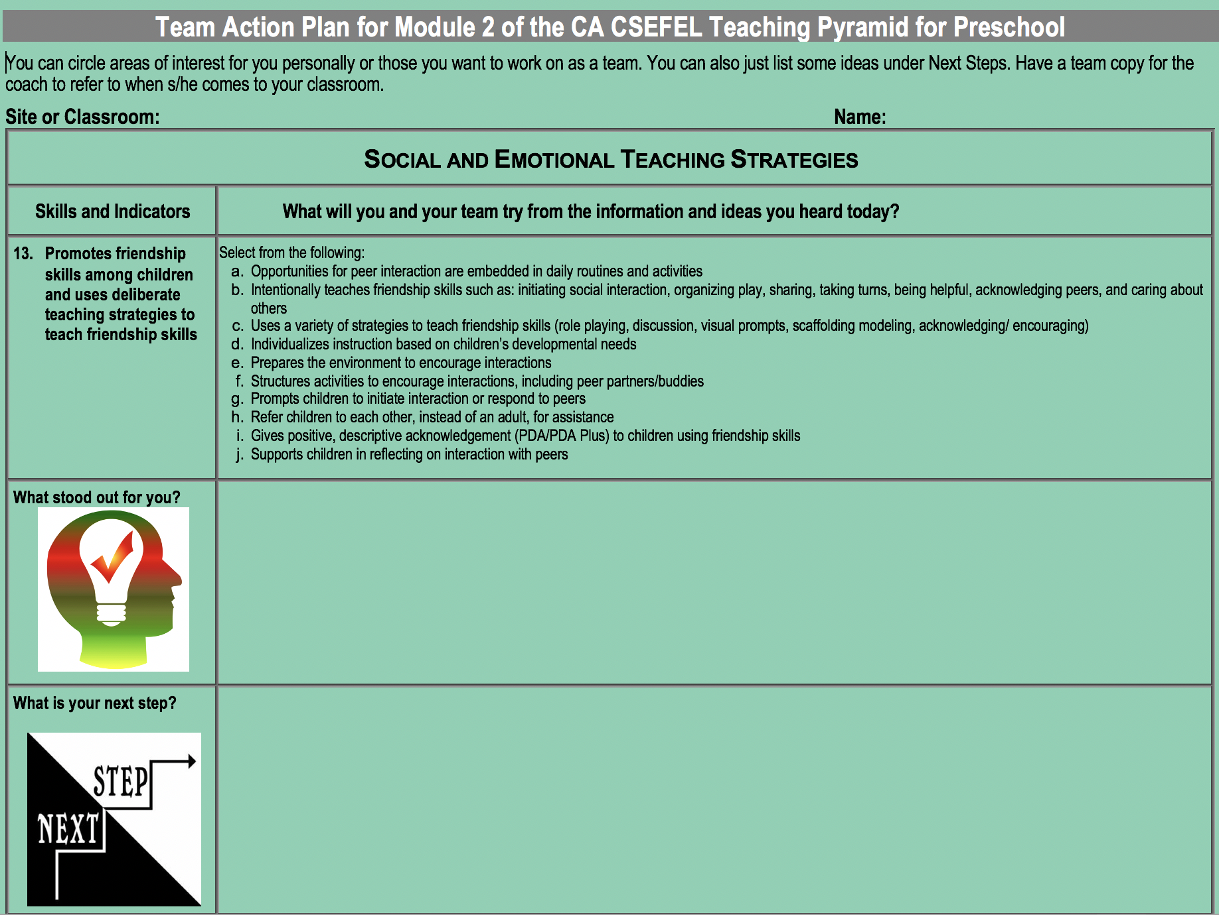

Slide 11
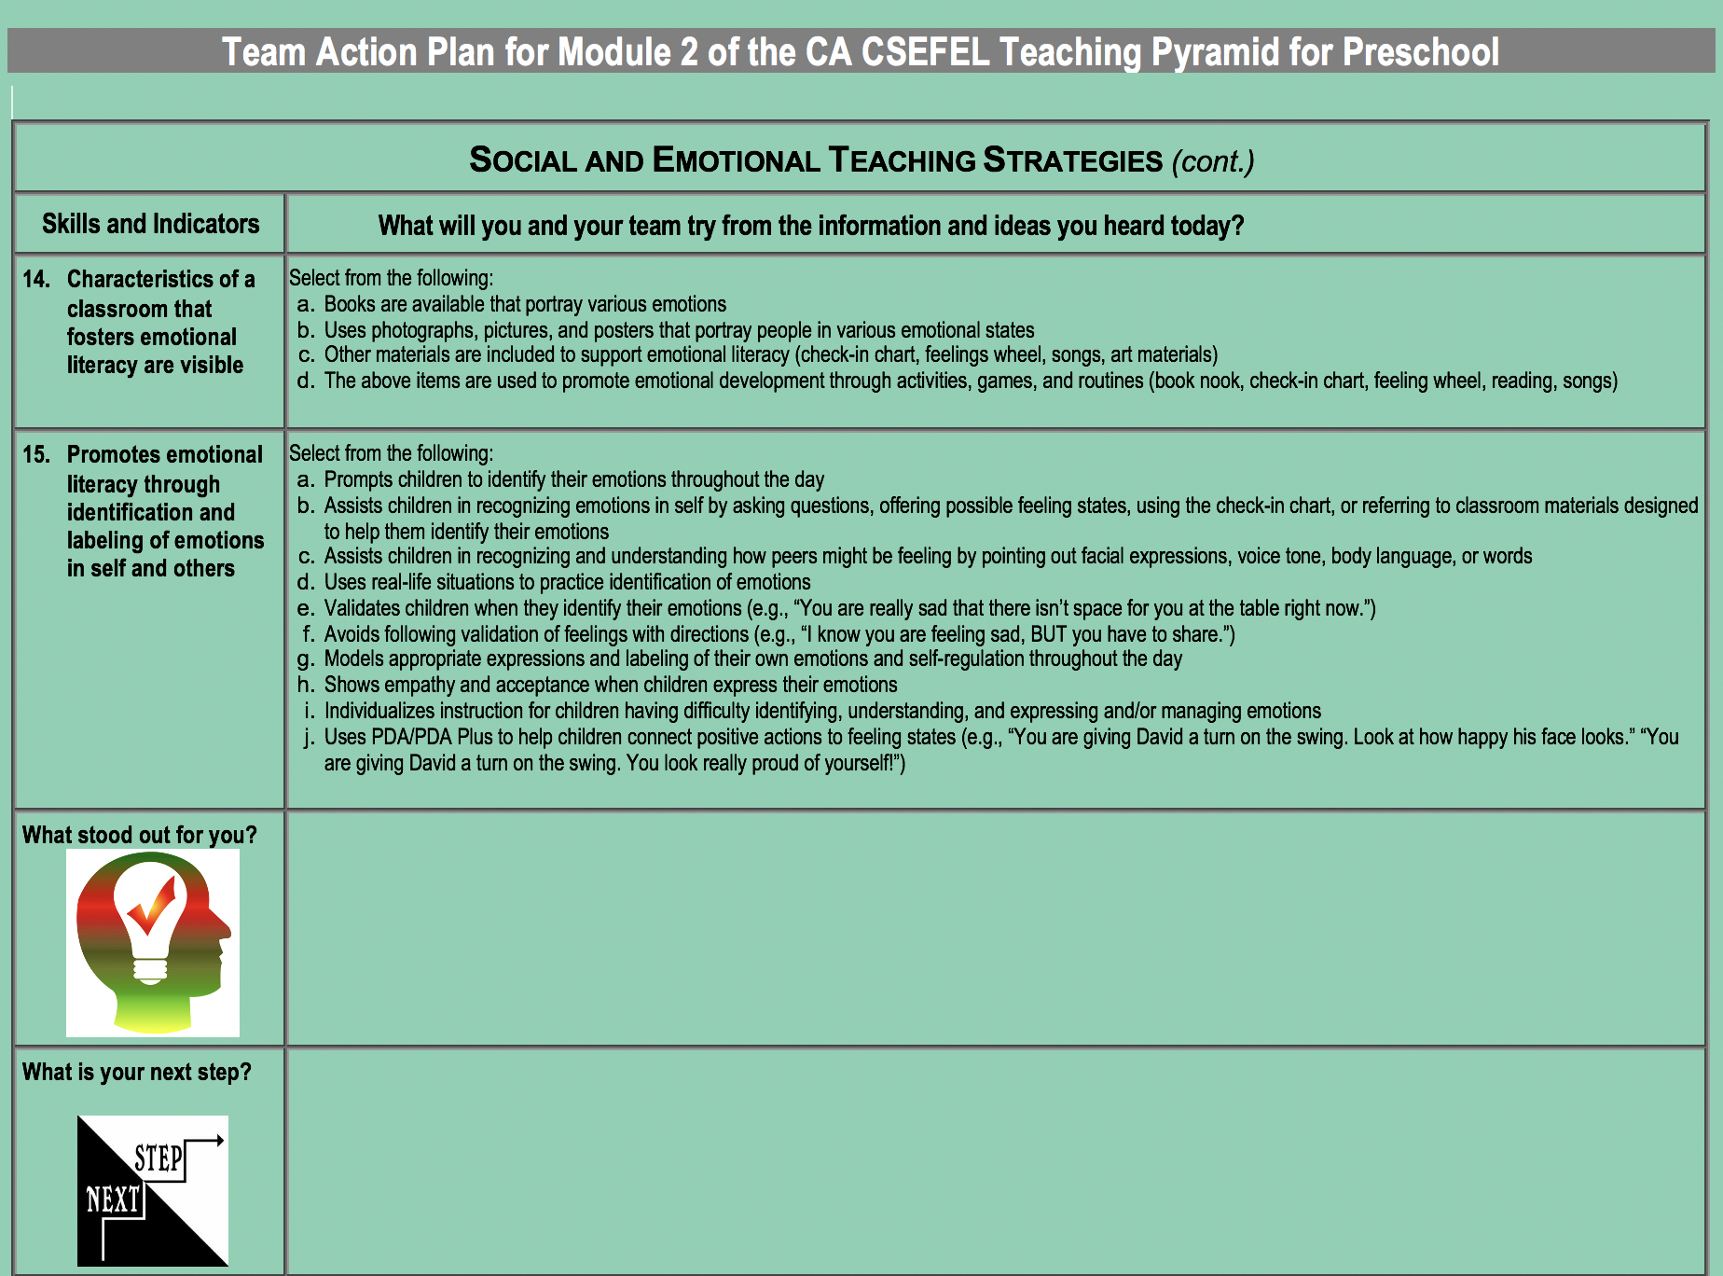

Slide 12
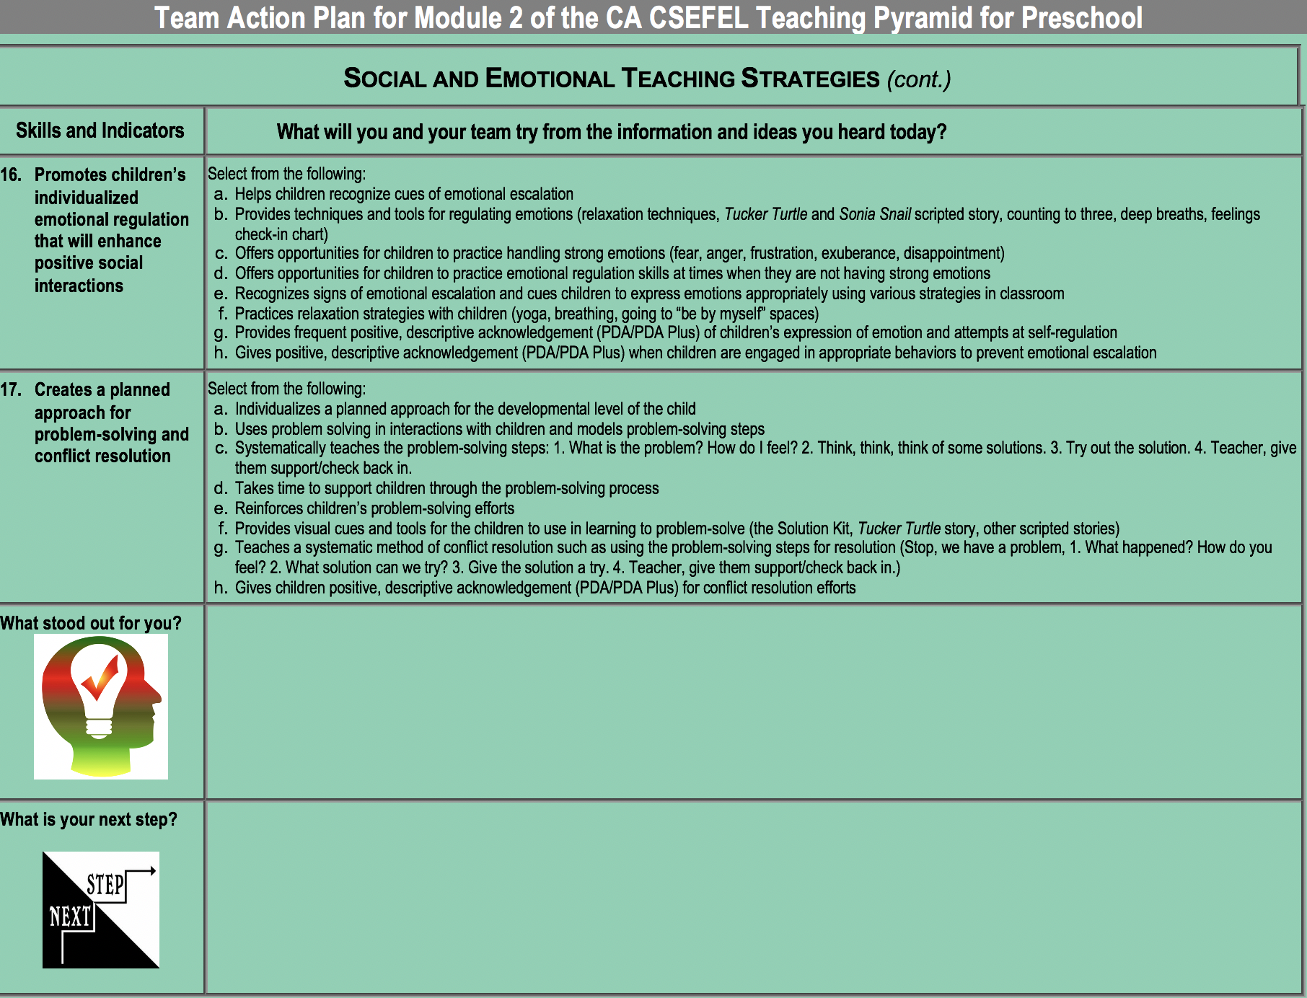

Slide 13
Next coaching meeting visit

