Slide 1
Visit #

Slide 2
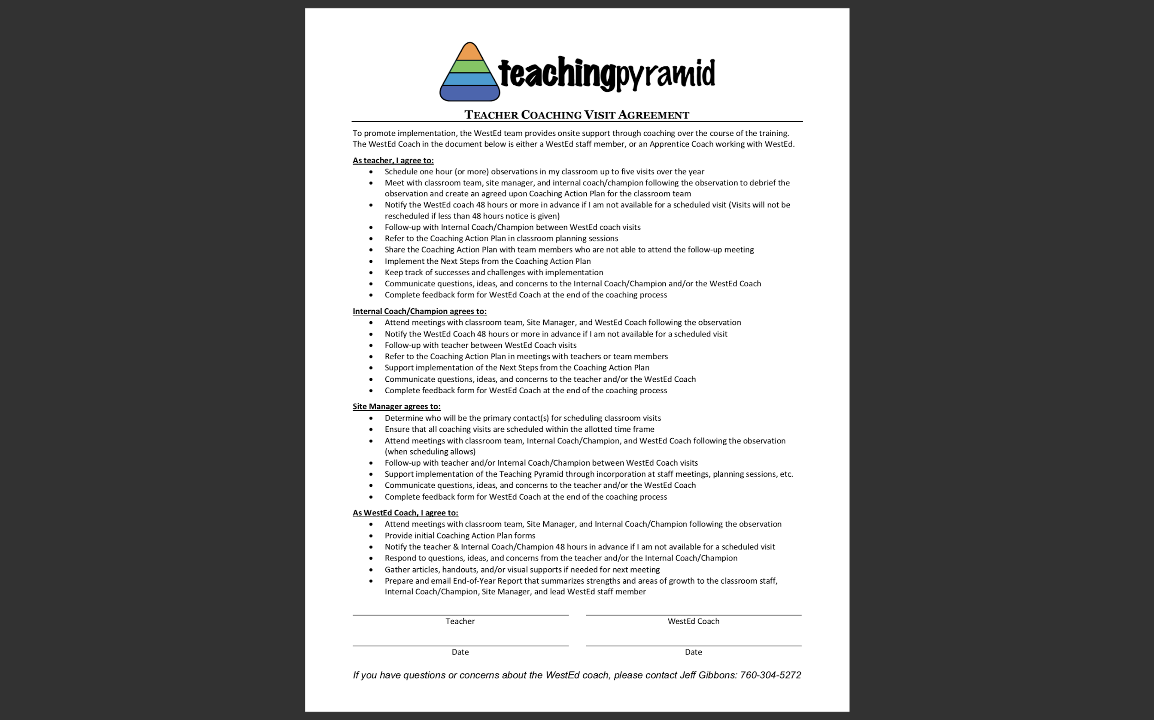

Slide 3
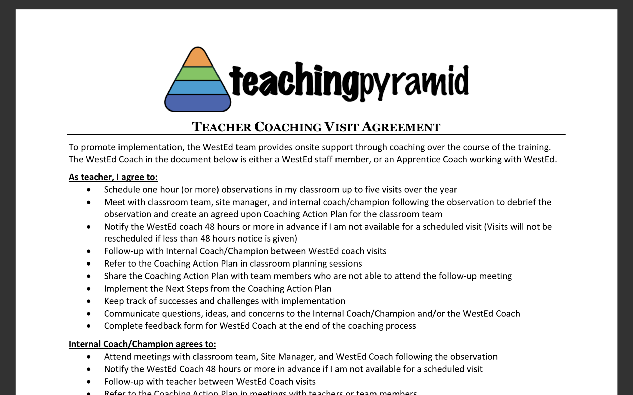

Slide 5


Slide 6

Focused Observation Videos

Slide 7
Coaching Action plan

Slide 8

As a team is there a Teaching Pyramid a skill/strategy from the last training that you would like to implement in your classroom to meet the current needs of the children?

Slide 9
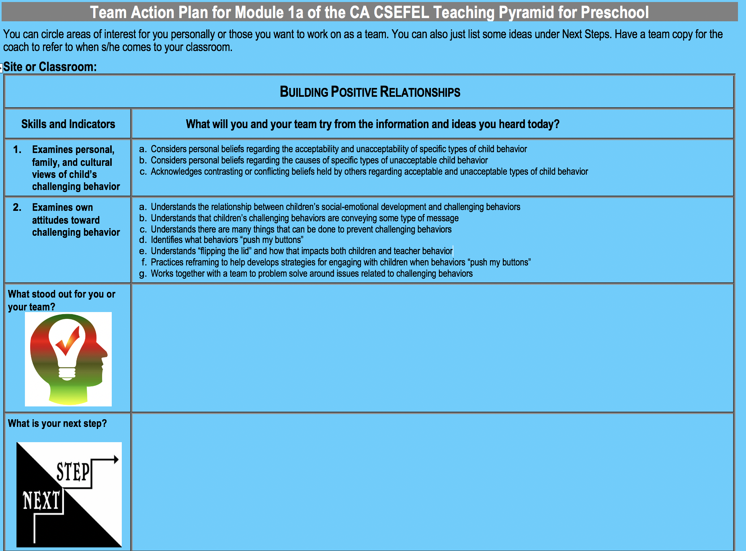

Slide 10
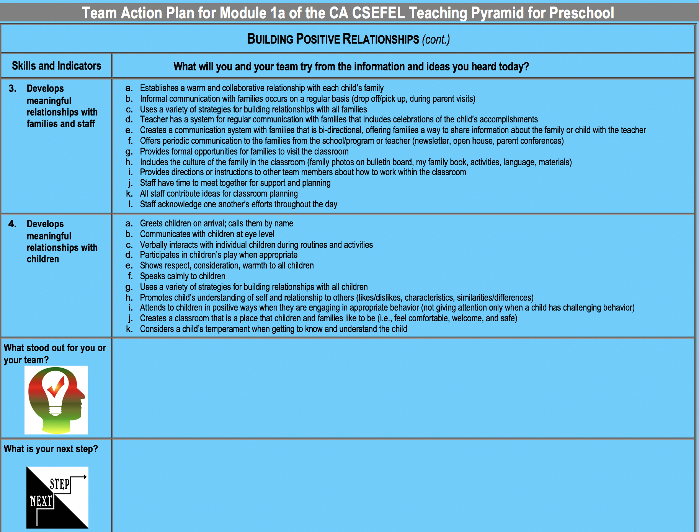

Slide 11
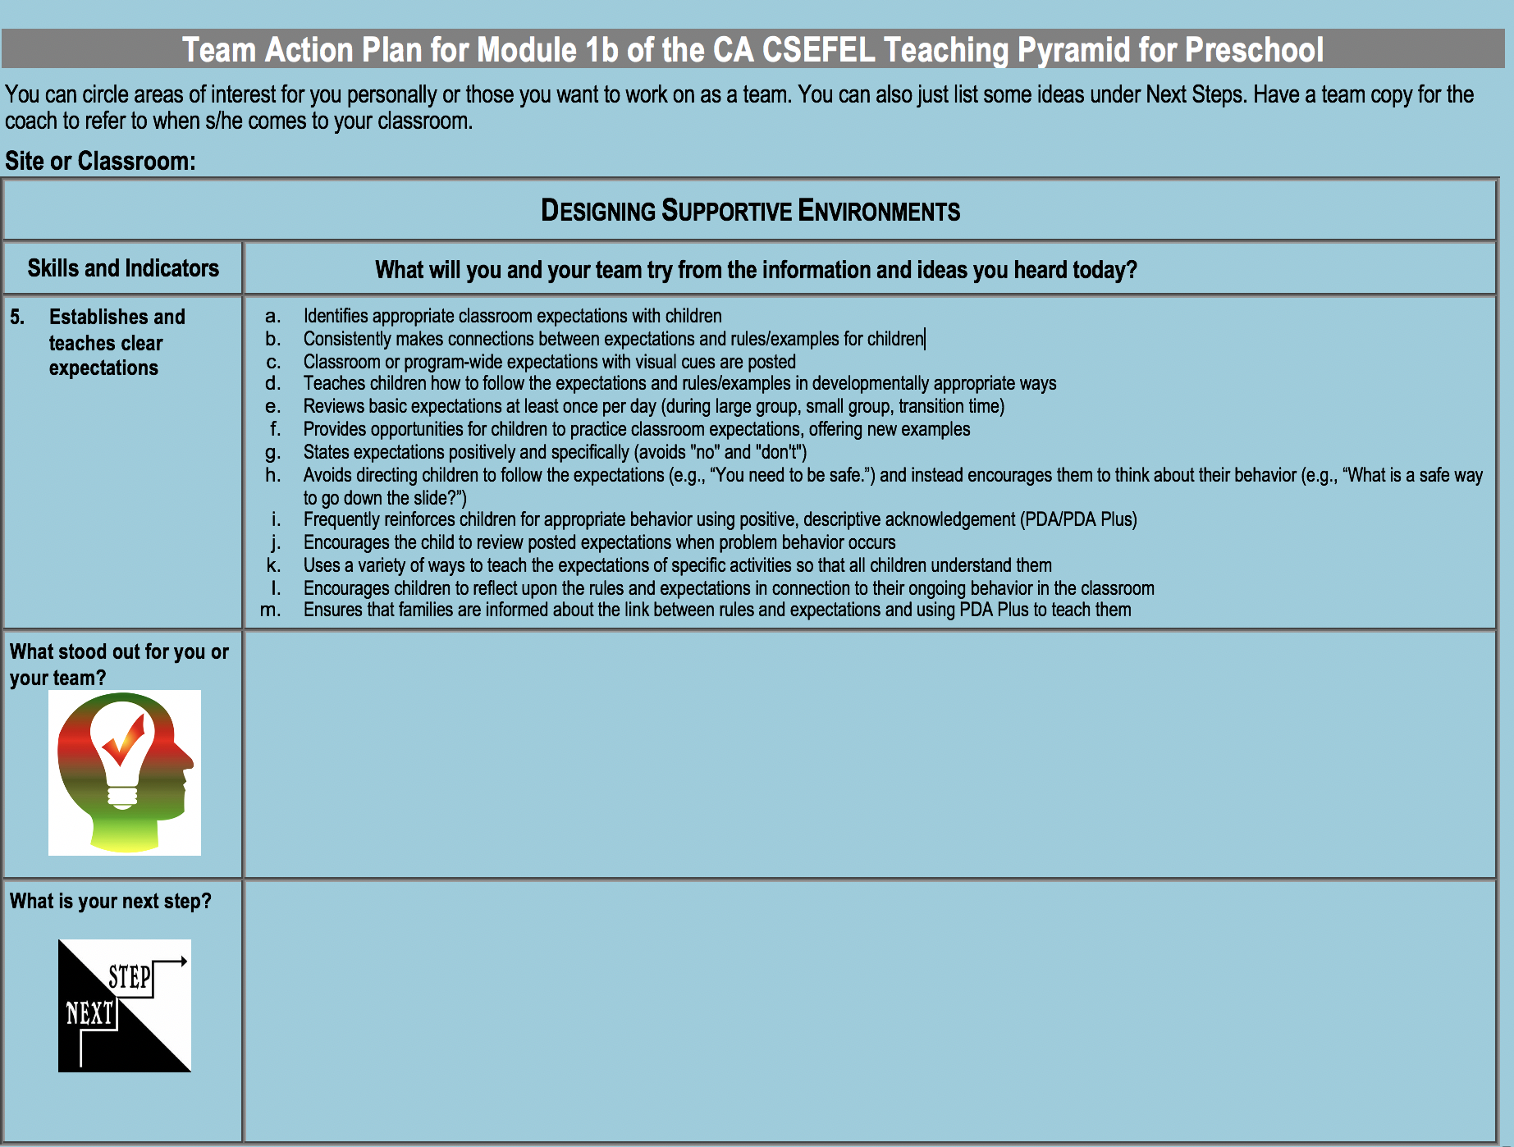

Slide 12
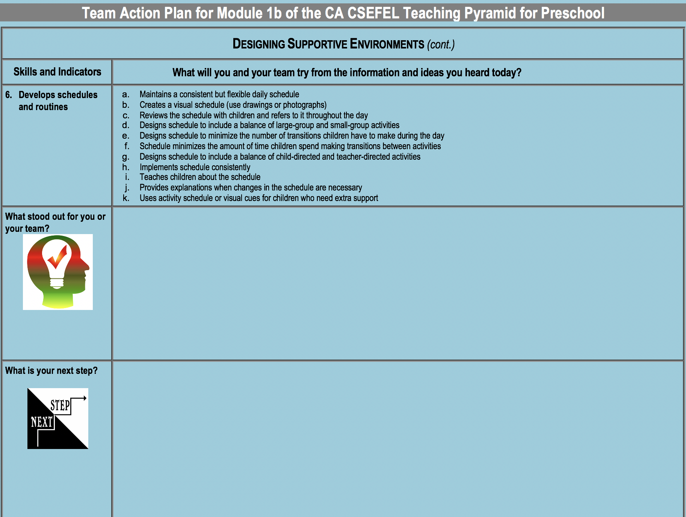

Slide 13
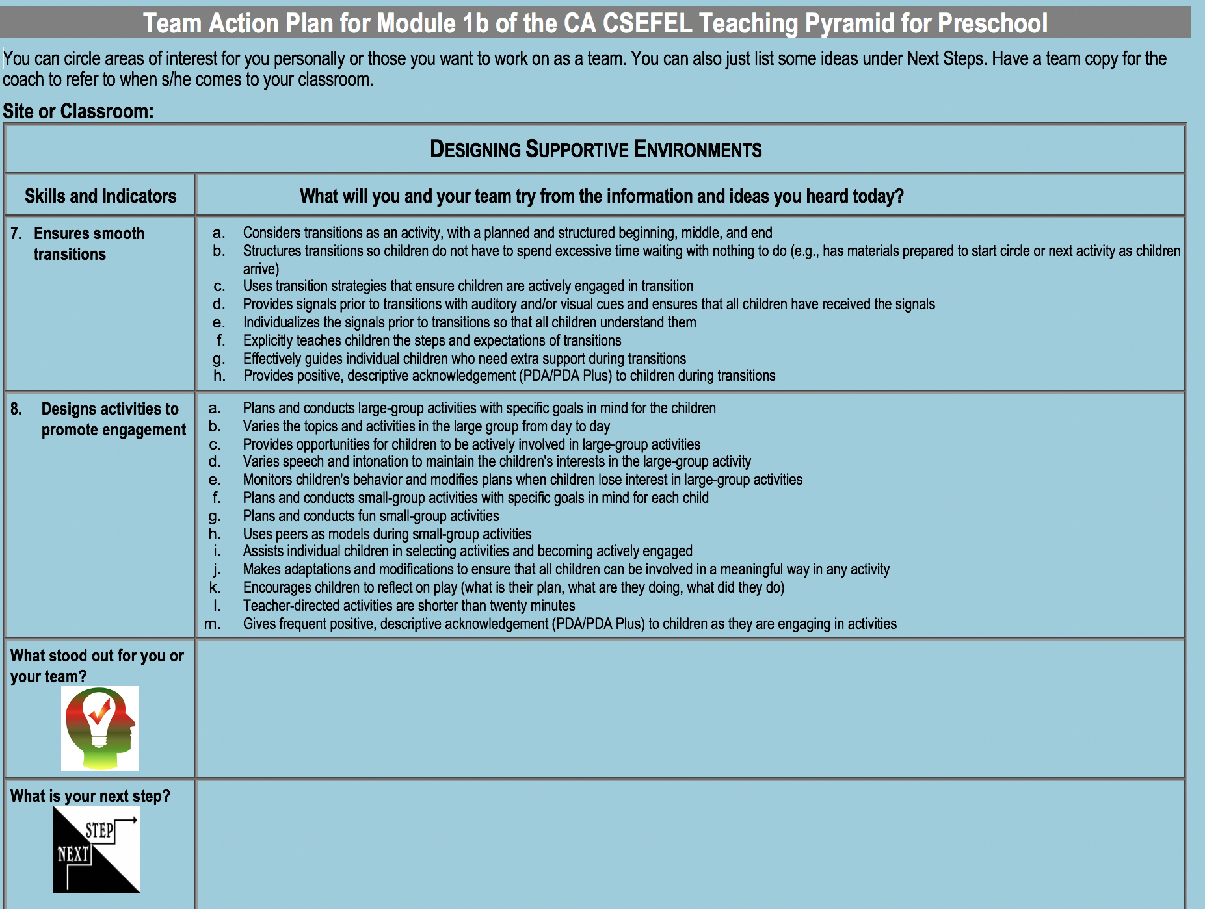

Slide 14
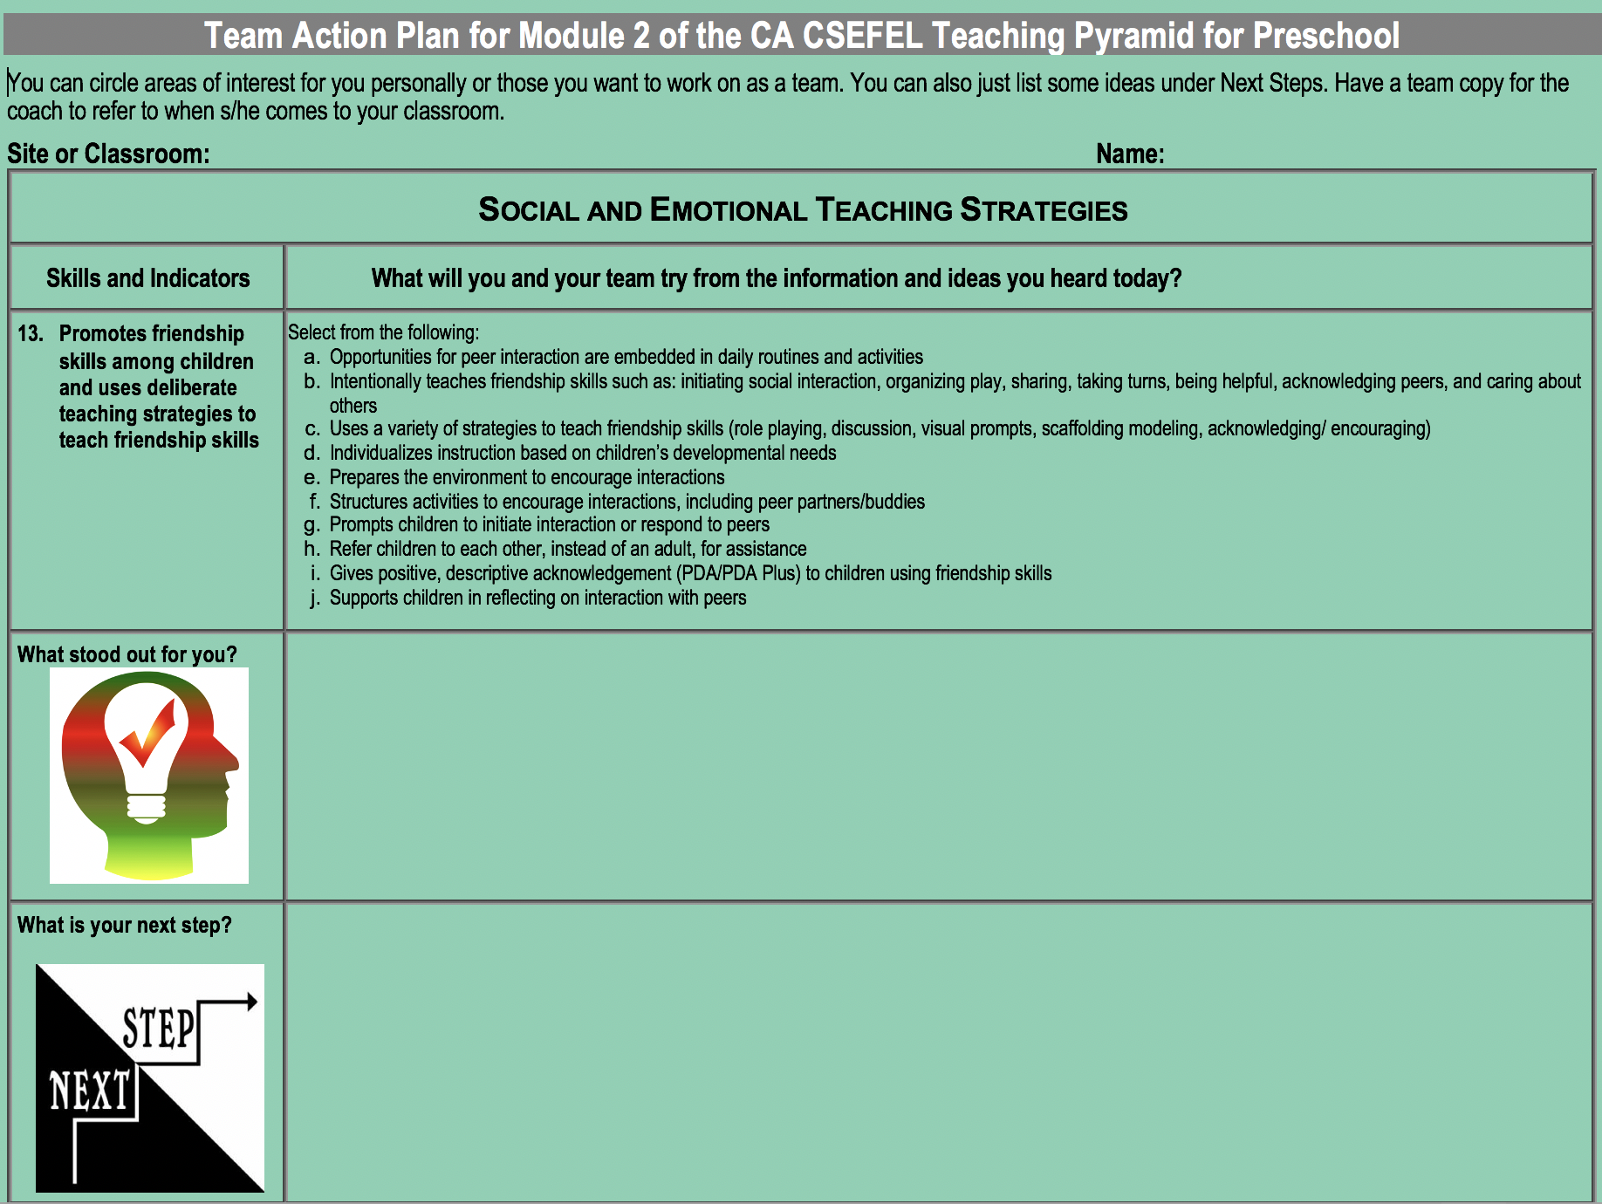

Slide 15
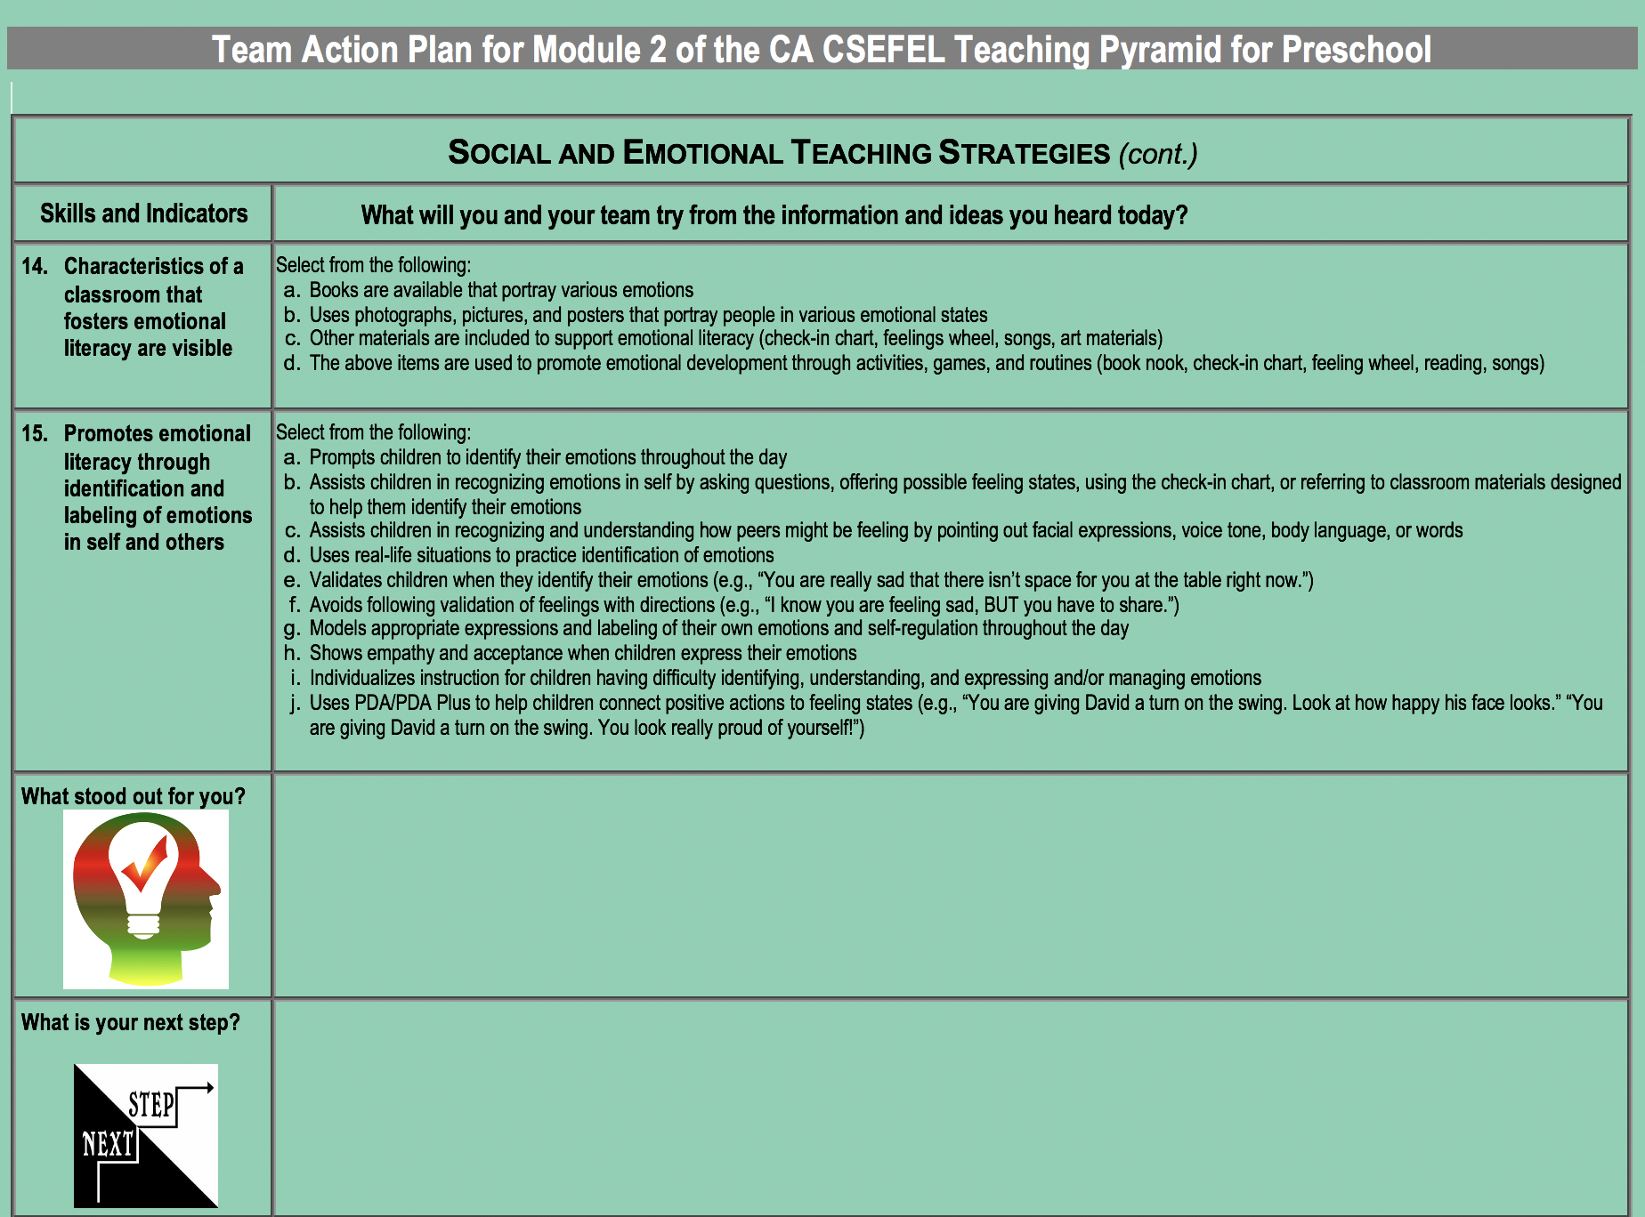

Slide 16
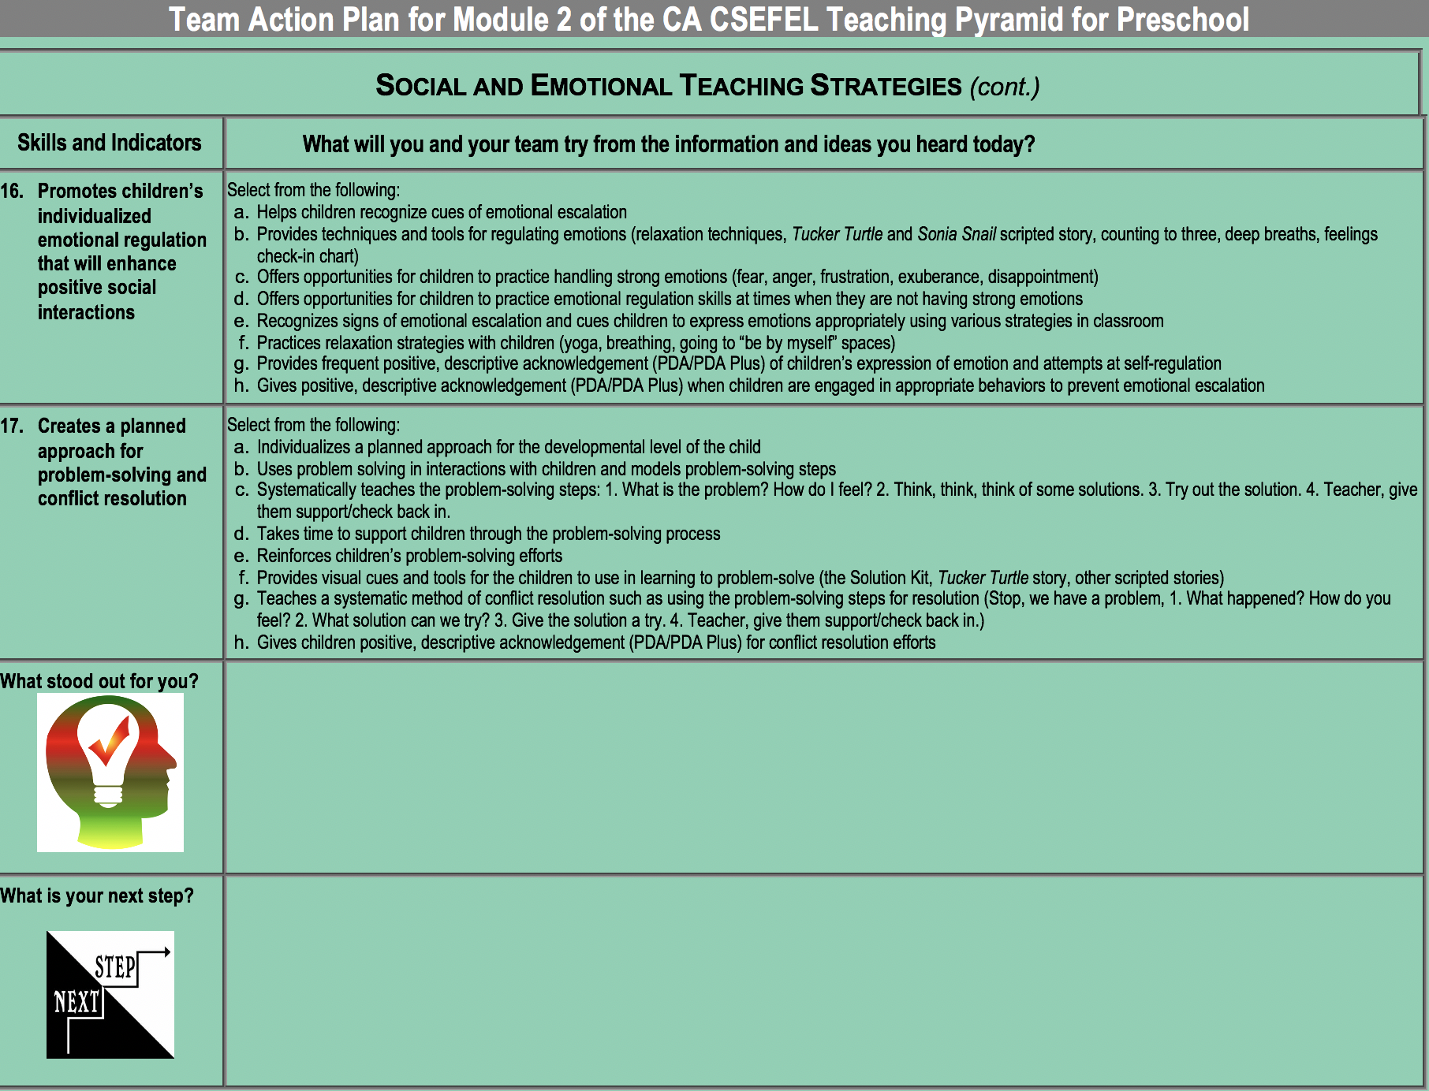

Slide 17
Next coaching meeting visit

