Slide 1
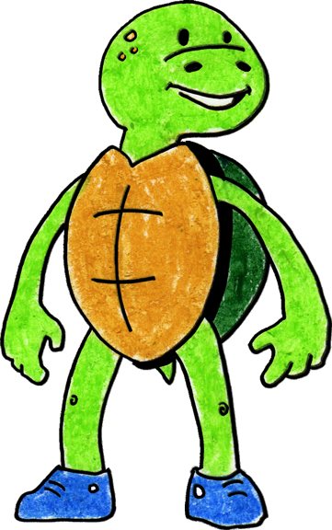
Tucker Turtle Takes Time to Tuck and Think
Adapted 2012 by WestEd Teaching Pyramid from a scripted story to assist with teaching the “Turtle Technique”
Original By Rochelle Lentini March 2005
Artwork by Alejandro Castillon, 2011 WestEd

Slide 2
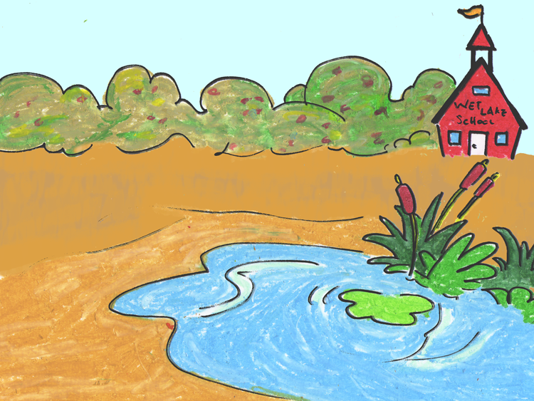
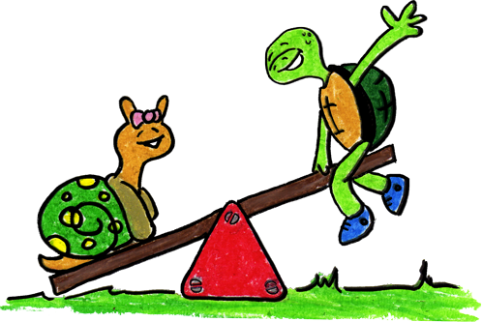
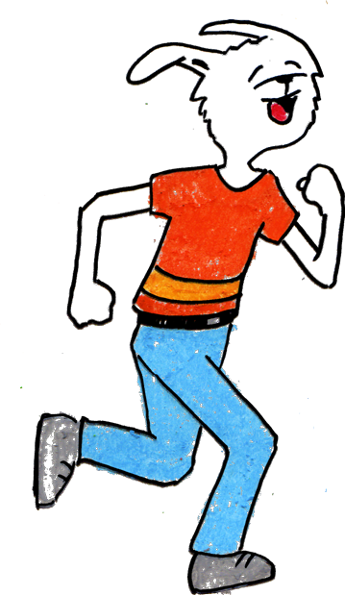
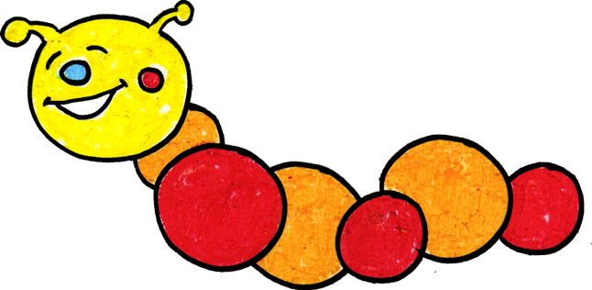
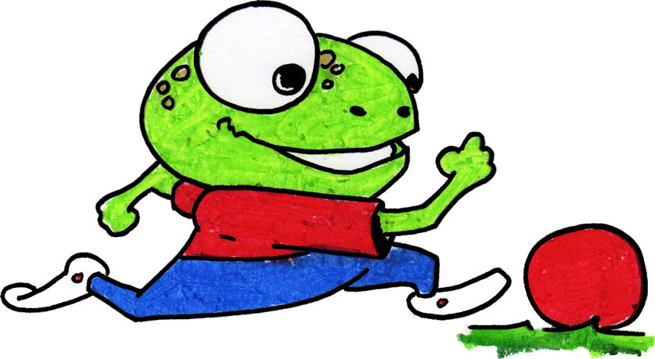
Tucker Turtle is a terrific turtle. He likes to play with his friends at Wet Lake School.

Slide 3
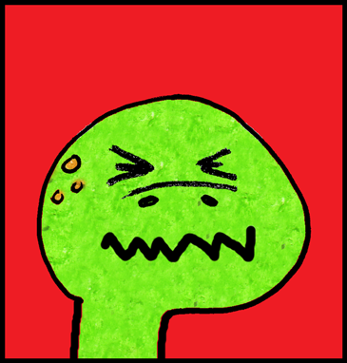
But sometimes things happen that can make Tucker really mad.

Slide 4
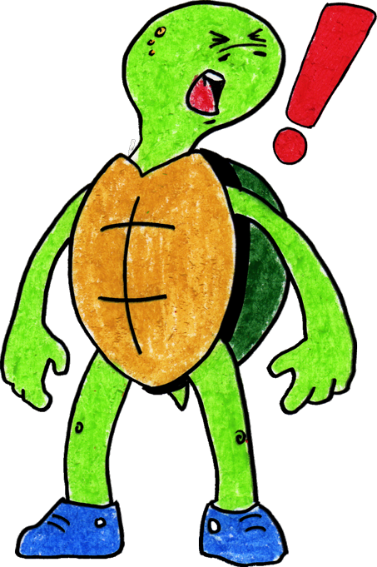
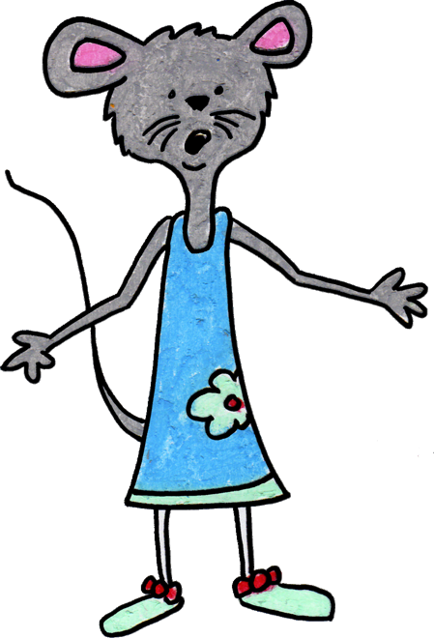
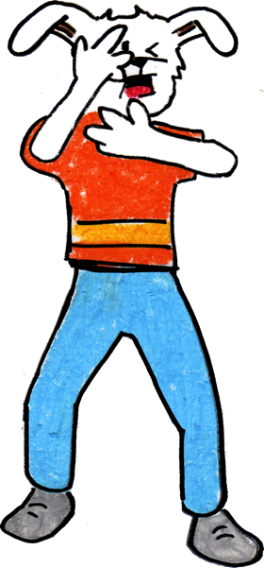
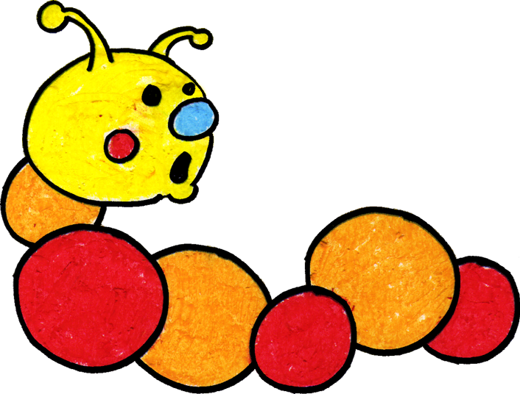
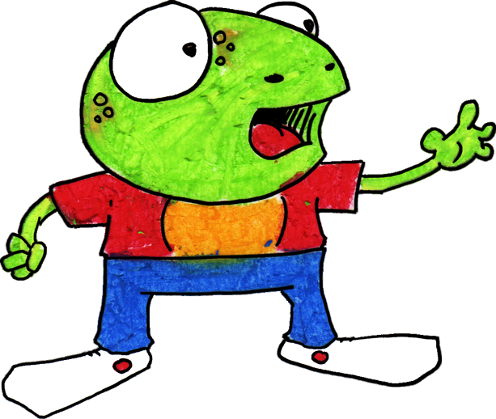
When Tucker got mad, he used to hit, kick, or yell at his friends. His friends would get mad or upset when he hit, kicked, or yelled at them.

Slide 5
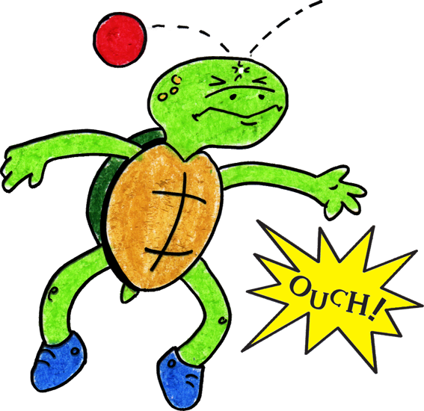
Tucker now knows a new way to “think like a turtle” when something happens to make him mad.
Step 1

Slide 6
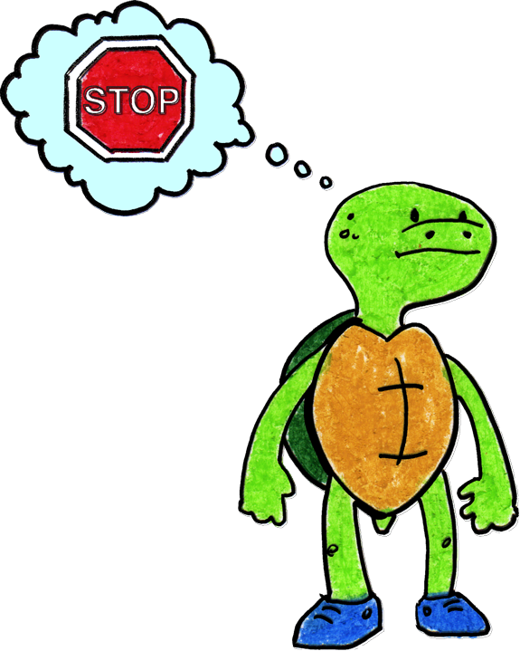
He can stop and keep his hands, body, and yelling to himself. He can think, “What am I feeling?” If he is angry, he can stomp his feet and say “I’m mad!”
Step 2

Slide 7
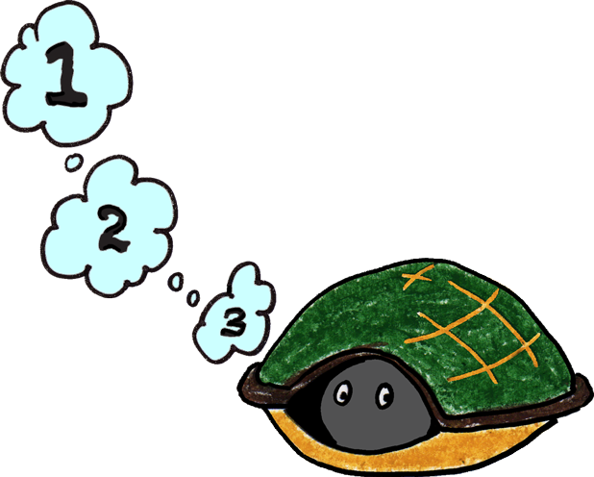
He can tuck inside his shell and take 3 deep breaths to calm down.
Step 3

Slide 8
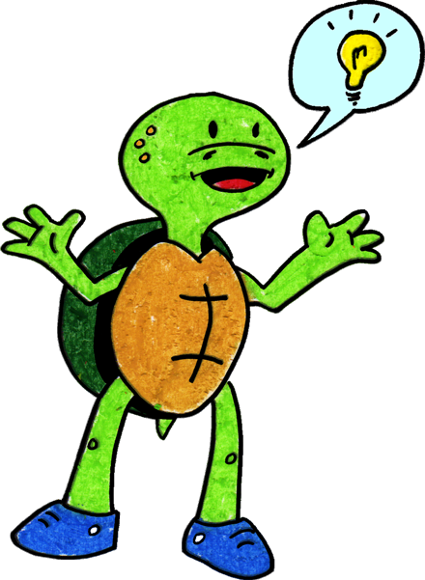
Tucker can come out of his shell, express his feelings, then think of a solution or a way to make it better.
Step 4

Slide 9
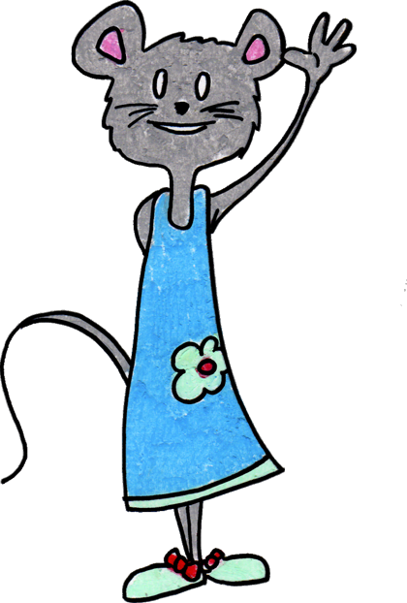
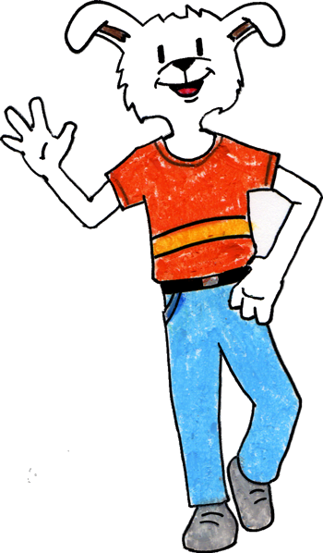
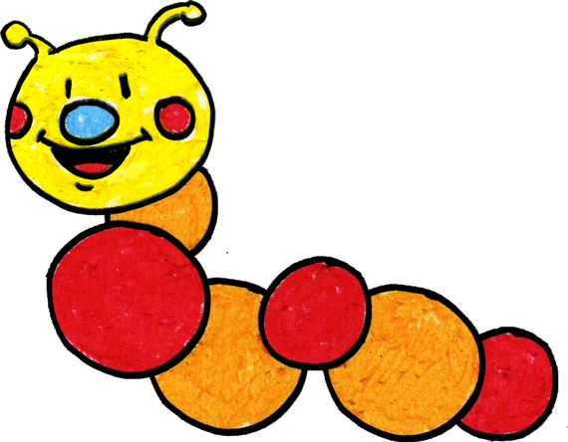
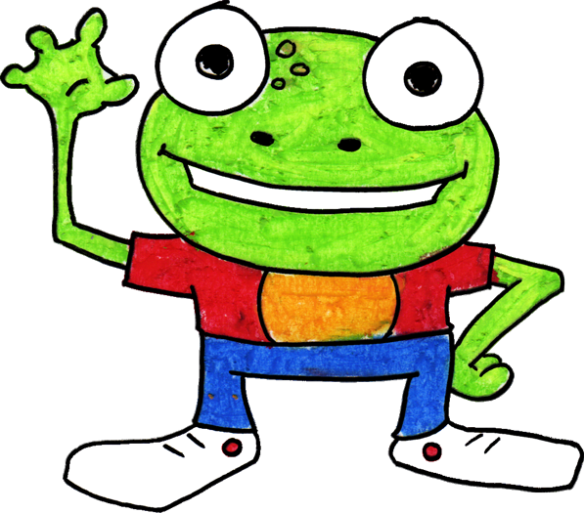
Tucker is happy when he plays with his friends and keeps his hands and body to himself. Friends also like it when Tucker stops and “thinks like a turtle” when he gets mad.
If he forgets what to do, his teacher can help him when he is upset. Tucker has fun with his friends at Wet Lake School.

Slide 10
The End!
Adapted by WestEd Teaching Pyramid – www.CAinclusion.org/teachingpyramid

Slide 11
Something happens
Step 1
Adapted by WestEd Teaching Pyramid – www.CAinclusion.org/teachingpyramid

Slide 12
Stop. Think: What Am I Feeling?
Step 2
Adapted by WestEd Teaching Pyramid – www.CAinclusion.org/teachingpyramid

Slide 13
Go into your shell.
Take 3 deep breaths and think calm thoughts.
Step 3
Adapted by WestEd Teaching Pyramid – www.CAinclusion.org/teachingpyramid

Slide 14
Come out of shell, express your feelings and think of a solution.
Step 4
Adapted by WestEd Teaching Pyramid – www.CAinclusion.org/teachingpyramid

Slide 15
Turtle Technique (CA CSEFEL)
Something happens
Stop. Think: What Am I Feeling?
Step 1
Step 2
Go into your shell. Take 3 deep breaths and think calm thoughts
Come out of shell, express your feelings and think of a solution
Step 4
Step 3
Adapted by WestEd Teaching Pyramid – www.CAinclusion.org/teachingpyramid

Slide 16
Teacher Tips on the Turtle Technique
Model remaining calm
Teach the child the steps of how to manage feelings and calm down (“think like a snail”)
Step 1: Recognize that something happened.
Step 2: Stop. Think: what are you feeling? Acknowledge your feeling and maybe do something physical to let that feeling out.
Step 3: Tuck inside your “shell” and take 3 belly breaths to help you become calm.
Step 4: Come out, express your feelings, and think of a solution.
Practice steps frequently (see cue cards outlining each step)
Prepare for and help the child handle strong emotions and to think of a solution (see “What Can the Child Do?” list)
Give encouragement and acknowledgement as children make efforts to do the steps
Involve families – teach the “Snail Technique”
Adapted from Webster-Stratton, C. (1991). The teachers and children videotape series: Dina dinosaur school. Seattle, WA: The Incredible Years.

Slide 17
What Can The Child Do?
Help the Child Think of a Possible Solution: (These are from the Solution Kit)
Get a teacher
Ask in a friendly way
Ignore
Play
Say, “Please stop.”
Say, “Please.”
Share
Trade a toy/item
Wait and take turns
Set a Timer

Slide 18
Super Turtle Letter
Dear Parent,
Billy was successful today with handling frustration and anger when we ran out of his favorite cracker at snack. When he felt himself getting upset, he stopped, took three deep breaths and decided he would try one of the other crackers. That was a great solution and he really liked the new cracker, too! You can help Billy at home by asking him what he did at school today when we ran out of his favorite cracker. Ask him how he calmed down. Comment on what a good problem solver he is. Tell him that you hope that he will do that again when he gets frustrated about something. Thank you so much! Ms. Laura

Slide 19
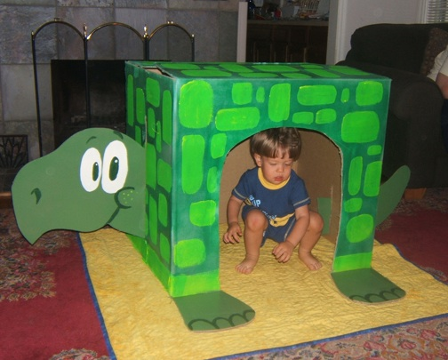
Turtle Time Is Great!
This is a place the child goes to play and pretend; he is not “sent” here

Slide 20
Turtle Puppets
Mini-turtle finger puppet
http://www.folkmanis.com

