Slide 1
We Help Our Substitute Teacher
A Scripted Story
Created by C. Zercher and Linda Brault
for the CA CSEFEL Annual Symposium

Slide 2

“We Help Our Substitute Teacher”
Sometimes our teacher needs to go to meetings and cannot come to school that day.
Sometimes she might be sick with a runny nose and cough and stays home so that we don’t get sick.

Slide 3
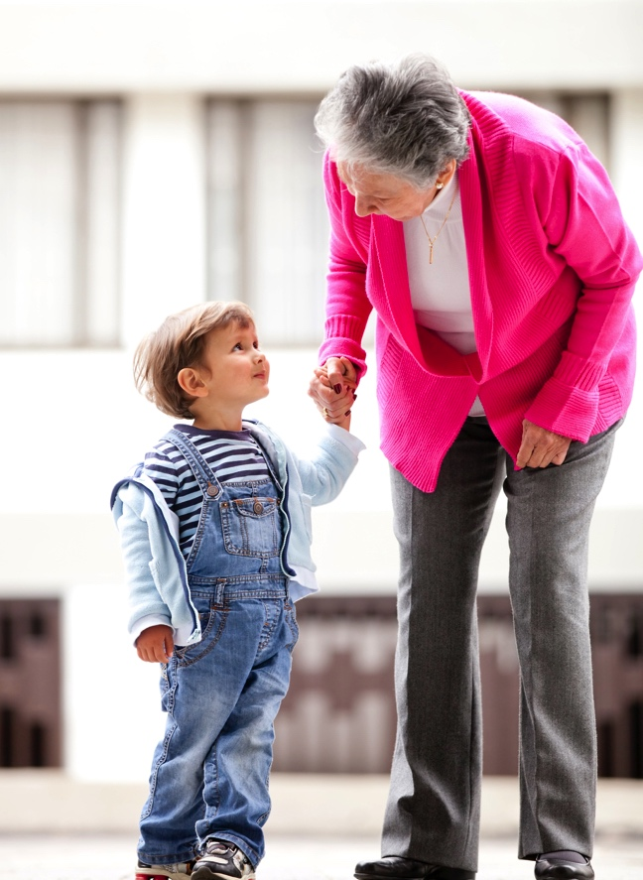
On those days we will have a different teacher, maybe a teacher we don’t know. This teacher is called a Substitute Teacher. She may be here for one day or for a few days.

Slide 4

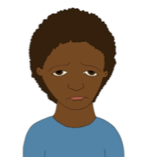
We might feel worried. “What will happen today? Will the substitute teacher take care of us? What will the substitute teacher be like?”
We might be sad. We might miss our teacher.

Slide 5
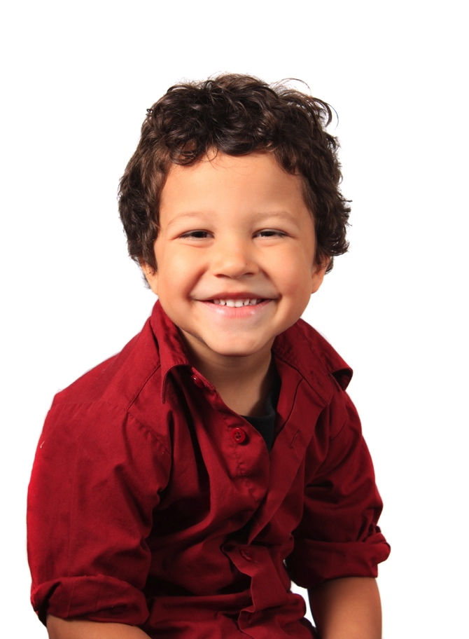
We will need to be brave. The substitute teacher may be worried too.
In our school, we are friendly and kind. We can help the substitute teacher.

Slide 6
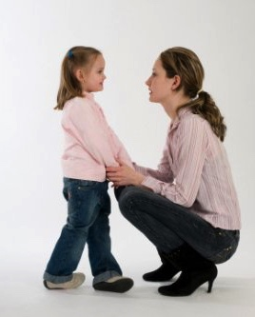
We can:
Tell the teacher our Expectations and some of the rules that go with them
Show the teacher how we follow the schedule
Be Respectful by doing what the teacher asks
We can answer questions the teacher asks us
Teacher: “What happens next?”
Children: “We wash hands and go to the table”

Slide 7

We think that probably the substitute teacher will be nice to us. She will help us to stay safe. She will teach us new things. We might really like the substitute teacher!

Slide 8
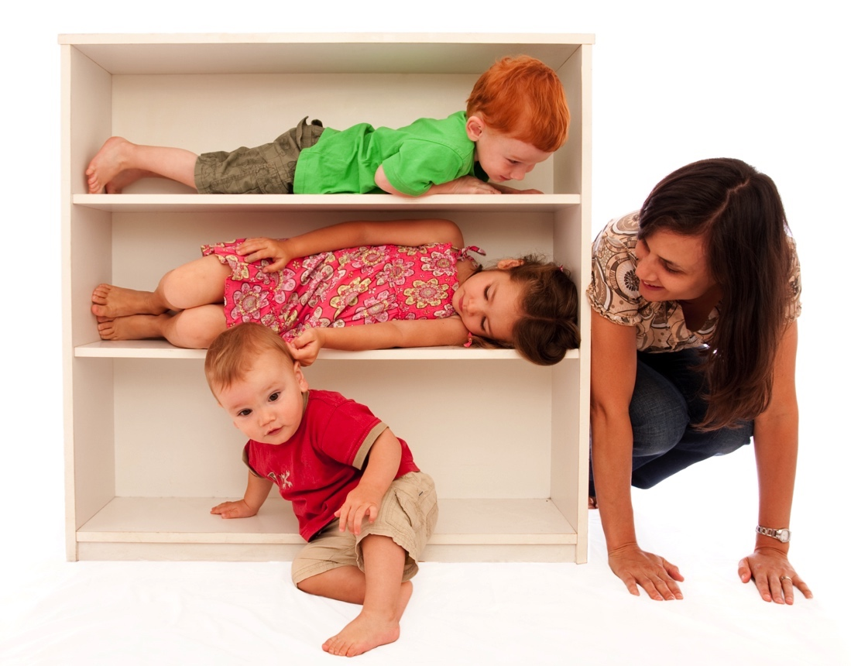
When our teacher is gone for the day, we can still have fun and learn at school.

Slide 9

“We Help Our Substitute Teacher”
The substitute teacher will help us.
And we can help the substitute teacher!
Created for WestEd Teaching Pyramid – www.CAinclusion.org/teachingpyramid

