Slide 1
Substitute Teacher
Introduction
A Scripted Story
Created by C. Zercher and Linda Brault
for the CA CSEFEL Annual Symposium

Slide 2
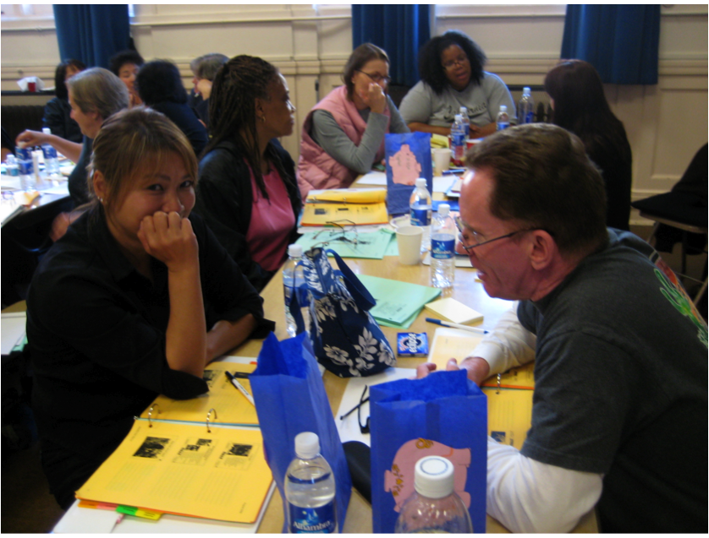
Good morning children! Ms. Gloria is out today. She is in a special meeting. (or She is not feeling well so she stayed home today. She will get better and come back soon.)

Slide 3
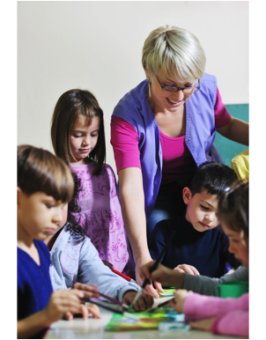
I’m happy to be here and to meet all of you. I have been a teacher for a long time. I really like school. Later on when we are playing, I would like you to show me your favorite things.

Slide 4
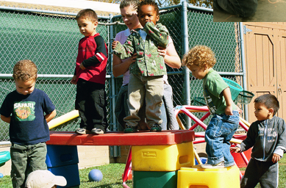
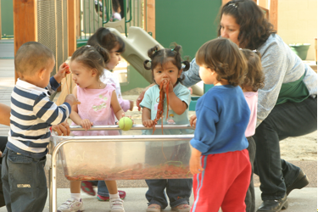
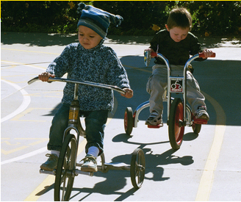
Before I grew up and became a teacher, I was little, too. I liked to play. My favorite things were playing house and riding bikes on the playground (or playing with blocks, etc.).

Slide 5
? ? ?
Here is something else about me: I have a favorite color. Can you guess it? (Let them guess.) It’s green! (or blue, etc.).
? ? ?

Slide 6
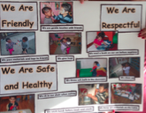
Your Teacher left me a special note.
  She told me that you are all very safe at school. What do you do to be safe? (Take some answers.)
  She also told me you are respectful and that you will treat me well—you’ll listen to me and take good care of the classroom.
  She told me that you are friendly and kind. Is that true? She told me that you will help me today. Thank you!

Slide 7
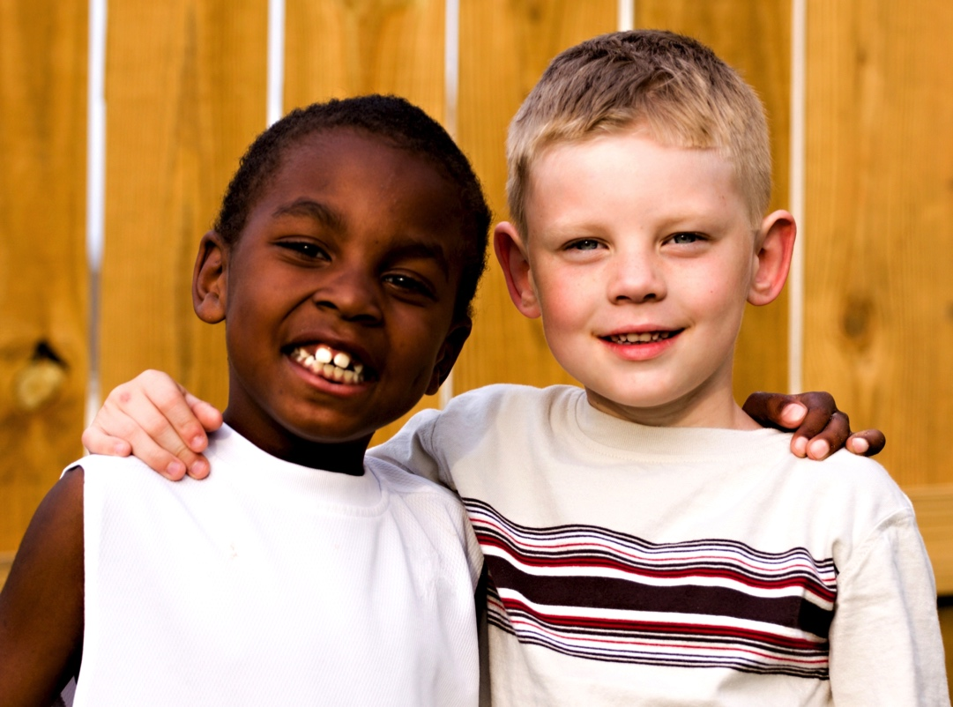
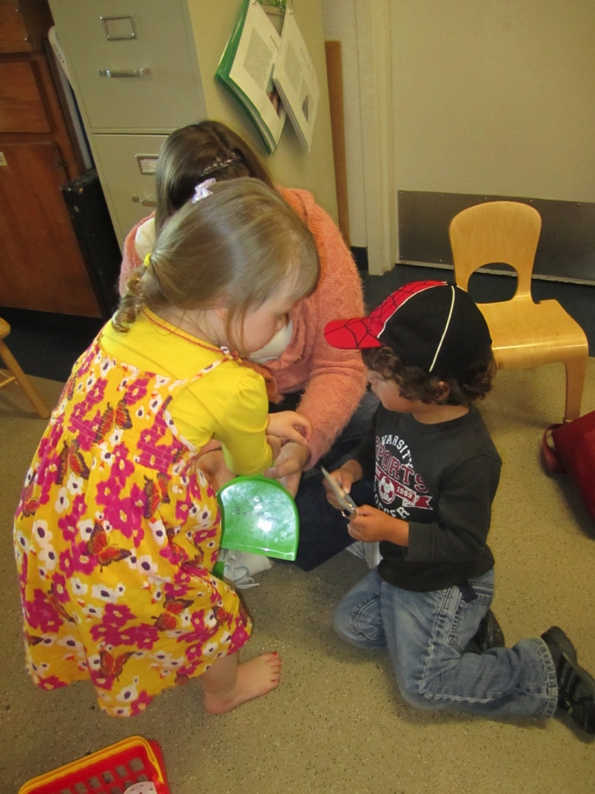
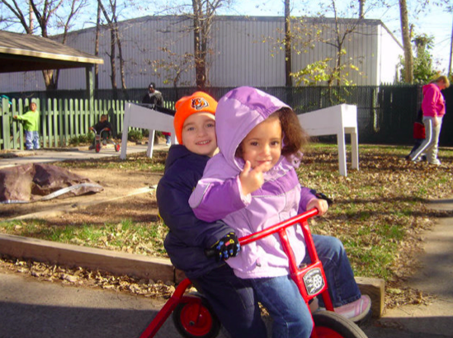
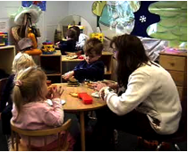
Do you have any questions?
Okay, let’s start . . . (begin activity)
Created for WestEd Teaching Pyramid – www.CAinclusion.org/teachingpyramid

